Slide 1



The Georgia Parent Mentor Partnership (GaPMP)
Led by the Georgia Department of Education, (GaDOE) Division for Exceptional Children/Outreach Unit
Rookie Training Guide

Slide 2

Mission and Vision
Mission Statement: Build effective family, school and community partnerships which lead to greater student achievement for all students, especially those with disabilities.
Vision Statement: Parent mentors and special education administrators will lead the way in Georgia to bridge the gap between home, school and community partnerships.

Slide 3
Our Story
The Georgia Parent Mentor Partnership (GaPMP) is celebrating over 20 years of working together to increase achievement for all students, especially those with disabilities.
The Partnership, started in early 2002 by Phil Pickens, Special Education Director, Georgia Department of Education, (GaDOE), with Family Engagement Specialist Patti Solomon and a small group of parents and administrators, now boasts more than 100 parent mentors helping families raising children with learning, behavioral and/or physical challenges. Parent Mentors have charted more than one million contacts.
Mentors listen to both parents and educators, and use their unique knowledge of both worlds to overcome obstacles in communication and build a bridge of communication between home and school that leads to more successful outcomes for students.
The GaPMP is supported by the Division for Exceptional Children/Outreach Unit. The parent leaders, moms and dads of children with disabilities, are hired by local school districts, state schools and the Department of Juvenile Justice to work with families, school teams, teachers, and the community. The goal is to build a bridge of communication between home and school that leads to more successful outcomes for students.
Parent Mentors partner with families to increase their engagement in education, address individual concerns and also to support initiatives designed to improve all children’s achievement levels. The Parent Mentor agenda is locally driven, which allows each program to meet the needs of its unique area.
Mentors do many things such as: build connections for families in the community; concentrate on the transition needs of middle and high school students as well as pre- kindergarten students; lead task forces; organize training sessions; collaborate with teachers; serve as leaders on community boards; stakeholder groups; collaborate with Title I Parent Involvement Coordinators; and create family engagement activities in schools.

Slide 4
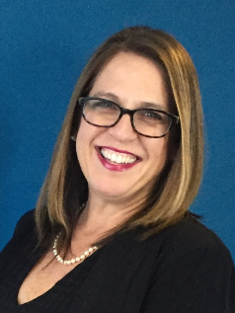
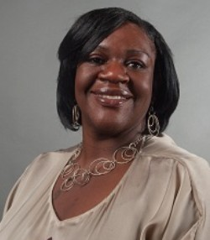
Getting Started
Anne Ladd, Family Engagement Specialist Office
404-423-6987
aladd@doe.k12.ga.us
Tracy Barber Jones, Family Engagement Specialist Office
404-844-8741
tracy.barberjones@doe.k12.ga.us
Other Names to Know:
Richard Woods
State Superintendent of Schools
Charity Roberts
Director, Division for Exceptional Children/Outreach Unit
Belinda Tiller
Program Manager
GaDOE
404-656-2800

Slide 5
Next Steps
Send all your contact information include your name, title, email address, office phone number and photo as well as your director’s name and office phone and email tracy.barberjones@doe.k12.ga.us.so that your name will be included in the email list.
Locate office space, set up the office, telephone, computer, email etc.
Facilities vary widely based on factors such as the district size, tax base, location, demographics, etc. It is generally expected that there will be office space in the district for the Parent Mentor; it is helpful if it is near other staff who may be working with families. It is best if parents can call a private voicemail message box so parents may call you directly.
Read the school district’s Policies & Procedures Manual. Discuss the local district’s policies and procedures for: attendance, work hours, personnel actions, phone and email use, dress codes, internet use, travel approval, reporting suspected child abuse, and expense reporting. Some of it may apply only to full time employees, but the information will still be useful. You now represent your school district and professional conduct is expected.
Discuss professional protocols with your Special Education Director. For example, how are media contacts to be managed, who needs to approve emails, group texts, social media postings, letters, brochures, or other materials before they are distributed, who approves travel requests, how is time documented, the dress code, managing schedule changes, reporting deadlines, travel and expense reports, call-in procedures etc.

Slide 6
Mandatory Trainings
Annual GaPMP Kick-Off Event
Four Regional Meetings - scheduled throughout the school year, your Region Rep will inform you about when and where
Parent Mentor online training and webinars
*Administrators have an open invitation to attend all mentor trainings and meetings. Directors are encouraged to attend the Orientation session or send another administrator with the mentor. Directors are strongly encouraged to attend the Annual GaPMP Kick-Off Event.
The more you know about what is expected and about mentors’ successes and challenges, the better you can support your mentor and the more your district will benefit from having a mentor.

Slide 7
Introducing Yourself
GaPMP website www.parentmentors.org Send a professional photo and contact information to tracy.barberjones@doe.k12.ga.us/ Your name will be added to the Find a Mentor listing.
Link www.parentmentors.org, the official web site,
to your school district’s special education page.
What kind of social media does your district use
and what are the protocols for use of social media
and virtual platforms?
Work with the district to promote the
parent mentor on the district’s special education page,
staff directories, and parent resource information sources

Slide 8
Being a Professional
Unlike volunteers, Parent Mentors are trained professionals working with families in your district. Confidentiality and trust are key.
ALWAYS re-read texts, facebook posts, emails and other correspondence as though the family involved or your director are looking at it. Make sure you spell check and read for continuity and clarity. It’s hard to take it back once it goes out there. Don’t share confidential information!!!
You will also need to earn the trust of staff.

Slide 9
Elevator Speech Activity
Your elevator speech should answer three questions:
Who are you?
What do you do?
Where do you want to go, or what are you looking for?
You need to know exactly what you want to achieve or no one can help you get there.
Take a minute to jot down some bullet points to practice: (use the back if needed)
My name is:
I am the parent mentor for: ______________________________________
My job is to: _______________________________________________
__________________________________________

Slide 10
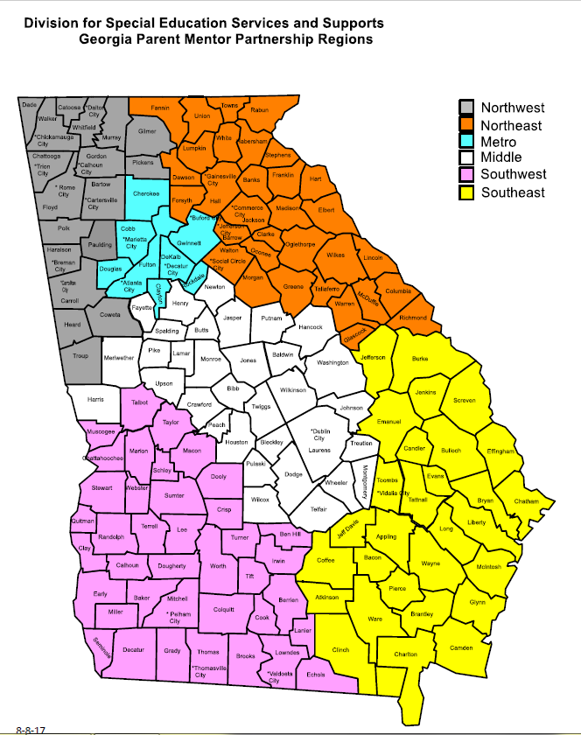
Where We Live and Work
The GaPMP consists of six regions served by a regional representative who will help mentors with mandatory accountability reporting and quarterly contacts
Your region rep will keep you advised of upcoming meetings and events.

Slide 11
Helpful Hints
Find your own “mentor” within your department, someone who can introduce you to key people in the district. If possible, work with the director and this local mentor to make a plan for introductions.
Focus on building the important relationships and partnerships, beginning with everyone in your department and moving out into the schools, the district, and the community.
Confidentiality safeguards are important to remember. As an employee, you may not talk about any students with disabilities with anyone unless that person also works with that student. This includes others within the school district, family or friends. It’s easy to get excited about your work and accidently share confidential information. Be careful!!
Boundary setting is critical. As a professional and a school district employee, you must also stay within the boundaries of your job. You can give advice and suggestions as a parent to other parents, but you are not a counselor, teacher, lawyer, or psychologist. You have an important role as a parent who mentors other parents, but it is important to honor the boundaries and not stray into another’s role.
Reporting possible or suspected child abuse: Find out what your school district’s procedures are for reporting suspected child abuse. By state law you are a mandated reporter: http://oca.georgia.gov/mandated-reporter
Respect co-workers by ensuring that you:
Are prepared for meetings with talking points and questions
Arrive on time for meetings and be sure your meetings begin and end on time
Wear district name tag/carry business cards with you
Dress appropriately
Communicate in an open and responsive manner
Respect different perspectives and learn from them
Honor each other’s expertise and experience
Safeguard confidentiality
Maintain accountability at the local and state level

Slide 12
Taking On Your New Role
Special Education Family Handbook/Manual
Most districts offer a special education manual to families as a valuable resource. This may be on the district website. You should print or obtain a hard copy and keep it for reference. It explains how the Individuals with Disabilities Education Act (IDEA) and the State Board of Education Rules for special education are followed in your school district. It provides the foundation for interactions between the school district and families, as their child is evaluated, eligibility for special education services is considered, the Individualized Education Program is developed, and the IEP is reviewed each year. It also outlines how to handle disagreements between parents and the school district. As a Rookie Parent Mentor, you should be very familiar with everything in this handbook/manual.
GaDOE Website
If your district does not have an existing handbook, then you may want to go to the GaDOE website to obtain generic information. Go to www.gadoe.org

Slide 13
Taking On Your New Role
Georgia Student Success Improvement Plan SSIP also known as Indicator 17 - The Office of Special Education Programs (OSEP) has required that each State Educational Agency (SEA) develop a State Systemic Improvement Plan that includes a comprehensive, multi-year focus on improving results for Students with Disabilities. Each state must develop a plan that will outline the development of strategies to increase state capacity to structure and lead meaningful change in Local Educational Agencies (LEAs).
Understanding your local district’s goals to improve services is important so that the family engagement work you do will align with your school district’s improvement plans.
Learn more: https://gadoe.org/special-education/state-performance-plan-annual-performance-results/

Slide 14
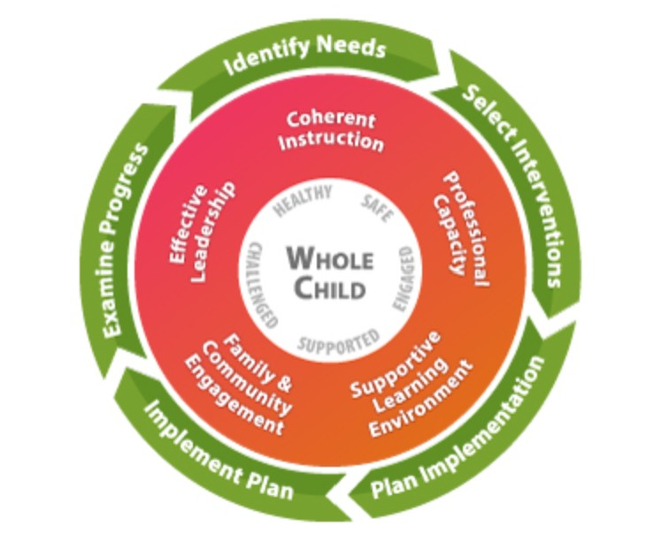
Where Do You Fit In?
This graphic shows all the considerations for educating students. Your role may move on this wheel, but it is important to see how Family Engagement and your work fits in.
Learn more: https://gadoe.org/school-district-improvement/systems-continuous-improvement/

Slide 15
Taking On Your New Role
The Implementation Manual explains the state special education rules in parent friendly terms and also provides school districts guidance in how to implement them. Most districts also provide a handbook for teachers that could provide useful information on how teachers are expected to implement special education rules.
Follow this link to learn more: https://gadoe.org/special-education/implementation/
The GaDOE website also includes a wealth of information about education in general and about special education, including eligibility, services, IEPs, assessment, Parents’ Rights, discipline, rules, resources, training etc.
Make sure you know how to find the Parents’ Rights (on the Special Education page. Here you’ll find descriptions of Parents’ Rights under the Individuals with Disabilities Education Act (IDEA) in seven different languages, as well as videos in English and Spanish explaining the rights.

Slide 16
Taking On Your New Role
The Parent Survey
The Georgia Department of Education distributes an online Parent Survey annually to parents in order to raise success rates for students with disabilities. The GaDOE asks parents to answer the survey to help assist local schools find ways find ways to better partner with families. All Parent Mentors are asked to assist with informing parents about the surveys and facilitating the return of as many surveys as possible. Parent Mentors view collecting such input as part of their Family Engagement process. Surveys are available in English and Spanish.
PTA Family Engagement Standards
The PTA Standards are a list the six types of involvement for successful partnerships with families.
Welcoming
Communicating
Supporting all students
Speaking up for every child
Sharing Power
Collaborating with the community

Slide 17
A First Month To-Do List
In Your District:
Introductions at Central Office Staff meetings and Coordinator, Lead Teacher meetings.
Find opportunities to tell your individual story to central office staff so colleagues can understand the challenges a parent faces and feels raising a child with a disability.
Your local special education director can send information about you to school administrators, counselors, teachers, therapists, psychologists, school district partners, etc., describing your role and providing your contact information.
Request technical training on platforms the district uses and become familiar with district policy.
After discussing with supervisor, create online presence on district website, and social media.
Does your district want you to do virtual meetings and trainings, webinars etc? Plan contents and frequency and then make sure you have approvals. Invite supervisor to the first few so they can get comfortable with you and offer feedback.
Ask your supervisor about creating a data base so you can share information with families, via mass emails and texts and through platforms like REMIND
With your Director’s approval, create some printed and online materials to market your program

Slide 18
More Things You Can Do
In Your District
Ask your supervisor to include you in district team meetings so you can meet with principals, counselors, and social workers in each school. Plan visits based on your district’s goals and priorities.
Join social media groups relating to families who receive sped services, attend family and community meetings and listen. Make sure you introduce yourself at the meetings.
Meet with individual school PTA/PTOs. Determine if ALL parents are being included and how you can help.
Build relationships and partnerships with leaders to work towards including ALL parents in their activities – especially Title I and English Language Learners programs.
Provide information about the Parent Mentor program to local newspapers, with prior approval from your Director and district Media Coordinator/Public Relations Director. Learn the approval protocol for any flyer, news item etc. and never distribute any information without first obtaining approval according to the local policy. Also find out what to do if a member of the media contacts you directly. Often you will need to refer the call to the Media Coordinator/Public Relations Director before responding to any requests for information or interviews.
Send an approved introduction letter to every family with a student who has an IEP and one to every teacher.
Decide with your director what services you are able to provide the first six months. Don’t promise services you are not yet ready to provide.
Distribute your contact information to intake staff, social workers, psychologists, counselors and diagnosticians to be given to parents at the time of referral or evaluation.

Slide 19
Taking On Your New Role
Partnerships with Other Agencies within the Community
Parent to Parent of Georgia (GaP2P) – Georgia’s federally funded Parent Information and Training Center. This is a key partner and a great source of information for parents. Please spend some time on their excellent website to familiarize yourself with GaP2P and the services and resources available. Most important to begin is to travel on their
Parent Leadership Coalition Agencies: Sharing information and resources to create better outcomes for children
Bright from the Start - Georgia Department of Early Care and Learning, Childcare
Inclusion and Pre-K Coordinators
Children with Special Needs, Babies Can't Wait, Project SCEIs, Parent Educators, Georgia Department of Education, Division for Special Education Services and Supports and Title I Parent Outreach
Georgia Council on Developmental Disabilities (GCDD)
Georgia Department or Behavioral Health & Developmental Disabilities (DBHDD)
Georgia Family Connection Partnership
Institute on Human Development and Disability (IHDD)
Leadership Institute on Developmental Disabilities, Georgia State University
State PTA
State Parent Information Resource Center (PIRC)

Slide 20
Parent Mentor Accountability
There are several statewide expectations for all Parent Mentors. The Georgia Parent Mentor Partnership (GaPMP) is accountable for meeting statewide expectations because the Partnership is partially funded through the GaDOE.
Parent Mentors work to engage all partners during family engagement initiatives, pursuing positive outcomes for students and their families, while reaching system related objectives. Parent Mentors and their administrative supervisor work together to plan for the upcoming year, using provided GaPMP implementation tools and resources.
Each school district and their Parent Mentor are accountable for:
1. Completing Quarterly Reporting Forms. This is the report that details what you have been doing with family engagement training. These are due on Oct. 15, Jan. 15, and April 15.
2. FY Pre and Post Surveys These surveys are what mentors use to determine the Family Engagement satisfaction status of your target group. Pre surveys should be entered by Jan. 15 and Post surveys are due on April 15.
3. Quarterly Contact Tracking – Parent Mentors report their collaborative contacts related to family, school, and community engagement work each quarter. These are due on Oct. 15, Jan. 15, April 15 and May 30 or before you leave for the summer.

Slide 21
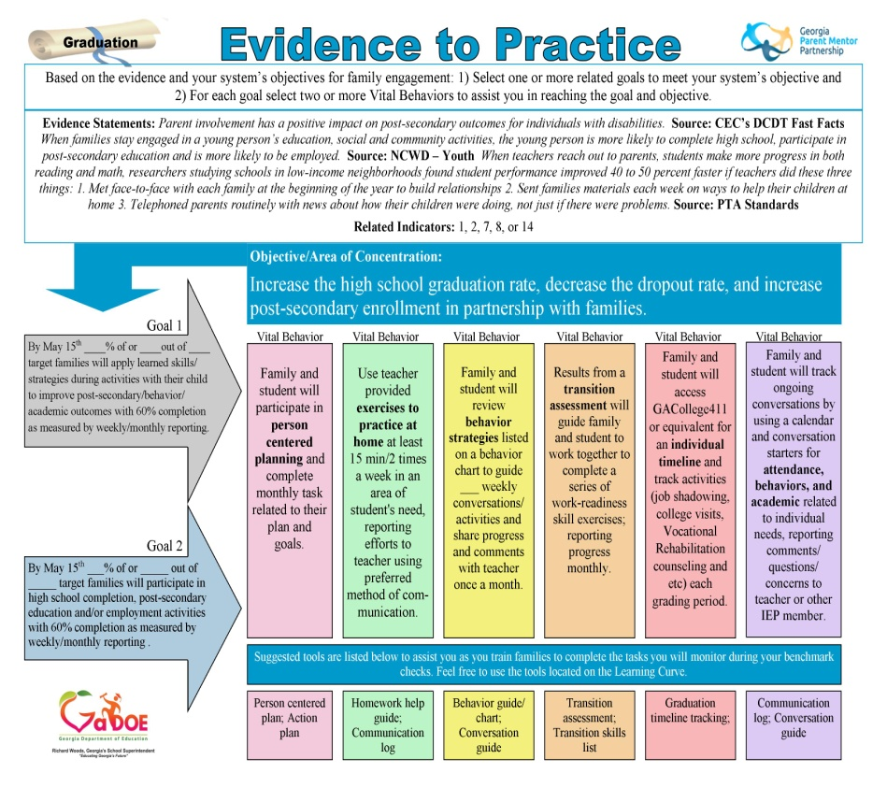
Collaboration and Tools
Parent Mentors have several opportunities to collaborate with one another during the school year. Parent Mentors are required to attend professional development opportunities once a quarter in their regions and once a year at the GaPMP Kickoff event in the fall. Other opportunities to collaborate together may include online learning opportunities, webinars, and/or other system or state related conferences you may attend as part of your local school system.
There are many research based Family Engagement Data Collection Tools that you will use to create your plan and collect data on the progress you are making with your target group.
Evidence to Practice or E2P Guides are created to give you ideas on what you want to train your families and how to show the impact of those trainings.

Slide 22
Online and Ongoing Support
The Community of Practice or COP, is there to assist you throughout the year with getting your reports organized and completed. The COP is made up of Parent Mentors and they volunteer to complete peer reviews of reports and assist new mentors and their region with reporting .
Other ways new mentors can find support:
Connect with seasoned mentors to help you.
Attend regional meetings and trainings for professional development and reporting support.
All tools mentors need for fulfilling their contract requirements can be found on the Learning Curve under the Reporting tab.

Slide 23
Participation & Leadership
Leadership Council
The Georgia Parent Mentor Partnership Leadership Council membership is made up of seasoned mentors who understand the mission and vision of the GaPMP and wish to help strengthen and improve this initiative.

