Slide 1
Linking the Classroom to the Living Room: Literacy and Home Learning Connections
Parent Mentor Conference
September 12, 2024
Outreach Unit- Family School Partnership
Notes:
Mandi

Slide 2
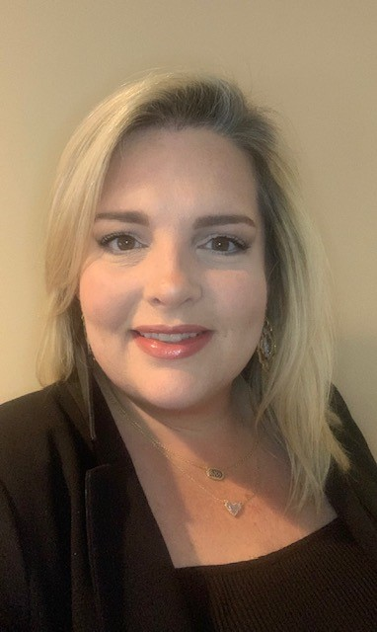
Presenter
Mandi Griffin​
Office of Federal Programs
ESSA Outreach Unit​
Program Specialist​
Notes:
Mandi

Slide 3
Learning Targets
Identify tips to encourage reading at home, which could be infused into communications
Identify book challenge activities to encourage students to read at home
Plan an effective literacy event
Notes:
Mandi
Before we get started, I would like to know who is in the room today. Today’s learning targets are (READ SLIDE) Great idea stations—chart paper

Slide 4
Georgia’s Systems of Continuous Improvement
Notes:
Mandi- Here on the screen you will see Georgia Department of Education’s Systems of Continuous Improvement. Today we will be focusing on the highlighted section of Family and Community Engagement. This area is a (READ BLACK BOX).

Slide 5
The Science of Reading
Notes:
Mandi- Raise your hand if you have ever heard of the Reading Rope? Scarborough's Rope captures the complexity of learning to read. Scarborough's Reading Rope is made up of lower and upper strands. When all these component parts intertwine it results in skilled and accurate, fluent reading with strong comprehension.

Slide 6
The Reading Rope
Literacy Short:
Scarborough’s Reading Rope
Notes:
Mandi- (SHOW VIDEO- 4 minutes 38 seconds)

Slide 7
Turn and Talk
If you were to use this video as a launchpad and focus on one or two elements during a family engagement event, what would that look like?
Notes:
Mandi- READ SLIDE (3 minute discussion)

Slide 8
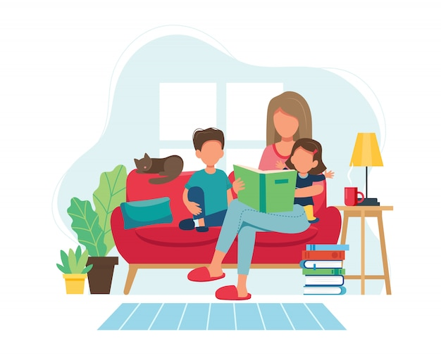
Infusing Reading into the Home
Communications
Book Challenges
Literacy Events
Notes:
Mandi- Today we are going to talk about ways that we can build the capacity of our parents and assist with infusing reading in our students’ homes. We are going to discuss three ways to get our families reading together; communications, book challenges, and literacy events. I am going to pass it over to Sunita to discuss communications.

Slide 9
Communications
Notes:
Sunita- Next, we are going to talk about Communications

Slide 10
Types of Communications
Newsletters
Flyers
Social Media
Class Communication Platforms
(e.g., DOJO/Seesaw)
Notes:
Sunita-
When we think of Communications, we often think of (read screen). These types of communications provide an easy way to encourage reading at home.
2. So, how many times do we need to send a message before the recipient gets the message? This is a common question in the world of advertising, which is what you are doing when you communicate with parents. In an article by Red Crow Incorporated, the author shares information from Historic businessman, Thomas Smith who indicates just how much ad frequency may be necessary:
The first 4 times you see an advertisement, you hardly notice it – it’s just entering your radar.
The fifth time you see it, you finally read it.
The 6th – 8th times it appears, it starts to annoy you.
By the 9th time, you start to wonder if there’s maybe something to it.
Views 10, 11, and 12 prompt you to casually think about it. Maybe you ask a friend about it or do a quick scan through their website, and the rest is history.
By the 13th time you see an advertisement, the product or service is worth something.
In views 14-19 you slowly convince yourself to make a purchase and start saving for it.
By the 20th time you see the same advertisement, sold.
The psychology behind this is pretty straightforward. The brain needs clear, frequent messages to be stored in long-term memory.
I recall when my daughter was in elementary school and there was an upcoming parent activity, I received numerous flyers leading up to the parent night and saw the advertisement written on a stand in the front office each time I picked up my daughter from after school care. By the time I had seen the advertisement for the parent activity countless times, I thought, they really want me to go to this parent night, which I did, and it was wonderful.
Activity: With a partner or group of three, in ten words or less, write down the gist of what I shared about frequency. You have two minutes.
Who would like to share?
As we think about communicating with parents, frequency is oh-so-important.

Slide 11
Encouraging Reading at Home
If you had a Reading Corner on your newsletter, web page, or social media account, what are some reading highlights that you could include in your communications to encourage reading at home?
Consider writing the reading highlights in such a way that a parent or family member can read them in less than 45 seconds.
Notes:
Sunita – Now let’s think about your communications. (Read screen)

Slide 12
Reading Highlights - Your Turn
On a sticky note, write an advertisement, a reading tip,
a quote, or a provoking thought that you could include in your school’s communications.
You could also highlight a book, an author, or a QR code with someone reading a book.
“Reading is a way for me to expand my mind, open my eyes, and fill up my heart.” – Oprah Winfrey.
Read!
Read!
Read!
Notes:
Sunita- (read screen) If you finish with your thought, grab another sticky note. See if you can complete 2-5 sticky notes. Also, consider checking the web for ideas. Place these in the middle of your table and snap a picture.
(10 minutes)

Slide 13
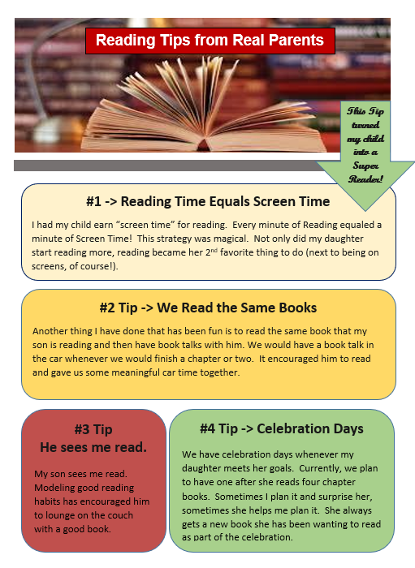
Flyers
Notes:
Sunita- In addition to newsletters, web pages, and social media accounts, flyers are another way to communicate with parents. Here are two examples of flyers. The one on the left is from Reading Rockets, a valuable resource worth checking out. The one on the right is one I created from experiences I had with my own children. I used this flyer as part of a parent engagement activity during a Thanksgiving lunch. As parents were waiting in line, our media specialist went over the tips with parents and each parent received a copy. This flyer was also shared in our parent-family engagement corner in the front lobby and was linked to our electronic newsletter.

Slide 14
Turn and Talk
How can you make newsletters and flyers accessible to all parents?
How would you communicate with parents who can’t read, have visual impairments, or who can’t access English print?
How can you ensure that the communication is in a language and format the parents can understand?
Notes:
Sunita- With all communications, it is important to make sure that the information is accessible to all parents. Take a few minutes to turn and talk with those at your table and answer the following questions (read the screen). If you have a great idea or hear a great idea, please put it on a post-it note and place it on a chart.
Did anyone hear a great idea worth sharing with the room?
My thoughts:
It’s important to know who your parents are. When practicable, translate the document. Have the teacher call the parent and read the flyer, newsletter, or notification.
How can you make newsletters and flyers accessible to all parents?
How would you communicate with parents who can’t read, have visual impairments, or who can’t access English print?
How can you ensure that the communication is in a language and format the parents can understand?
For example, if you have a digital copy, a parent could zoom in or have the digital device read it to them. Consider an App that could translate or read it to them.

Slide 15
Book Challenges
Notes:
Mandi- Another way to infuse reading into the homes of our students is book challenges.

Slide 16
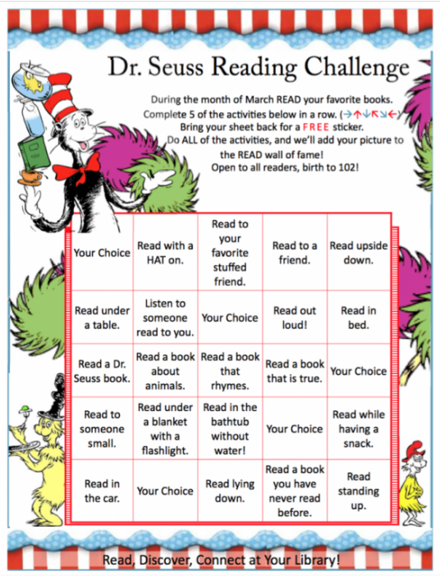
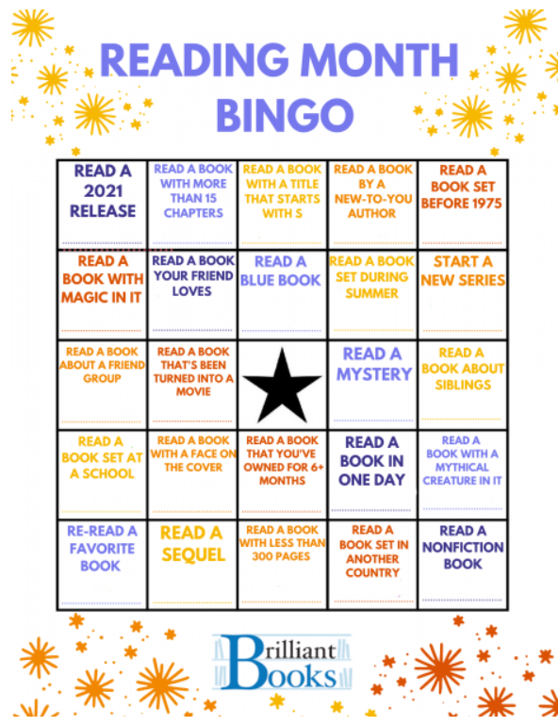
Book Challenge Activity
Notes:
Mandi- Here you can see a few examples of monthly book challenges. You can design these types of challenges any way you choose; have a monthly theme, have students complete them in a pattern, complete the whole board, have parents initial each task completed, etc. (POINT OUT SOME OF THE ACTIVITIES IN THE EXAMPLES)

Slide 17
Book Challenge Activity
Think about your student population and use the sticky notes at your table to write down a reading challenge activity that students can complete. (1 activity per sticky note)
Post your activities on the large poster paper to create a completed book challenge for students.
Check out the posters around the room and feel free to take pictures of the posters to use for inspiration when you return to your district/schools.
Notes:
Mandi- Explain the activity to participants (10 minute activity)

Slide 18
Literacy Events
Notes:
Mandi- The last way to infuse reading into the homes of our students is through literacy events.

Slide 19
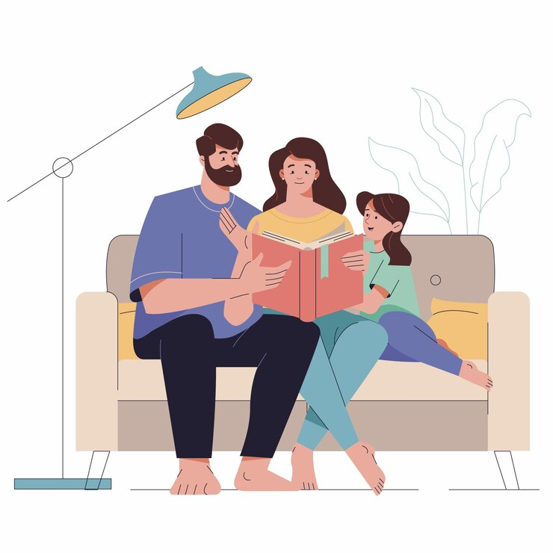
Literacy Event School Spotlight
Reading Skills Family Dinner Night
Notes:
Mandi- These events can look different from district to district, school to school, grade level to grade level. I am going to share an example of a literacy event that I attended at Fair Oaks Elementary School in Cobb County. (DESCRIBE EVENT)

Slide 20
Literacy Event for Families
Sample Family Literacy Event Objectives:
Increase the knowledge level of parents and family members about things they can do at home to help nurture readers.
Involve more parents and family members in the education of their children and help them feel welcome as learning partners.
Host a fun, free, multi-generational activity where families and teaching staff can show students that they value reading and learning.
Notes:
Mandi- Why literacy events? Some sample family literacy event objectives could be (READ SLIDE). I am now going to pass it over to Tammie to discuss some ways to make sure you are supporting English learners and their families at home.

Slide 21
Supporting Young English Learners (ELs) at Home
REL: Regional Educational Laboratory Program
Notes:
Tammie- How can you personal learning at home activities for English learners? I am going to quickly share a resource available to each of you for supporting young ELs at home. All of these resources and many more can be found on the REL website. We will make the link available to you.

Slide 22
Family and Caregiver Activities (FCA)
Includes simple, fun activities that families and caregivers can use with young English learner children at home
Strengthens language development in either the home language or English
Aligned to the What Works Clearinghouse practice guide "Teaching Academic Content and Literacy to English Learners in Elementary and Middle School"
Is available in multiple languages
Notes:
Tammie- In an effort to make learning together fun REL has developed a Family and Caregiver Activities (they refer to them as FCAs) resource.
These family and caregiver activities (FCAs) are designed to provide simple, fun activities families and caregivers can use with young English learner children at home to leverage cultural and linguistic assets and knowledge to strengthen language development in either the home language or English. The resources are based on the What Works Clearinghouse practice guide "Teaching Academic Content and Literacy to English Learners in Elementary and Middle School. These are available in multiple languages.

Slide 23
Family and Caregiver Activities (FCA), continued
Link to Web Page – Family and Caregiver Activities
Notes:
Tammie-

Slide 24
Living Room Activity in Action
Notes:
Tammie-

Slide 25
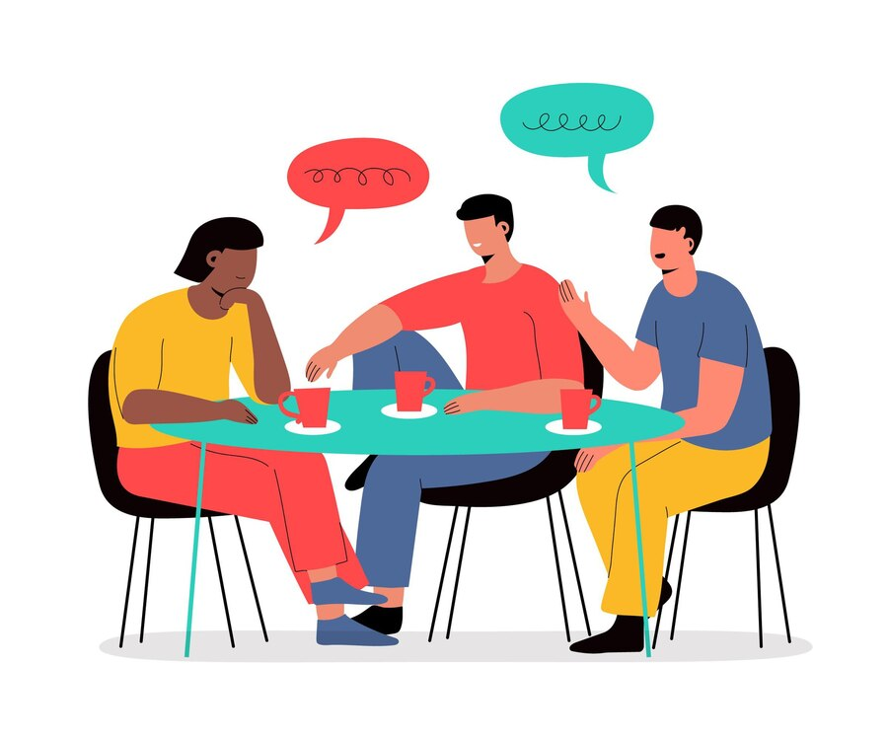
Table Talk
Share literacy events that have taken place at your school, events you have observed, or events have heard about.
Notes:
Mandi- Table Talk activity (3 MINUTES)

Slide 26
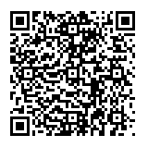
Literacy Event Planning
Use the template provided or the QR code below to plan a literacy event for your school, district, or LEA.
Notes:
Mandi- Explain activity (45 minutes)

Slide 27
Resources
Notes:
Mandi-

Slide 28
Educator Resources for English Learners
These resources support educators in helping families and caregivers make the most of the activities:
TOOL: Educators' Guide Read the Educators' Guide to learn more about the activities as well as tips to help families and caregivers make the most out of them.
VIDEO: Introductory Webinar Watch a webinar that introduces the research behind the activities and provides suggestions to maximize learning and fun while families, caregivers, and children engage with the FCAs.
VIDEO COLLECTION: Activities in Action See educators and families in action! View three videos that connect classroom instruction with use of the family and caregiver activities at home.
Notes:
Tammie- Educator resources are available to support teachers and parent coordinators make the most of these activities. REL has provided an Educator’s Guide, an Introductory Webinar, and a Video collection of the activities in action.

Slide 29
Resource for Communicating with Parents with Limited English Proficient (LEP)
Information for Limited English Proficient (LEP) Parents and Guardians and for Schools and School Districts that Communicate with Them
Notes:
Tammie-

Slide 30
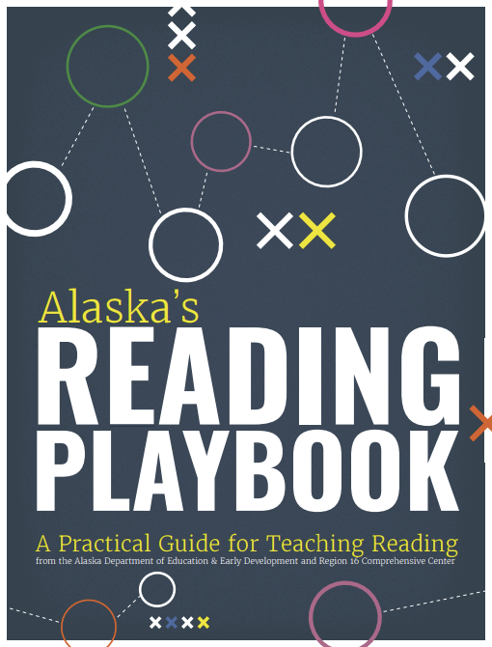
A Guide for Teaching Reading
“Our role as educators is to inform parents of the great value in both talking to and reading to their children. We should also consider how we ensure all families have access to the materials they need.” (Alaska’s Reading Playbook, p. 30)
Note: This resource is primarily for Reading Teachers but has some ideas and thoughts worth considering.
Alaska’ Reading Playbook
Notes:
Sunita- (read screen) Not only that, if you have not taught reading, it will build your capacity as you help promote literacy in the home.

Slide 31
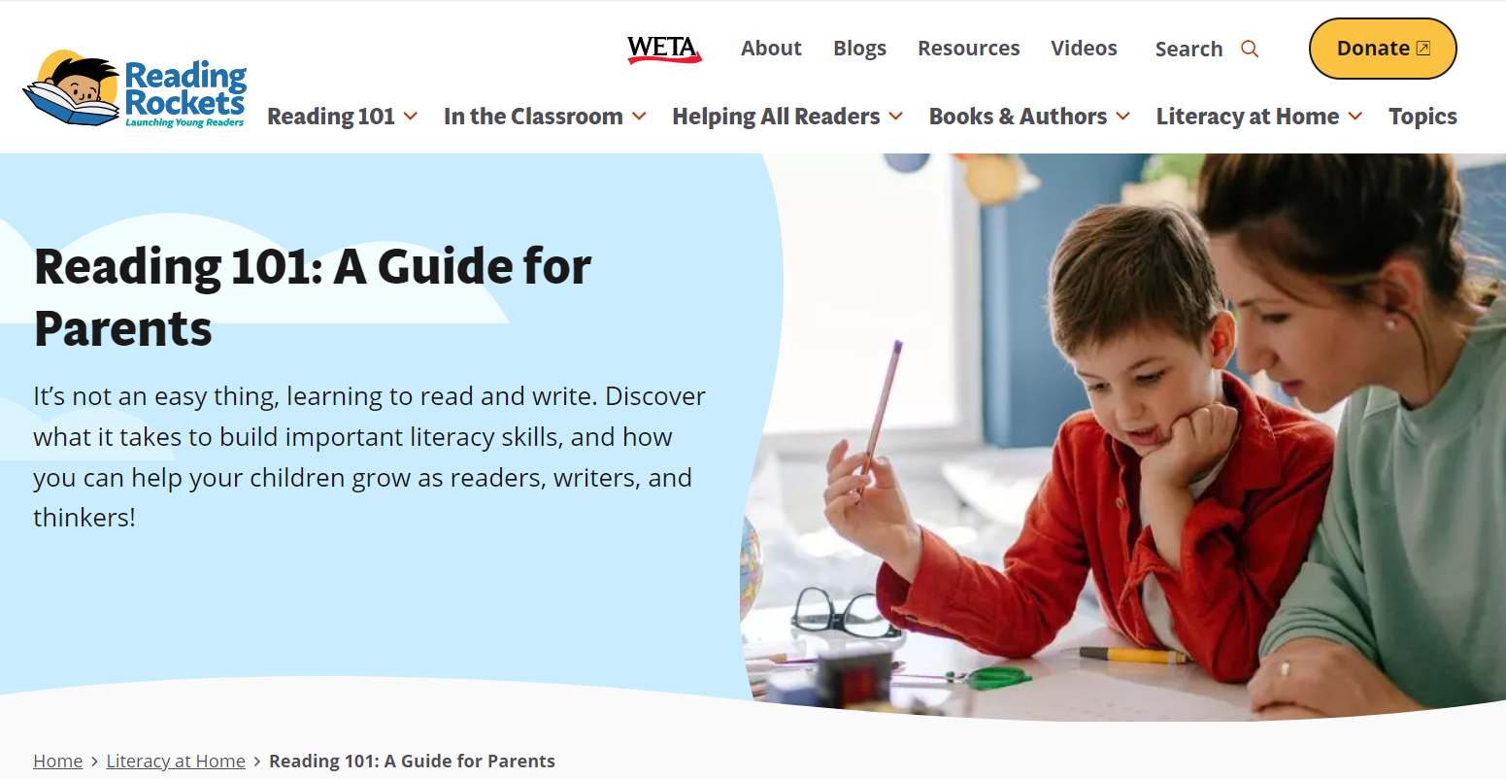
A Web Page Worth Exploring
Reading Rockets, Reading 101: A Guide for Parents
Notes:
Sunita- This is the resource I mentioned earlier and is a resource definitely worth exploring.

Slide 32
A Parent Guide
Put Reading First, Helping Your Child Learn to Read, A Parent Guide
Notes:
Sunita- Lastly, we have A Parent Guide. This guide gives practical and simple tips for parents to support reading at home. For example,
● Rereading familiar books. Children need practice in reading comfortably and with expression using books they know.
● Building reading comprehension. Talk with your child about what she is reading. Ask about new words. Talk about what happened in a story. Ask about the characters, places , and events that took place. Ask what new information she has learned from the book. Encourage her to read on her own.
NOTE: If time allows, have participants explore the different resources.

Slide 33
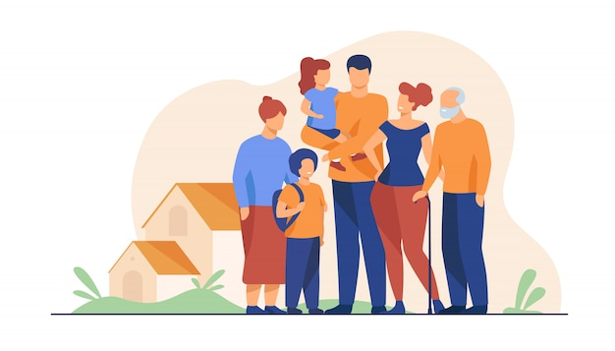
“At the heart of family engagement is an opportunity for parents and children to spend quality time together focused on developing a life-long love of learning.”
(Paraphrased from a conversation with Dr. Maria Paredes)
Notes:
Sunita

