Slide 1
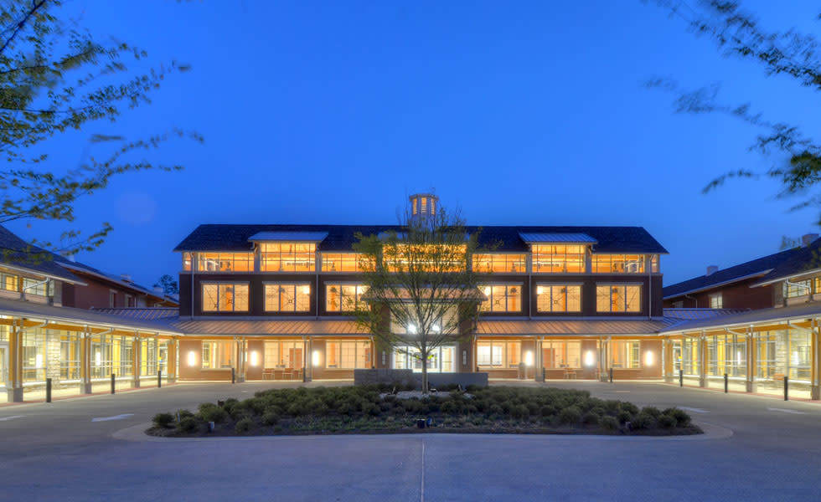


Roosevelt
Warm Springs
#RWS-2.0

Slide 2

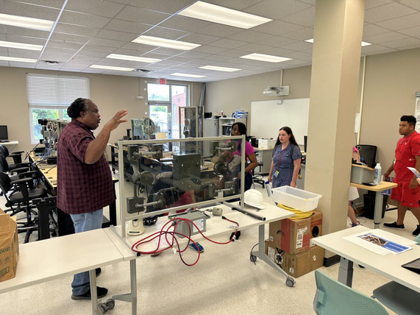
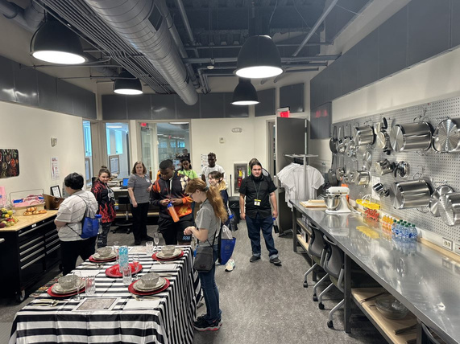
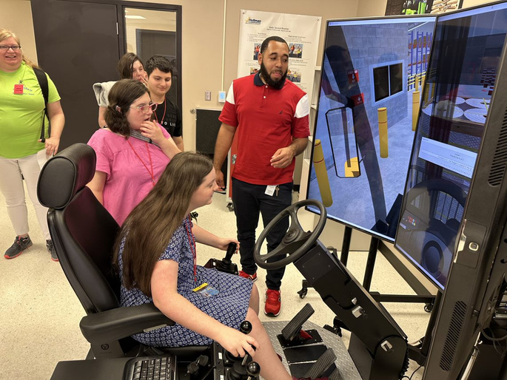

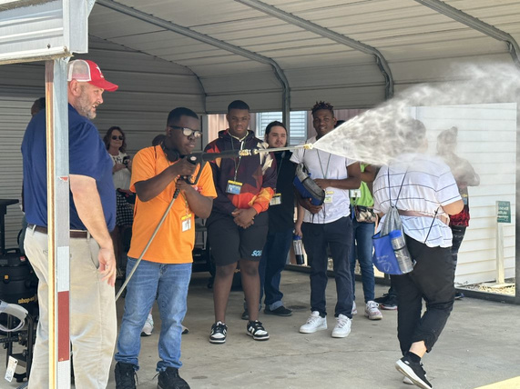
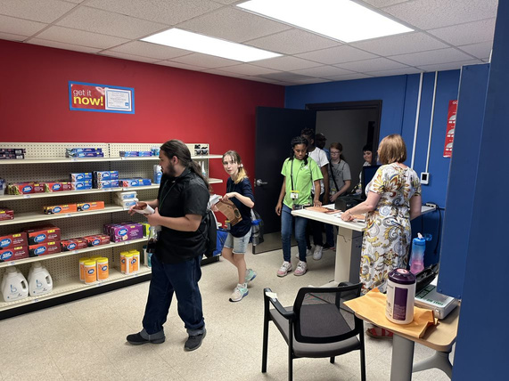
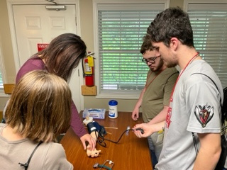
Current PATHWAY Offerings
Light Electrical/
Carpentry
Logistics/Warehousing
Hospitality
Low Voltage Wiring
Certified Nursing Asst.
(C.N.A)
Auto Detailing
Retail (CVS)
Heavy Equipment
Operator
(Excavator & Bulldozer)
* * All program offerings allow for the opportunity to earn nationally accredited industry certifications ! * *

Slide 3

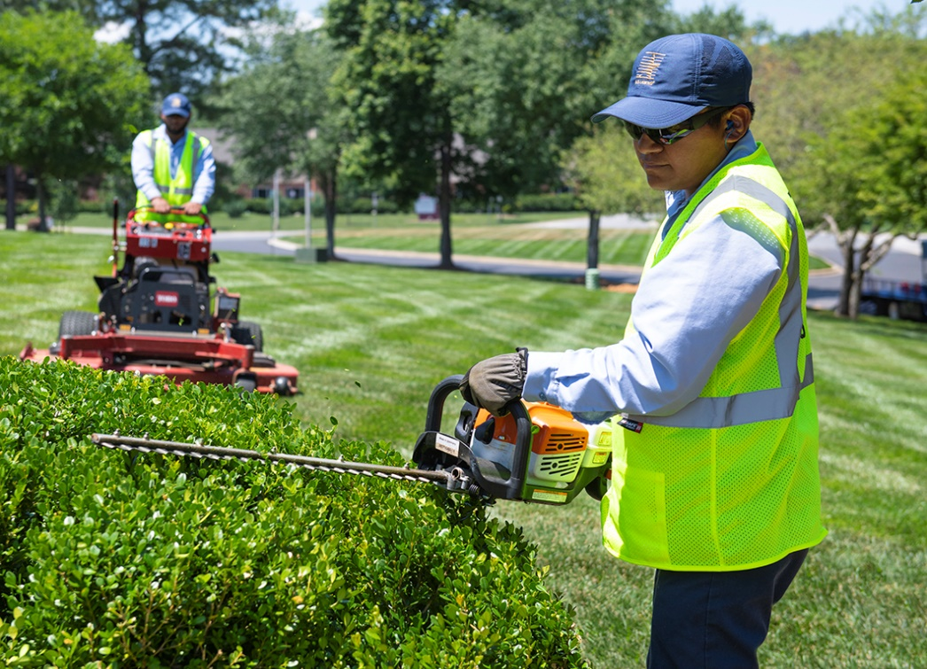

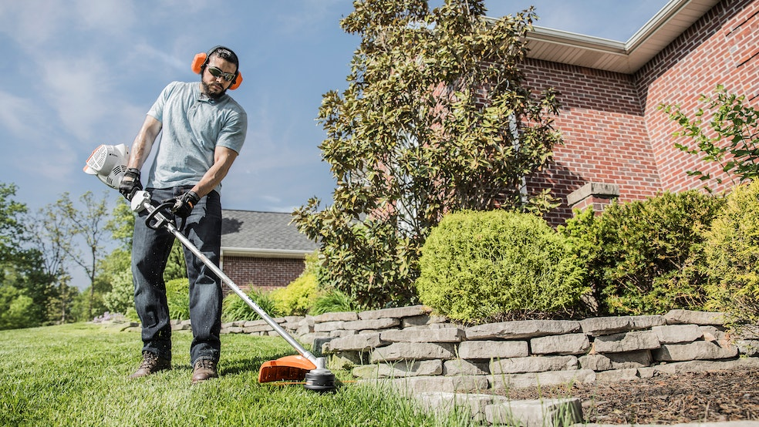


New PATHWAY Offering Coming Jan. 2025
Landscape Maintenance & Design
(w/ Small Engine Repair)

Slide 4

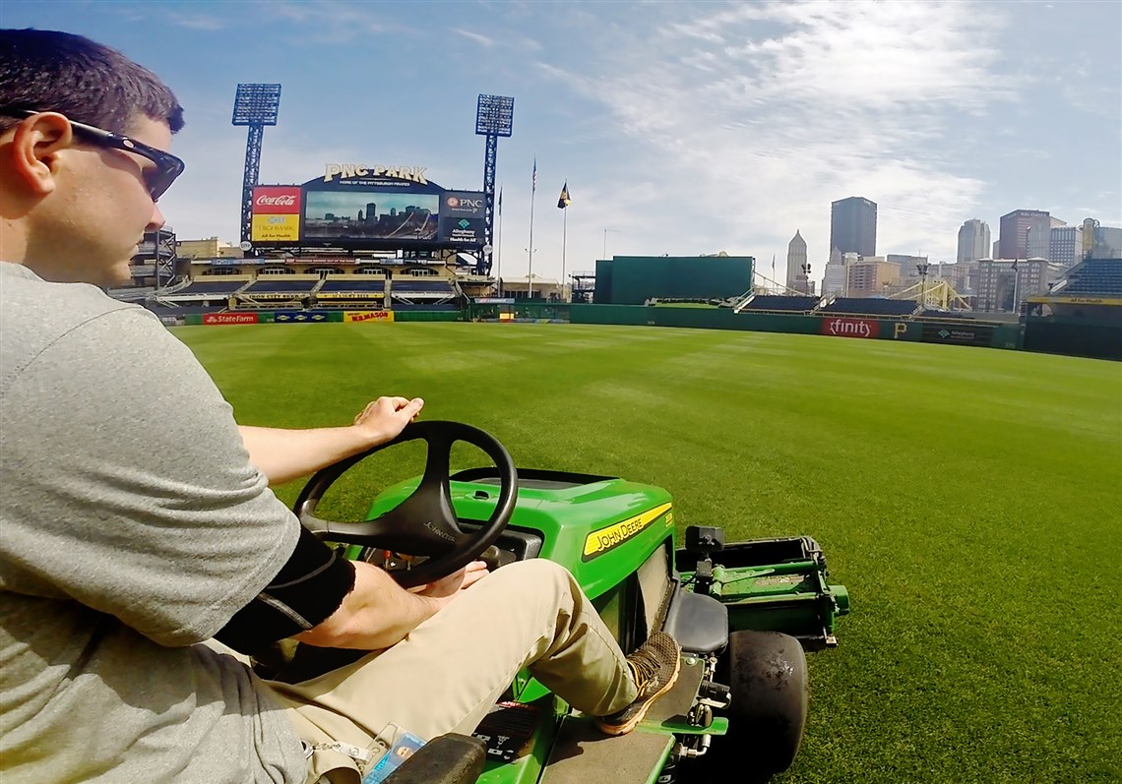
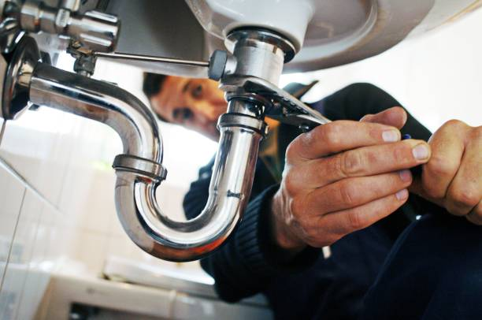

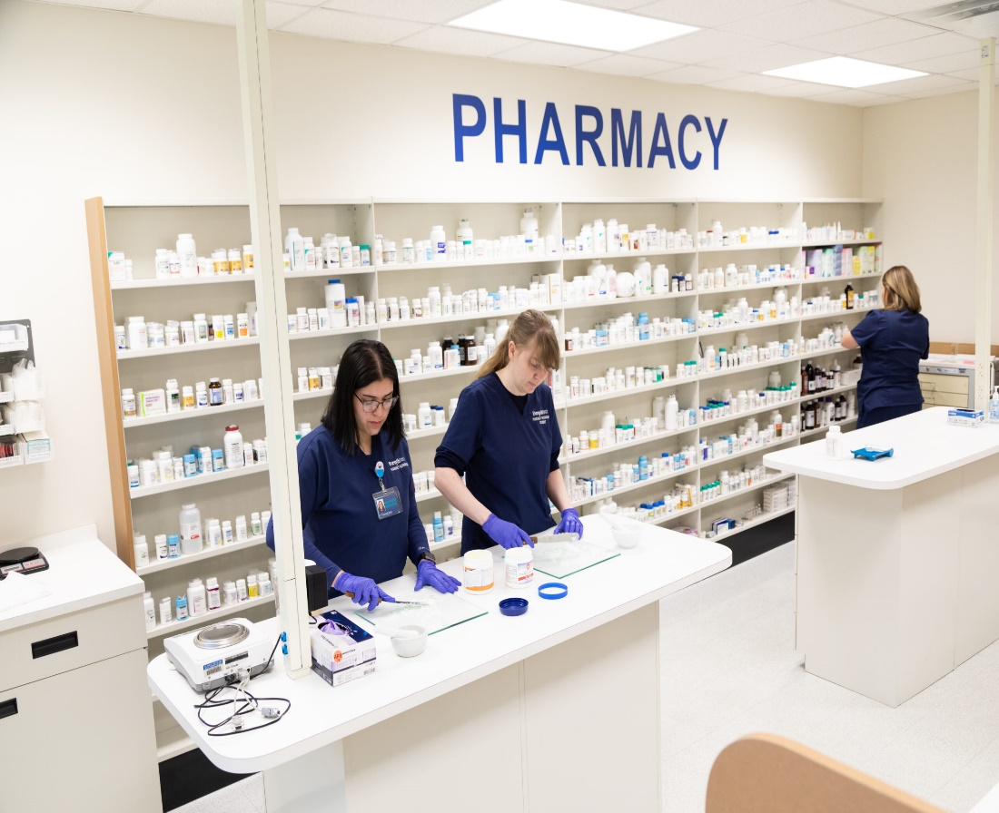


Future pathway expansion Plans including…
Construction Jumpstart Options Such As:
HVAC Basics
Plumbing
Commercial and Residential Painting
Groundskeeping / Turf Management
Pharmacy Technician

Slide 5
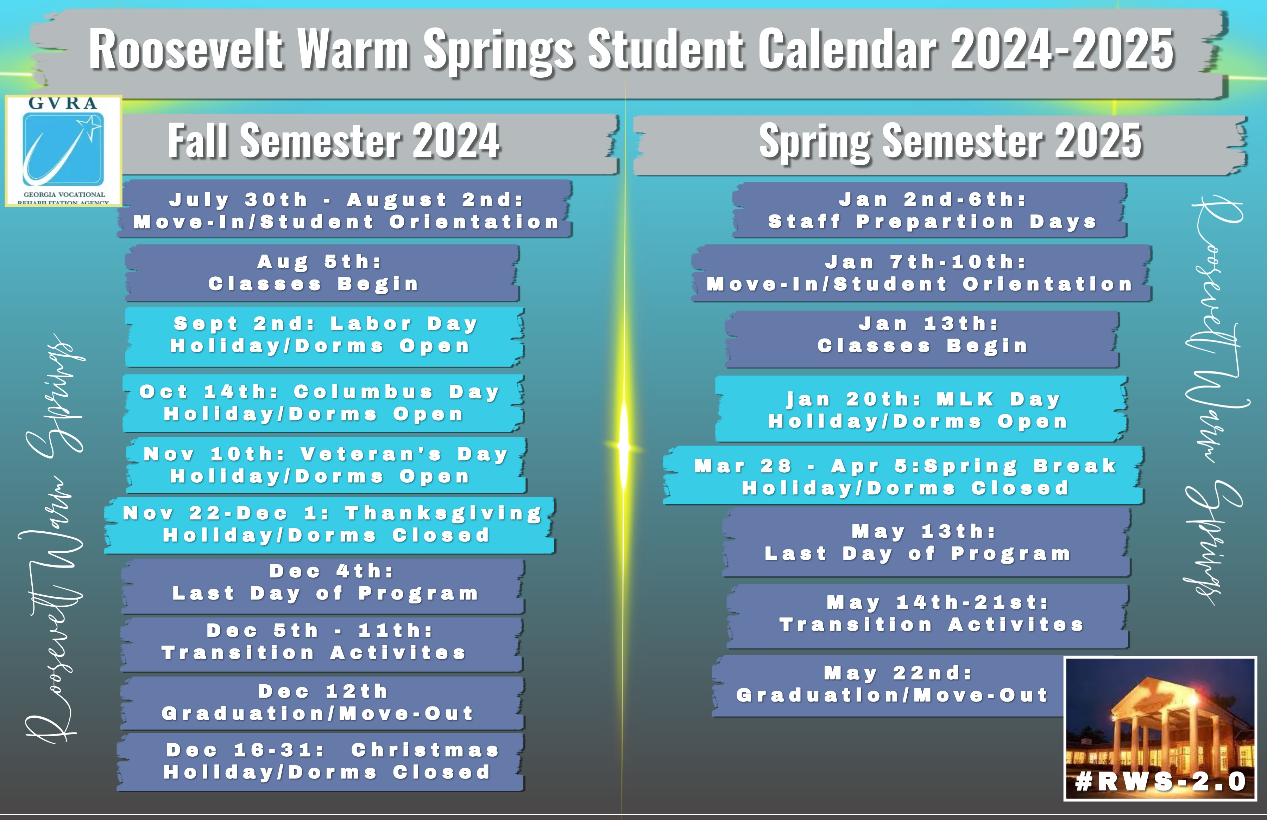

Slide 6
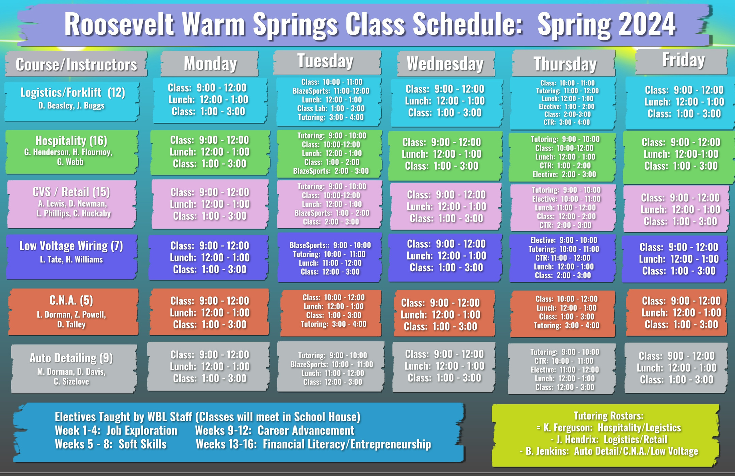

Slide 7
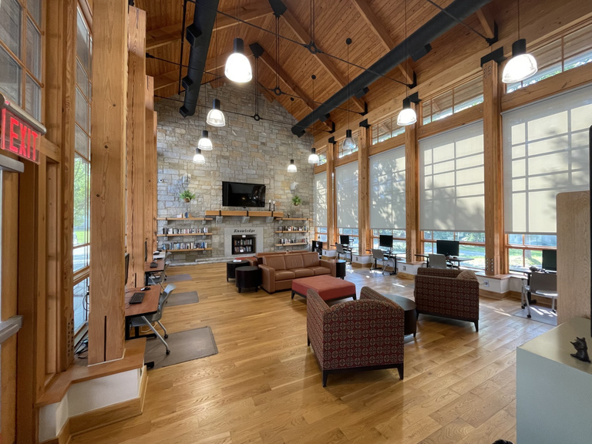
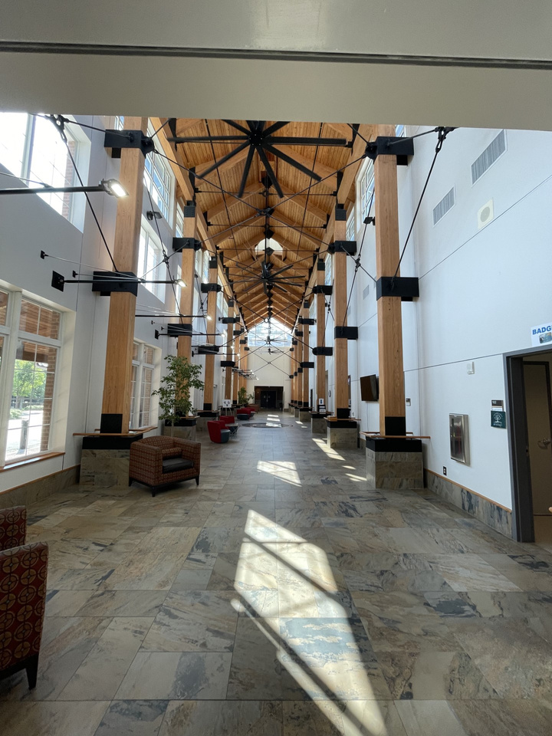
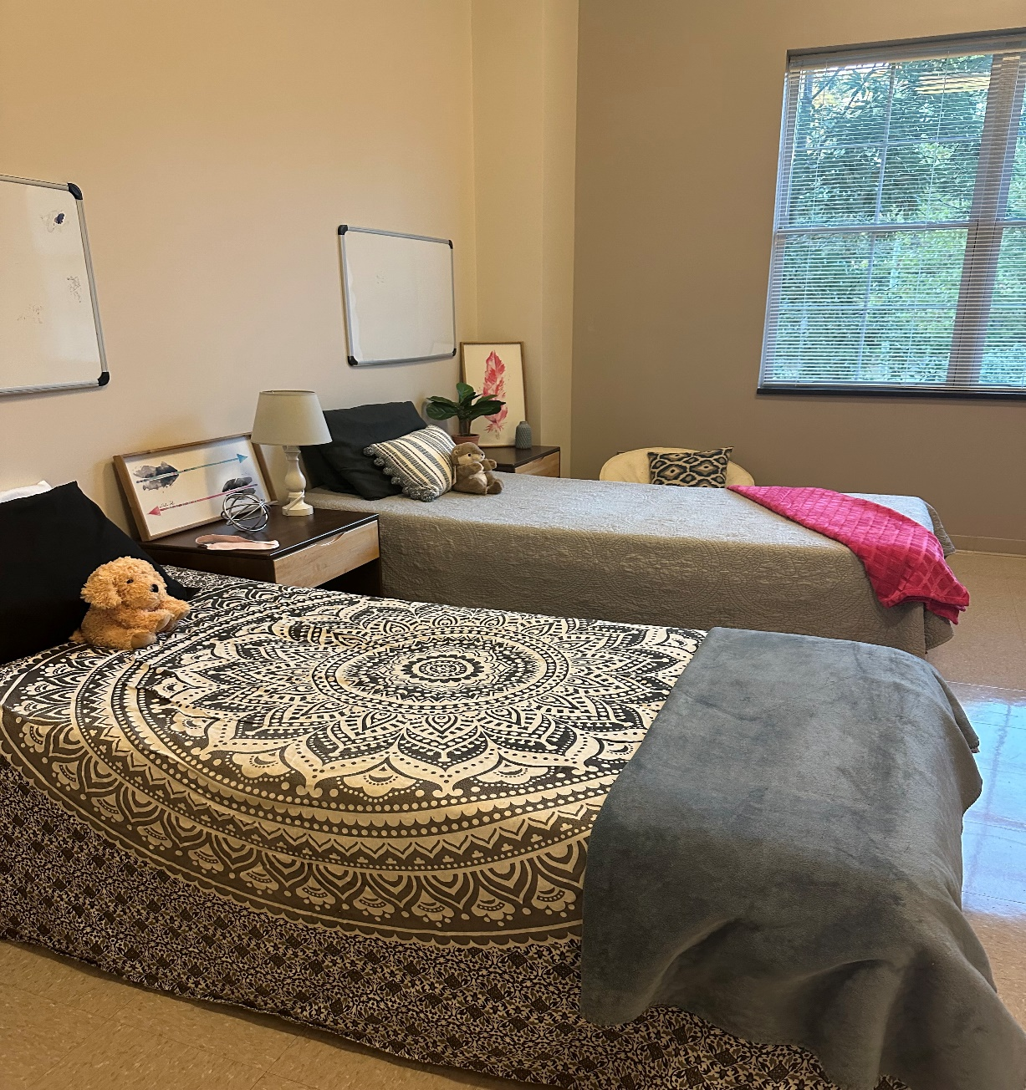
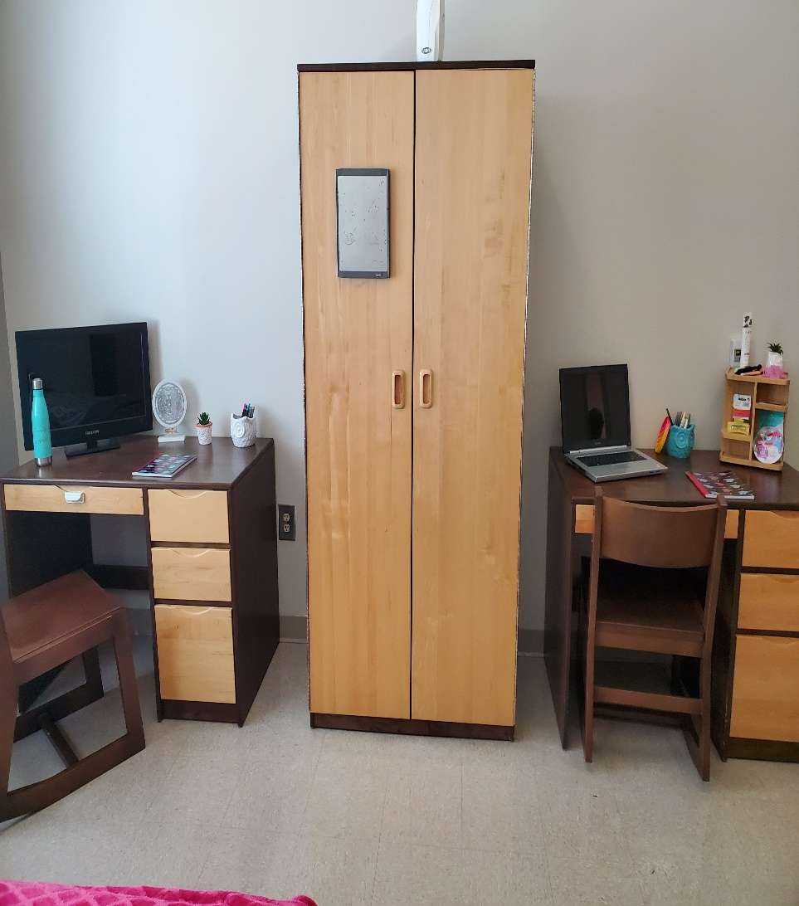
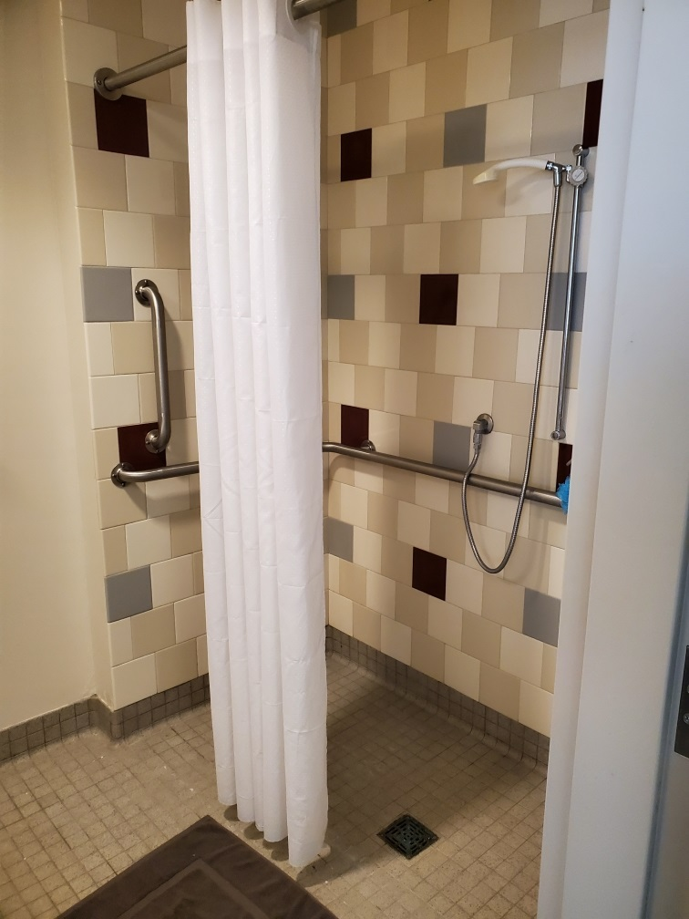
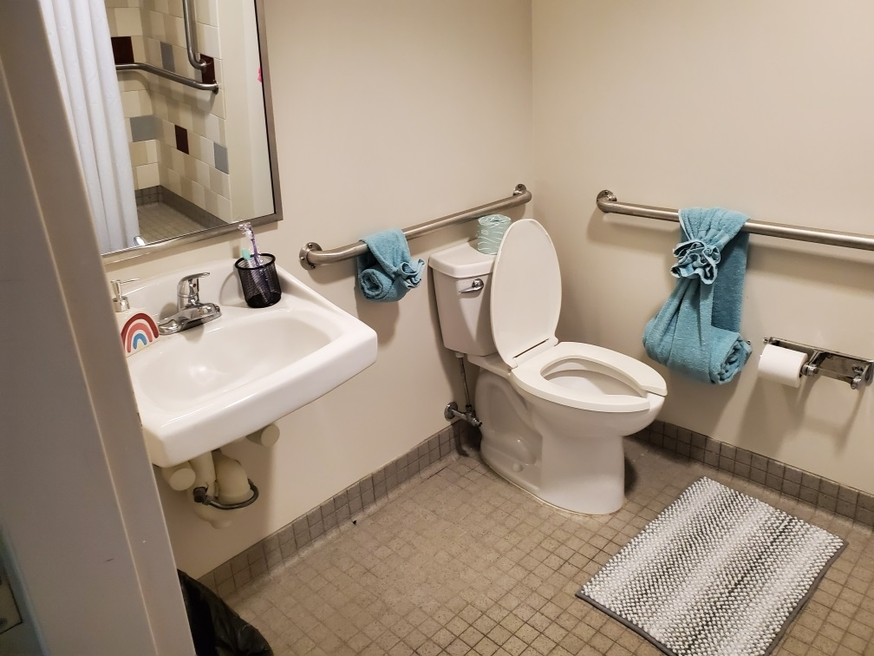
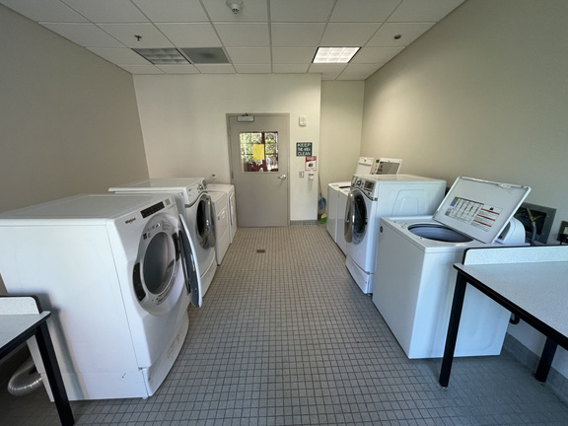
Dorm Life

Slide 8
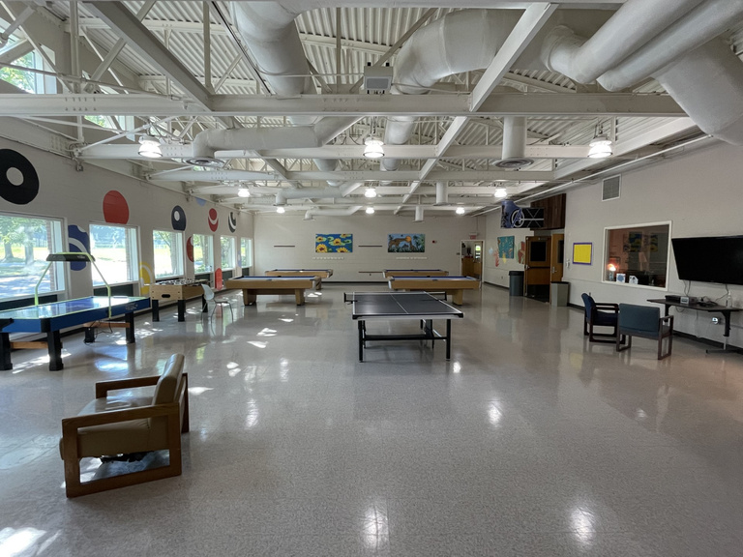
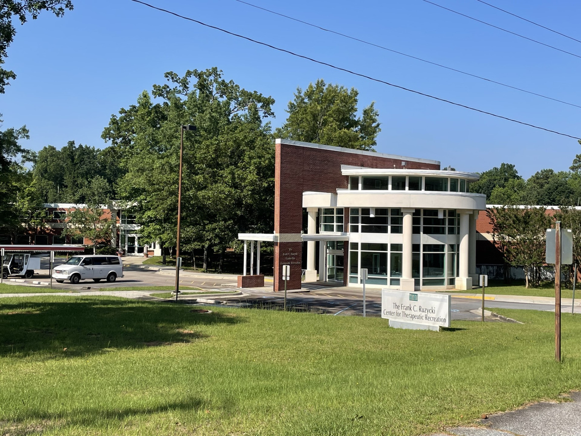
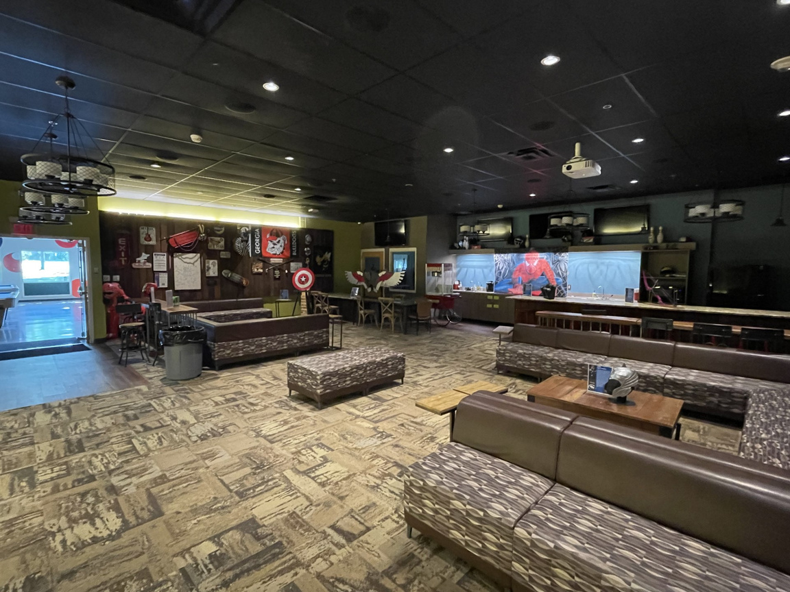
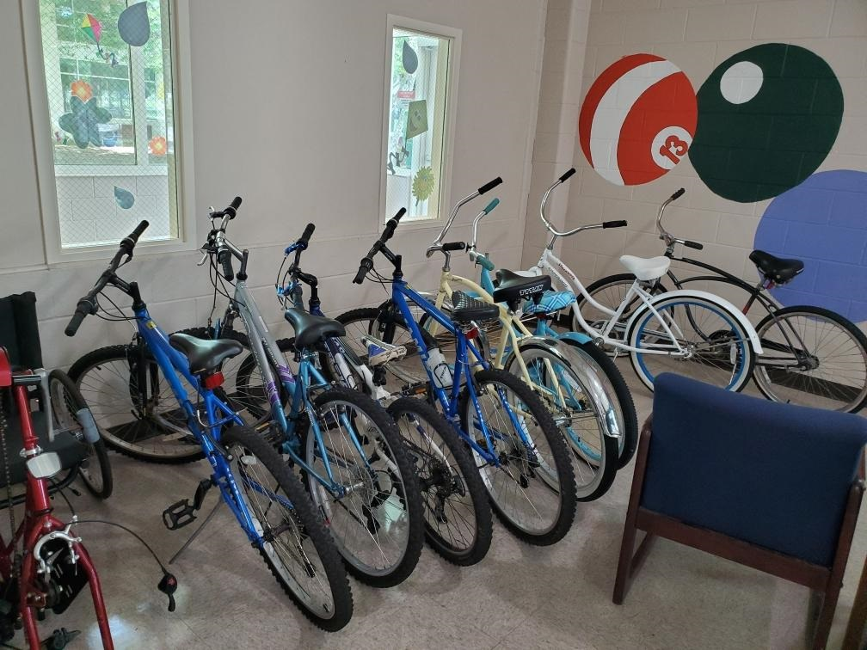
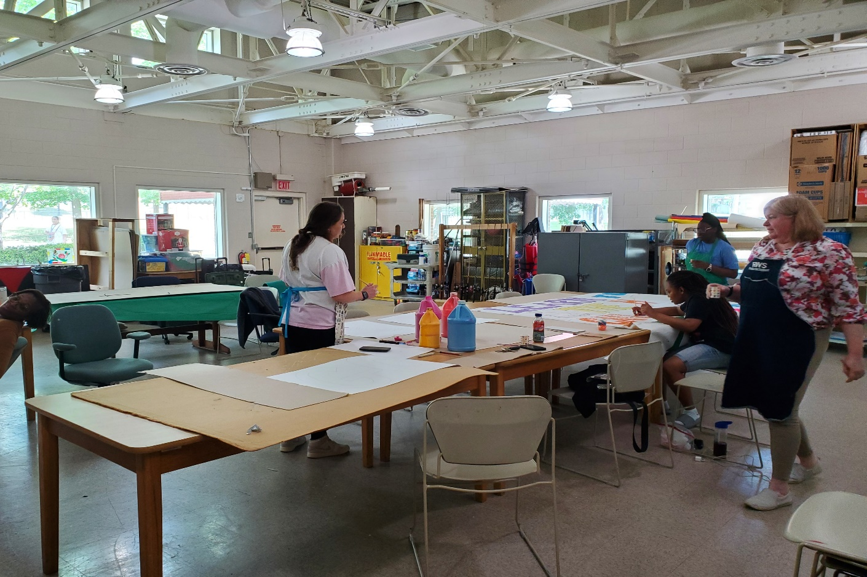
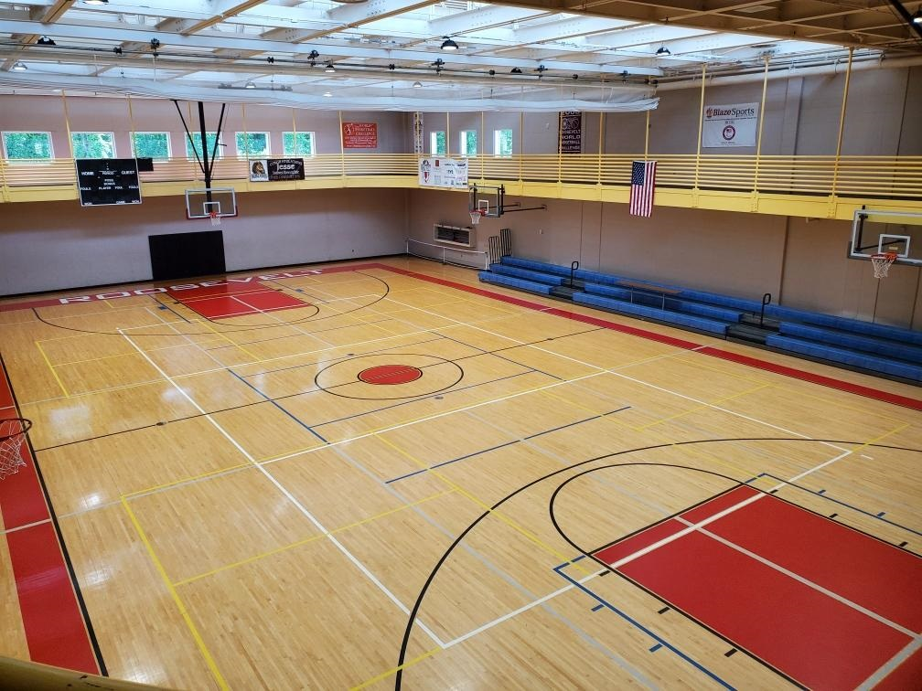
Center for Therapeutic Recreation (CTR)

Slide 9
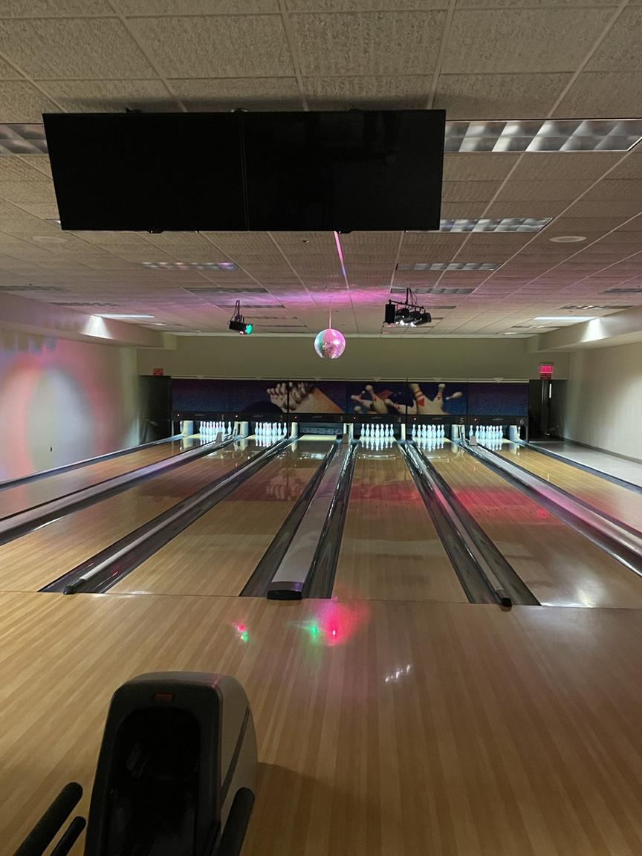
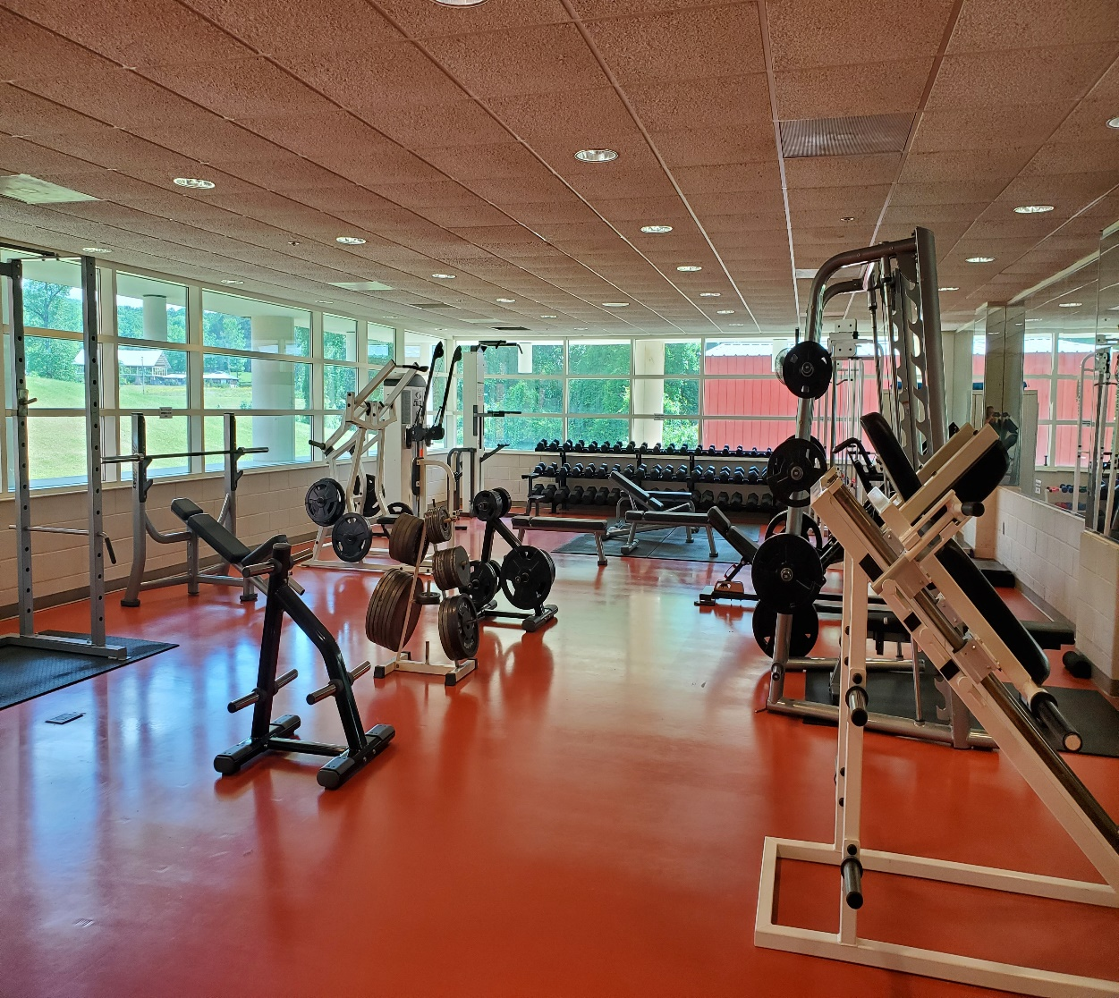
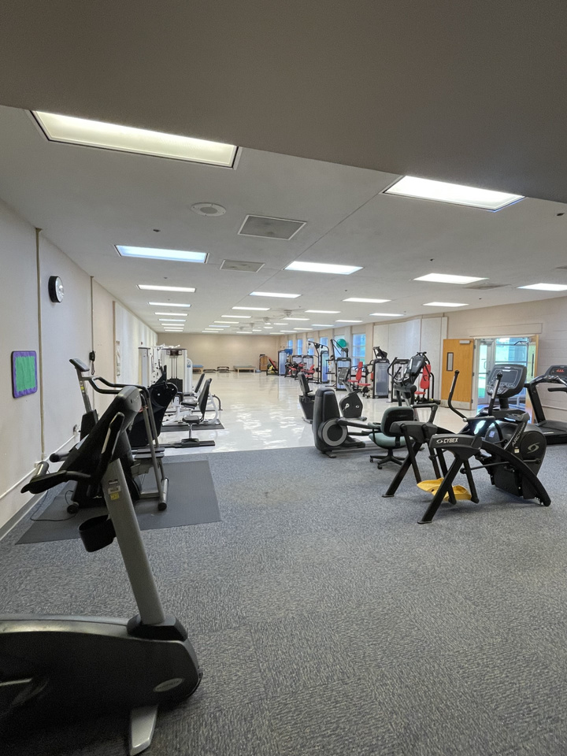
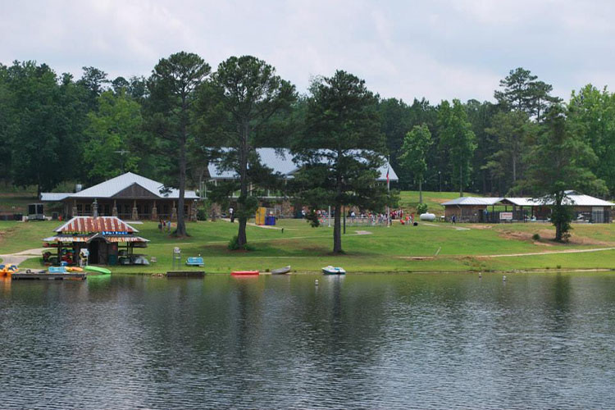
More CTR and Campus Amenities

Slide 10
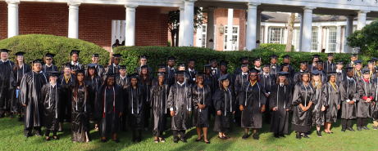
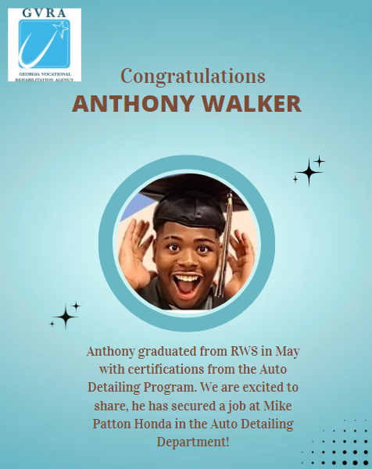
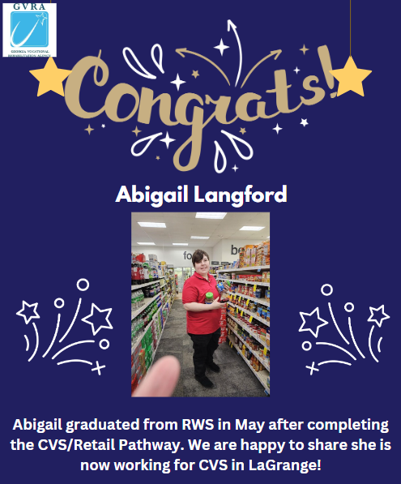
What happens after graduation?
Each student is assigned a provider and employment specialist at beginning of semester
They work with students throughout semester to determine strengths, weaknesses, and job opportunities that exist in hometowns
Help them build resumes and set up job interviews for once they leave campus
Providers and employment specialists continue to work with student for 90 days after graduation to ensure gainful employment

Slide 11

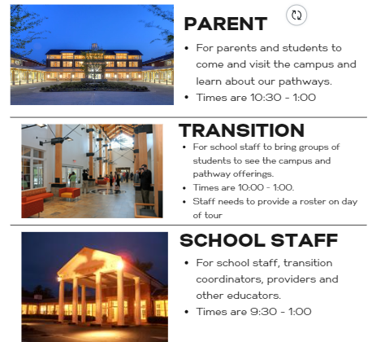


TOURS
Include the following in the email:
Contact Name, Email address and phone number
What type of tour? Parent, Transition or School Staff
Number of participants (Max 32)

Slide 12


Already a VR Client?
Not a VR Client?
  Contact Jamie Fox, Admissions Manager, at Jamie.fox@gvs.ga.gov OR reach out to your local VR counselor
  RWS staff will work with applicant to determine if they are eligible for VR services and if they meet RWS admissions criteria (determination with in 10 days)
  If the applicant is eligible for VR services and meets criteria for admissions, counselor will notify the client and work with them to develop an IPE
  If the applicant does not meet RWS criteria, they will be notified by RWS staff and the case will be transferred to local field office to develop an optional plan for supports.
  Contact your VR counselor or reach out to RWS directly at rws.csc.referrals@gvs.ga.gov to receive an application for admission and information on admissions criteria
  Admission decision made within 10 business days of receipt of completed application and required supporting documents
  Clients will be notified directly by RWS staff of their admissions status (admissions packet if accepted to RWS, referral to local field counselor for additional supports if criteria is not met)
Current Admissions Process

Slide 13
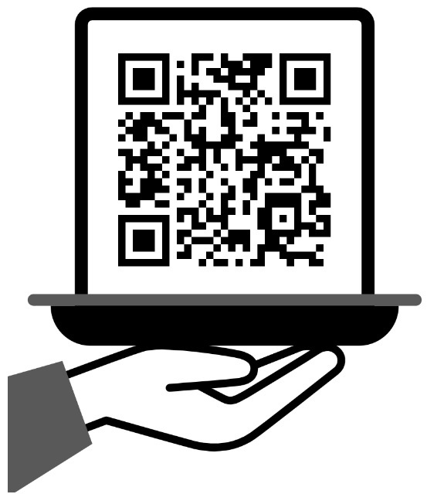

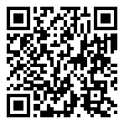
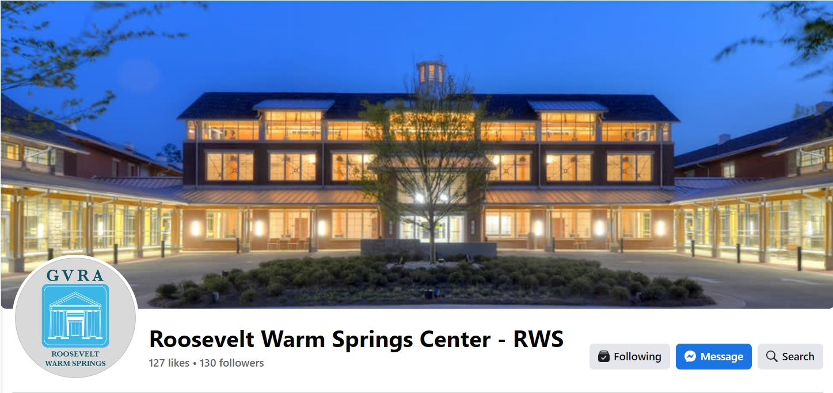

#RWS-2.0

