Slide 1
Georgia Vocational Rehabilitation Agency
September 12, 2024
GVRA Supporting Transitioning High School Students
Georgia Vocational Rehabilitation Agency
Brittanie Burdette, Transition Coordinator
Brittanie.burdette@gvs.ga.gov

Slide 2
Presentation Objectives
Learn about how GVRA supports high school students
Who qualifies for services?
What services might my student receive
Notes:
Our goal with this presentation is to address these most frequently asked questions, and state the questions.

Slide 3
How to Access GVRA Services
Through your local school.
Designated GVRA Staff work with local school system staff
Invite GVRA staff to attend IEP meeting
Transition fairs
School referrals to GVRA with Parental Permission form and copy of IEP or 504 plan
Through GVRA
Referral for HS services only - https://gvs.georgia.gov/form/parental-permission-form
VR Services Referral - https://gvs.ga.gov
GVRA Customer Support - 844-367-4872
Attend Virtual Potential Client Orientation- “Is VR Right for Me”
Held on the Third Wednesday of the month
A recording of the session will also be available on the GVRA website- gvs.ga.gov
Notes:
This slide addresses the first FAQ.
1st – we have transition staff throughout the state assigned to cover all public school districts. Students are typically introduced to GVRA through their schools connecting them. IEP case managers, transition specialists and school counselors are the most common school staff to make referrals to GVRA
2nd - GVRA can also receive referrals directly from anyone for anyone, including for students attending private schools or those homeschooled
3rd – GVRA has a similar live forum as this for potential clients to explore applying for VR services.

Slide 4
Who Qualifies
Potentially Eligible Student (for HS services only):
Between the ages of 14-21 (up until their 22nd birthday)
Eligible and receiving services under an IEP or Section 504
Is participating in a recognized academic setting. (public, private, home based schools, Post-Secondary training.
VR Client:
Permanent physical or mental disability
Poses a substantial impediment to employment
Can benefit from Vocational Rehabilitation Services in terms of a competitive integrated employment outcome.
Notes:
This slide addresses the 2nd FAQ.
Students can qualify for services from GVRA 2 ways.
The first is as a Potentially Eligible Student. Qualifying this way allows them to receive Pre-Employment Transition Services ONLY and these services will only last as long as the student is enrolled in school.
The second way students qualify for GVRA services is to apply and be determined eligible for VR services which allows them to be served as a VR client. This allows students, typically those closer to HS exit or needing more individualized services, to receive Pre-employment transition services as well as individualized VR Transition Services and future VR Employment Services. The whole continuum shown on our earlier slide. Typically, HS students are referred to GVRA early in HS and are served as potentially eligible students and then decide prior to graduation if they will apply for VR services depending upon their needs after HS. Ideally, students who will require VR services after HS to be successful in competitive integrated employment will apply, be determined eligible and have a VR Work Plan in place prior to exiting HS.

Slide 5
Potentially Eligible Student (PTS) Process
GVRA Receives completed Parental Permission Form (PPF) and begins case
GVRA Obtains a copy of the IEP/504/Disability Documentation and case is updated to reflect SWD able to receive Pre-ETS.
GVRA Begins coordinating with Pre-ETS approved Vendors/Providers and Providing direct Pre-ETS Services to students.
Notes:
Briefly describe the process, highlight the needed documentation, and show the simplicity of getting started with Pre-ETS

Slide 6
What are Pre-Employment Transition Services (Pre-ETS)
Pre-ETS represent the earliest set of services available for students with disabilities under the GVRA program
These services are short-term in nature and are designed to help students identify career interests.
Specific set of five required activities
Pre-ETS services are individualized based on the student’s interest and transition goals.
Pre-ETS supplement the school services already in place to support college and career readiness and community participation.
Notes:
These next few slides address the 3rd FAQ regarding what services a student could receive. We will discuss the first group of services on the continuum Pre-ETS.

Slide 7
These are the Five Pre-ETS:
Job exploration counseling- Discussion and activities on job opportunities intended to foster motivation and informed decision-making
Workplace readiness training- Development activities on social and other soft skills that are necessary for employment and independent living
Work-based learning experiences- Placing student in workplaces to help them connect school experiences to future career opportunities
Post-secondary education counseling- Discussion and activities regarding college and other post-secondary opportunities
Instruction in self-advocacy- Activities to improve abilities to communicate, negotiate, and assert one’s interests and desires
Notes:
Our staff work closely with school staff to determine what Pre-ETS are most needed by a student or group of students based upon what the school is already providing to all students, what the school is providing to specific students as part of class curriculum, and what the school is providing to students as outlined in their IEPs and/or 504 plans. Some Pre-ETS are offered as part of the school day by GVRA staff or contracted providers as guest speakers at the school. Other Pre-ETS are offered over school breaks or outside of school hours.

Slide 8
How many Pre-Employment Transition Services?
None of the provisions mandate that all five Pre-ETS activities be provided to each qualifying student by GVRA.
There is no requirement that any one type of Pre-ETS precede another type.
There is no requirement that a person receive a prescribed number of Pre-ETS.
Notes:
Our staff work closely with school staff to determine what Pre-ETS are most needed by a student or group of students based upon what the school is already providing to all students, what the school is providing to specific students as part of class curriculum, and what the school is providing to students as outlined in their IEPs and/or 504 plans. Some Pre-ETS are offered as part of the school day by GVRA staff or contracted providers as guest speakers at the school. Other Pre-ETS are offered over school breaks or outside of school hours.

Slide 9
Getting Ready for Opportunities in Work (GROW)
GROW is available to students looking for an opportunity to explore work and post-secondary education opportunities in a 4-5 day camp-like structure.
GROW is typically during the summer months, but sometimes is scheduled during school breaks
Sites include Roosevelt Warm Springs and Cave Spring campuses
GROW is also offered through private providers across the state
During GROW, students will join peers in work-based learning, career exploration, workplace readiness, post-secondary counseling and self-advocacy activities
Notes:
Look for communication through GVRA website to apply for the summer GROW program

Slide 10
Georgia Vocational Rehabilitation Agency
VR Transition Services

Slide 11
VR Transition Services
Available to students who have applied and been determined eligible for VR services
Documented in the Individualized Plan for Employment (IPE)
VR Transition services allow the student to receive more individualized and intensive Pre-ETS while they are still enrolled in school.
Based upon the unique needs of the student AND requirements to reach their specific vocational goal in competitive integrated employment

Slide 12
GVRA Client Process/Applying for VR Services
GVRA Receives Referral (or the student is already receiving Pre-ETS and requests to apply for VR Services).
The student completes a VR Intake with a VR staff member and signs an application for services.
GVRA Counselor will begin eligibility process, which includes assignment of priority category.
Once eligibility is determined, then GVRA will conduct a needs assessment.
Utilizing information collected during the needs assessment an Individualized Plan for Employment (IPE) will be developed, reviewed and agreed upon by both GVRA and the Client.
Notes:
Again, highlight process, required documentation, etc.

Slide 13
Common Transition Services
Community Work Adjustment Training (intensive Pre-ETS)
Assistive Work Technology
On-the-job training
Specific Vocational training
GVRA Residential Services Pathway Training Programs
Job coaching
Supported Employment
Customized Supported Employment
Individualized Job Placement Services
Notes:
Remind that this is not an exhaustive list, but some of the most frequently used services.
Give a short description of each one

Slide 14
Transition to College Degree, Diploma, and Technical Certificate Programs
Necessary in order to reach their Vocational Goal:
Support Needs/Services
Measurable Skill Gains (progress monitoring)
Credential Attainment
Funding Options include the Bud McCall Grant
Notes:
Some clients will transition to college programs. They go through the regular college application and admissions process and can request VR support for their programs. VR support may be approved for clients if the program is needed for the client to reach their job goal. When VR supports a client in college programming, the client and VR counselor work together to identify support needs and services, track educational progress, document their credential attainment/getting their diploma or degree, and at least annually assess their financial aid and funding options.

Slide 15
Transition to Inclusive Post-Secondary Education
What is IPSE/CTP?
Which colleges have the programs?
www.thinkcollege.net
Georgia has 9 this year, currently 8 are Certified Transition Programs
Important Considerations
Housing/Transportation
Financial Barriers
If approved, GVRA support of up to $3000 per semester may be sent to the program. GVRA contracts with them to provide Pre-ETS and/or work readiness services qualifying students.
Eligible for federal financial aid?
Private and school scholarships?
Educational loans?
Notes:
Inclusive Post-Secondary Education/Certified Transition Programs are college and university programs designed to give students who don’t meet the academic requirements to be considered for college admission to enroll in a college experience on campus that allows them to audit some college classes, have college peers, participate in college activities, & prepare for employment. These programs can be very costly to families, but are one additional options for students considering post HS options for further education and training.
BE SURE TO EMPHASIZE: talk with the school you plan to attend on how they apply GVRA funding.

Slide 16
VR Postsecondary Services & Funding
Services
Funding
Postsecondary Training
Inclusive Postsecondary Training
Vocational Training, Supported Employment, & Job Placement Services
Financial Aid, Need-Based Scholarships, Bud McCall Grant
Georgia Student Finance Commission Grants (IPSE Grant), GVRA supports programs up to $3000 per semester for Pre-ETS per student for up to 4 semesters
GVRA funded – no cost to individuals and families.

Slide 17
Bud McCall Post Secondary Vocational Rehabilitation Grant
Eligibility Requirements:
Meet GVRA eligibility
Provide an acceptance letter to an accredited school
Complete FAFSA
Grant Amount:
Tuition: $7,395 per year
Maintenance: (room, board, and meals) $9,430 per year
Books: $900 per year
Students may qualify for other services such as assistive work technology, or other tools and equipment needed for training.

Slide 18
Transition to Employment Common Services
Work Readiness Training
Job Search/Placement Assistance
Supported Employment or Short-Term Job Coaching
Job Accommodation and Support Guidance
Job Retention Strategies
Job Follow-Up/Follow Along
Notes:
This is the last category of services on the continuum and is available to VR clients. These services are not related to student status of an individual and typically occur toward the end of a VR case. Successful VR cases proceed until the client has obtained competitive integrated employment in their vocational goal area and have maintained employment for at least 90 days.

Slide 19
Questions?
September 12, 2024
GVRA Supporting Transitioning High School Students
Georgia Vocational Rehabilitation Agency
Brittanie Burdette, Transition Coordinator
Brittanie.burdette@gvs.ga.gov

Slide 20
Georgia Vocational Rehabilitation Agency
September 12, 2024
Partnership with Schools: Pre-ETS
Katherine Brown – Assistant Director RWS Transition Initiatives
Katherine.Brown@gvs.ga.gov

Slide 21
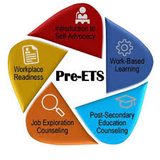
Liaisons In the Schools
Partnering Together with the School Systems
Liaisons primary role is one of exploring appropriate post-secondary goals and needed supports that lead to employment
Services supplement those not provided by the school
Liaisons will:
Participate in 504 and IEP meetings
Consult with teachers
Attend parent/teacher conferences and meetings
Share information about Vocational Rehabilitation Services
Provide individual and/or group lessons on Pre-ETS to students at the high school
Connect schools with providers that can also provide Pre-ETS

Slide 22
What Needs to Happen Before Work Can Begin?
Planning Agreement with Schools
What students need a permission form?
Who is the case manager for each student?
What times in the day are ideal to pull student or groups of students?
Where in the building can the liaison work with students?
How will liaison be informed of any parent nights, collaborative planning sessions, and/or IEP/504 meetings?
What students may need to become VR clients this year?
What specific behavior concerns do we need to be aware of?
How will information be shared between school and liaison?
How can liaison help with transition goals/outcomes?
Which Pre-ETS should be delivered and to whom?
What are the outcomes to be achieved because of this partnership?
Advantages for the School
Pre-ETS can increase CCPRI Scores (School’s State Report Card) in the areas of Closing the Gaps, Graduation Rate, and College and Career Readiness. VR can also help with post-secondary outcomes that have to be reported to DOE.

Slide 23
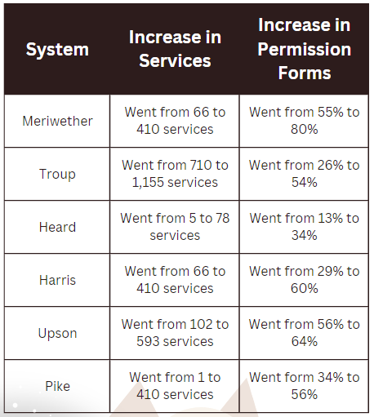
Data 2023-2024

Slide 24
Questions?
September 12, 2024
Partnership with Schools: Pre-ETS
Katherine Brown – Assistant Director RWS Transition Initiatives
Katherine.Brown@gvs.ga.gov

Slide 25
Georgia Vocational Rehabilitation Agency
September 12, 2024
Pathways to Partnerships
Shannah Mabry– Pathways to Partnerships, Project Manager
Vincent Bass- Pathways to Partnerships, Project Coordinator
Leigh Thrailkill- Pathways to Partnerships, Family Liaison
Shannah.Mabry@gvs.ga.gov
Vincent.Bass@gvs.ga.gov
Leigh.Thrailkill@gvs.ga.gov

Slide 26
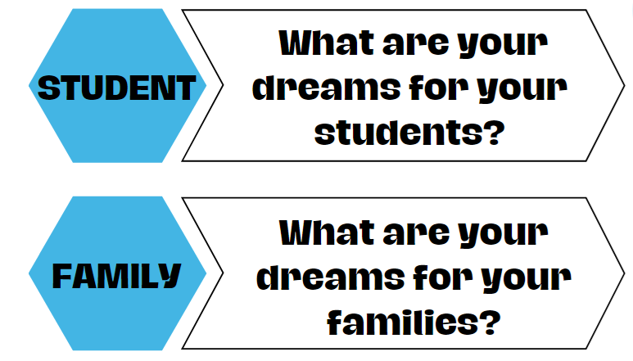
Big Dreams
Notes:
Introductions- Shannah, Vince, and Leigh introduce themselves

Slide 27
Disability Innovative Fund - 5-year grant awarded to the Georgia Vocational Rehabilitation Agency (GVRA) and the Centers for Independent Living (CIL)
To substantially improve training and preparation of children and youth with disabilities in Georgia to eventually obtain and maintain competitive integrated employment (CIE) in conjunction and coordination with other state, local, and private entities

Slide 28
Pathways to Partnerships(P2P)
Why Pathways to Partnerships?
Identified Needs in Georgia
Underserved children and youth populations by GVRA and Centers for Independent Living
Lack of awareness regarding Vocational Rehabilitation services and Centers for Independent Living services
Determined engagement and education regarding transition and career planning services should begin as early as middle school
Lack of job preparation, skills, and education needed for employment
Stronger relationships between entities: GVRA, CILs, LEAs, students, families, communities
Notes:
Some of the needs included

Slide 29
Pathways to Partnerships(P2P): Mission and Goals
P2P Mission: To improve training and preparation of children and youth with disabilities in Georgia to eventually obtain and maintain competitive integrated employment in conjunction and coordination with other state, local, and private entities.
P2P Grant Goals
Goal 1: Increase children and youth with disabilities and their families' ability to access available resources to achieve positive post secondary outcomes and competitive integrated employment (CIE) through participation in innovative P2P instructional programming.
Goal 2 : Foster strategic collaborations and partnerships among entities (GVRA, CILs, LEAs, SEA, and other youth service professionals) to promote shared accountability for children and youth with disabilities. Developing a seamless transition system that supports both individuals and providers, while identifying and removing barriers, leveraging unique strengths, increasing capacity, and fostering collective collaboration among all entities involved.
Goal 3 : Increase children and youth with disabilities and their families' ability to access available resources to achieve positive post secondary outcomes and competitive integrated employment (CIE) through systematic outreach and sharing of available resources in local communities and state.
Notes:
Goal improve collaborations with GVRA, CILs, local LEAs, and DOE. Key are relationships, collaboration, seamless transition of services for children and youth, empowering families to know and access resources

Slide 30
Pathways to Partnerships(P2P): Mission and Goals
P2P Action Steps
Work to ensure students have access to vocational rehabilitation and post-secondary options. Build CIL capacity to deliver Pre-Employment Transition Services ("Pre-ETS"), and increase students, families and district awareness of Pre-ETS, CILs and post-secondary options (workforce, residential vocational training, and post-secondary colleges). Improve communication and trust with VR and schools/families. Ensure quality staff and provide professional learning to staff. Cultivate relationships: CILs, GVRA, LEAs, students, families, community partners. Target children and youth in middle school and high school.
Notes:
Some of our team’s daily action steps- Goal improve collaborations with GVRA, CILs, local LEAs, and DOE. Key are relationships, collaboration, seamless transition of services for children and youth, empowering families to know and access resources

Slide 31
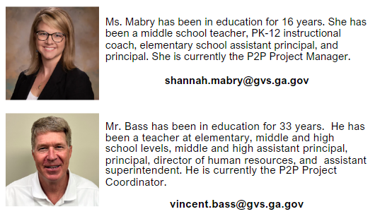
Pathways to Partnerships(P2P) Team
P2P Project Manager
P2P Project Coordinator
Notes:
School based team members

Slide 32
Pathways to Partnerships(P2P) Team
School Based P2P Team Members:
P2P Educator Liaisons and Family Liaison
Notes:
School based team members

Slide 33
Pathways to Partnerships(P2P) Partners
GVRA (Georgia Vocational Rehabilitation Agency)
GVRA oversees the grant initiatives, provides collaborative oversite to early intervention transition services instruction and assists in providing avenues for CIL support efforts to students (children and youth) with disabilities and their families.
Centers for Independent Living (CIL)
Centers for Independent Living (CIL) actively participate in early intervention transition services instructional initiative and provide core services and unique learning opportunities through CIL programs for students (children and youth) with disabilities and their families.
Local Education Agency (LEA)
Local Education Agency (LEA) provides time in the school day for lesson implementation and join in collaborative feedback for continuous improvement. Active participant in Core Work Group.
State Education Agency (SEA)
Local Education Agency (LEA) assist GVRA, local school systems, and the CILs to achieve the grant’s purpose. Active participant in Stakeholder Advisory Group.
Notes:
The success of this project is driven by important partnerships between GVRA, local school districts, nine Georgia-based Centers for Independent Living, the Georgia Department of Education, and other entities. GVRA’s implementation team, Pathways to Partnerships (P2P), will work with these centers, which are distributed across the state, to coordinate programming in local school districts. We are excited about this collaboration because in addition to soft skills curriculum, it provides students in middle school, along with their families, information regarding available support, services, and resources prior to entering high school.
All great partners and in this together! Overtime hear more about us and see us in your schools.
Currently partnering with CILs (Disability Connections (Macon); NWGACIL (Rome); Walton Options (Augusta). LEAs- Houston, Columbia, and Polk. Thank you to these district for partnering with us this first year! Look to grow into other school district in the near future. If you think your school would be interested in the upcoming years, please reach out to us for consideration of participating in our program.
Thank you to:
- SEA contacts who are supporting the work of this grant and also a part of our Stakeholder Advisory Group.
Rebecca and Brittanie at GVRA
Anne Ladd for allowing us to come to this event

Slide 34
Pathway to Dreams
Middle School
Middle school students with disabilities, who are enrolled in the P2P programming, have the opportunity to receive in-school early intervention soft skills (Pre-Employment Transition Services) lessons. While engaging in fun lessons, students:
Develop and reflect on their dreams
Set goals
Learn soft skills
Learn about local community resources available through their Center for Independent Living (CIL)
Have the opportunity to participate in a culminating activity experience to further their soft skills learning and learn more about career and post-secondary options
Students will have the opportunity to make personal connections to the Center for Independent Living employees in their local community.
Students will learn more about post-secondary options when they enter high school.
Notes:
Pathway to Dreams will provide soft skills from three of the Pre-ETS categories to participating middle school students (aged 10-14). Lessons are tailored specifically for grades 6-8 and include: Job Exploration, Workplace Readiness, and Self-Advocacy. By laying this foundation earlier, students learn critical soft skills, become better connected with available resources, and learn more about future educational opportunities.
Have developed a universal design, vertically aligned curriculum. The lessons incorporate a Universal Design for Learning (UDL) framework to accommodate diverse learning styles and needs. This ensures that every student has equitable access to the content and can participate fully in the learning experience.

Slide 35
Pathway to Dreams
High School
High school students with disabilities receive peer mentor support, through CIL and GVRA VR collaboration, to engage in goal setting, planning, and learning of skills to support successful post secondary outcomes and employment.
Students will have the opportunity to make personal connections to the Center for Independent Living employees in their local community.
Eligible students have the opportunity to participate in an intensive Pre-ETS and soft skills training in a supportive environment, including a financial literacy course, at Roosevelt Warm Springs.

Slide 36
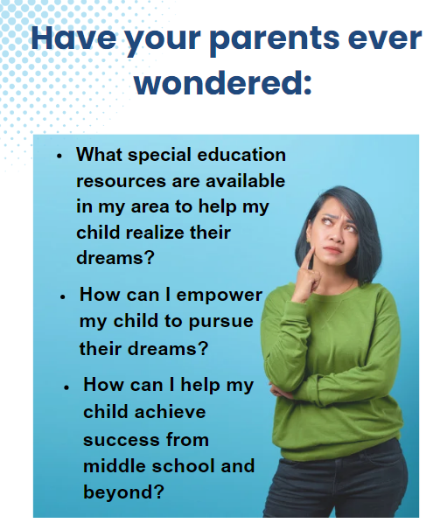

Slide 37
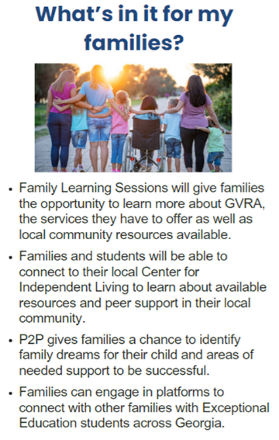
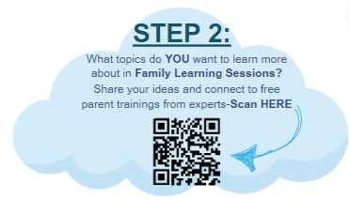
Notes:
Brochures- to take back to your special ed. Director to see if interested in connecting to P2P

Slide 38
Together, our team is dedicated to collective collaboration to develop and implement innovative programming designed to empower children and youth with disabilities, as well as their families. We aim to enhance awareness of available resources, build a solid foundation of essential soft skills, support a smooth transition process, and help students discover and achieve their dreams for successful post-secondary outcomes.
Contact:
Shannah Mabry– Pathways to Partnerships, Project Manager
Shannah.Mabry@gvs.ga.gov
Vincent Bass- Pathways to Partnerships, Project Coordinator
Vincent.Bass@gvs.ga.gov
Leigh Thrailkill– Pathways to Partnerships, Family Liaison
Leigh.Thrailkill@gvs.ga.gov
The contents of this presentation were developed under a grant number H421E230027 from the Department of Education. However, those contents do not necessarily represent the policy of the Department of Education, and you should not assume endorsement by the Federal Government.
(Authority: 20 U.S.C. §§ 1221e-3 and 3474)
Notes:
Thank everyone
GVRA, 3 school systems, and organizer of the event
Anyone that might be interested- growing state wide over next 4 years
If you think your district interested in this great opportunity in the near future, reach out to us for consideration in participation in the program

