Slide 1
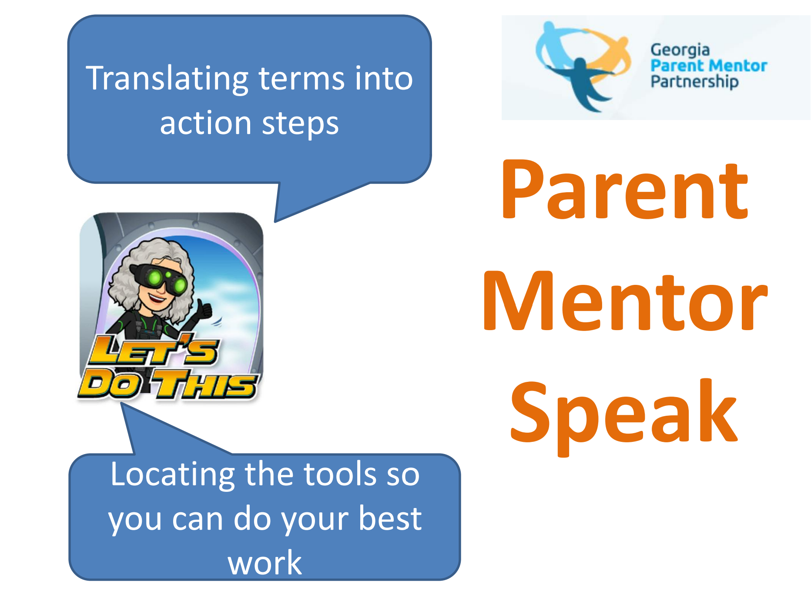
The Parent
Mentor
Guide
Revised 2024

Slide 2
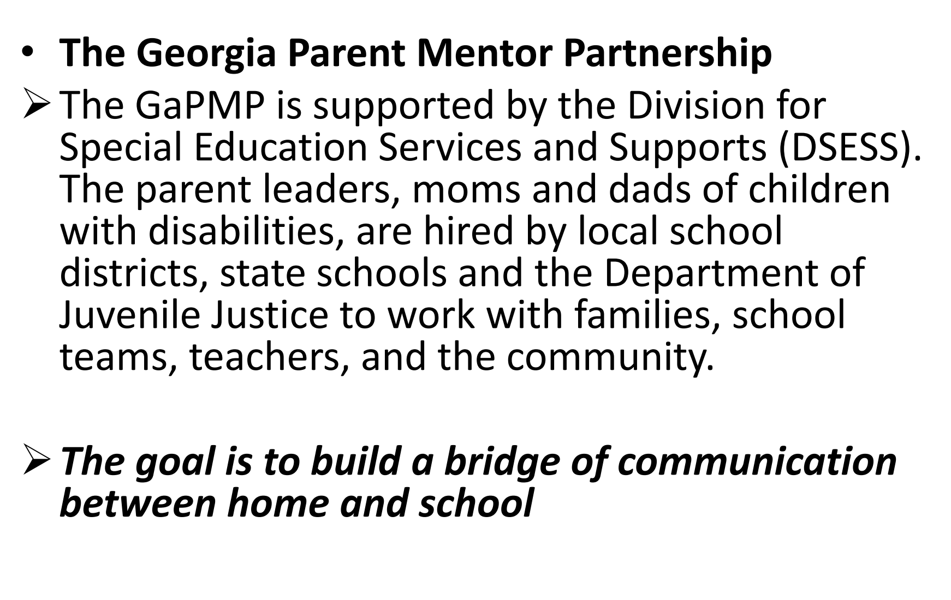
GAPMP

Slide 3
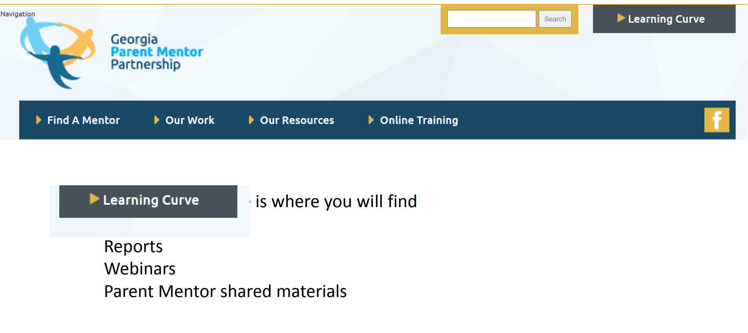
Get to know the Website and the Learning Curve
Information on GaPMP regions
Leadership team
Annual Kickoff meeting

Slide 4
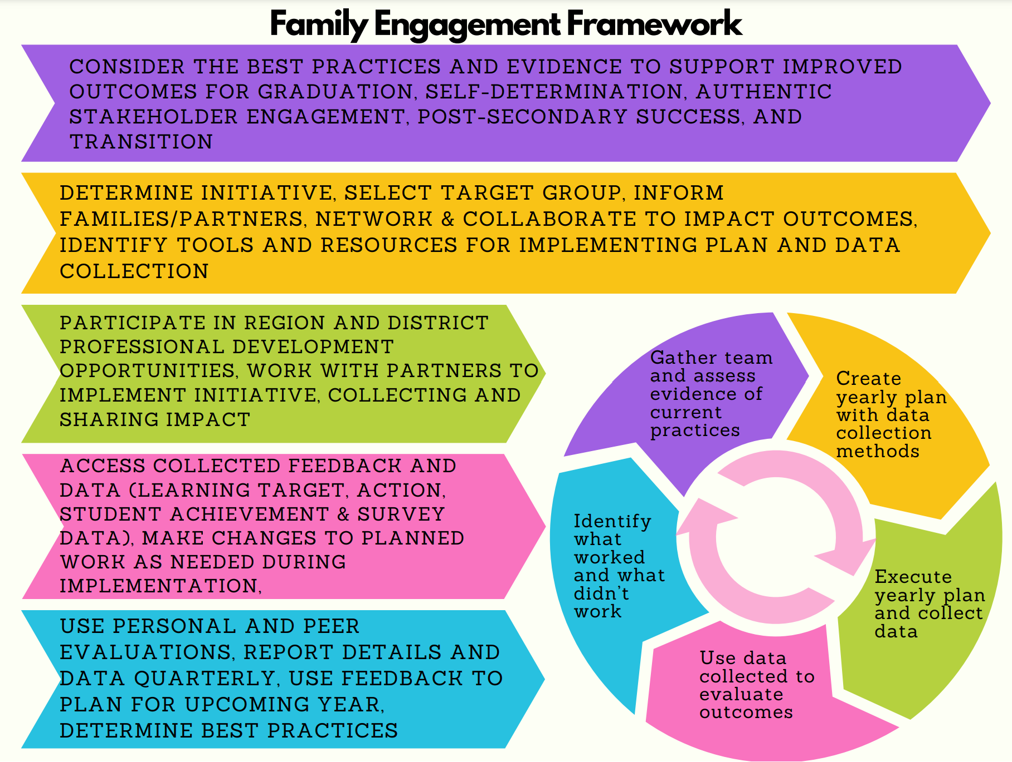
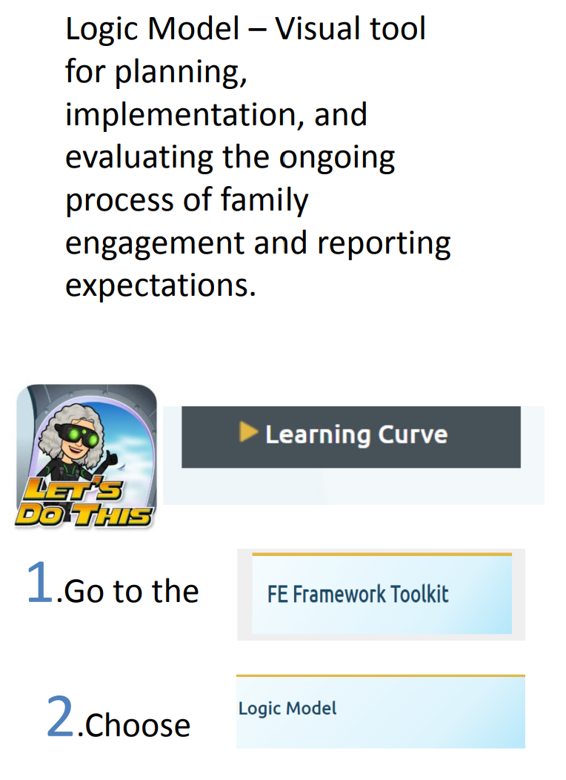
Let Logic be your Guide

Slide 5
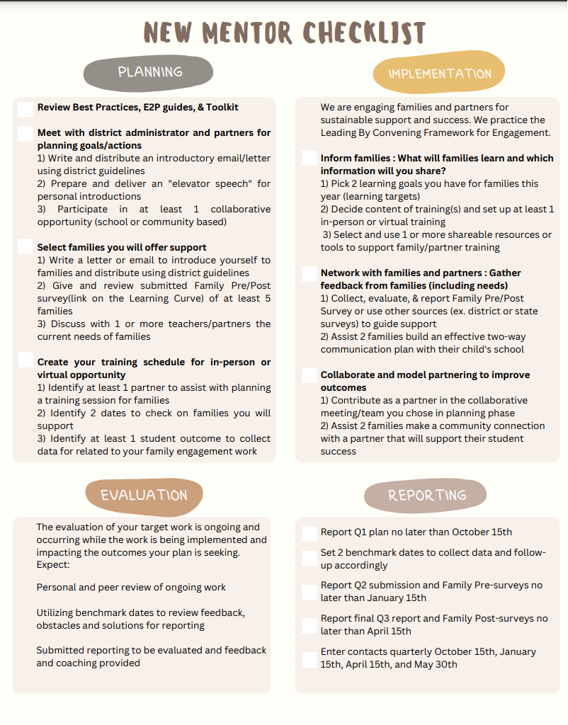
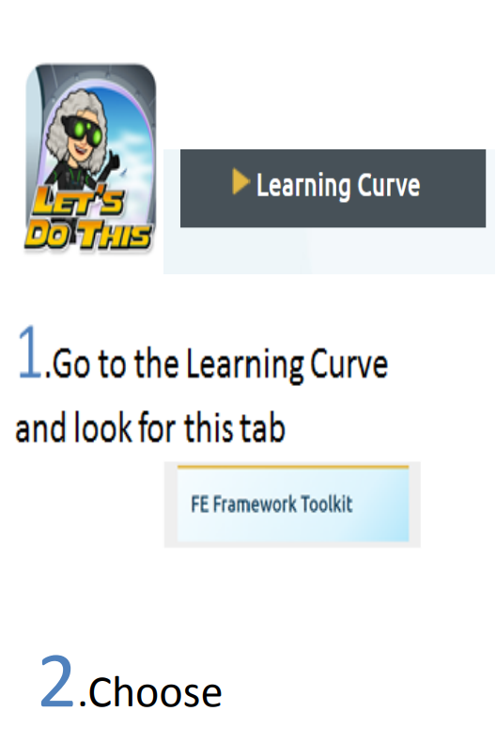
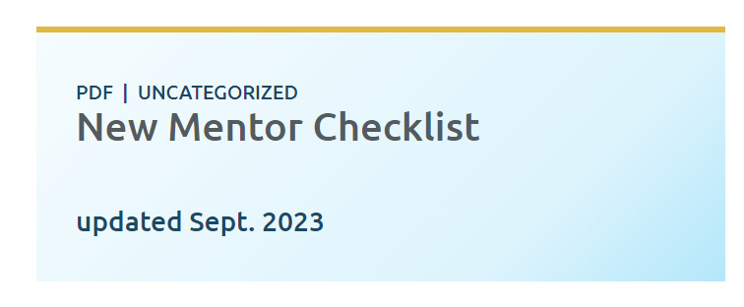
Use a Checklist to Help You Stay on Track

Slide 6
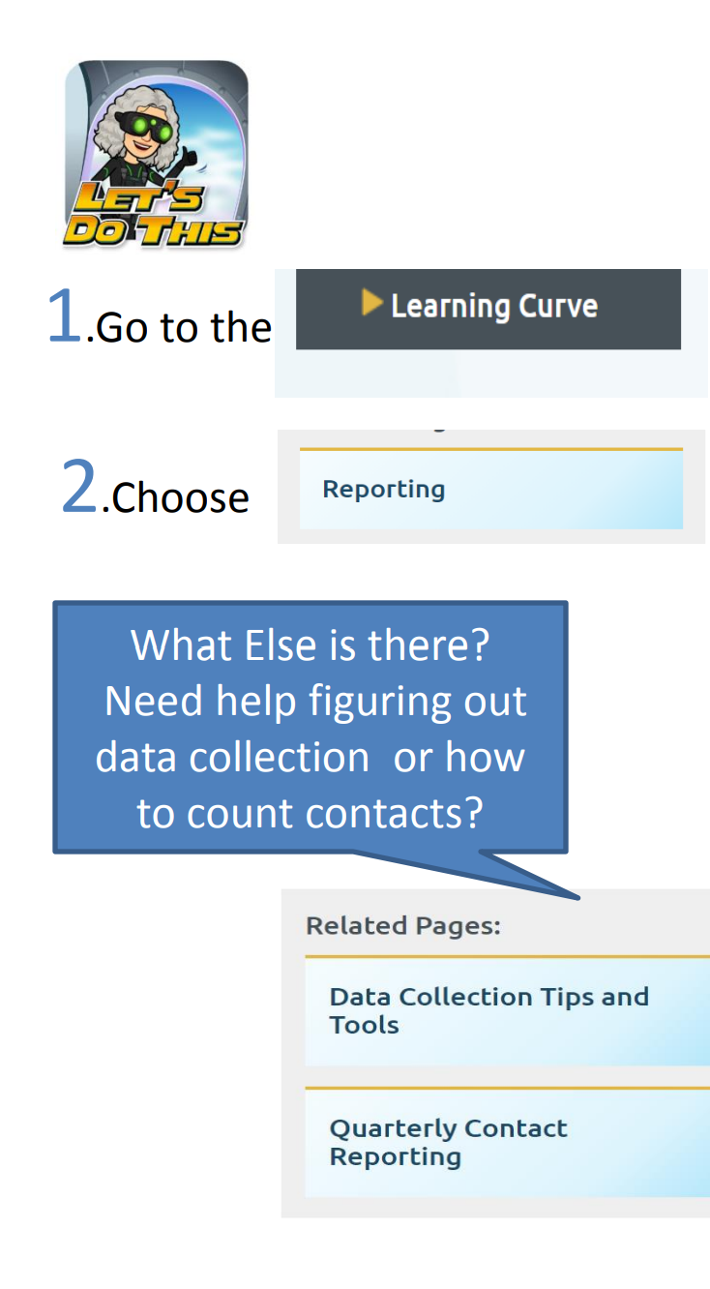
Reporting
Traditional Family Engagement Report
Next Year
Rookie Mentor Family Engagement Report
Due Oct. 15 Jan. 15 and April 15
Quarterly Contact Reporting
Due Oct. 15 Jan. 15 April 15 Final contact report is due before you leave school in May
Family
Pre and Post
Surveys
Pre surveys are due on Jan. 15 and Post are due on April 15

Slide 7
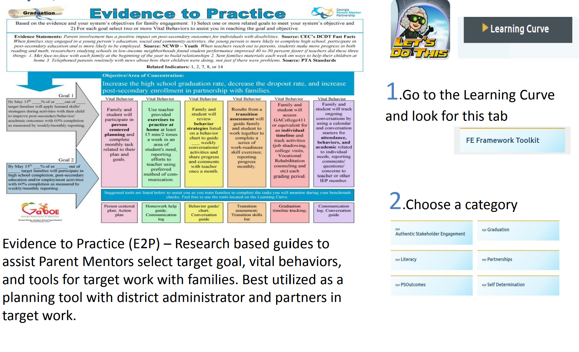
A Closer Look at What’s in the FE Framework
Evidence to Practice Guides
Also called
E2P Guides

Slide 8
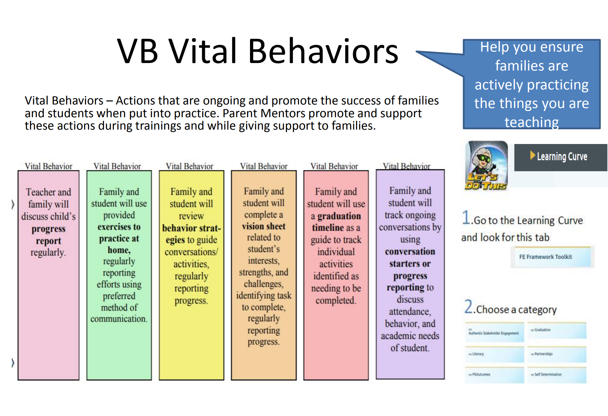
A Closer Look at What’s in The FE Framework
HINT: “FE” STANDS FOR FAMILY ENGAGEMENT

Slide 9
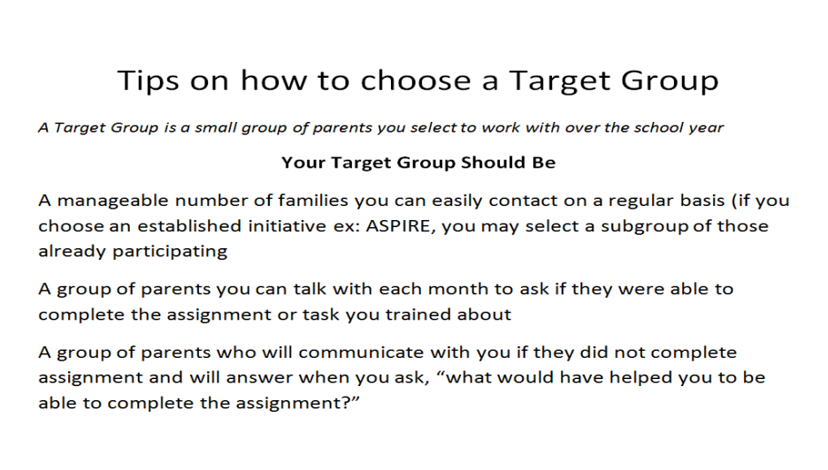

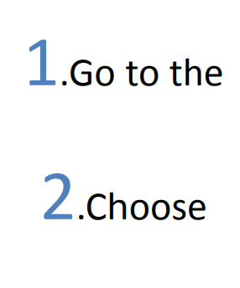


A Closer Look at What’s in the FE Framework
Target Groups
Use the Framework Tools to Train your Target Group:
– Pre Surveys
– Choose big topic from E2P Guide
– Select VBs
– Plan Trainings
– Collect data
– Post Surveys

Slide 10
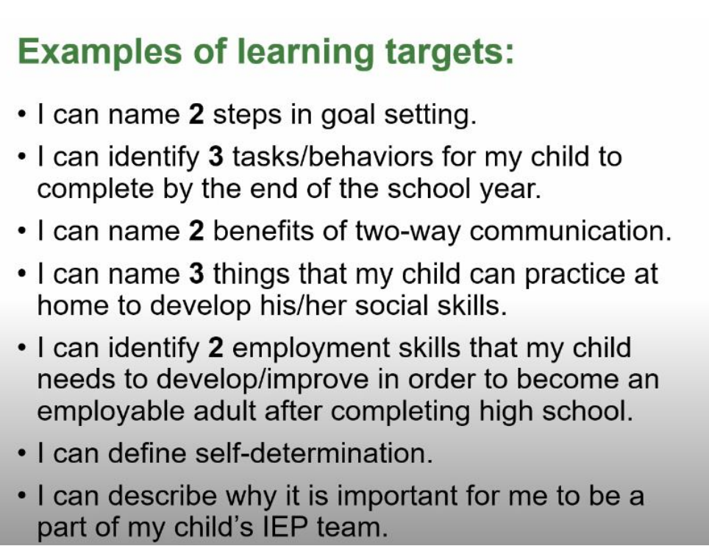


A Closer Look at the FE Framework
Learning Targets
“I Can” statement for what the family can expect to learn during a learning session tied to the target work and vital behaviors they will be asked to complete. Measured at time of initial training, before family members are asked to do the vital behaviors.

Slide 11
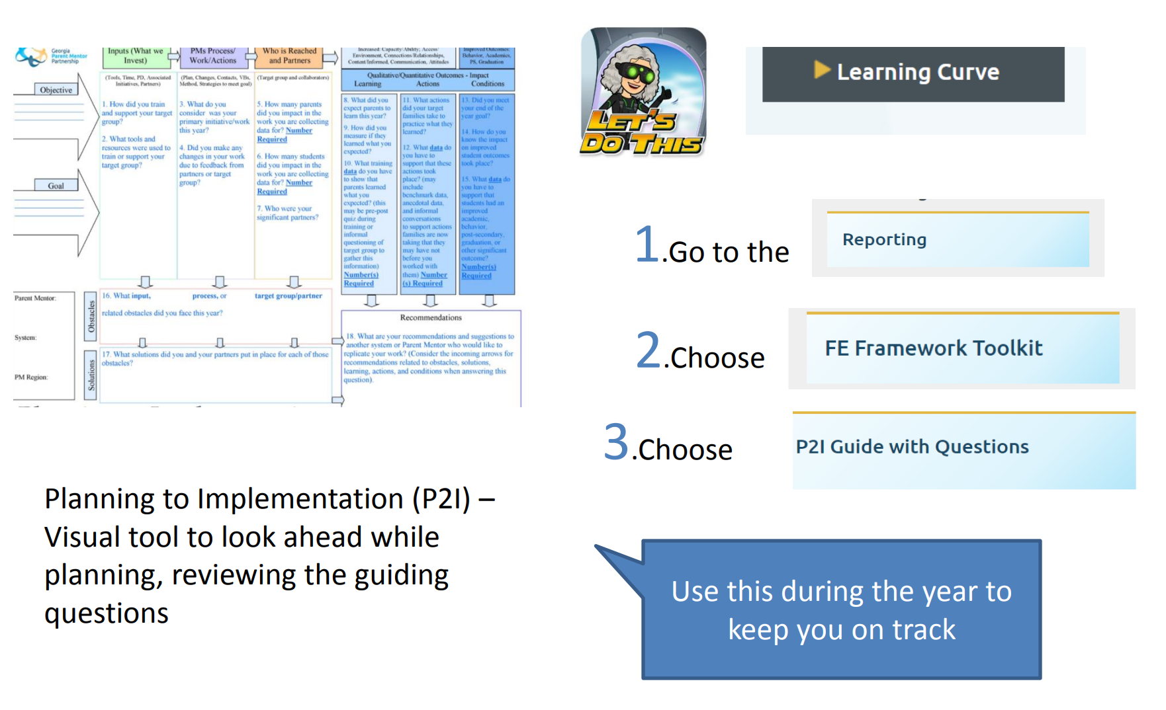
A Closer Look at the FE Framework
Planning to Implementation
or
P2I Guides

Slide 12
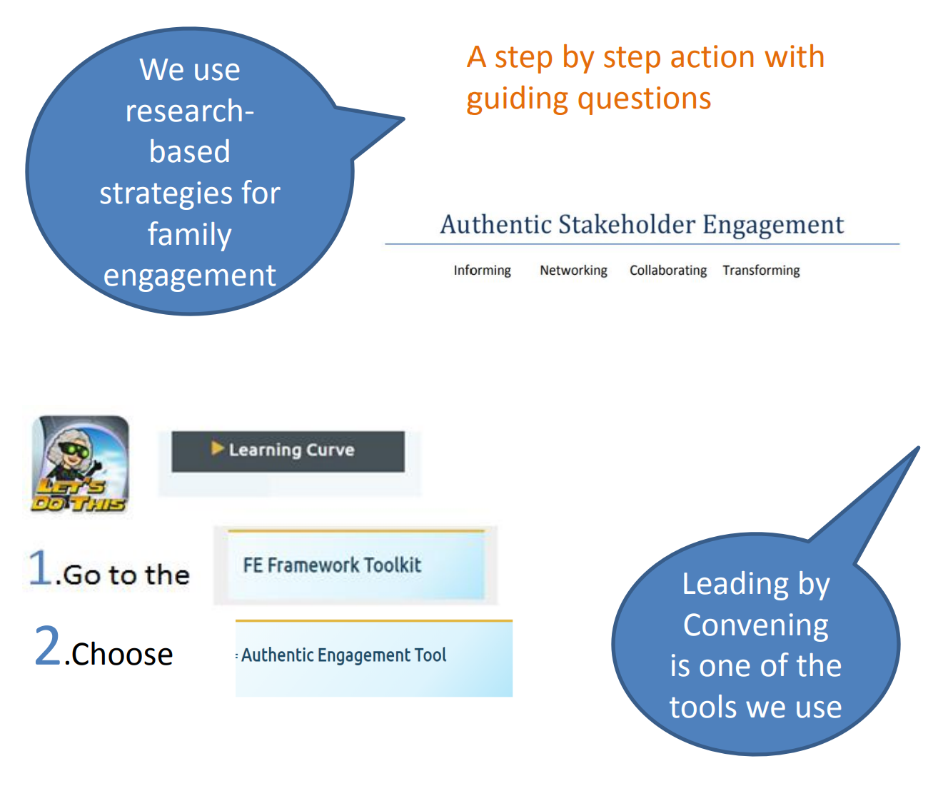

A Closer Look at the FE Framework
Leading By Convening
Questions related to informing, networking, collaboration, and transforming levels of engagement as part of our use of Leading by Convening Framework for authentic stakeholder engagement practices. Use this for peer and personal review of target work

Slide 13

A Closer Look at the
FE Framework
The Standards
The PTA developed national standards for successful family school partnerships We use researchbased strategies for family engagement Measure your family engagement work by asking yourself how your trainings are: Welcoming families to partner with schools Promoting and insuring effective Communication Supporting student success Are the activities Speaking Up for every child Are you training families so they can become advocates to Share Power Are you Collaborating with the community and agency partners
You will be asked to report on these different aspects of the Standards, so think about them as you plan your work with families

Slide 14
Other Stuff
Need Help? Just Reach Out to Your Region Rep or your Communications Coach
Is a Link no longer working? Just Reach Out to Your Communications Coach
Want to see what other mentors have done?
Parent Mentors in Action

