Slide 2
Transition Preparation from Pre-School to Postschool Outcome
Elise James
Program Specialist Transition Postschool Outcomes and Section 504
404-326-0421
ejames@doe.k12.ga.us
LaTanya Barkley-Washington
Program Manager
Outreach, IDEA Ombudsman
latanya.barkley@doe.k12.ga.us

Slide 3
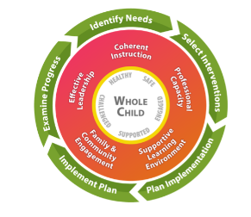
Georgia’s Systems of Continuous Improvement
Identify Needs
Select interventions/Strategies
Plan Strategy Inplementation
Implement Plan/Strategies
Examine Progress and Impact

Slide 4
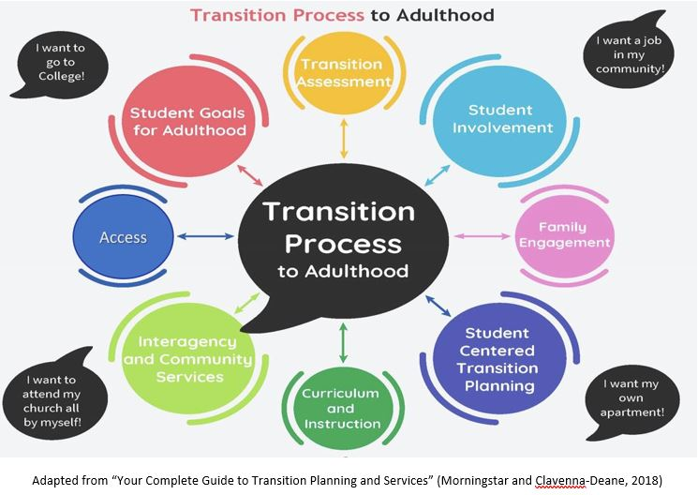
Transition Process to Adulthood
Each area is necessary for students with disabilities to transition. successfully to their postschool environment

Slide 5
Sec. 300.43:Transition Services #1
…coordinated set of activities for a child with a disability that…
  …designed to be within a results-oriented process…
  …focused on improving the academic and functional achievement…
  …facilitate the child’s movement from school to post-school activities…
…based on the individual child’s needs taking into account the child’s strengths, preferences, and interests

Slide 6
Sec. 300.43:Transition Services #2
Accomplished through
  Instruction
  Related services
  Community experiences
  Development of employment and other post-school adult living objectives
  Acquisition of daily living skills, and functional vocational evaluation, if appropriate

Slide 7






Begin with the End in Mind #1
College or university
Competitive employment
Postsecondary training
Vocational school
18- 22 Transition Programs
High School
Middle School
Elementary School
Preschool

Slide 8

The Power of High Expectations
Self-fulfilling phenomenon
Individualized skill development
Builds self-esteem
Increases confidence
Intellectual and skill preparation for transition
Improved academic performance
  Exposure to general education standards
Notes:
Pygmalion Effect
Classroom experiment

Slide 9

It Takes A Village
Student
Families
Educators
School Personnel
Practitioners
Service Providers
Community

Slide 10
Transition Planning Strategies
Preschool through 18-22

Slide 11

Begin with the End in Mind #2
TRANSITION PROGRAMS
HIGH
ELEMENTARY
MIDDLE
PRESCHOOL

Slide 12

What Does this Look Like

Slide 13

Preschool
Start general conversation about expectations for the student’s future.
Give a heads up on
  Diploma options (FAPE)
  Transfer of rights
  State agency services
Set positive atmosphere about services by emphasizing strengths.
Students begin participating in IEP (Self-Determination)

Slide 14
Elementary School
Start exploring :
  Academic content (general education)
  Career awareness (counselor standards)
Establish intra-agency collaboration
Start developing:
  Self-determination skills
  Pre-employment transition skill (Community-based Instruction)
  Social skills
  Communication

Slide 15
Career Awareness
Traditional Career Day w/ Business & Industry visits
Transform Job/ Classroom Helpers
Introduce students to non-traditional Careers
Virtual Reality Tours
Partner with CTSO’s
Introduce Employability Skills
Trade Talks/ Industry Tours
Career Lessons
Exposure is key
Notes:
Nicohl- Career Aware/Explor/Readiness starts early. Creating ideas about educational plans for postsecondary options is vital to the whole child in an elementary setting. Real world conversations in elementary; instead of pencil sharpener – equipment manager; instead of helping with lights – you are the energy conservationist; job application for student’s first delve into the “world of work”
Developing self awareness in elementary, traditional career day, virtual reality tours, classroom job helpers
Discuss abc’s, partnering with CTSO’s, B&I visits, guest speakers, ASCA career conversation examples;
– show Career lessons for elementary and where they are housed - will reference for breakout

Slide 16
Transition Strategies
Participate in IEP meeting
Choice-making, Self-management, Self-awareness
Strength-Based Building Experiences
Begin Using Interest Inventories
Opportunities for Extra-Curricular Activities with Non-Disabled Peers
Introduce Self-Determination Skills
Community-based Instruction with Industry Tours
Simulations and Guided Practice
Intentionality and Family Engagement are key
Notes:
Elise

Slide 17

Middle School #1
IEP participation
Goal setting/goal attainment focused on academic skills
Explore strengths and challenges aligned with Present-levels of Performance
Provide hands on experience through Community-Based Vocational Instruction (CBVI), and club participation aligned to career interests
Partner with career and technical student organizations (CTSO).

Slide 18
Middle School #2
Exploring careers aligned to academic strengths
Engage students in planning for high school (pathways, dual enrollment, work-based learning, etc.)
Target and enhance executive functioning skills
Medicaid waiver (Planning List)
Georgia Vocation Rehabilitation Agency (GVRA)

Slide 19
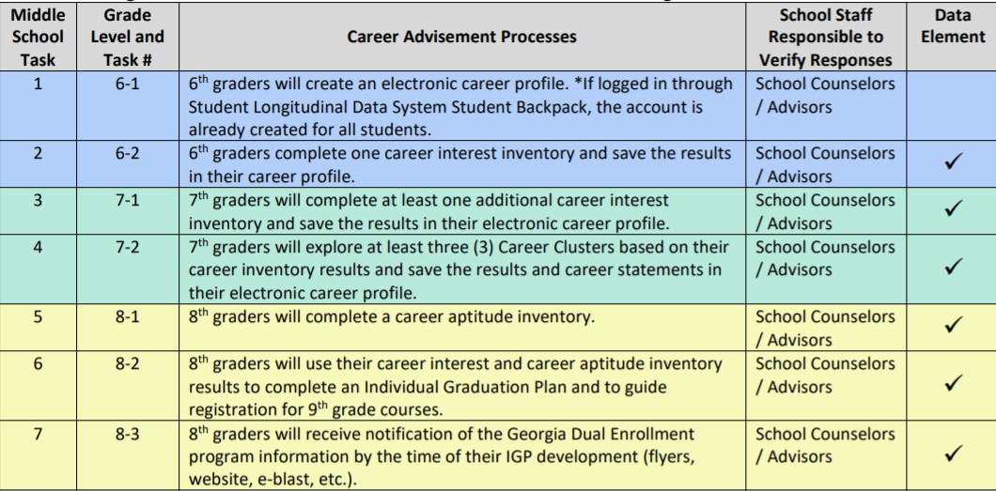
B.R.I.D.G.E. Law Checklist #1
Notes:
Sheila

Slide 20

Self-Determination Skills #1
Goal setting
Self-evaluation
Self-regulation
Self-advocacy
Self-awareness
Self-knowledge
Leadership

Slide 21
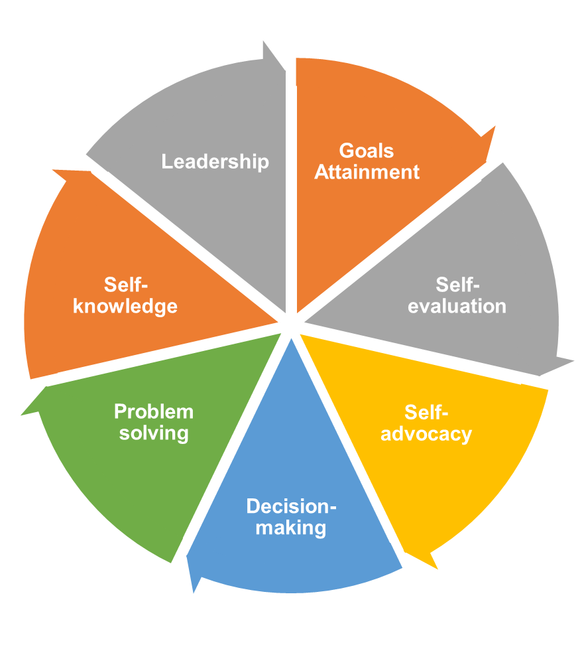
Self-Determination Skills #2

Slide 22

High School
Career, Technical, and Agricultural Education
Internships/apprenticeships
Vocational Rehabilitation Agency referral
Paid employment
Support available with outside agencies
Dual enrollment

Slide 23
The Individual Graduation Plan (IGP)
Spring semester of the 8th grade
Indicates:
  Academic subjects
  Based on selected academic and career area of choice
  Developed in conjunction with parents/guardians, student, counselor or teacher as advisor
Can include:
  Career-orientation
  Work-based learning
  Dual Enrollment
Notes:
Nicohl - Another part of the BRIDGE Act is the requirement that all 8th grade students during their spring semester create an Individual Graduation Plan (IGP). This graduation plan helps “map out” the rigorous academic core subjects and focused work in mathematics, science, or humanities, fine arts, world languages or sequenced career pathway coursework. The IGP is based on the student’s selected academic and career area to prepare them for their chosen career. This plan must be developed in consultation with parents/guardians, students, school counselor or teacher as advisor. The parent is supposed to sign off on the IGP. This represents a true collaboration of the school, student and families.
It can include career-oriented and work-based learning experiences, and postsecondary studies through Georgia’s multiple College Credit Now programs. Collaboration within the school walls and within the district coordinates the efforts so that all components of the Bridge Act are implemented and the Individual Education Plan developed reflects the student’s postsecondary desires based on the activities conducted prior to its creation. This becomes the foundation for the creation of the IEP with transition components addressed.

Slide 24

From IGP to IEP and Transition Goals
Course of Study
Career Pathways
  School Counselors
  Career Technical Instruction
    Working in collaboration with instructors from the Career, Technical and Agricultural Education programs
Notes:
Elise - Prior to beginning an IEP (especially when transition is being discussed), the IGP should be reviewed to ensure that it aligns. Students can change their Individual Graduation Plan. It is advisable that any changes to the plan be based on career data gathered from career interest inventories or transition assessments. These changes can be made during the high school ongoing review of the Individual Graduation Plan. During the IGP review, courses completed, schedules, career pathway, postsecondary plans, and related topics can be reviewed and revised, if appropriate, upon approval by the student and the student’s parent or guardian with guidance from the student’s school counselor or teacher-advisor.
Remember:
All students must have an IGP.
The IGP should be in place prior to the development of the IEP and the transition component of the IEP.
Based on the IGP, the IEP Team will complete the transition portion of the IEP.
The IGP will also determine the special education supports and services that will be needed in addition to the necessary coursework.
This transition plan will serve as a guide to the development of the rest of the IEP.
Without a strong collaboration with school personnel, something could be missed. Collaborating with GVRA can also help provide support for transition assessments for work and postsecondary education and technical training.

Slide 25
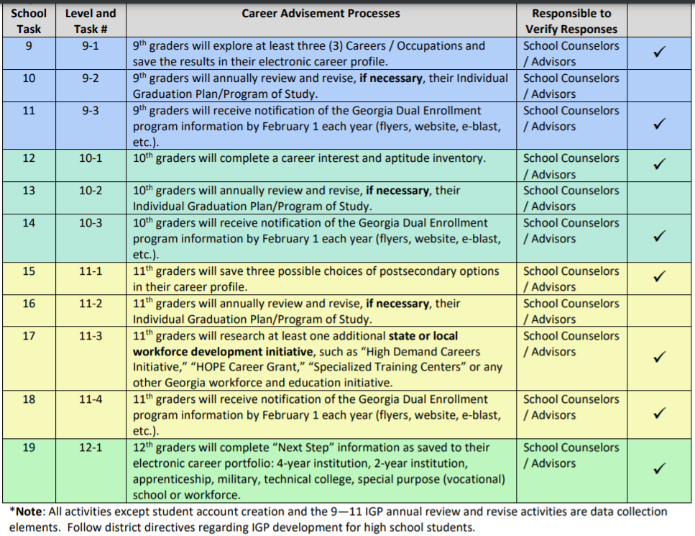
B.R.I.D.G.E. Law Checklist #2
Notes:
Sheila’s slide

Slide 26
High School Transition Activities
Postsecondary Employment | Postsecondary Education and Training | Independent Living/Adult Living/Community Living
Community-based vocational instruction, Work-based learning, | Dual enrollment (2 & 4 Year Programs, and Technical) | Lead IEP meetings/Active transition planning and engagement
Pre-Employment Transition Services, Pre-employment skills | Explore Inclusive Postsecondary Education (IPSE) | Financial literacy
Job search and attainment | Funding and scholarships | Address transportation/mobility
Entrepreneurship | College preparation skills | Explore housing possibilities
Apprenticeships/Internships |  | Community involvement and relationships
Exploration of service providers and related agencies | Exploration of service Providers | Exploration of service providers and related agencies
Notes:
Elise -

Slide 27

Bridges to Opportunities for All Career, Technical, and Agricultural Education (CTAE) Participation
Career Technical Instruction (CTI)
Co-teaching in CTAE classes
Extended Transition Programs with CTAE support
Notes:
Elise

Slide 28
18-22 Transition Programs
Part-time employment
Apprenticeships
Internships
School sponsored career exploration
Technical school participation

Slide 29
Contact Information
Elise James
Program Specialist Transition Postschool Outcomes and Section 504
404-326-0421
ejames@doe.k12.ga.us
LaTanya Barkley-Washington
Program Manager
Outreach, IDEA Ombudsman
latanya.barkley@doe.k12.ga.us

Slide 30
GaDOE Social Media Pages

