Slide 2
Supporting Hispanic Families
Presented by: Tania Amerson
Executive Director for Exceptional Education, Bartow County School System

Slide 3


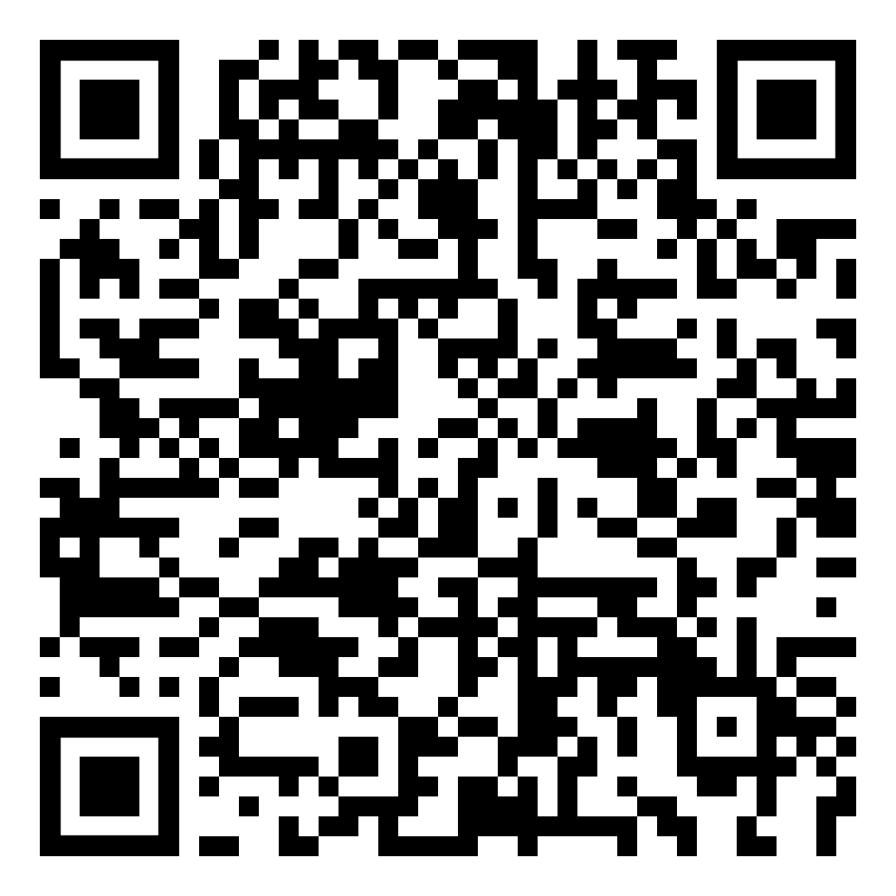
A Little About Me

Slide 4
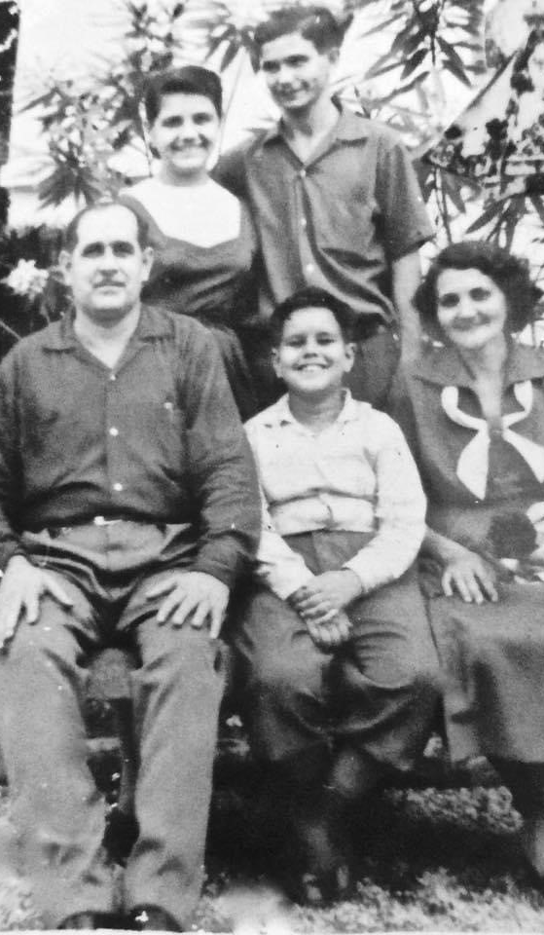
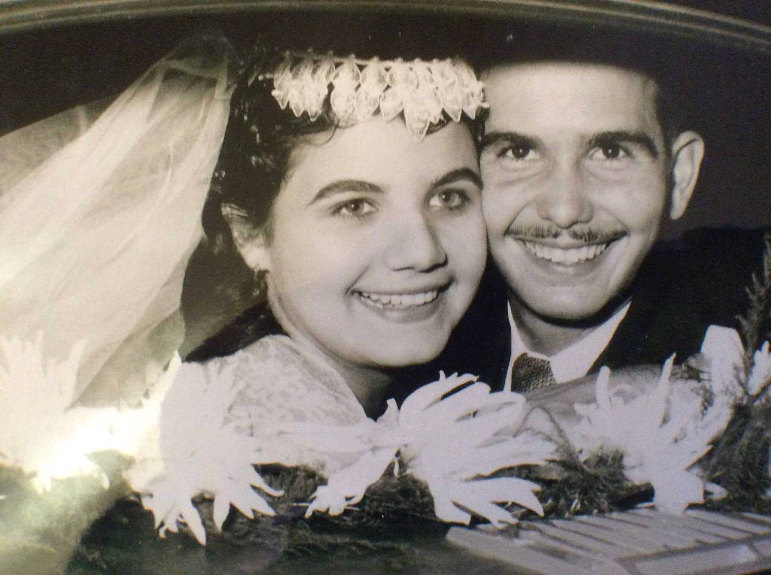
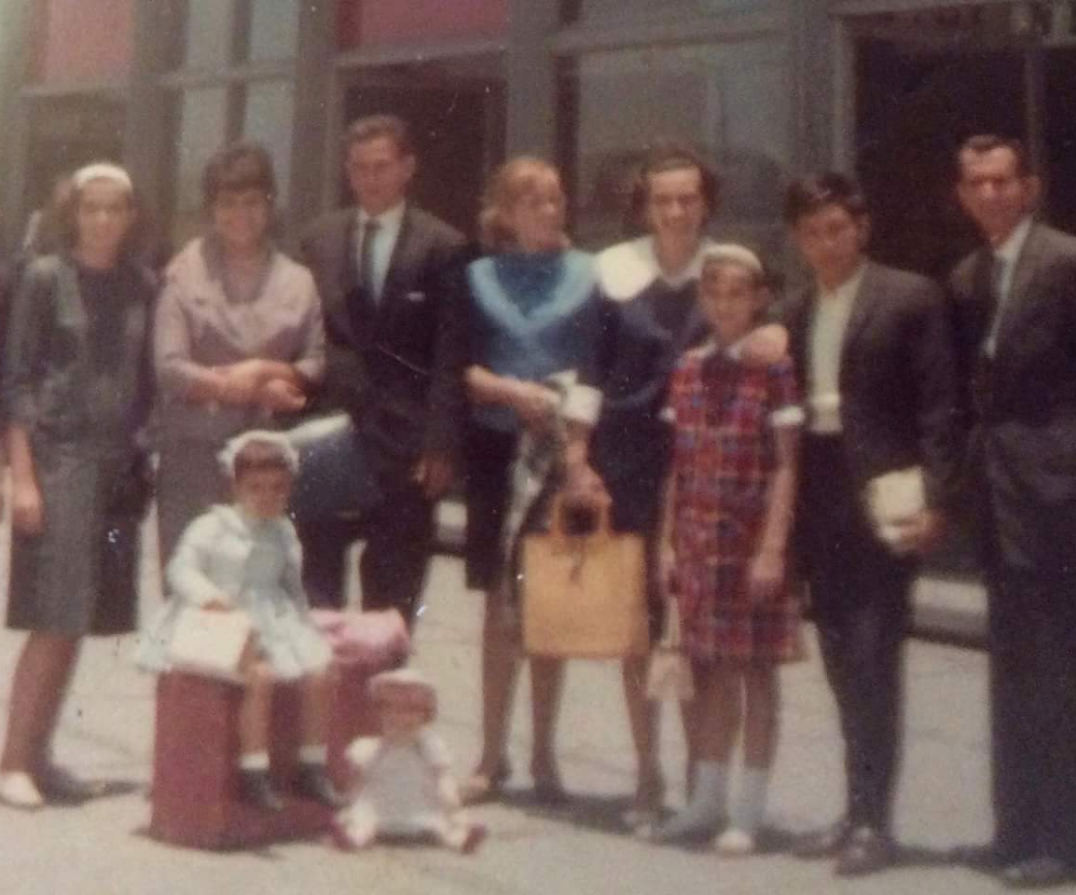
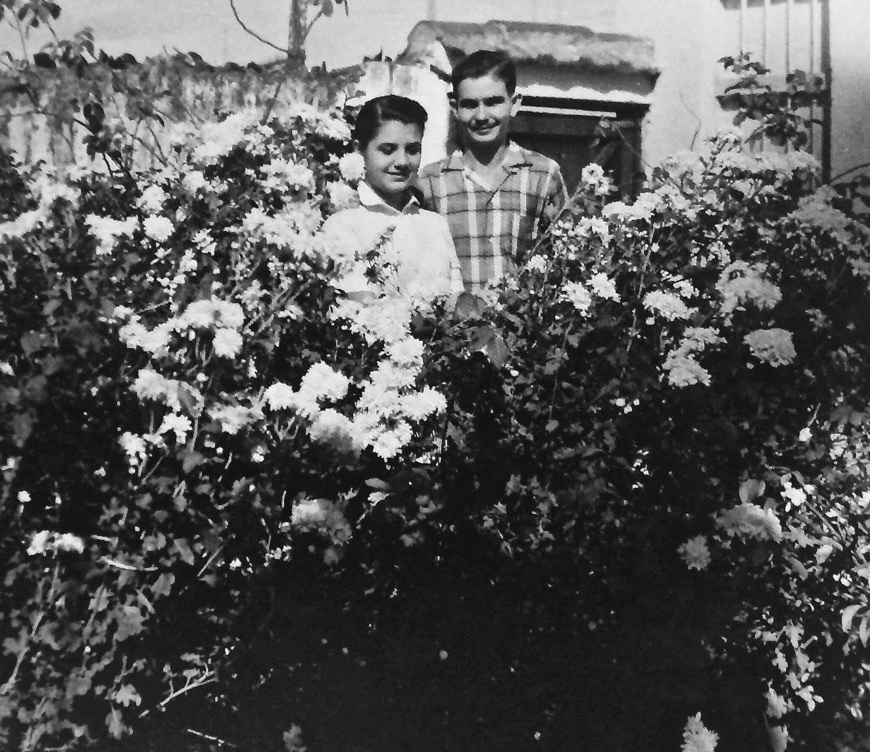
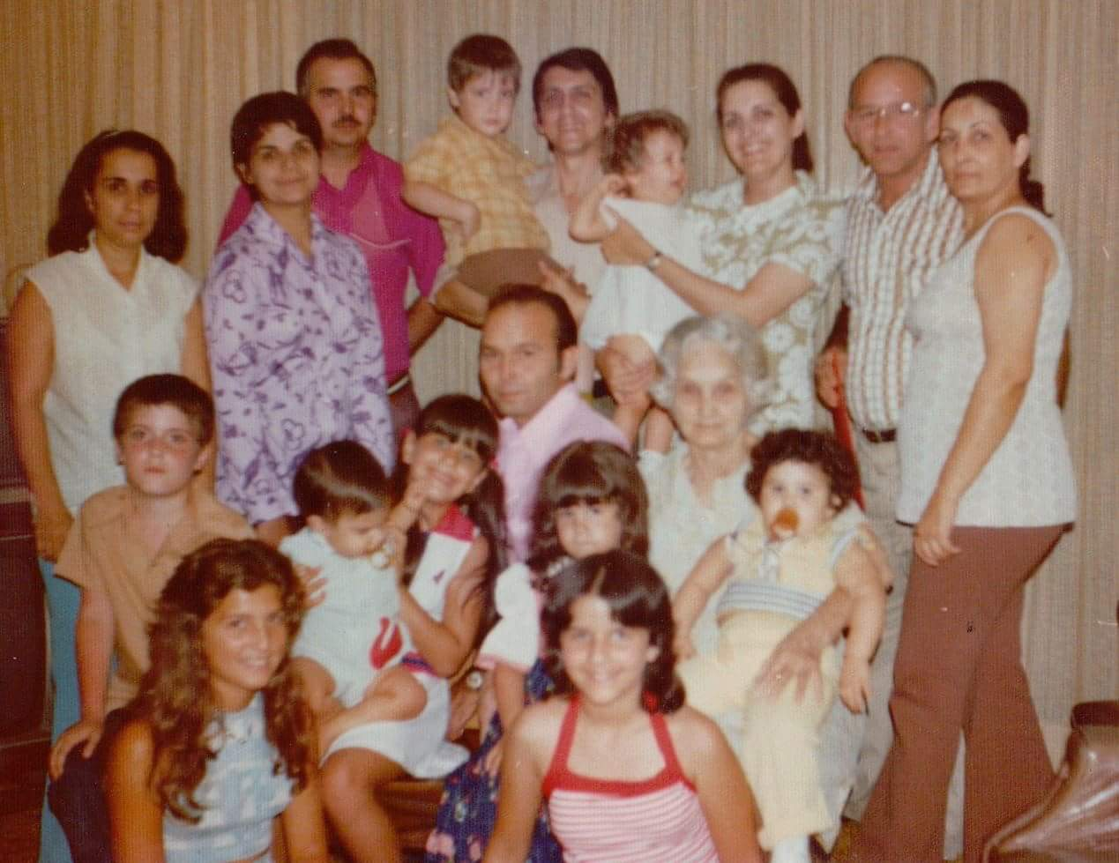
Family photos

Slide 5
Three Types of Bilingual
Simultaneous Bilingual- Individuals who learned English and Spanish at the same time.
Additive Bilingual- Spanish is the native language, and English was added later.
Subtractive Bilingual - Spanish is the native language, and English was added later.

Slide 6
Language Considerations
Be Aware of Language Barriers
Offer translation services when necessary.
Never ask the child to be the official translator for the meeting.
Learn Basic Phrases to Show Effort and Empathy
Use Clear and Simple Language, Avoiding Jargon or Educational Acronyms
Use Multiple Methods of Communication Such as Email, Phone, and Face to Face Meetings

Slide 7
Tips for Using Translation Technology
Avoid mulitple adjectives for one noun.
Passive tense voice does not translate well.
Be cautious with multiple meaning words.
Always have someone who is familiar with the language check before sending home written communication. Have both the English and Spanish version available for the person reviewing.

Slide 8
Tips for Using Translators
Chunk information into small segments with pauses for interpretation.
Look at the parent rather than the translator when speaking.
Caution team to refrain from side bar conversations or multiple conversations at once.
Involve the committee in discussions.
Ensure the translator understands terms used.

Slide 9
Cultural Awareness
Cultural Awareness includes understanding the diverse cultural backgrounds, traditions, and languages.
  Be familiar with various customs, celebrations, and language preferences represented in your school community.
  Understand that priorities could be different.
Cultural Awareness helps develop meaningful connections, mutual respect, and understanding.
Cultural Awareness helps foster a positive learning environment.

Slide 10
Build Trust and Respect
Building Trust and Respect is key for all families, but with cultural differences and language barriers, these are even more important for effective teamwork:
  Be open
  Be approachable
  Be genuine
Show respect for cultural values and beliefs, even if they are different from your own.
Be familiar with local Hispanic community organizations and resources.
  Refer families to these resources when appropriate.

Slide 11
Encourage Parental Involvement
Involve Family Members in Decision-Making.
Encourage families to be involved in school activities.
Value input and perspective when discussing progress and goals.
Provide resources and suggestions for supporting learning at home.
  Encourage reading and discussing educational topics, as well as engaging in educational activities as a family.
  Be sure that what is sent home can be done at home – consider supports needed.

Slide 12

Celebrate Hispanic Heritage
Hispanic Heritage Month is
September 15-October 15
  Consider using social media to highlight Hispanic Heritage.
  Invite Hispanic community members to share stories and experiences, etc.

Slide 13

Perspective:
To better understand people, we need to consider all the things we do not initially see or hear, as well as experiences we have not encountered.
The tip of the iceberg is what we see being done or what we hear being said. It is only a small part of a person and doesn’t tell the whole story.
The bulk of the iceberg below the surface consists of values, beliefs, emotions, thoughts, culture, experiences, fear, expectations, etc.

