Slide 2
Georgia Parent Mentor Partnership
Let’s Plan It
FY24 Planning for Success
April Lee – E2P Framework Coach
leecrew555@gmail.com

Slide 3
Learning Targets
I can identify 3 tools to assist with creating and implementing my FY24 GaPMP target plan.
I can describe the link between learning, action and student outcomes being reported in my districts FY24 GaPMP target report.

Slide 4
Start Planning for Success
Using the Toolkit and Learning Curve
Building Partnerships
Working with families and partners
Training and support
Timeline and benchmarks for goals
Additional tools and professional development

Slide 5
GaPMP Toolkit for Family Engagement
Evidence-based Framework
The GaPMP framework outline includes well documented and studied components such as: student success objectives, SMART goals, vital behaviors (Influencer), benchmark timeline, tools for recording actions, and research statements to guide support. Each framework component encourages growth from promising practices (demonstrating limited success) to evidence-based practices (recorded success with a systemic review process to evaluate evidence).

Slide 6
Toolkit Resources
Logic Model
Common Terms and Acronyms
Evidence to Practice (E2P) Guides
Planning to Implementation (P2I) Guide
Family Pre/Post Survey
Checklist: for the Traditional and Rookie reporting
Evaluation: Authentic Stakeholder Engagement (4-page Tool)

Slide 7
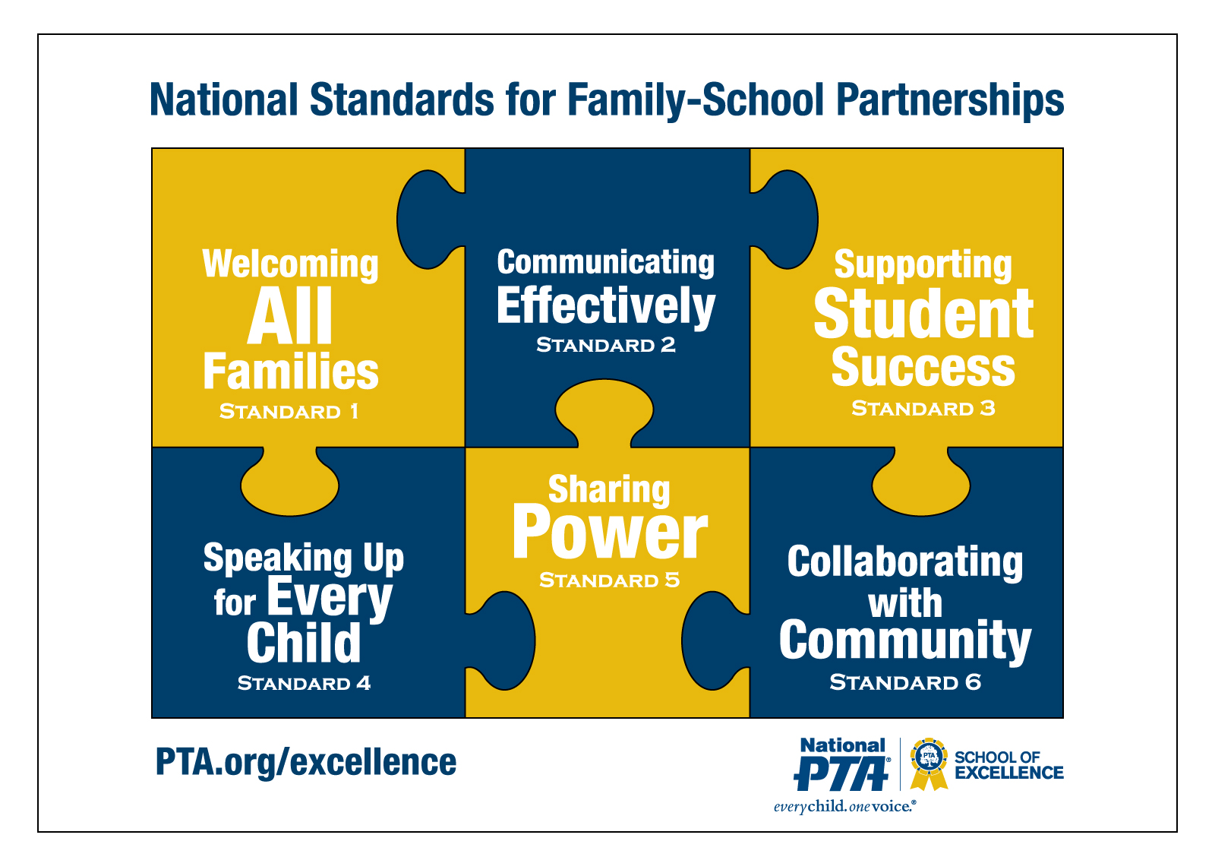
National Standards for Family-School Partnerships

Slide 8

Leading by Convening Framework
Meet people where they are on an issue.
Bring people together to build support for addressing the issue.
Convene the stakeholders to discover why this is important and how it will improve practice.
Translate complex challenges into ways that the individuals can contribute.
Help people lead in place regardless of role, position or title.
Create new knowledge together.
Solve complex issues that need the various perspectives/aspects that contribute to problems/solutions.
Build a personal commitment to working in this way because we believe inclusive work is better and more sustainable work.
Cultivate the habit of collaboration.
Integrate collaboration into the identity of the group and the individual.

Slide 9
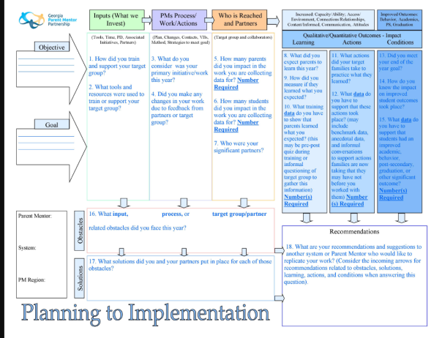
The End is the Beginning

Slide 10

Building Partnerships
In your region
  Seasoned Mentors
  Mentors working on similar work
  Communities of Practice
In your district
  School staff and teachers
  Community partners
  Parents and family members

Slide 11

Finding a Target Group
Small group of families to work with more closely for target work and data collection
Should be 5 to 20 families (most pick 10 or more)
Consider your partners and what families need
  Teachers and other community partners
  Your conversations with families
  Survey results

Slide 12
Finding an Initiative or Area of Focus
What are district goals?
What initiatives are already in place?
Where are your possible partners?
Review the E2P Guides with your administrator:
  Graduation
  Partnerships/Stakeholder Engagement
  Self-determination/IEP Participation
  Post-secondary
  Literacy/Academics/Behavior/Attendance

Slide 13
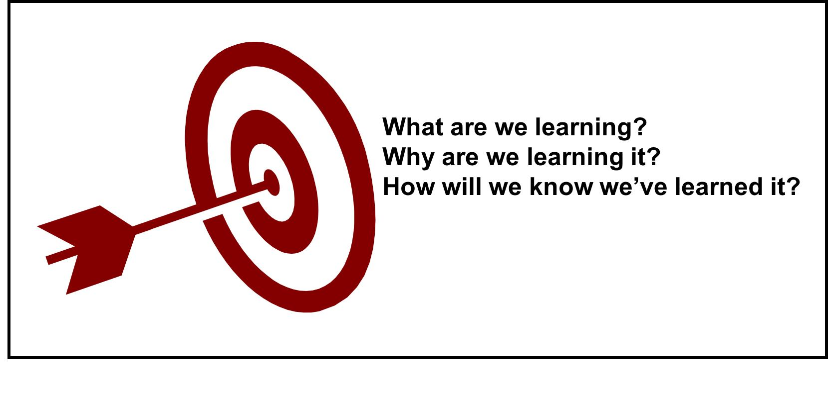
Training Families
What topics will you train on and why?
What will parents do with the new information?
How will you know they learned something from you?

Slide 14
Learning Targets
If my goal of training is to make sure my
Families are better informed on the topic of: Supporting Growth in Literacy
I might present a 30 min presentation to include:
  Benefits reading
  Ideas for practicing skills at home
In order to measure what they know on these topics before I train (Pre)I will show them what I expect them to learn through I CAN statements:
  I can name at least 3 reasons my child needs to be reading regularly at home.
  I can describe 2 actions my child will work on to improve his/her reading scores.

Slide 15

Learning Target Data
The questions I will use to measure their Pre and Post learning could be:
  Which of the following are reasons why your child should read?
    Improved self esteem
    Improved concentration
    Develop critical thinking skills
    Stronger memory skills
    All of the above
  My child can work on these two skills at home to be improve their reading scores:
    _________________
    _________________

Slide 16
Ongoing Support of Families
To ensure they use the new information I might:
  Use a age appropriate reading checklist (tool) during the training and show them how to use it to identify and complete skill-building at home
  Offer to check on them throughout the year (benchmark checks) by phone or in person to share new ideas and support skill-building
  Gather feedback from families to change or offer new supports so more families benefit from what is learned during the year.

Slide 17
Timeline to Reach Goals
Planning with your administrator and/or partners
Be aware of reporting dates
  October 15th - Submit your plan
  January 15^{th _} Update your progress
  April 15^{th _} Submit final submission with data
Set benchmarks to check on current status
  2-3 that are asked about during reporting

Slide 18

Other Resources and Professional Development
Region meetings/other Parent Mentors
Local and region trainings/conferences
Local or district teams/boards
Other agencies

Slide 19
Reporting Your Success
Anecdotal Details
Benchmark Checks and Changes to the Work
Obstacles and Solutions
Linking Outcomes
  Learning
  Action
  Student
Building Capacity

Slide 20
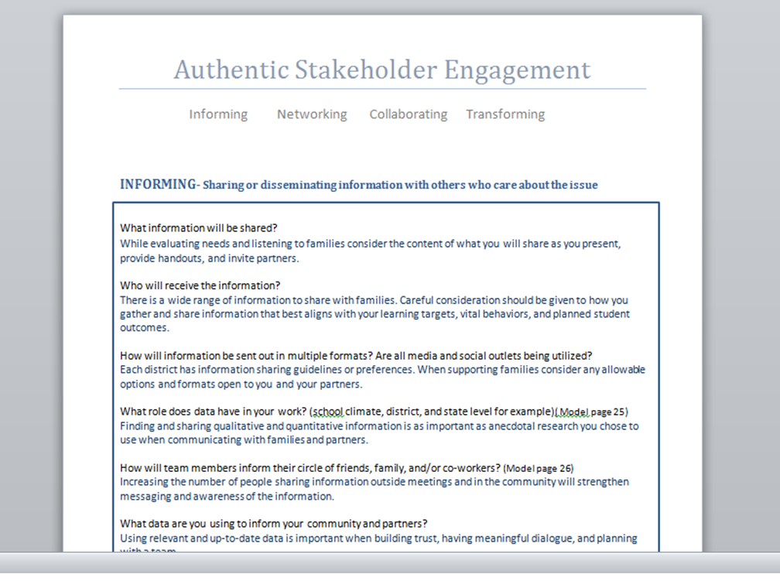
Asking Yourself Questions to Reflect and Ensure Replication
Authentic Stakeholder Engagement Tool

Slide 21
Measuring the Impact
Sharing Outcomes

Slide 22

The End Result Leads the Work
What RESULTS do you plan to see due to what you have
  Learned
  Taught
  Supported
  Partnered with others on
  Collected data for

Slide 23
FY24 GaPMP Goals for Reporting
Showcase our adaptive skills.
Embedding National PTA Standards
Listen and share parental concerns and needs.
Model and encourage partnership building.
Model and encourage communication in order to support student success.
Build capacity among Parent Mentors and in districts.

Slide 24
Questions and Thoughts
April Lee
leecrew555@gmail.com

Slide 25
Georgia Parent Mentor Partnership
Let’s Plan It
FY24 Planning for Success
April Lee – E2P Framework Coach
leecrew555@gmail.com

Slide 26
Learning Targets
I can identify 3 tools to assist with creating and implementing my FY24 GaPMP target plan.
I can describe the link between learning, action and student outcomes being reported in my districts FY24 GaPMP target report.

Slide 27
Start Planning for Success
Using the Toolkit and Learning Curve
Building Partnerships
Working with families and partners
Training and support
Timeline and benchmarks for goals
Additional tools and professional development

Slide 28
GaPMP Toolkit for Family Engagement
Evidence-based Framework
The GaPMP framework outline includes well documented and studied components such as: student success objectives, SMART goals, vital behaviors (Influencer), benchmark timeline, tools for recording actions, and research statements to guide support. Each framework component encourages growth from promising practices (demonstrating limited success) to evidence-based practices (recorded success with a systemic review process to evaluate evidence).

Slide 29
Toolkit Resources
Logic Model
Common Terms and Acronyms
Evidence to Practice (E2P) Guides
Planning to Implementation (P2I) Guide
Family Pre/Post Survey
Checklist: for the Traditional and Rookie reporting
Evaluation: Authentic Stakeholder Engagement (4-page Tool)

Slide 30
National Standards for Family-School Partnerships

Slide 31
Leading by Convening Framework
Meet people where they are on an issue.
Bring people together to build support for addressing the issue.
Convene the stakeholders to discover why this is important and how it will improve practice.
Translate complex challenges into ways that the individuals can contribute.
Help people lead in place regardless of role, position or title.
Create new knowledge together.
Solve complex issues that need the various perspectives/aspects that contribute to problems/solutions.
Build a personal commitment to working in this way because we believe inclusive work is better and more sustainable work.
Cultivate the habit of collaboration.
Integrate collaboration into the identity of the group and the individual.

Slide 32
The End is the Beginning

Slide 33
Building Partnerships
In your region
  Seasoned Mentors
  Mentors working on similar work
  Communities of Practice
In your district
  School staff and teachers
  Community partners
  Parents and family members

Slide 34
Finding a Target Group
Small group of families to work with more closely for target work and data collection
Should be 5 to 20 families (most pick 10 or more)
Consider your partners and what families need
  Teachers and other community partners
  Your conversations with families
  Survey results

Slide 35
Finding an Initiative or Area of Focus
What are district goals?
What initiatives are already in place?
Where are your possible partners?
Review the E2P Guides with your administrator:
  Graduation
  Partnerships/Stakeholder Engagement
  Self-determination/IEP Participation
  Post-secondary
  Literacy/Academics/Behavior/Attendance

Slide 36
Training Families
What topics will you train on and why?
What will parents do with the new information?
How will you know they learned something from you?

Slide 37
Learning Targets
If my goal of training is to make sure my
Families are better informed on the topic of: Supporting Growth in Literacy
I might present a 30 min presentation to include:
  Benefits reading
  Ideas for practicing skills at home
In order to measure what they know on these topics before I train (Pre)I will show them what I expect them to learn through I CAN statements:
  I can name at least 3 reasons my child needs to be reading regularly at home.
  I can describe 2 actions my child will work on to improve his/her reading scores.

Slide 38
Learning Target Data
The questions I will use to measure their Pre and Post learning could be:
  Which of the following are reasons why your child should read?
    Improved self esteem
    Improved concentration
    Develop critical thinking skills
    Stronger memory skills
    All of the above
  My child can work on these two skills at home to be improve their reading scores:
    _________________
    _________________

Slide 39
Ongoing Support of Families
To ensure they use the new information I might:
  Use a age appropriate reading checklist (tool) during the training and show them how to use it to identify and complete skill-building at home
  Offer to check on them throughout the year (benchmark checks) by phone or in person to share new ideas and support skill-building
  Gather feedback from families to change or offer new supports so more families benefit from what is learned during the year.

Slide 40
Timeline to Reach Goals
Planning with your administrator and/or partners
Be aware of reporting dates
  October 15th - Submit your plan
  January 15^{th _} Update your progress
  April 15^{th _} Submit final submission with data
Set benchmarks to check on current status
  2-3 that are asked about during reporting

Slide 41
Other Resources and Professional Development
Region meetings/other Parent Mentors
Local and region trainings/conferences
Local or district teams/boards
Other agencies

Slide 42
Reporting Your Success
Anecdotal Details
Benchmark Checks and Changes to the Work
Obstacles and Solutions
Linking Outcomes
  Learning
  Action
  Student
Building Capacity

Slide 43
Asking Yourself Questions to Reflect and Ensure Replication
Authentic Stakeholder Engagement Tool

Slide 44
Measuring the Impact
Sharing Outcomes

Slide 45
The End Result Leads the Work
What RESULTS do you plan to see due to what you have
  Learned
  Taught
  Supported
  Partnered with others on
  Collected data for

Slide 46
FY24 GaPMP Goals for Reporting
Showcase our adaptive skills.
Embedding National PTA Standards
Listen and share parental concerns and needs.
Model and encourage partnership building.
Model and encourage communication in order to support student success.
Build capacity among Parent Mentors and in districts.

Slide 47
Questions and Thoughts
April Lee
leecrew555@gmail.com

