Slide 1



Let’s Build It:
“Designing An Initiative Start To Finish”
Do it!
The Georgia Parent Mentor Partnership
Jennifer Anderson janderson@georgiacyber.org
404-334-4790 ext. 2198
Power of the Past /Force of the Future
Hello!

Slide 2

01
Agenda
02
03
04
05
Collaboration
Who are your stakeholders?
Choosing Your Goal
Which Evidence to Practice Form to use?
Designing Your Initial Training
How will you introduce your initiative?
Presenters:
Jennifer Anderson & April Lee
Recruiting Your Target Group
How will you find families that will participate?
Executing Your Plan
How will you document progress and outcomes?

Slide 3

Learning Targets
Define
Select/Match
I can define Learning Target and Vital Behavior.
I can select and/or match an Evidence to Practice Guide that will track specific student outcomes.

Slide 4

01
Collaboration
Who are your stakeholders?

Slide 5
1st
Meet With/ Reference Your Stakeholders
Who Are Your stakeholders?
List Here
List Here
List Here
List Here
List Here
Before we begin to design an initiative, we have to know what direction we want to follow. Stakeholders play a vital role in this process.
Where have we been, where are we now, and where do we want to go?
Notes:
Poll the audience and discuss – Add to list with audience answers

Slide 6
In Depth
Topics to Discuss
Where are Special Education students/families struggling?
What skill can you share with families that will address these needs?
What student outcomes can improve by your work with families?
Will this work benefit your district in the long term?
Notes:
What does the data say needs to be improved? Can you do something with families that will help improve this data? Will your work this year translate into long term success for a group of students or families if it becomes best practice? Have the audience share some ideas.

Slide 7





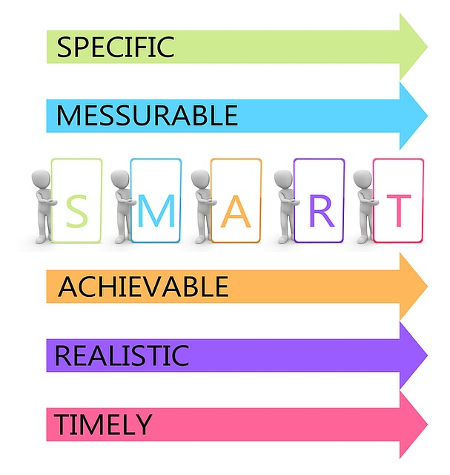
2nd
Select Your Evidence to Practice Guide
Attendance, Behavior, Academic Achievement
Or Literacy
Partnerships or Authentic Stakeholder Engagement
Once you have identified the outcome you are looking for, choose the Evidence to Practice Guide that best meets your need. This will be your Primary Initiative Category.
Post-Secondary or Graduation
Select one
Self-Determination
Notes:
Remember that you should only choose one primary category and it should tie to the student outcome data you want to achieve. Discuss data points and sources. Discuss how to choose Vital Behaviors from the Evidence to Practice Guide that will help families affect the student outcome you want to see.

Slide 8

3rd
Design Your Initial Training
You are now ready to design your initial training for families.
Ask yourself the following:
What do I need to share with families about the topic I have chosen?
What do they need to know in order to complete the vital behaviors I want to see?
What level of participation will I ask families to commit to?
                How many meetings?
                What activities and how often?
                Phone Check-ins, etc…
            What resources will you need to provide them?
By this step you should know:
What student outcome you are looking for
Which E2P Guide you will use
Your annual goal
The Vital Behaviors you will ask families to use
Notes:
Explain gathering information about your topic, getting ready to prepare families for action, have a plan to collect progress and data points and be able to explain this process to families. Ask audience if they can think of anything else they need to know to plan that first meeting.

Slide 9

03
In depth
Your learning targets will be the “I can…” statements you will use during your initial training. These will help you make sure that families know about the topic you taught them and understand how to complete the vital behaviors.
Ask yourself, “If the family answers yes to this will they be able to do what I am asking them to do down the road?”
Vital Behaviors
Vital Behaviors are the ongoing actions you want families to take that will lead to the improved student outcome you are looking for.
Let’s discuss Learning Targets and Vital Behaviors.
Ask yourself, “If families do this all year will student outcomes improve?”

Slide 10


4th
Recruit Your Target Group
How to you recruit target group members?
Recruitment Flyer from Canva
List Here
List Here
List Here
List Here
Once you are ready to begin, you will need to identify families to work with. Some ways I have used are newsletters, topic inclusion in large group sessions and surveys. I have also used staff and teacher suggestions.
Notes:
Poll the audience and discuss – Add to list with audience answers Remind audience that target families must be willing to commit to all the activities involved. This is why it is so important to know what you are going to ask them to do before the recruitment stage.

Slide 11

5th
Execute Your Plan
Things to think about:
Does you plan fit the PTA Standards?
Did you consider the levels of Leading by Convening?
Do you know what checkpoints you will need for your data and how you will collect this data?
Do you have a backup plan for families that may need more support or accommodations?
Have you provided all the tools and information that will help families be successful?
Did you include all of the relevant stakeholders that can help you support your families?
Now you know what outcome you are looking for, what you will train on, who will participate and what you expect them to do. From here you can follow-up with families, provide resources and collect that data.
Notes:
Poll the audience and discuss – Add to list with audience answers

Slide 12

More Resources
01
02
03
2nd Quarter Reporting Guide
Click here for link
Link to the Learning Curve
Click here for link
Link to the E2P Page
Click here for link

Slide 13
Thanks!
Bye!
Do you have any questions?
janderson@georgiacyber.org
404-334-4790 ext. 2198
good!
Please keep this slide for attribution

