Slide 2
GVRA & Pathful Explore Student Accounts
Rebecca Williamson, Strategic Initiatives Manager
Rebecca.williamson@gvs.ga.gov

Slide 3
Agenda
Last Year’s Usage
Adding students
Adding educators and paras
Assessments
Road maps
Data, Reports, and tracking
Q&A

Slide 4
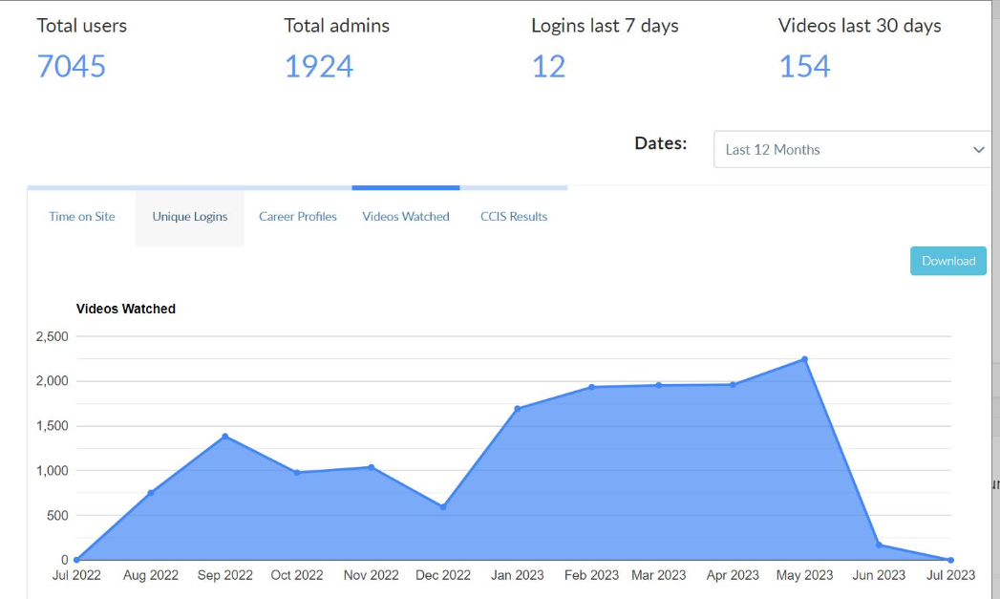
Georgia Vocational Rehabilitation Agency Pre-Employment Transition Services
Pathful Explore

Slide 5
Referring Students for Pathful Explore Accounts
GVRA receives the Parental Permission form and IEP/504 plan for each student to create their GVRA Participant ID
Students should be listed on the “Bulk Upload” template and sent to the GVRA contact for your schools.
Once the GVRA cases are created, the GVRA Participant ID will be added to the Bulk Upload form to complete it.
The Bulk upload form is then sent by GVRA to Pathful Explore which creates the student accounts.
Pathful Explore lets GVRA know when the student accounts are active and GVRA will notify the school contacts.

Slide 6
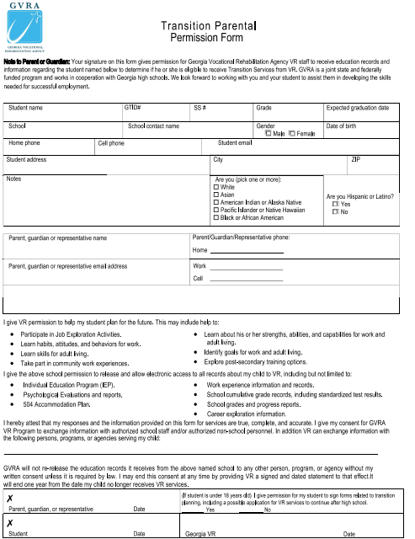
Parental Permission Form

Slide 7
Bulk Upload Template
This is an Excel spreadsheet

Slide 8
Adding Educators and School Staff
Teachers and other school or district staff can be added to the list on the Bulk Upload form to create their accounts.
GVRA staff can also have teachers and staff accounts created by GVRA administrators individually
Teacher and school staff accounts will only have access to the school they serve. Only Special Education Directors can designate someone to have School District wide access to all their HS accounts in Pathful Explore. They can do this by emailing Elise James at GaDOE and copying Rebecca Williamson at GVRA.

Slide 9
Pathful Explore Assessments
Career Clusters Interest Survey (CCIS) The Career Clusters Interest Survey (CCIS) is an interest inventory that matches your interests to career clusters based on activities you most enjoy. This survey contains 102 questions.
Career Cluster Interest Survey EZ (CCIS-EZ) The Career Clusters Interest Survey EZ (CCIS-EZ) is an interest inventory that matches your interests to career clusters based on activities you most enjoy. This survey contains 85 questions.
O*Net Ability Profiler The O*Net Ability Profiler is a series of tests designed to match your abilities with potential careers. It takes about an hour to complete this assessment.
O*Net Ability Profiler with Testing Accommodations This article explains how to add testing accommodations when assigning the O*Net Ability Profiler.
O*Net Interest Profiler (O*Net IP) The O*Net Interest Profiler helps you identify your interests and how they relate to the world of work. This survey contains 60 questions and typically takes 10-30 minutes to complete.
O*Net Work Importance Locator (O*Net WIL) The O*Net Work Importance Locator (O*Net IP) is a survey that helps you learn more about your work values and can help you decide what is important to you in a job.

Slide 10
Pathful Explore Road Maps
9TH GRADE: Understanding Myself & Career Interests
In 9th grade, students gain insights into their career interests by completing FlexLesson “Careers and YOUR Interests” which includes the Career Cluster Interest Survey or CCIS-EZ if preferred. Students research their highest rated careers in Career Central featuring job shadowing videos from a “day in the life” perspective.
10TH GRADE: Understanding Myself & Postsecondary Education Options
In 10th grade, students build upon their insights and understanding gained in 9th grade career exploration. Students complete the O*NET Interest Profiler (O*NET IP) to gain valuable insights into their own preferences. Students begin exploring postsecondary options further by researching the different types of education that may be connected with their specific career survey interest results.
11TH GRADE:: Connecting My Initiative to Career Choices
In 11th grade, students will deepen their understanding of the role that soft skills and values play when making career choices. By completing the O*NET Work Importance Locator (O*NET WIL) students are introduced to values they hold that will shape their ongoing thought process about what careers and postsecondary education options best match who they are and want to become. Topic
12TH GRADE:: Connecting My Initiative to Career Choices
In 12th grade, students will deepen their understanding of factors that play a role when making career choices. By completing the Career Cluster Interest Survey (CCIS) or CCIS-EZ if preferred, students focus on finalizing their postsecondary plans and gaining skills such as financial literacy needed to be successful.

Slide 11
Pathful Explore Data, Reports, & Tracking
Individual Student Data
Assessment Reports in PDF format
Resumes and Cover Letters
Data export of time on their accounts, total videos watched, and lessons completed
Group Data for a Class
Flex Lesson Progress Reports and Grades
Shared Lesson Reports and oversight
Reports of videos watched and popular careers
HS or District
Review of student and staff accounts
Planning around school calendar
Identifying trends and barrieres

Slide 12
Demonstration

Slide 13
Questions and Suggestions
Now – What’s on your mind?
Later – Reach out to your local GVRA staff, Pathful Explore (customerservice@virtualjobshadow.com), or GVRA Rebecca.williamson@gvs.ga.gov

Slide 14
GVRA & Pathful Explore Student Accounts
Rebecca Williamson, Strategic Initiatives Manager
Rebecca.williamson@gvs.ga.gov

Slide 15
Agenda
Last Year’s Usage
Adding students
Adding educators and paras
Assessments
Road maps
Data, Reports, and tracking
Q&A

Slide 16
Georgia Vocational Rehabilitation Agency Pre-Employment Transition Services
Pathful Explore

Slide 17
Referring Students for Pathful Explore Accounts
GVRA receives the Parental Permission form and IEP/504 plan for each student to create their GVRA Participant ID
Students should be listed on the “Bulk Upload” template and sent to the GVRA contact for your schools.
Once the GVRA cases are created, the GVRA Participant ID will be added to the Bulk Upload form to complete it.
The Bulk upload form is then sent by GVRA to Pathful Explore which creates the student accounts.
Pathful Explore lets GVRA know when the student accounts are active and GVRA will notify the school contacts.

Slide 18
Parental Permission Form

Slide 19
Bulk Upload Template
This is an Excel spreadsheet

Slide 20
Adding Educators and School Staff
Teachers and other school or district staff can be added to the list on the Bulk Upload form to create their accounts.
GVRA staff can also have teachers and staff accounts created by GVRA administrators individually
Teacher and school staff accounts will only have access to the school they serve. Only Special Education Directors can designate someone to have School District wide access to all their HS accounts in Pathful Explore. They can do this by emailing Elise James at GaDOE and copying Rebecca Williamson at GVRA.

Slide 21
Pathful Explore Assessments
Career Clusters Interest Survey (CCIS) The Career Clusters Interest Survey (CCIS) is an interest inventory that matches your interests to career clusters based on activities you most enjoy. This survey contains 102 questions.
Career Cluster Interest Survey EZ (CCIS-EZ) The Career Clusters Interest Survey EZ (CCIS-EZ) is an interest inventory that matches your interests to career clusters based on activities you most enjoy. This survey contains 85 questions.
O*Net Ability Profiler The O*Net Ability Profiler is a series of tests designed to match your abilities with potential careers. It takes about an hour to complete this assessment.
O*Net Ability Profiler with Testing Accommodations This article explains how to add testing accommodations when assigning the O*Net Ability Profiler.
O*Net Interest Profiler (O*Net IP) The O*Net Interest Profiler helps you identify your interests and how they relate to the world of work. This survey contains 60 questions and typically takes 10-30 minutes to complete.
O*Net Work Importance Locator (O*Net WIL) The O*Net Work Importance Locator (O*Net IP) is a survey that helps you learn more about your work values and can help you decide what is important to you in a job.

Slide 22
Pathful Explore Road Maps
9TH GRADE: Understanding Myself & Career Interests
In 9th grade, students gain insights into their career interests by completing FlexLesson “Careers and YOUR Interests” which includes the Career Cluster Interest Survey or CCIS-EZ if preferred. Students research their highest rated careers in Career Central featuring job shadowing videos from a “day in the life” perspective.
10TH GRADE: Understanding Myself & Postsecondary Education Options
In 10th grade, students build upon their insights and understanding gained in 9th grade career exploration. Students complete the O*NET Interest Profiler (O*NET IP) to gain valuable insights into their own preferences. Students begin exploring postsecondary options further by researching the different types of education that may be connected with their specific career survey interest results.
11TH GRADE:: Connecting My Initiative to Career Choices
In 11th grade, students will deepen their understanding of the role that soft skills and values play when making career choices. By completing the O*NET Work Importance Locator (O*NET WIL) students are introduced to values they hold that will shape their ongoing thought process about what careers and postsecondary education options best match who they are and want to become. Topic
12TH GRADE:: Connecting My Initiative to Career Choices
In 12th grade, students will deepen their understanding of factors that play a role when making career choices. By completing the Career Cluster Interest Survey (CCIS) or CCIS-EZ if preferred, students focus on finalizing their postsecondary plans and gaining skills such as financial literacy needed to be successful.

Slide 23
Pathful Explore Data, Reports, & Tracking
Individual Student Data
Assessment Reports in PDF format
Resumes and Cover Letters
Data export of time on their accounts, total videos watched, and lessons completed
Group Data for a Class
Flex Lesson Progress Reports and Grades
Shared Lesson Reports and oversight
Reports of videos watched and popular careers
HS or District
Review of student and staff accounts
Planning around school calendar
Identifying trends and barrieres

Slide 24
Demonstration

Slide 25
Questions and Suggestions
Now – What’s on your mind?
Later – Reach out to your local GVRA staff, Pathful Explore (customerservice@virtualjobshadow.com), or GVRA Rebecca.williamson@gvs.ga.gov

