Slide 1
Implementing Best Practices for Results
Hosted by: GaPMP Community of Practice for Building Capacity and Professional Development
Presenters:
Dawn Albanese – Parent Mentor in Gwinnett County
Jane Grillo – Parent Mentor in White County
Jennifer Anderson – Parent Mentor for GA Cyber Academy

Slide 2
Learning Targets:
I can list at least 3 benefits of communicating effectively
I can identify the five parts of a GaPMP Story
I can identify which of the five National PTA Standards my work most impacts in my district
Go to the Chat for the Pre-quiz link

Slide 3
Effective Communication Skills 101: How To Communicate So Others Understand
Presented by:
Dawn Albanese – Parent Mentor
Gwinnett County Public Schools
September 30, 2021

Slide 4
What is Communication?
Communication is the two way process of passing information from one person to another.
Every communication consists of at least one sender, a message, and a recipient.
During communication, the sending and the receiving of messages are equally important.

Slide 5
What are the benefits of communicating Effectively?
Improves relationships and partnerships.
Increases engagement and improves quality of interactions.
Allows participants to gain different perspectives.
Builds a culture of teamwork and trust.
Mitigates conflict.
Creates cohesion within the team.
Encourages the exchange of new ideas.
Fuels innovative solutions.

Slide 6
Important Verbal Communication Skills
Think before you speak.
Be respectful and use appropriate language.
Be clear and concise.
Speak with confidence.
Be objective and open minded.
Don’t be afraid to ask questions.
Paraphrase content for clarity purposes.

Slide 7
Important Nonverbal Communication Skills
Attitude: Can set the tone of the entire interaction.
Eye Contact: The most powerful form of communication.
Voice Tone: How something is said is just as important as what is said.
Body Language: Accounts for half of the message conveyed.
Listening: Allows gathering of data and information to make sound decisions.

Slide 8
Closing Question
How will you maintain ongoing communication throughout the year, even when circumstances change?

Slide 9
Questions?
Dawn Albanese – Parent Mentor
Gwinnett County Public Schools
dawn.albanese@gcpsk12.org
678-301-7212

Slide 10
Telling our Stories
Telling Our GaPMP
Stories

Slide 11
Identifying a Story
Anytime a mentor talks about their work it is a potential story!
By Andrea Kowch

Slide 12
The 5 Parts of a Parent Mentor Story
What did you do as a parent mentor to resolve this problem?
Hint: This is where you describe the training or assistance you provided.
4
1
Does the story reflect the Mission of the Ga. Parent Mentor Partnership?
What is the problem you are trying to solve in this story?
Hint: Look at the Family Engagement Standards
3
Who are the players in this story?
Hint: Sharing only the first names of individuals means you don’t need a release. Tell us what agencies or organizations are involved.
2
What happened as a result of your work?
5

Slide 13
Let’s Look at a Story
Does the story reflect the mission of the Ga. Parent Mentor Partnership?
Who are the players in this story?
What is the problem the parent mentor is trying to solve?
What did the parent mentor do to solve this problem?
What happened as a result of the work this parent mentor did?

Slide 14
Let’s Practice Now
Share Your Story
Use the button on the Learning Curve under the section Parent Mentors in Action
Keep it simple
Pretend you know nothing about the Parent Mentor program
Don’t worry about spelling, grammar or style … just write it
Send it!

Slide 15
Your Turn...
What are the 5 parts of a Parent Mentor Story?

Slide 16
Questions?
Jane Grillo– Parent Mentor
White County Public Schools
Jane.grillo@white.k12.ga.us

Slide 17
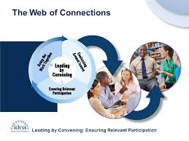
Universal Best Practices
How Parent Mentors can build successful family-school partnerships.

Slide 18
Universal Best Practices Welcoming
We want families to be active participants in the school. In order to do that we must help them become connected to what their students are doing and how their teachers are helping.
How do we accomplish this? We can…
Establish a smooth line of communication to our families.
Target our work based on parent feedback and concerns.
Invite teacher and school staff to participate in our work and welcome parent input and support.
Notes:
How do you contact your families. Do you have a direct email list, work with the school media team, or have to rely on parents to opt in?
What were your survey results? What did parents feel that they need but are missing? How can your work meet their need?
Have you ever laid out a spectacular plan only to have the teachers turn around and say we don’t want our students and/or families doing this? Make sure the teachers you work with are willing to support what you are having families do? Remember if we have families complete a task that is counterintuitive to what a teacher is doing this can cause frustration an create barriers to success.

Slide 19
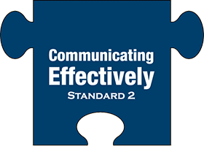
Universal Best Practices Communicating Effectively
Families and school staff engage in regular, two-way, meaningful communication about student learning.
Wait? This up to the teachers not me! Yes and No
We can…
Give the parents the tools to effectively communicate with school staff.
Give them tips on working together with teachers and other staff by managing their emotions, communicating with purpose, and provide skillful observations that are relevant to the student’s success.
Help decode the “education” language that often becomes a barrier between schools and families.

Slide 20
Universal Best Practices Supporting Student Success
Facilitate collaboration between families and school staff to support student’s learning and development both at home and at school and have regular opportunities to strengthen their knowledge and skills to do so effectively.
Supporting the “Support Staff” (Teachers, Transition, and Admin)
Educate parents about the strategies schools use to support students.
Empower parents to become a welcome and integral member of the IEP team.
Foster relationships between parents and teachers in order to coordinate efforts at school and at home to achieve common goals.
Notes:
What are our schools already doing that we can help drive success by securing parent buy in?
Do your parents fully understand all the components of the IEP and what goes into to creating the plan and the interventions to execute the plan? Can you help them understand that better?
Have you surveyed the teachers of the families you are working with to see what they would like parents to know more about and how parents can support their efforts at home?

Slide 21
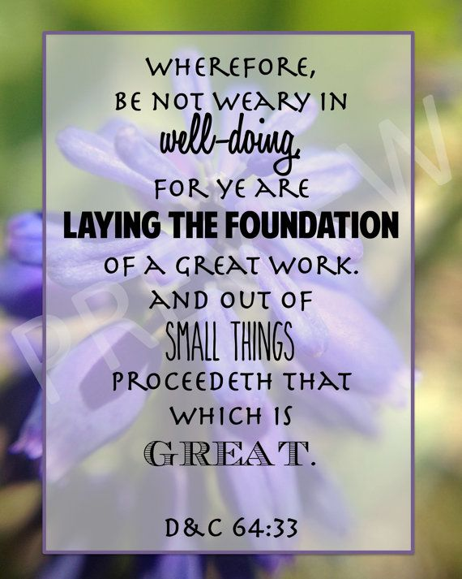
Universal Best Practices Speaking Up for Every Child
Empower families to become advocates for their student and other children to help students have access to learning opportunities that will support success.
It’s hard enough to help one child. How do we help all children?
Sharing tools and resources to a small group can lead to the utilization of successful tools and resources for a larger group of students. It is okay to start small.
Empowered partners in student success can drive the bar forward by bringing knowledge to the table that might not come to light otherwise.
When one parent brings an issue to the forefront and comes equipped with solutions and ideas, it can provide a needed spark to ignite real change.
Our work empowers families to become that spark by giving them the knowledge they need to Speak Up.
Notes:
Don’t overthink your work
Start small so you can remain targeted and focused.
Be flexible and meet families where they are.

Slide 22
Universal Best Practices Sharing Power
Families and school staff are equal partners in decisions that affect children and families and together inform, influence, and create policies, practices, and programs.
Parent Mentor work is vital to giving parents a voice.
Our communication skills with school staff is just as important as the skills we are teaching parents.
By building partnerships within the school district, we can bring parent and family concerns directly to those in charge.
Our work empowers families to be on equal footing with the school when it comes to making decisions regarding programs and interventions.
We can help families understand the different methods that they can influence decisions. (Surveys, emails, attending and participating in school events etc.…)

Slide 23
Universal Best Practices Collaborating with the Community
Families and school staff collaborate with community members to connect students, families, and staff to expanded learning opportunities, community services, and civic participation.
Parent Mentors are making connections:
Finding links in your community that can meet your families’ needs is vital to the success of our work.
Community resources will vary greatly depending on your project and your area but finding the right resource to provide information and collaboration is key.
Examples: Vocational Rehab to help students access Work Based Learning Programs.
Parent to Parent to help families connect to SSI, Medicaid, and Waiver Programs
Local Businesses that can provide employment information
Agencies that are already tied into your school system
Our Parent Mentor Network is an excellent resource to locate agency information and community partner opportunities.

Slide 24
Learning Targets:
I can list at least 3 benefits of communicating effectively
I can identify the five parts of a GaPMP Story
I can identify which of the five National PTA Standards my work most impacts in my district
Go to the Chat for the Post-quiz link

Slide 25
Questions and Follow-up
Community of Practice
Jennifer Anderson – Parent Mentor
Georgia Cyber Academy
and GaPMP Education Chair
Janderson@georgiacyber.org
Parent Mentors from each region will work together to:
Share information
Create tools and trainings
Build Capacity
Contact April Lee or Jennifer Anderson for more details

