Slide 1


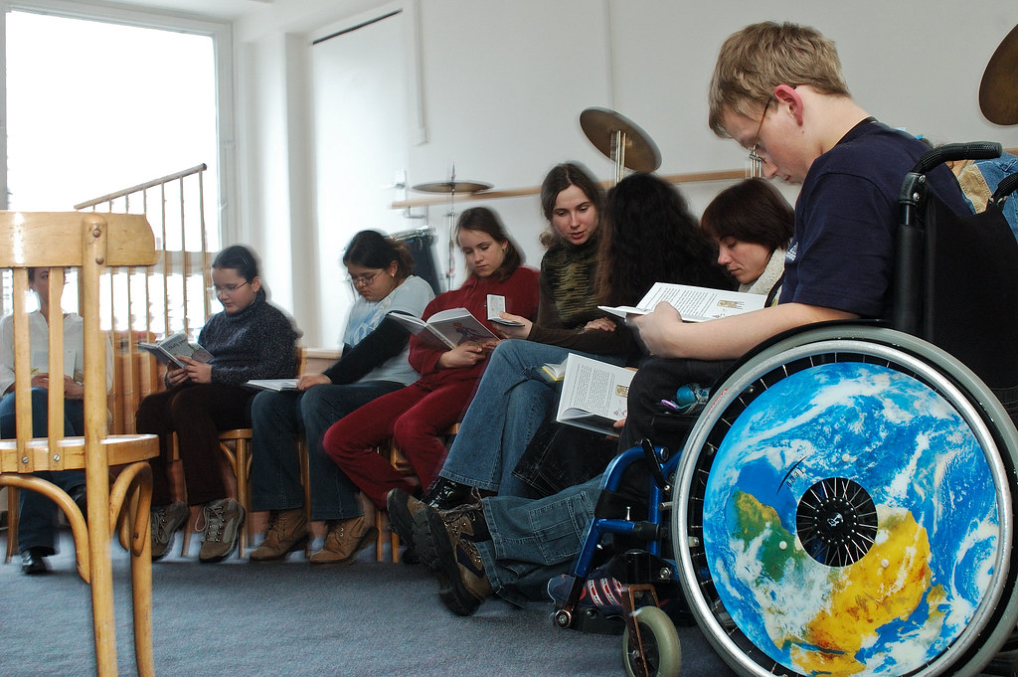


Authentic Stakeholder Engagement:
A Key Component of the 2020-2025
State Performance Plan (SPP)/
Annual Performance Report (APR)
This Photo by Unknown Author is licensed under CC BY-NC-ND
This Photo by Unknown Author is licensed under CC BY-SA
This Photo by Unknown Author is licensed under CC BY-NC-ND
Division of Special Education Supports and Services, Data & GO-IEP Unit
Dawn Kemp, Part B Data Manager
September 30, 2021
Richard Woods, Georgia’s School Superintendent | Georgia Department of Education | Educating Georgia’s Future
Notes:
Linda
Today we will be discussing the changes to the SPP/APR that begin with the submission of the 2020-2021 school year report in February 2022.

Slide 2
Goals of the SPP/APR Feedback Session
Sign in and Provide Your Role(s) sign-in
Identify the key points of the SPP/APR.
Review a process for SPP/APR development using Indicators grouped together in clusters.
Review stakeholder requirements.
Examine processes for target setting.
Evaluate the trend data for the High School & Life Outcomes Cluster of Indicators of the SPP/APR requiring targets.
Opportunity for Parent Mentors to assist in Stakeholder Input Sessions with participants from their local school system.
Plan for feedback collection and finalizing targets.
Notes:
The goals of the work session are to:
Sign in and Provide Your Role(s) HS & Life Outcomes Sign-In 9-2-2021 or QR code – Place the link in the chat or take roll or have them enter name and role in chat
Review a process for SPP/APR development using Indicators grouped together in clusters.
Evaluate the trend data for Indicators 1, 2, 13, and 14 of the SPP/APR and identify which are Results Indicators requiring targets.
Examine processes for target setting.
Identify stakeholder requirements
Plan for feedback collection and finalizing targets.

Slide 3
What is the State Performance Plan (SPP)/ Annual Performance Report (APR)? #1
State Performance Plan/Annual Performance Report
Developed for a 6 Year Interval with a Measurement Table
17 Total Indicators -- Targets for Each Indicator
Composed of Results and Compliance Indicators
Results Indicator Targets -- such as Graduation Rate can be set by the State
Compliance Indicator Targets -- such as Child Find (100%) are set by the federal Office of Special Education Programs (OSEP)

Slide 4
What is the State Performance Plan (SPP)/ Annual Performance Report (APR)? #2
State Performance Plan/Annual Performance Report
Annual Performance Report Submitted Each Year
Includes Trend Data for Each Year
Developed with Input from SAP
OSEP Reviews the State’s SPP/APR
States Receive a Determination (i.e., Meets Requirements, Needs Assistance) from OSEP

Slide 5
Data Reporting Year for SPP/APR Indicators #1
Most Indicators use data from the most recently completed full school year (SPP/APR due Feb. 2022 will be based upon SY 2020-2021):
Indicator 3 (Assessment)
Indicator 5 (School Age Settings)
Indicator 6 (Early Childhood Settings)
Indicator 7 (Preschool Outcomes)
Indicator 8 (Parent Involvement)
Indicator 9 & 10 (Disproportionate Representation)
Indicator 11 (Child Find)
Indicator 12 (Part C to B Transition)
Indicator 13 (Secondary Transition with IEP Goals)
Indicator 14 (Secondary Transition)
Indicator 15 (Hearing Requests Resolved)
Indicator 16 (Mediation Agreement)
Indicator 17 (State Systemic Improvement Plan)
Notes:
Most Indicators use data from the most recently completed full school year (SPP/APR due Feb. 2022 will be based upon SY 2020-2021): Indicators 3, 5, 6, 7, 8, 9, 10, 11, 12, 13, 14, 15, and 16 will be from school year 2020-2021.
Indicator 3 (Assessment)
Indicator 5 (School Age Settings)
Indicator 6 (Early Childhood Settings)
Indicator 7 (Preschool Outcomes)
Indicator 8 (Parent Involvement)
Indicator 9 & 10 (Disproportionate Representation)
Indicator 11 (Child Find)
Indicator 12 (Part C to B Transition)
Indicator 13 (Secondary Transition with IEP Goals)
Indicator 14 (Secondary Transition)
Indicator 15 (Hearing Requests Resolved)
Indicator 16 (Mediation Agreement)

Slide 6
Data Reporting Year for SPP/APR Indicators #2
Three Indicators use lagging data from a year prior to the most recently completed full school year (SPP/APR due Feb. 2022 is based upon SY 2019-2020):
Indicator 1 (Graduation Rate)
Indicator 2 (Dropout Rate)
Indicator 4 (Disproportionate Suspension/Expulsion)
Notes:
Three Indicators use lagging data from a year prior to the most recently completed full school year (SPP/APR due Feb. 2022 is based upon SY 2019-2020):
Indicator 1 (Graduation Rate)
Indicator 2 (Dropout Rate)
Indicator 4 (Disproportionate Suspension/Expulsion)

Slide 7
State Performance Plan/Annual Performance Report
High School & Life Outcomes
Graduation Rate-1
Dropout Rate-2
Disproportionality
Significant Discrepancy-4
Disproportionate Representation (Specific Disabilities)-10
Environment & Timelines
School Age Environments-5
Preschool, Parent Involvement & Legal
Preschool Outcomes-7
Parent Involvement/Survey-8
Assessment
Assessment-3
Post Secondary Transition- 13
Post School Outcomes-14
Disproportionate Representation (All Disabilities)- 9
Early Childhood Environments-6
Child Find/Initial Evaluation-11
Part C to B Transition-12
Resolution Sessions-15
Mediation-16
State Systemic Improvement Plan (SSIP)-17
Facilitators: Ann Cross, Wina Lowe
Facilitators: Felicia Peavy, Vickie Cleveland, Linda Castellanos
Facilitators: Amber McCollum, Phoebie Atkins
Facilitators: Jamila Pollard, Kachelle White, Scott Smith
Facilitators: Lynn Holland, Karen Suddeth, Carson Cochran
Notes:
This graphic provides the Indicator Cluster groupings that the DSESS staff signed up to support. The facilitators for the clusters are listed above as well. The purpose of clustering the Indicators is to provide a reasonable and logistically possible method for stakeholders to provide input. In other states a similar type of framework has been used. In addition to DSESS staff participating in the process, there will also be SAP members as well as other individuals and groups that are needed to provide feedback.

Slide 8
Collaborative Process for SPP/APR Development #1
SPP/APR 2020-2025 Process
  February 2021, Development of an Excel Template of SPP/APR 2020-2025 Requirements and Data with Targeted Questions for all Indicators by Part B Data Managers shared with Zelphine Smith-Dixon and Kachelle White
  May 6, 2021, SAP meeting - members chose an Indicator Cluster for which to provide feedback and set targets
  June 2, 2021, Meeting with Part B Data Managers, Zelphine Smith-Dixon and Kachelle White regarding SPP/APR 2020-2025
  August 4, 2021, Georgia Learning Resource Systems (GLRS) and District Liaisons (DLs) Presentation
  August 10, 2021, Department of Special Education Services and Supports (DSESS) Staff Presentation
  August 11, 2021, DSESS SPP/APR Group Facilitator share information
  August 18, 2021, SSIP (Indicators 1 & 2) Presentation
Notes:
The 2020-2025 process for the SPP/ is provided on this slide and the next two slides.
February 2021 Development of an EXCEL Template of SPP/APR 2020-2025 Requirements and Data with Targeted Questions for all Indicators by Part B Data Managers shared with Zelphine Smith-Dixon and Kachelle White.
May 6, 2021, SAP meeting- members chose an Indicator Cluster for which to provide feedback and set targets
June 2, 2021, Meeting with Part B Data Managers, Zelphine Smith-Dixon and Kachelle White regarding SPP/APR 2020-2025
August 4, 2021, GLRS and District Liaisons (DLs) Presentation
August 10, 2021, DSESS staff Presentation
August 11, 2021, DSESS SPP/APR Group Facilitator share information
August 18, 2021, SSIP (Indicators 1 & 2) Presentation

Slide 9
Collaborative Process for SPP/APR Development #2
September 2021- November 2021 - stakeholders provided with current data on Indicators and feedback gathered to provide advisement on the targets for the SPP/APR 2025
November 2021 - specific targets set for each Indicator for the SPP/APR 2020-2025
November 2021 (late) - public access to the targets and opportunity for comment
December 2021 - updates provided to participating stakeholders of the targets established and any updated data provided
December 2021 (late) - SPP/APR template published by OSEP and available for entry on EMAPS
December 2021-January 10, 2022 - Development of SPP Narrative and Editing with DSESS Program Managers, Part B Data Managers, and other relevant staff
January 15, 2022 - SPP/APR provided to the Director of DSESS for review and submission to OSEP by Feb. 1, 2022
Notes:
September 2021- November 2021 stakeholders provided with current data on Indicators and feedback gathered to provide advisement on the targets for the SPP/APR 2025
November 2021 specific targets set for each Indicator for the SPP/APR 2020-2025
November 2021 public access to the targets and an opportunity to comment
December 2021 updates provided to participating stakeholders of the targets established and any updated data provided
December 2021 (late) SPP/APR template published by OSEP and available for entry on EMAPS
December 2021-January 10, 2022- Development of SPP Narrative and Editing with DSESS Program Managers, Part B Data Managers, and other relevant staff
January 15, 2022- SPP/APR provided to the Director of DSESS for review and submission to OSEP by Feb. 1, 2022

Slide 10

Stakeholder Input
Notes:
In this section, we will discuss the heightened requirements for additional stakeholder input and generate some possible ideas for increase feedback from a diverse group of stakeholders.

Slide 11
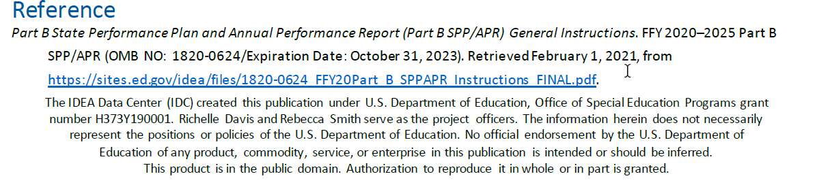
Stakeholder Feedback Requirements #1
Notes:
The Stakeholder Feedback Requirements are dramatically enhanced in the new SPP/APR. This slide and the next are excerpts from an IDC one pager regarding requirement. As indicated in the items in this slide and the next slide, parent input must be more pervasive and documented. There must be activities to increase input from diverse groups of parents.

Slide 12
Stakeholder Feedback Requirements #2
Notes:
The mechanisms for the process must also be more highly documented with opportunity for public commentary of targets, data analysis improvement strategies, evaluating progress. The public must also be made aware of the results of the process.

Slide 13
Setting Baselines & Targets #1
Notes:
In this section, we will discuss the specifics about when new Baselines are set and some possible methods for setting targets as we move forward.

Slide 14
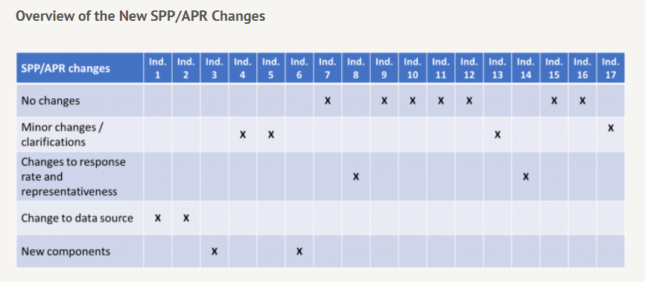
Setting Baselines & Targets - Impacted Indicators #2
Indicators requiring a new baseline for the SPP/APR to be submitted in Feb. 2022 are circled in red.
Indicators with new baselines in the SPP/APR submitted Feb 2021 are enclosed in a blue box
IDC Monthly Webinar: Setting Baselines and Targets in a World of Questionable Data Quality March 25, 2021, PPT Slides/Webinar Recording Setting Baselines & Targets-Webinar Setting Baselines & Targets- PPT
(PPT in Facilitator Resources Folder)
Notes:
The chart above from IDC shows all Indicators on the SPP/APR. It shows the relative status on the Indicators. Circled in red are Indicators that will require a new Target. Indicators in a blue box had a new baseline set in last year’s SPP/APR submission. We will be discussing both baselines and targets, but this provides the broad overview of the Indicators for the 2020-2025 package.
As you can see, many of the Indicators have no changes at all. However, several require changes due to new components or changes in measurement. These are circled in red. There are also 3 Indicators which had changes last year 5, 6, and 8. Five and 6 were changed to reflect the move of 5 year old students in K in the School Age Count. The change dramatically decreased the numbers in Indicator 6 as well as the environments (i.e., more younger children in more restrictive placements and fewer children over all). Indicator 8 also required a new baseline because the calculation began to include the category Agree as indicating satisfaction with involvement. In the past it was only Strongly Agree and Very Strongly Agree.

Slide 15
Compliance & Results Indicators
Compliance Indicators have a mandatory target that is set at 0% or 100%.
  4b, 9, 10, 11, 12, and 13
Results Indicators require targets that must show an increase over baseline, be rigorous, and set with the advice of stakeholders.
  1, 2, 3, 4a, 5, 6, 7, 8, 14, 15, 16, and 17
Notes:
We will examine the distinction between the Compliance and Results indicators as shown on the slide. Individuals need to understand this to realize targets will not be required for all Indicators. For the DSESS staff, this is likely already known, but as the SAP and other stakeholders are involved, they may not understand.
Compliance Indicators have a mandatory target that is set at 0% or 100%.
4b, 9, 10, 11, 12, and 13
Results Indicators require targets that must show an increase over baseline, be rigorous, and set with the advice of stakeholders.
1, 2, 3, 4a, 5, 6, 7, 8, 14, 15, 16, and 17

Slide 16
Setting Baselines & Targets #3
When do you set new baselines and targets?
Only when there is a new component added to an Indicator or
Changes in the formula, method, or group being measured in the Indicator
Not just because of a new SPP/APR package (i.e., SPP/APR 2020-2025) if there are no new components or measurement
IDC Monthly Webinar: Setting Baselines and Targets in a World of Questionable Data Quality March 25, 2021, PPT Slides/Webinar Recording Setting Baselines & Targets-Webinar Setting Baselines & Targets- PPT
(PPT in Facilitator Resources Folder)
Notes:
In examining when new baselines and targets are set the following must be considered:
When there is a new component added to an Indicator or
Changes in the formula, method, or group being measured in the Indicator
Not just because of a new SPP/APR package (i.e., SPP/APR 2020-2025) if there are no new components or measurement

Slide 17
Setting Baselines & Targets
IDC Monthly Webinar: Setting Baselines and Targets in a World of Questionable Data Quality March 25, 2021, PPT Slides/Webinar Recording Setting Baselines & Targets-Webinar Setting Baselines & Targets- PPT
(PPT in Facilitator Resources Folder)
Notes:
This slide is particularly focused on any Indicators that may be significantly impacted by COVID and some considerations in setting targets. Let me provide an example. For Indicator 1 Graduation Rate, there are two factors that are impacting the data: 1) a new formula- leading to a much higher rate of graduation, 2) COVID in the first year of data, which may have elevated the data even higher. If Georgia wanted to do so, it could use a prior year (not 2020) recalculated using the new formula to be the baseline. Instead of using 79%, Georgia could use the 2017 rate of 68.88% or 2018 rate of 70%. This is only a consideration.

Slide 18
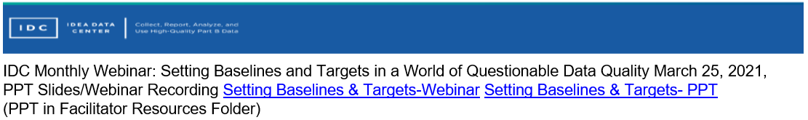
Setting Targets
Notes:
Read the slide

Slide 19
INDICATOR DATA - High School & Life Outcomes
Notes:
We will now do an examination of the data. We will view general trends and briefly discuss any with changes or significant variability. We will only view and discuss. After that, we will review some methods for target setting as we move forward.

Slide 20
SPP/APR INDICATOR 1
Indicator 1: Graduation
Percent of youth with Individualized Education Programs (IEPs) graduating from high school with a regular high school diploma. (20 U.S.C. 1416 (a)(3)(A))
Current Calculation: Adjusted Cohort Rate - same as Every Student Succeeds Act (ESSA)
Updated Calculation: Report the Same Data used for Reporting under Section 618
FS009 - Children with Disabilities Exiting Special Education File Specifications
Richard Woods, Georgia’s School Superintendent | Georgia Department of Education | Educating Georgia’s Future
20
Notes:
Indicator 1 of the SPP/APR has a significant change based upon the calculation and data source. The calculation for the SPP/APR through FFY2019 submitted in February 2021 was the Adjusted Cohort Rate which is the same rate used for ESSA for Title I accountability. The data source was comprised of students in grades 9 through 12. The updated calculation for the SPP/APR contains students age 14-21 regardless of grade. There are also other differences between the data sources and calculation elements that will be explored as we move forward.
The data source for Indicators 1 and 2 is the same moving forward. It is the Ed Facts/Eden File 009 for both. Prior calculations were completely different and yielded percentages that were not aligned for these 2 indictors. It was possible to have an 80% graduation rate and a 4% dropout rate. The new denominator contains all students with disabilities age 14-21 exiting special education as graduates, dropouts, or students who received a certificate. The number of exiters leaving with a certificate is generally small. Using the new formula, an LEA or State with a graduation rate of 80% will also have dropout rate of just under 20%.

Slide 21
Students with Disabilities Graduation Rate
Notes:
The graduation rate for students with disabilities has dramatically increased across the past few years.
What are your thoughts? What impact do you think COVID has had on the 2020 rate?

Slide 22
SPP/APR INDICATOR 2
Indicator 2: Dropout
Percent of youth with IEPs dropping out of high school.
(20 U.S.C. 1416 (a)(3)(A))
Current Calculation: Use the annual event school dropout rate for students leaving a school in a single year determined in accordance with the National Center for Education Statistic's Common Core of Data
Updated Calculation: Report the Same Data used for Reporting under Section 618
FS009 - Children with Disabilities Exiting Special
Education File Specifications
Richard Woods, Georgia’s School Superintendent | Georgia Department of Education | Educating Georgia’s Future
22
Notes:
The previous SPP/APR had a very different calculation than the updated calculation. Specifically, the prior denominator contained all students with disabilities in grades 9-12 reflecting all SWDs who COULD have dropped out. The new denominator is the same as the new graduation denominator and contains all students with disabilities exiting special education age 14-21 as graduates, dropouts, or students who received a certificate.

Slide 23
Students with Disabilities Dropout Rate
Notes:
Georgia has met its dropout rate target for 6 out of 7 years. The rate has remained below 6% using the old formula. The red bar reflects the recalculation of that year using the new exiters dropout rate.

Slide 24
SPP/APR INDICATOR 14
Indicator 14: Post-School Outcomes
Post-school outcomes: Percent of youth who are no longer in secondary school, had IEPs in effect at the time they left school, and were:
Enrolled in higher education within one year of leaving high school.
Enrolled in higher education or competitively employed within one year of leaving high school.
Enrolled in higher education or in some other postsecondary education or training program; or competitively employed or in some other employment within one year of leaving high school.
(20 U.S.C. 1416(a)(3)(B))
Calculation Changes: No Changes
Updated Analysis: Representativeness Requirements are Solidified
Richard Woods, Georgia’s School Superintendent | Georgia Department of Education | Educating Georgia’s Future
24
Notes:
There is no change in the Indicator 14 definition nor any changes in calculation. There are changes in representativeness requirements that are like those in Indicator 8.

Slide 25
Indicator 12 A Postschool Outcomes
Notes:
Trend data indicates that Georgia has consistently remained near the set targets for post school outcomes or surpassed them, except for higher education/college enrollment. Georgia has remained slightly below the target in the past 4 years.

Slide 26
Notes:
Trend data indicates that Georgia has consistently surpassed targets for the Higher Education & Competitively Employed part of the Indicator.

Slide 27
Notes:
Georgia has also met or surpassed the target for Enrolled in Higher Education, Competitively Employed, and Post School Training or Other Employment.

Slide 28
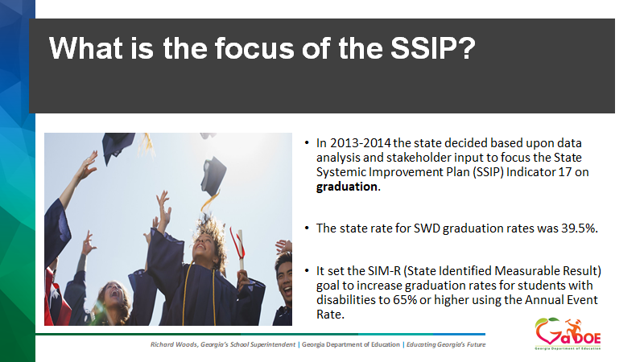

Slide 29
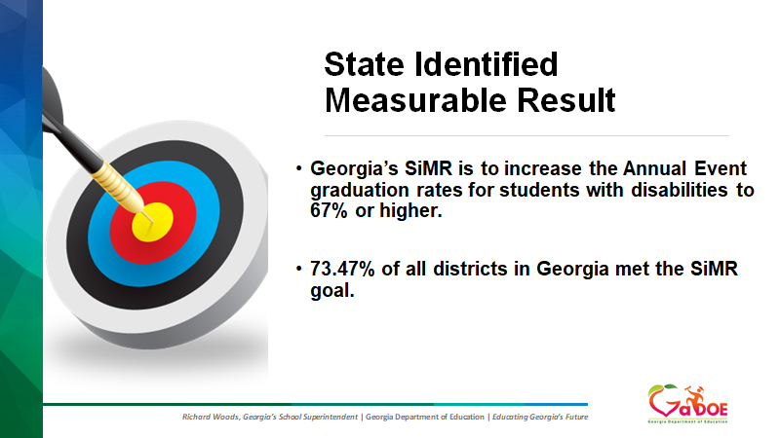

Slide 30
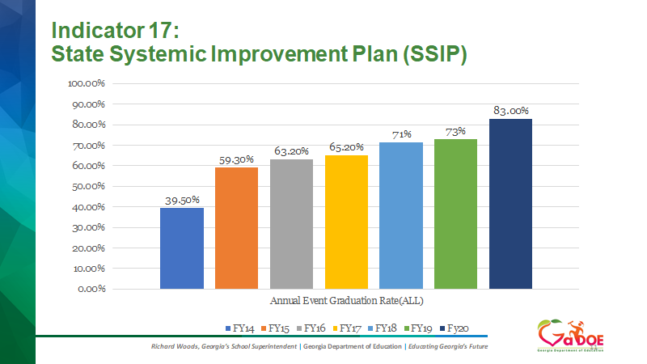

Slide 31
Collaborative Process for SPP/APR Completion 1
September 2021- November 2021 stakeholders provided with current data on Indicators and feedback gathered to provide advisement on the targets for the SPP/APR 2025
November 2021 specific targets set for each Indicator for the SPP/APR 2020-2025
November 2021 (late) public opportunity to comment on targets
December 2021 updates provided to participating stakeholders of the targets established and any updated data provided
December 2021 (late) SPP/APR template published by OSEP and available for entry on EMAPS
December 2021-January 10, 2022- Development of SPP Narrative and Editing with DSESS Program Managers, Part B Data Managers, and other relevant staff
January 15, 2022- SPP/APR provided to the Director of DSESS for review and submission to OSEP by Feb. 1, 2022
Notes:
Summary of the Process:
September 2021- November 2021 stakeholders provided with current data on Indicators and feedback gathered to provide advisement on the targets for the SPP/APR 2025
November 2021 specific targets set for each Indicator for the SPP/APR 2020-2025
November 2021 (late) public opportunity to comment on targets
December 2021 updates provided to participating stakeholders of the targets established and any updated data provided
December 2021 (late) SPP/APR template published by OSEP and available for entry on EMAPS
December 2021-January 10, 2022- Development of SPP Narrative and Editing with DSESS Program Managers, Part B Data Managers, and other relevant staff
January 15, 2022- SPP/APR provided to the Director of DSESS for review and submission to OSEP by Feb. 1, 2022

Slide 32
Collaborative Process for SPP/APR Completion 2
Parent Mentor Process for Assisting with Feedback
Stakeholder Input Meetings Scheduled for October for Parent Mentors, Parents, and High School Students with Disabilities
  Parent Mentors attempt to get two to three parents and one high school student with disabilities from their school system to participate in a Stakeholder Input Meeting
Anne Ladd shares the registration links for the Feedback Meetings in early October to be held by the end of October
Please contact me at dkemp@doe.k12.ga.us for additional information on the SPP/APR.
Notes:
Summary of the Process:
September 2021- November 2021 stakeholders provided with current data on Indicators and feedback gathered to provide advisement on the targets for the SPP/APR 2025
November 2021 specific targets set for each Indicator for the SPP/APR 2020-2025
November 2021 (late) public opportunity to comment on targets
December 2021 updates provided to participating stakeholders of the targets established and any updated data provided
December 2021 (late) SPP/APR template published by OSEP and available for entry on EMAPS
December 2021-January 10, 2022- Development of SPP Narrative and Editing with DSESS Program Managers, Part B Data Managers, and other relevant staff
January 15, 2022- SPP/APR provided to the Director of DSESS for review and submission to OSEP by Feb. 1, 2022

Slide 33

This Photo by Unknown Author is licensed under CC BY
Notes:
Thanks so much for all you do!

