Slide 1
Georgia Parent Mentor Partnership
Family Engagement Framework
Planning, Implementation, Evaluation, and Building Capacity
April Lee – E2P Framework Coach

Slide 2
Learning Targets #1
I can list two ways I may learn what families are in need of in my district.
I can list two ways to build partnerships in my district.

Slide 3
Pre-assessment
T or F
  I can use the Family Pre/Post Survey and conversations with student’s teachers to identify family needs.
I will build partnerships this school year by:

Slide 4
Start Planning for Success
Using the Toolkit and Learning Curve
Building Partnerships
Working with families and partners
Training and support
Timeline and benchmarks for goals
Additional tools and professional development

Slide 5
GaPMP Toolkit for Family Engagement
Evidence-based Framework
The GaPMP framework outline includes well documented and studied components such as: student success objectives, SMART goals, vital behaviors (Influencer), benchmark timeline, tools for recording actions, and research statements to guide support. Each framework component encourages growth from promising practices (demonstrating limited success) to evidence-based practices (recorded success with a systemic review process to evaluate evidence).

Slide 6
Toolkit Resources
Logic Model
Common Terms and Acronyms
Evidence to Practice (E2P) Guides
Planning to Implementation (P2I) Guide
Family Pre/Post Survey
Best Practice Summaries
Checklist: for the Traditional and Alternative
Authentic Stakeholder Engagement (4-page Tool)

Slide 7

National Standards for Family-School Partnerships

Slide 8

Leading by Convening Framework
Meet people where they are on an issue.
Bring people together to build support for addressing the issue.
Convene the stakeholders to discover why this is important and how it will improve practice.
Translate complex challenges into ways that the individuals can contribute.
Help people lead in place regardless of role, position or title.
Create new knowledge together.
Solve complex issues that need the various perspectives/aspects that contribute to problems/solutions.
Build a personal commitment to working in this way because we believe inclusive work is better and more sustainable work.
Cultivate the habit of collaboration.
Integrate collaboration into the identity of the group and the individual.

Slide 9
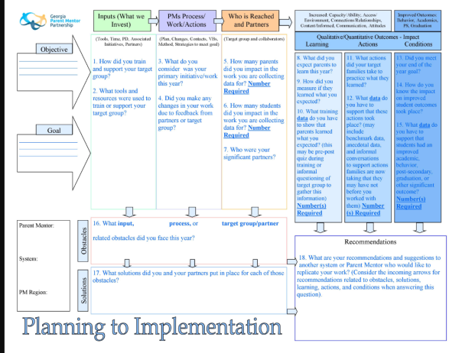
The End is the Beginning

Slide 10
Checklist

Slide 11
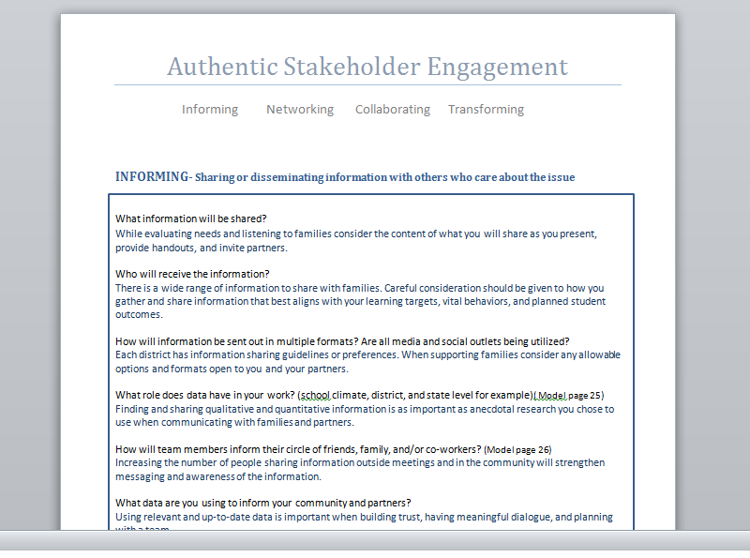
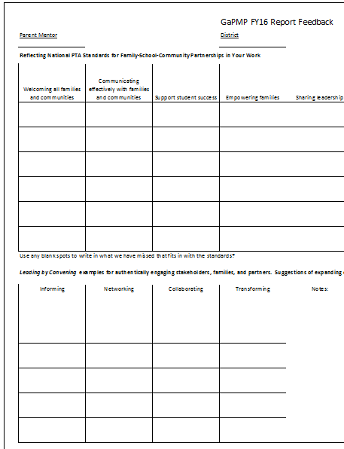
Promote Self and Peer Evaluation

Slide 12

Building Partnerships
In your region
  Seasoned Mentors
  Mentors working on similar work
  Communities of Practice
In your district
  School staff and teachers
  Community partners
  Parents and family members

Slide 13

Finding a Target Group
Small group of families to work with more closely for target work and data collection
Should be 5 to 20 families (most pick 10 or more)
Consider your partners and what families need
  Teachers and other community partners
  Your conversations with families
  Survey results

Slide 14
Finding an Initiative or Area of Focus
What needs improving?
What initiatives are already in place?
Where are your possible partners?
Review the E2P Guides with your administrator:
  Graduation
  Partnerships/Stakeholder Engagement
  Self-determination/IEP Participation
  Post-secondary
  Literacy

Slide 15
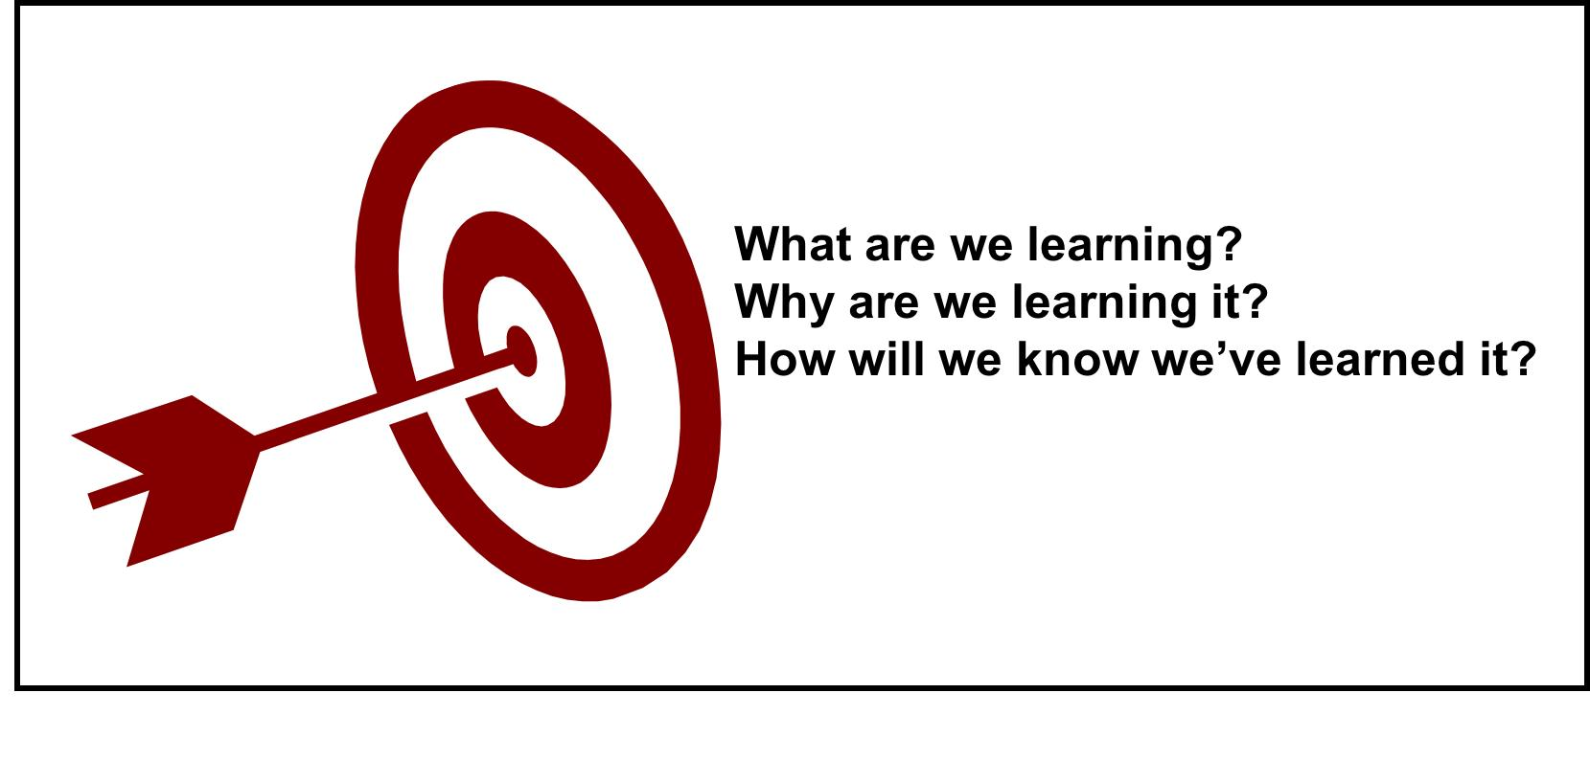
Training Families
What topics will you train on and why?
What will parents do with the new information?
How will you know they learned something from you?

Slide 16
Learning Targets #2
If my goal of training is to make sure my
Families are better informed on the topic of: Self-determination
I might present a 30 min presentation to include:
  Benefits of self-determination skills
  Ideas for teaching the skills at home
In order to measure what they know on these topics before I train (Pre)I will show them what I expect them to learn through I CAN statements:
  I can list 2 reasons my child needs to be more self-determined.
  I can describe 2 actions my child will work on to build his/her self-determination skills

Slide 17

Learning Target Data
The questions I will use to measure their Pre and Post learning could be:
  Which of these are likely to improve if your child is more self-determined?
    Self-advocacy
    Independent skills
    Goal setting is important
    They talk more
    All of the above
  My child can work on these two skills at home to be more self-determined:
    _________________
    _________________

Slide 18
Ongoing Support of Families
To ensure they use the new information I might:
  Use a self-determination checklist (tool) during the training and show them how to use it to identify and complete skill-building at home
  Offer to check on them throughout the year (benchmark checks) by phone or in person to share new ideas and support skill-building
  Gather feedback from families to change or offer new supports so more families benefit from what is learned during the year.

Slide 19

Timeline to Reach Goals
Partnership Webinar October 6th
Be aware of reporting dates
  October 15th
  January 15th
  April 15th
Set benchmarks to check on current status
  2-3 that are asked about during reporting

Slide 20

Other Resources and Professional Development
Region meetings/other Parent Mentors
Local and region trainings/conferences
Local or district teams/boards
Other agencies

Slide 21
Reporting Your Success
Anecdotal Details
Benchmark Checks and Changes to the Work
Obstacles and Solutions
Linking Outcomes
  Learning
  Action
  Student
Building Capacity

Slide 22
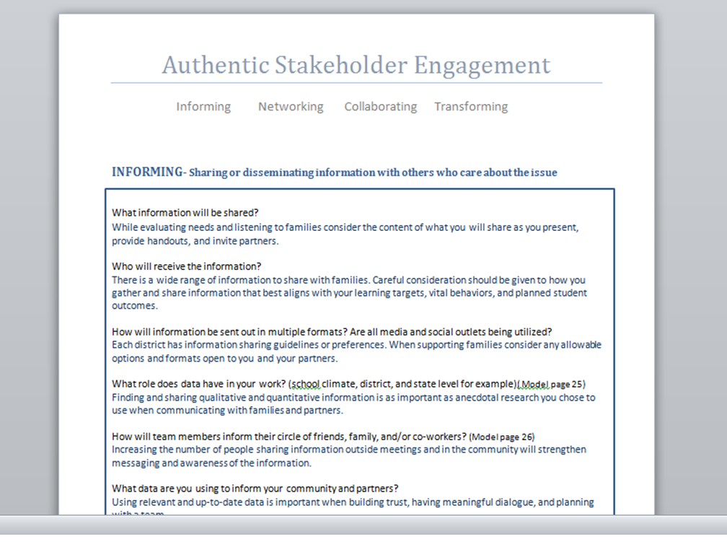
Asking Yourself Questions to Reflect and Ensure Replication
Authentic Stakeholder Engagement Tool

Slide 23
Measuring the Impact
Sharing Outcomes
Measuring the Impact
Sharing Outcomes

Slide 24

The End Result Leads the Work
What RESULTS do you plan to see due to what you have
  Learned
  Taught
  Supported
  Partnered with others on
  Collected data for

Slide 25
FY22 GaPMP Goals for Reporting
Showcase our adaptive skills.
Embedding National PTA Standards
Listen and share parental concerns and needs.
Model and encourage partnership building.
Model and encourage communication in order to support student success.
Build capacity among Parent Mentors and in districts.

Slide 26
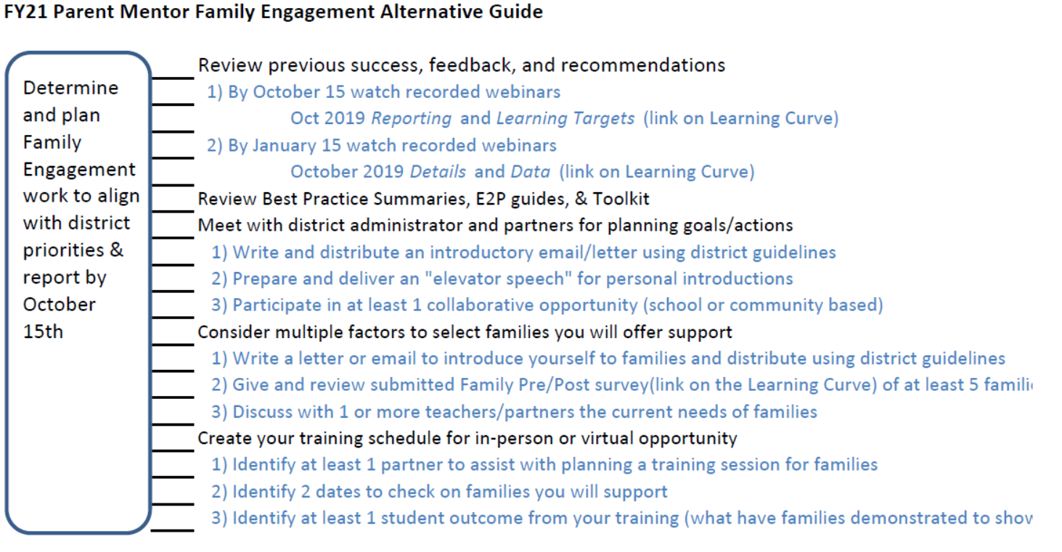
FY21 Alternative Guide

Slide 27
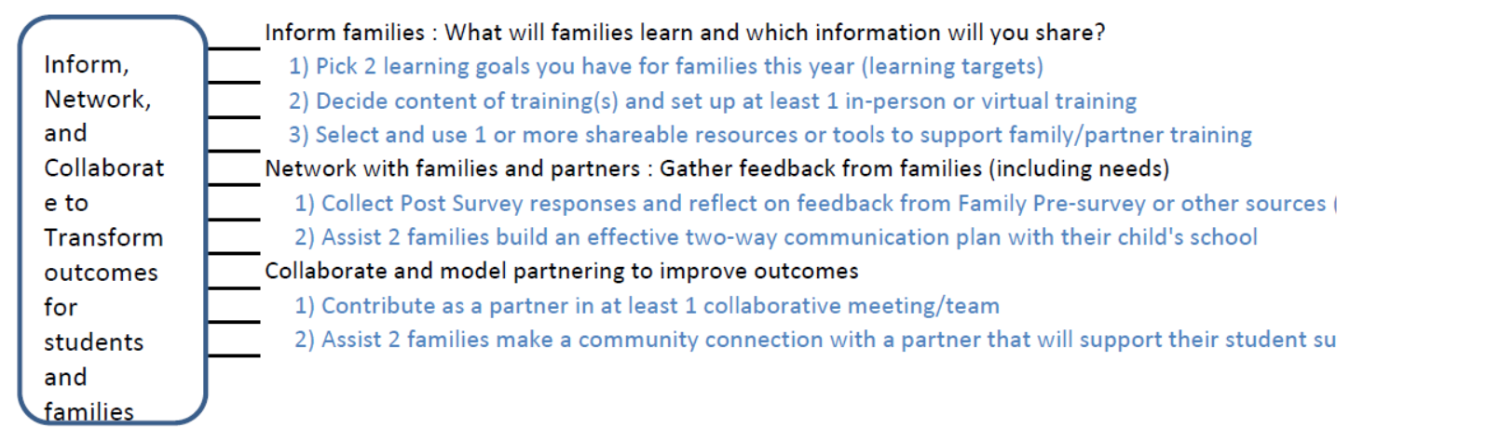
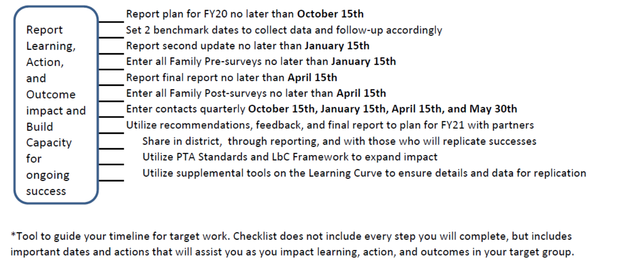
Tools to Guide Your Timelines

Slide 28
Building Capacity
Improving communication and information sharing
Improving engagement of volunteers and partners
Shared leadership
Effective use of technology and media outlets
Improving how team measures outcomes
Improved skills, strengths, and knowledge
Greater impact and success

Slide 29
Questions and Thoughts
April Lee
leecrew555@gmail.com

