Slide 1
Dual Enrollment for Students with Disabilities

Slide 2
So what is Dual Enrollment?

Slide 3
The Mission of Dual Enrollment
The purpose of the Dual Enrollment program is to promote and increase access to postsecondary educational opportunities for Georgia high school students while increasing high school graduation rates, preparing a skilled workforce, and decreasing time and cost to postsecondary credential completion.

Slide 4
A Brief History of Dual Enrollment in Georgia
Early 1990s - Dual Enrollment becomes available to Georgia high school students. It was called Post Secondary Joint Enrollment and was more between the college and the student.
2015 – The Georgia Legislature passes the Move on When Ready Act (MOWR) which marked a huge expansion of the dual enrollment option. This act allowed students to access DE as early as 9th grade without any limits in terms of credit hours they could earn or number of hours they could take in a semester or quarter. It also created Senate Bill 2 (SB2), which has evolved into Option B, which is a special DE program that provides an alternate path to high school graduation.
2020 – The Georgia Legislature passes HB 444, which was the first real revision to MOWR. All Dual Enrollment is now called Dual Enrollment. MOWR language has been phased out. Bigger revisions include limits to what courses students can take, who is eligible and introduced a funding cap for the first time.

Slide 5
What makes Georgia’s Dual Enrollment program unique?
Our DE programs is one of the most accessible and robust programs in the country
Represents a unique partnership with the Georgia Department of Education, the University System of Georgia, the Technical College System of Georgia, the Georgia Independent Colleges Association and Georgia Student Finance. All of the agencies work together to make our Dual Enrollment program is open, smooth and effective as possible for the largest number of students possible.
In 2020, more than 58,000 students participated in Dual Enrollment either part time or full time.
Dual Enrollment currently provides 30 hours worth of funding for Dual Enrollment, which generally equates to 2 semesters (plus a little) of full time enrollment or 4 semesters of part time enrollment.

Slide 6
Benefits of Dual Enrollment
For the Student
Students can access 30 hours of college credit for free
Can provide flexibility in student scheduling
Can make the transition from high school to post secondary experience much more successful
Provide opportunities for courses and programs that the high school doesn’t offer
A way to stay engaged with school when they are DONE with school
Can shorten the student’s timeline to a job in a desired career field.
For the School
Can maintain full FTE funding for Dual Enrollment students whether they are accessing DE coursework on your campus or at the college
Can augment and expand available programming for students, particularly in CTAE
Provides a meaningful way to improve student engagement and graduation rates

Slide 7
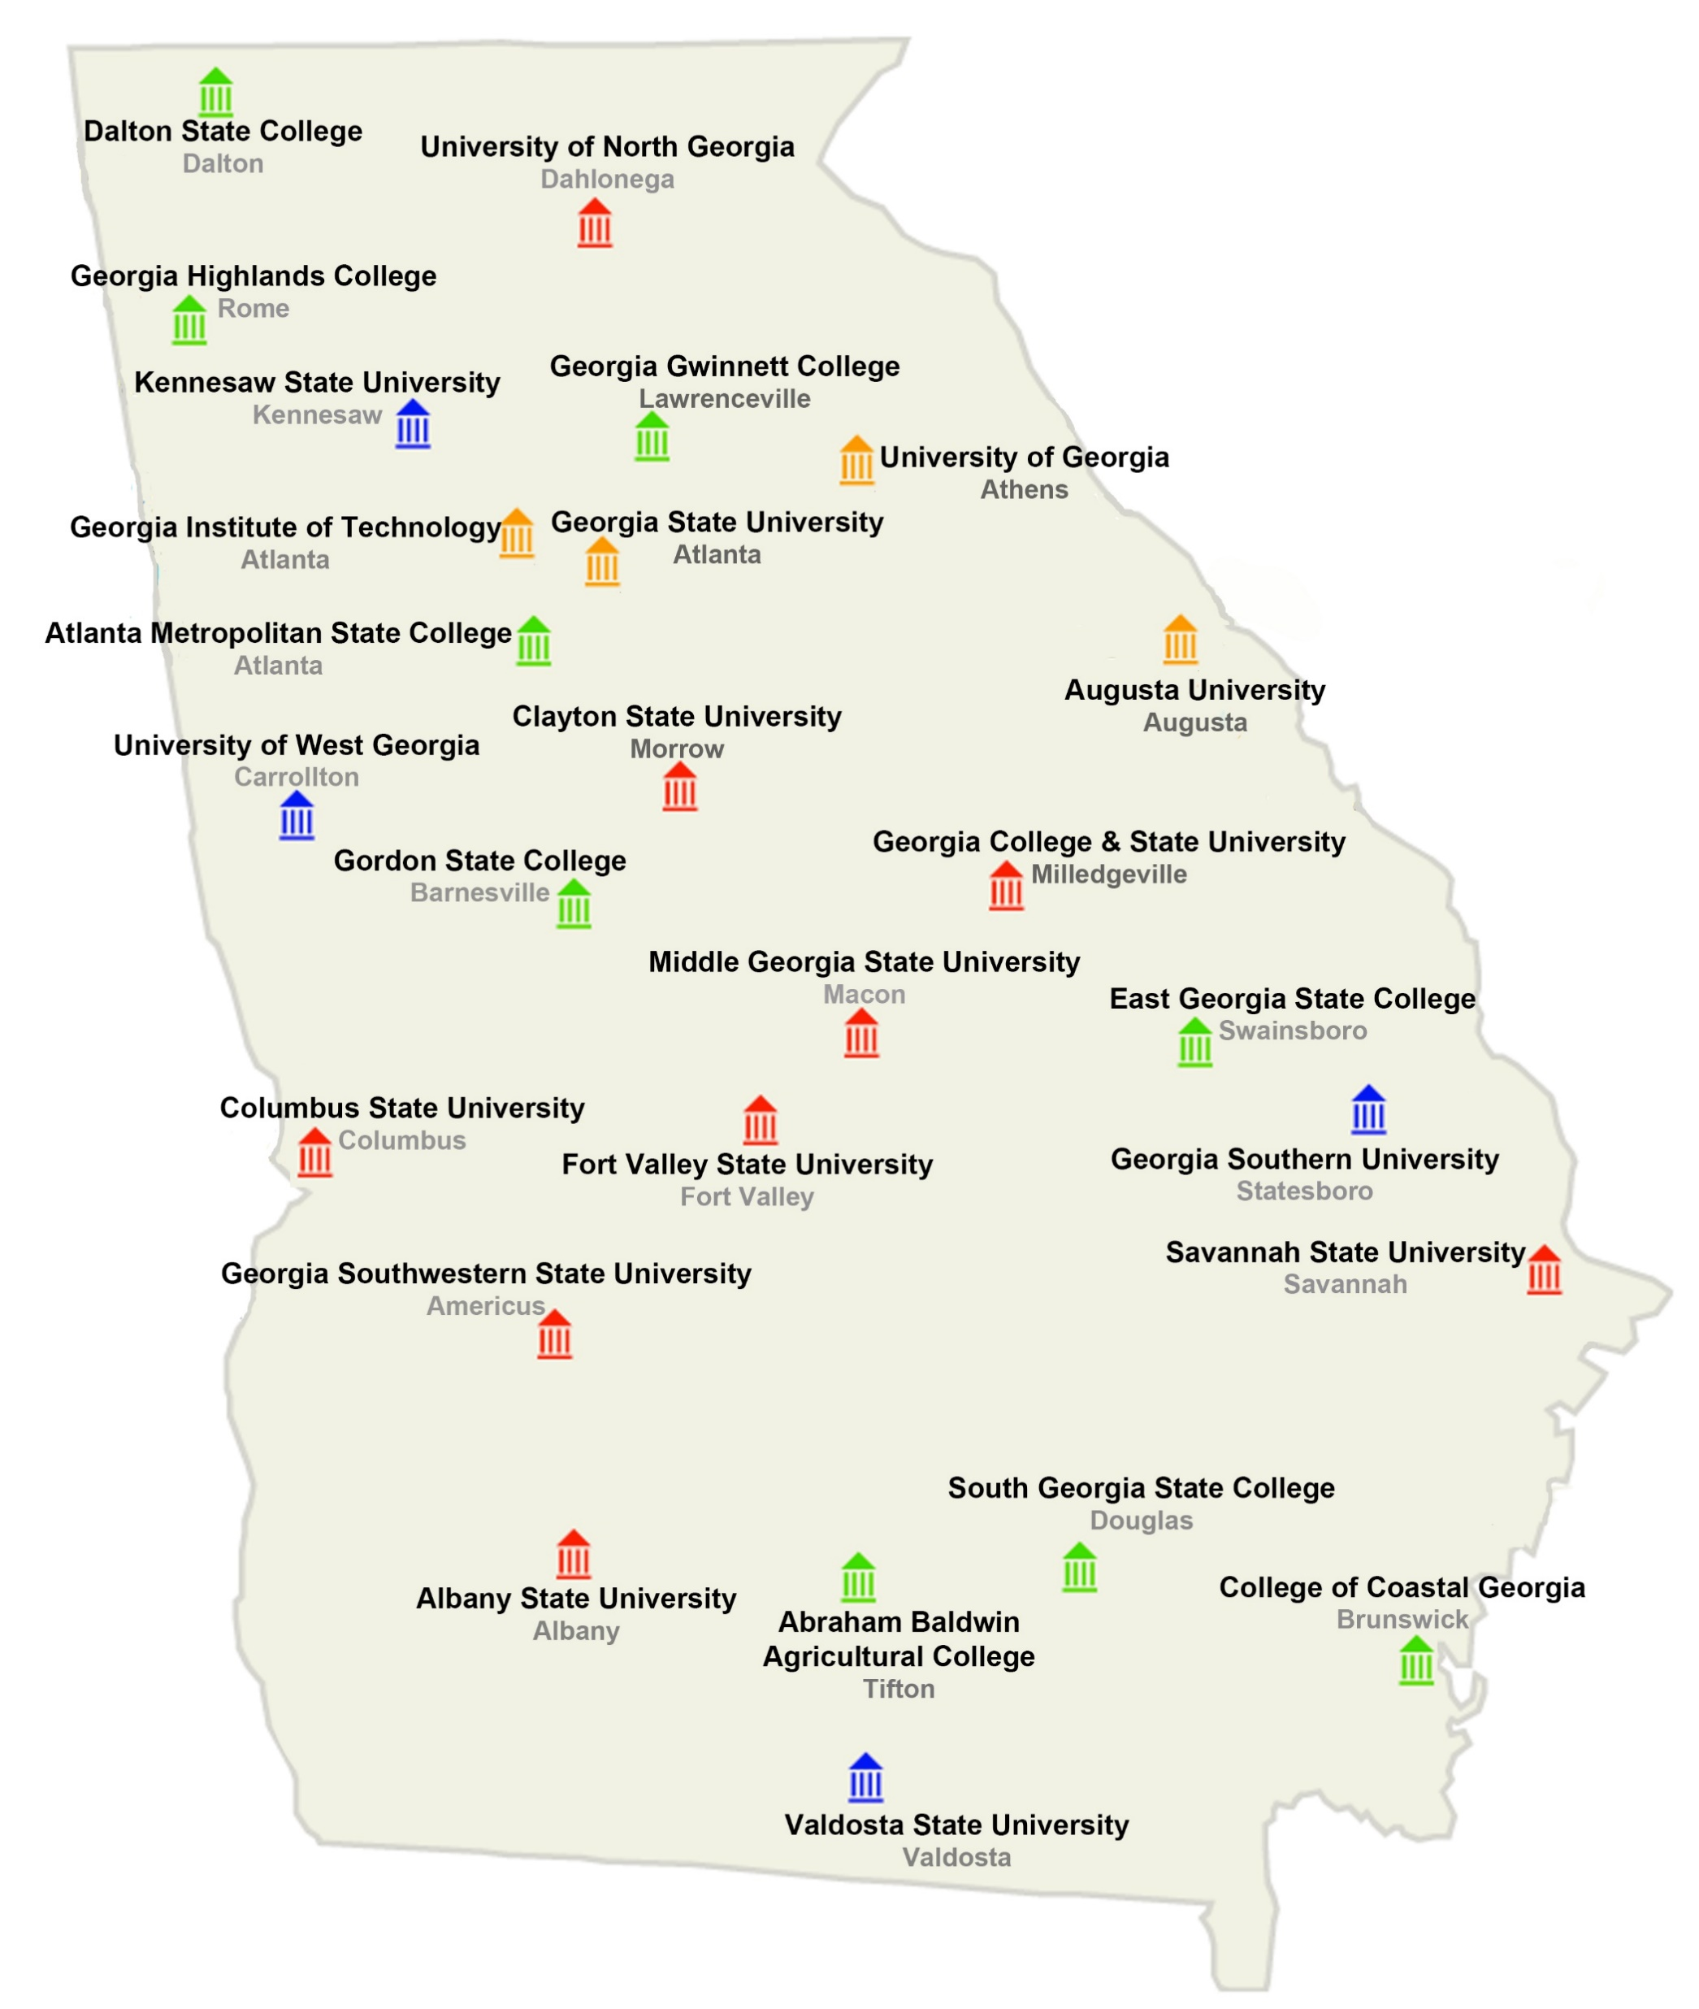
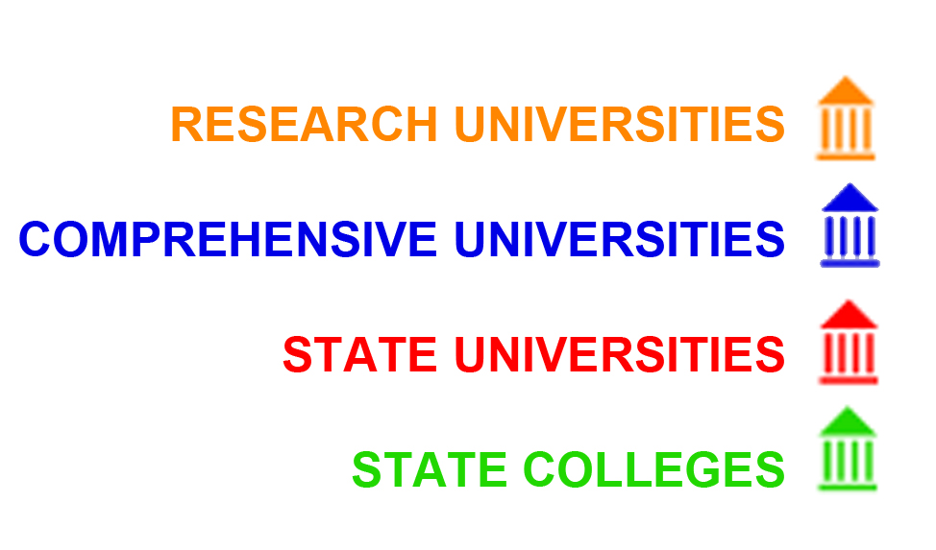
The University System of Georgia
www.usg.edu/institutions
Fall 2020
13,748 total Dual Enrollment students
9,278 new Dual Enrollment students

Slide 8
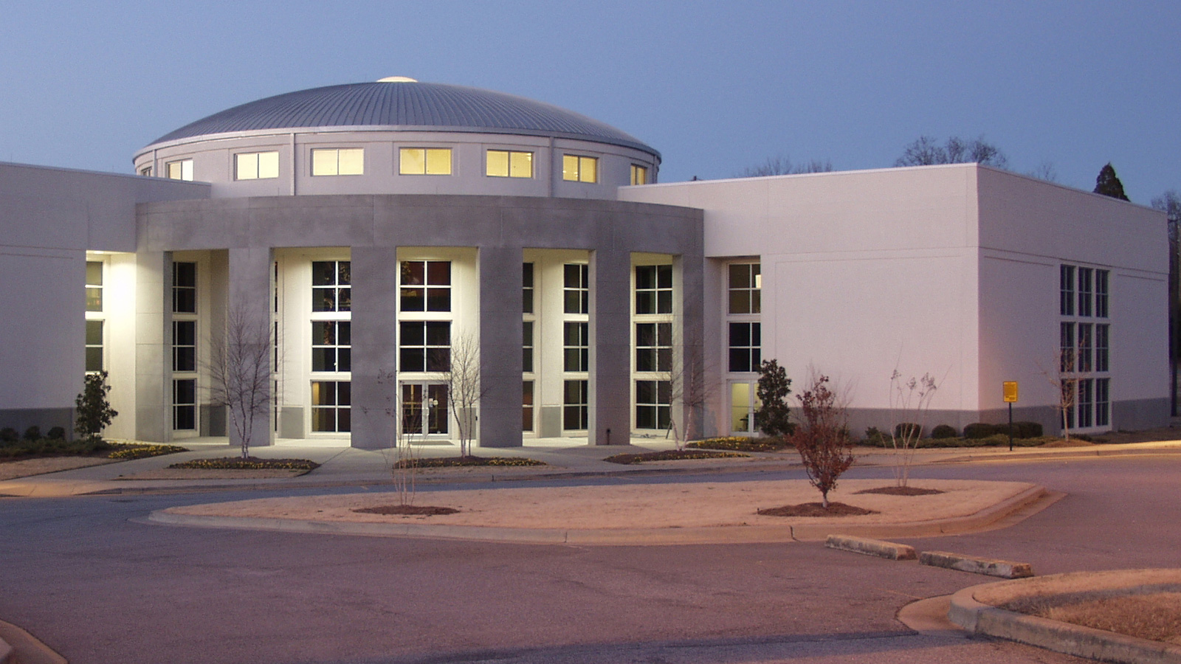
22 Technical Colleges
88 Campuses

Slide 9
Georgia’s 2 Dual Enrollment Options
Option A
Option B
More traditional dual enrollment option
Students can enroll part time or full time
Can participate at either a USG or TCSG institution
Subject to 30 hour funding cap
An alternate path to graduation
Students take fewer credits at their high school
Must complete an Associate’s Degree, Diploma Program, or two Technical Certificates to be eligible to graduate from high school
Must participate at a TCSG (or participating USG institution)
Subject to 30 hour funding cap

Slide 10
12/07/2020 Who is Eligible for Dual Enrollment?
Any student enrolled in a participating Georgia High School is eligible if:
10th graders may participate & take (will begin using their 30 hours of funding):
Any CTAE course or​
Any CORE course:​
If they have a 26 ACT or 1200 SAT score
11th and 12th graders are eligible to take any Core or CTAE course, if they qualify for Dual Enrollment, but are subject to the 30 hour funding cap.
9th graders are NOT eligible for Dual Enrollment using state funding.

Slide 11
Steps to participate in Dual Enrollment
1. Talk to your high school counselor/DE Coordinator
2. Apply to the college you are interested in attending as a Dual Enrollment Student
3. Complete a funding application at GaFutures.org (you may already have an account)
4. Once you have been accepted, work with your counselor and the college advisor assigned to you to create your schedule

Slide 12
For students with disabilities…
There is no longer a cohort deadline for Dual Enrollment. As long as a student is enrolled in a participating high school, he or she is eligible for DE funding.
Many colleges provide support for students with disabilities. Check with student support offices, advisors, learning centers, etc to find out what services are offered and what documentation is necessary to access them.

Slide 13
Resources
GSFC Regulations
https://gsfc.georgia.gov/regulations/regulations-2020-2021
ListServe
Join-Dual-Enrollment@list.doe.k12.ga.us
GaDOE Dual Enrollment webpage
https://www.gadoe.org/Curriculum-Instruction-and-Assessment/CTAE/Pages/Transition-Career-Partnerships.aspx
HB 444 Law
http://www.legis.ga.gov/Legislation/20192020/192065.pdf

Slide 14
Dual Enrollment Contacts
Georgia Department of Education
Jennifer Phinney Jennifer.Phinney@doe.k12.ga.us
Georgia Independent College Association
Jenna Colvin
jcolvin@georgiacolleges.org
Georgia Student Finance Commission
dualenrollment@gsfc.org
Technical College System of Georgia
Dianne Lassai Barker
dbarker@tcsg.edu
University System of Georgia
Sarah Wenham
sarah.wenham@usg.edu
Notes:
JP

