Slide 1
Supported decision-making: A path to Self-Determination
2022 Kickoff Conference
Dana lloyd
PROject COORDINATOR
Georgia Advocacy Office, Inc.
One West Court Square, Suite 625
Decatur, GA 30030
404-885-1234
Notes:
John is a member of our SDMAC, as well as a national SARTAC Fellow; his fellowship project is entitled It's My Life: Expanding Supported Decision Making. John uses a letterboard to communicate and is here with his communication partner Joan. John wrote his portion of the presentation which Joan will read and during the Q&A he will type responses using a wireless keyboard.

Slide 2
Who Is GAO
GAO is the Independent, Federally Mandated Protection and Advocacy Program for People with Disabilities in Georgia.
GAO envisions a Georgia where all people have value, visibility, and voice; where even the most difficult and long-lasting challenges are addressed by ordinary citizens acting voluntarily on behalf of each other; and where the perception of disability is replaced by the recognition of ability
Notes:
Devon

Slide 3
WHAT DOES GAO DO
Protection from Abuse and Neglect
Investigations
Nursing Facility Transition to the Community
Assistive Technology
Housing
Supporting Self-Advocacy
Voting
Employment
Information and Referral
Notes:
Devon

Slide 4
A new way of thinking
The real question is “what kind of support people with disabilities need in order to be involved in decision-making and promote their autonomy.”
(Pesiah et al, 2013)
Notes:
Capacity is fluid and can change over time and depending on the subject at hand. I believe that everyone can learn and grow. Capacity doesn’t stay the same, I’m not a very capable engineer but I’m better advocate now than when I started.

Slide 5
John’s Story
Notes:
https://www.selfadvocacyinfo.org/resource/supported-decision-making-and-guardianship-termination/

Slide 6
A balancing act
Capacity is Fluid
Support should be responsive
Support should be transparent
Support should be beneficial
Support should be efficient
Support
Capacity
Notes:
not based on a single factor like diagnosis can change over time and based on the category is often increased by the opportunity to practice and explore presume every student can make decisions with support
. Capacity is not “all or nothing” or Based solely on IQ or diagnosis. lack of opportunity can prevent or decrease
Try not to avoid learning opportunities because of failures in other areas or the difficulty of a task

Slide 7
Decision Making is a Skill
Taught
Over Time
Multiple modalities
Opportunities for practice
Mistakes enhance learning
Can seem invisible
Notes:
difference between choice and decision and problem solving
Managing money, eating healthy, addressing health care needs, when were you taught to make these decisions, when did you make your first decision.
First decision, first credit card, car you bought where you went to college spouse? Make better more informed choices now? How did that happen?

Slide 8
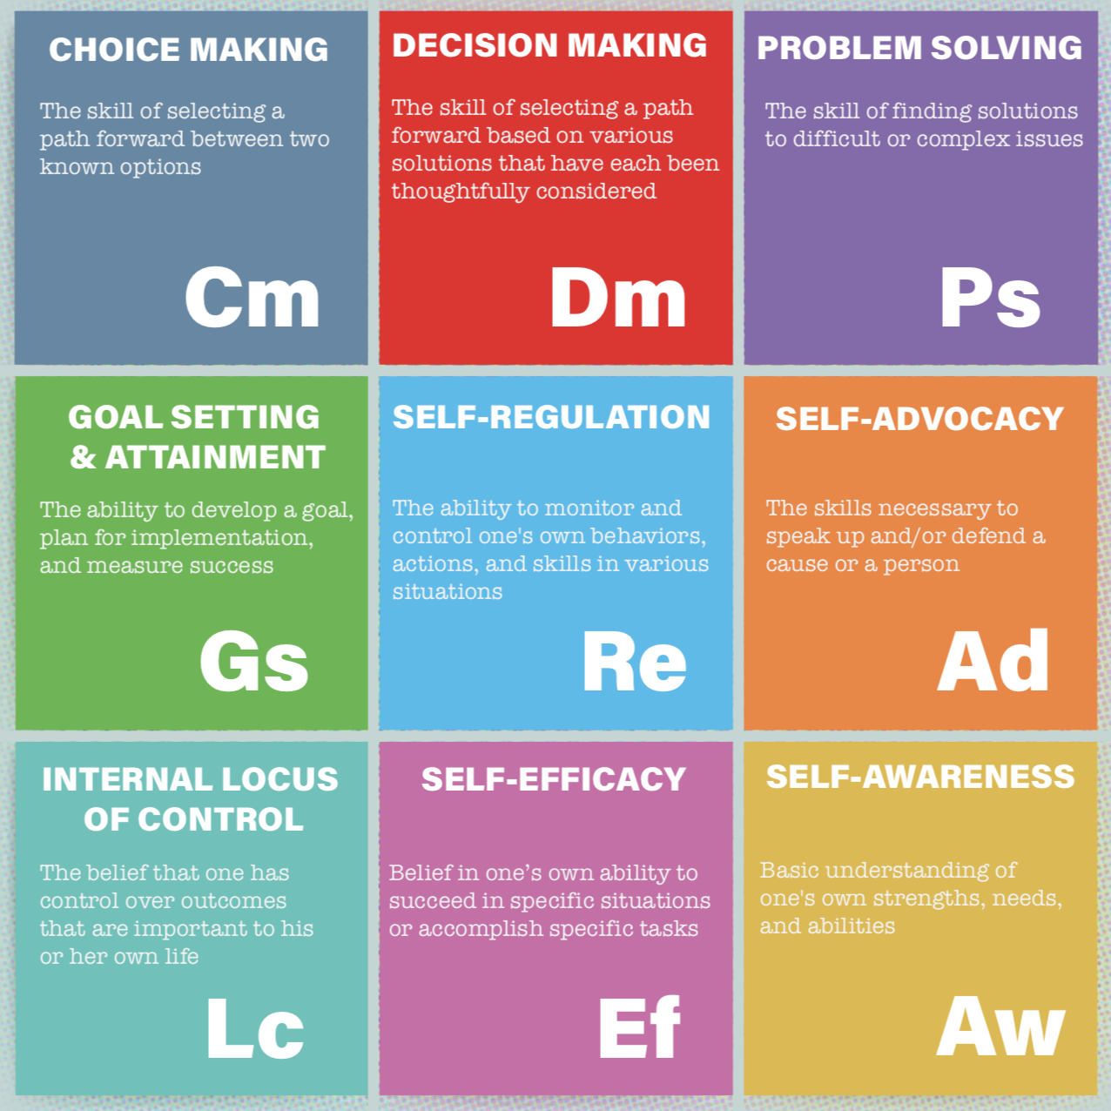
Elements of Self Determination
Notes:
VCU I’m Determined (Virginia uced)
Elements of self determination, this is the goal when working with youth especially those who are challenged by their circumstances or trauma or disability or legal status. We will talk about all these and their intersections and how to use the process of supported decision making to build not only the skill of decision making but these other areas as well. (Summarize each briefly)How many of you are standing beside kids who could grow in these areas?
When thinking about teaching decisions making skills think about which element to strengthen.

Slide 9
Decision-making options
Supported Decision Making
Changeable, Person Directs, Limited
Permanent & Total
Notes:
Supported decision making enables the person to make his or her own decisions with assistance from a network of supporters. This is in contrast to a guardianship where substituted decision making is used to make decisions on behalf of the person. The goal is supported decision-making not just less restrictive alternatives, power of attorney STABLE Accounts and trust still remove decisions making rights power or authority if a family chooses this encourage them to work to increase decision making skills/autonomy in another area.

Slide 10
Medical proxy
Georgia Consent Law
A. Any person authorized to give consent for the adult under an Advanced Directive or Power of Attorney.
B. A Spouse
C. An Adult Child or a Majority
D. A Parent
E. An Adult Sibling
F. Grandparent for Grandchild
G. Adult Grandchild for Grandparent
H. Adult niece, nephew, aunt, uncle (first degree)
I. Adult Friend
Notes:
Devon
Highlight where the audience would fall on the list; parents or adult children/spouse are all pretty high and most people would have someone in one of these roles in their life
For people with disabilities if the person that would decide for you is not who you would choose who do you want to replace them with and include in your supported decision-making plan

Slide 11
GUARDIANSHIP AS A LAST RESORT
O.C.G.A. 29-4-1(4)(f): All guardianships ordered pursuant to this chapter shall be designed to encourage the development of maximum self-reliance and independence in the adult and shall be ordered only to the extent necessitated by the adult's actual and adaptive limitations after a determination that less restrictive alternatives to the guardianship are not available or appropriate.
Notes:
This doesn’t happen, 5 mins you can help ensure that the law is followed and supports people the way it is intended to, study after study has shown the vast majority are plenary and courts prefer it even when alternatives exist (ease convenience)
How can you interrupt and show skills

Slide 12
Rights Lost and Impact of Guardianship
Presumed incapable
Denied the “dignity of reasonable risk” – opportunity to try new things, to test limits, to discover capabilities that they never knew they had.
More isolated and their lives often become smaller as a result.
It is difficult to restore rights once a Guardianship Order is issued.
Right to contract
Marriage & reproductive rights
Place of residence & travel
Association
Healthcare decisions
Financial decisions
Notes:
Devon

Slide 13
Supported Decision Making
Ensures the person with a disability makes their own decision.
Is a combination of relationships, practices, arrangements and agreements designed to assist an individual with a disability to make and communicate to others decisions about their life
Supported decision making agreements can be provided to a court that is considering guardianship as evidence that the person already has the support they need.
Notes:
We all do this, helps to have a plan so everyone knows and understands if people don’t listen or you need to be protected from guardianship make a legal document

Slide 14
SUPPORTED DECISION-MAKING CAN HELP Determine when & How
Strategies for Support
Understand information
Focus attention in decision-making;
Identify options and choices
Ensure that decisions are based on the person’s own preferences;
Interpret and/or communicate decisions to other parties.
(Salzman, 2011)
When do I need Support?
Budgeting
Health care
Living Arrangements
Choosing Supporters
Notes:
Dana
People with disabilities may need assistance making decisions but they do not necessarily need someone else to make those decisions for them. A trusted network of supporters can field questions and review options to help the person with the disability make their own decisions.
Extra time technology (AAC), note taking

Slide 15
Impact of Supported Decision making
Increases Self-Determination
Life control — People’s ability and opportunity to be “causal agents . . . Actors in their lives instead of being acted upon”
(Wehmeyer, Palmer, Agran, Mithaug, & Martin, 2000, p. 440)
People with greater self-determination are:
More independent
More integrated into their communities
Healthier
Better able to recognize and resist abuse
(Powers et al., 2012; Shogren, Wehmeyer, Palmer, Rifenbark, & Little 2014; Wehmeyer & Shwartz, 1997 & 1998; Wehmeyer & Palmer, 2003; Khemka, Hickson & Reynolds 2005; Wehmeyer, Kelchner, & Reynolds 1996)
Notes:
John’s going to tell us more about what he’s been working on and how you can start thinking about your own supported decision making plan.

Slide 16
Supporters
Those who believe in the person
Those who presume the person is capable
Family
Co-Workers
Neighbors
Teachers/Coaches
Faith Community members

Slide 17
Thinking about supporters
Supporters should:
Be chosen by the person
Know the person well
Know how they learn and what they may need to help process new information
Ensure that they are making an informed choice
Know where to find information and other support
Who is supporting matters!

Slide 18
John’s supported decision-making Strategies
Notes:
https://www.selfadvocacyinfo.org/resource/supported-decision-making-and-guardianship-termination/

Slide 19
South Carolina Stoplight tool
Notes:
Part 1 input from an individual decision maker and at least one adult supporter
Part 2 Guidance for implementation, how to increase opportunities to learn and practice critical, adult skills that promote independence.
Part 3 Additional Guide for IEP or support teams to plan for the age of majority
Appendix x list of suggestions, role plays apps exercises trails visits and experiences

Slide 20
School Based Opportunities
IEP Meetings
Choosing Classroom Accommodations
Extracurricular Activities/Time Management
Transition Planning: High School and Post High School
Buying Lunch or Spirit Gear
Notes:
Put your ideas in the chat

Slide 21
Accommodations: Be creative!
Help in knowing what choices are available
Plain language
Materials or information in an audio or visual format
Visits and trials
Reminders about important dates and times
Talking to experts who know a lot about the choice
Role-playing activities to help understand choices
Taking a supporter into important appointments to take notes and help remember options
Notes:
Slide 22
Supporters need to be creative! Everyone needs something different The tools supporters might use to help you could include
Help in knowing what choices are available
Plain language
Materials or information visual format
Materials or information in an audio format
Research to learn more about choices
Visits and trials
Reminders about important dates and times
Talking to experts who know a lot about my choice.

Slide 22
Questions?
Notes:
It seems like supported decision-making wouldn’t protect against abuse/exploitation?
Exists in every arrangement supported decision-making lends it self to having more people involved which provide checks and balances
What about older people who may not have anyone to support them?
Someone is asking use the principles if there’s no one for SDM who will be the g’dian if state then what service options
Who could be supporters, is it ok for case managers or other paid staff to take that on?
Chosen, know the person well and most importantly understand their role is to effectuate the person to make their own decisions not to make or judge the decisions. It would be important to consider any conflict of interest but no one is truly conflict free so proceed with caution.
Sheila case highlights SDM to terminate guardianship
Some cognitive impairments due to TBI, some psychosocial issues.
pending eviction, consented to g'ship to save her apartment or provide help to relocate
Found services outside of guardianship able to transition to new housing
successfully terminated guardianship

Slide 23
Resources
National Resource Center on Supported Decision-Making
www.supporteddecisionmaking.org
National Guardianship Association Position Statements:
https://www.guardianship.org/advocacy/position-statements/
PRACTICAL Tool for Lawyers
https://www.americanbar.org/content/dam/aba/administrative/law_aging/PRACTICALGuide.pdf
SC Supported Decision-Making Project:
https://scsupporteddecisionmaking.org/resources/
Debunking the Myths of Supported Decision-Making and Guardianship, Q&A:
https://tinyurl.com/585z3j4
SARTAC Guardianship Resource Page:
https://www.selfadvocacyinfo.org/resource/supported-decision-making-and-guardianship-termination/

Slide 24
Contact Info
dlloyd@thegao.org
404-885-1234
Voice/TDD: 800-537-2329
www.thegao.org
Notes:
Dana

