Slide 1
Confidentiality
In Special education

Slide 2
Confidentiality
• I can identify the basic rules of confidentiality in special education.
• I can identify ways to avoid sharing confidential information unintentionally.
• I can name strategies for practicing and maintaining student confidentiality.

Slide 3
What is Confidentiality?
Confidentiality is the act of protecting all personally identifiable data, information, and records collected, used, or kept by the school district about a student.
Confidentiality requirements also apply to discussions (verbal or written) about a student and the student’s record.

Slide 4
Confidentiality Laws
FERPA-Family Education Rights and Privacy Act related to education records.
IDEA-Individuals With Disabilities Education Act protects the privacy of students who are receiving special education services.
HIPAA - Health Insurance Portability & Accountability Act is the privacy and security protection of health information.

Slide 5
Confidentiality
Personally Identifiable Information
The name of the student, the student's parent, or other family member;
The student’s address;
Any personal identifier such as the student's social security number or student number;
Any personal characteristics or other information that would make it possible to identify the student.

Slide 6
Confidentiality
Definition of
Records, files, documents and other materials which contain information directly related to a student and are maintained by an educational agency or institution, or by a person acting for such agency or institution.

Slide 7
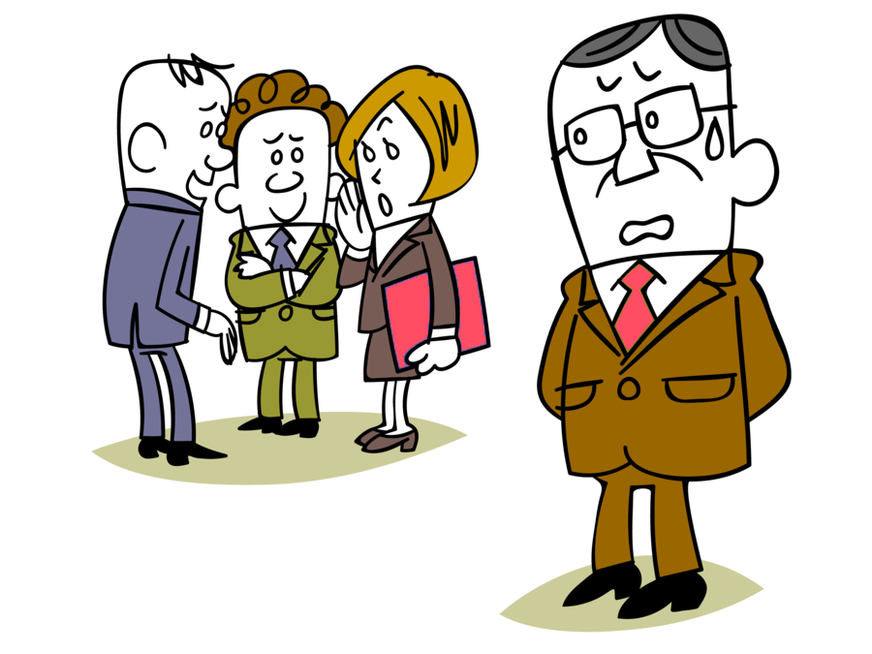
Gossip vs…Professional Sharing of Information When talking/writing to a colleague about a student or his family, apply these four tests to see if the discussion may be violating the student’s confidentiality rights:

Slide 8
TEST TIME Ask these questions to protect yourself:
Who is listening or could be?
Where is the discussion taking place?
1
3
Who/What is being discussed?
Why is the discussion taking place?
2
4

Slide 9
Who is listening?
If the parties to the discussion are school officials with legitimate educational interest there is no problem with confidentiality
If others are listening who have no legitimate educational interest such as a teacher or paraprofessional who does not work with the child, another child, students in the hall, parents, people in a store, then confidentiality may be violated.

Slide 10
What is Discussed?
If the discussion involves directory information there is no problem unless the parent has refused to have this information released
If the discussion involves other personally identifiable information that is confidential, the parties should be sure that legitimate educational interest/need is involved
If the discussion involves information that is rumor, opinion, or hearsay, chances are that confidentiality will be in question, and the parties have moved from professionalism to gossip

Slide 11
Where the Discussion Takes Place?
If the discussion occurs in a private place such as a teacher’s empty room, empty teacher’s lounge there is no problem with confidentiality.
If the discussion occurs in a public place such as the playground, halls, a busy teacher’s work area, a store, at church, there is a good chance that confidentiality could be violated.

Slide 12
Why the Discussion Took Place?
If the parties have legitimate educational interest in a student and are sharing information that will help them work with the child, then there is no problem with confidentiality
If the parties are gossiping to pass time, comparing students, sharing worst case stories, carrying tales about a student or his family, or for other non-educational reasons, there is probably a problem with confidentiality.

Slide 13
Confidentiality
DON’T
Display sensitive student or class information on walls, whiteboards, etc.
Share students’ faces or names without explicit parental consent.
Use students’ FULL names when naming files, sending emails, or setting up calendar meetings.
Publicly share grades, assessments, or any part of a student’s educational record.
Forget that handwriting is personally identifiable information.

Slide 14
Confidentiality
REMINDERS
Be mindful of social posts that feature or promote an educational product.
Closely review any picture you share before posting.
Look out for name tags and jerseys.
Turn off location services for your phone when taking pictures.
If you have any doubt if you are about to breach confidentiality, DON’T do it without discussing it with your supervisor.

Slide 15
Confidentiality
Scenario A
When asked if his confidential files were secured, the teacher replied, “Yes. I keep them in my desk drawer, and when I leave the room, I lock the door to my room.”
Scenario B
A general ed and a special ed teacher were sitting in the teachers’ lounge discussing a child they taught in their co- teaching class. They called the child by name and talked about his behavior problems, and his disability.

Slide 16
Confidentiality
Scenario A
Was he correct?
No. His files are not secure because anyone with a door key has access. It is better to have a file cabinet, cabinet or desk with a lock.
Scenario B
Were the teachers violating confidentiality?
If the discussion was in private – no others around, and they both had a legitimate educational interest in the child, they were probably not violating the child’s confidentiality. But, if anyone not having a direct educational interest in the student were to walk in and hear any of the conversation they would be in violation of the child’s confidentiality.

Slide 17
Quiz Yourself
Identify the basic rules of confidentiality in special education.
Identify ways to avoid sharing confidential information unintentionally.
Name strategies for practicing and maintaining student confidentiality.
CAN YOU

Slide 18
Building Positive Relationships
Parent Mentors
It is important to not only build a positive relationship with the parents, but also with their supervisor(s) and other school personnel.
Understand you are an employee of the school system and should work with your school district to provide information to their parents and students.
Be sure not to talk negatively about your school district to parents, other school personnel, or in the community. This will only promote negativity.
If you have concerns discuss them with your supervisor(s) for clarification and/or to reach a resolution.
If you witness a breach in confidentiality be sure to report it immediately to your supervisor(s).
If you unintentionally breach confidentiality report it immediately to your supervisor(s).

Slide 19
Leadership Chair Karen Tharpe – Parent Mentor
APPLING COUNTY SCHOOL SYSTEM
Office: (912)367-8600 ext. 166
Email: Karen.Tharpe@appling.k12.ga.us

