Slide 1


Translating terms into action steps
Parent Mentor Speak
Locating the tools so you can do your best work

Slide 2
GaPMP
The Georgia Parent Mentor Partnership
The GaPMP is supported by the Division for Special Education Services and Supports (DSESS). The parent leaders, moms and dads of children with disabilities, are hired by local school districts, state schools and the Department of Juvenile Justice to work with families, school teams, teachers, and the community.
The goal is to build a bridge of communication between home and school

Slide 3


The website & The Learning Curve
www.parentmentors.org
The Learning Curve is where you will find
Documents
Reports
Webinars
Parent Mentor shared materials

Slide 4
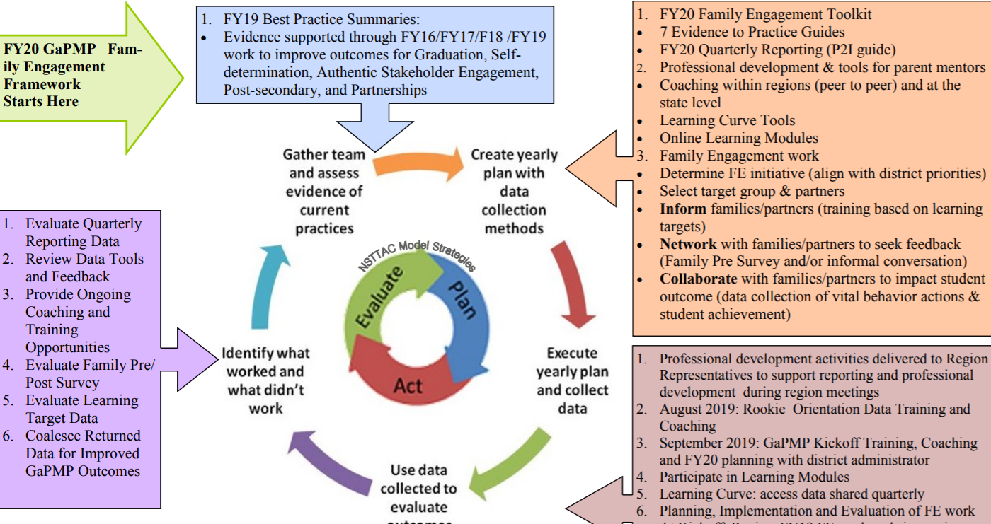


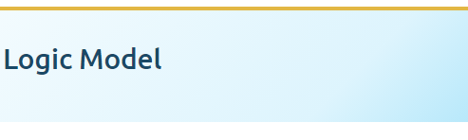
Logic Model
How do I know what to do?
Logic Model – Visual tool for planning, implementation, and evaluating the ongoing process of family engagement and reporting expectations.
1.Go to the
2.Choose

Slide 5
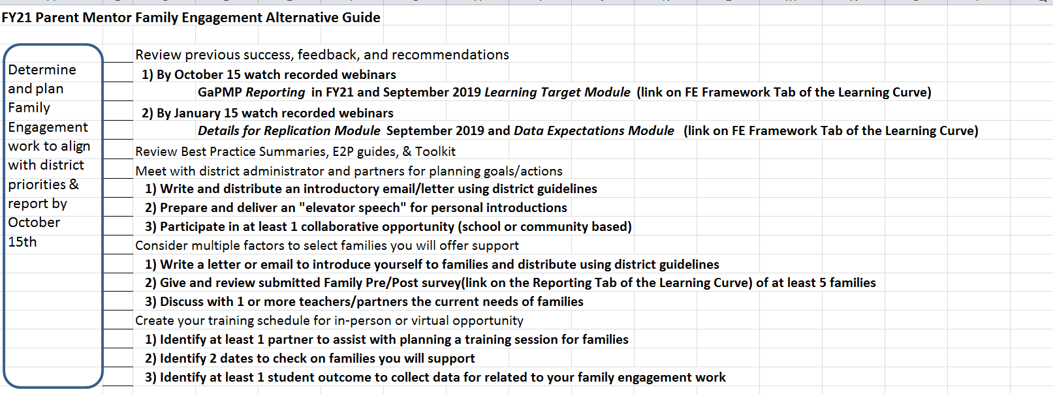
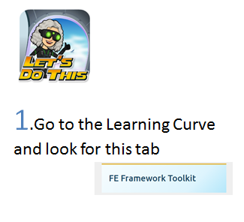

Checklist
How do I know what to do?
2.Choose

Slide 6

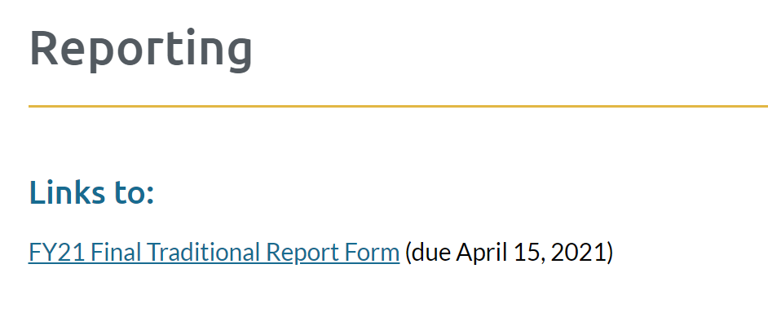
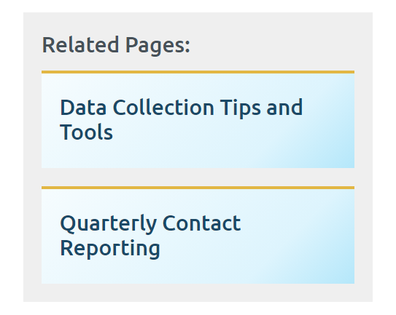
Reports
1.Go to the
Alternate Report
Traditional
Pre and Post Survey
Quarterly Contacts
2.Choose
What Else is there?
Need help figuring out data collection or how to count contacts?

Slide 7
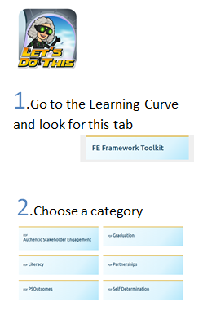
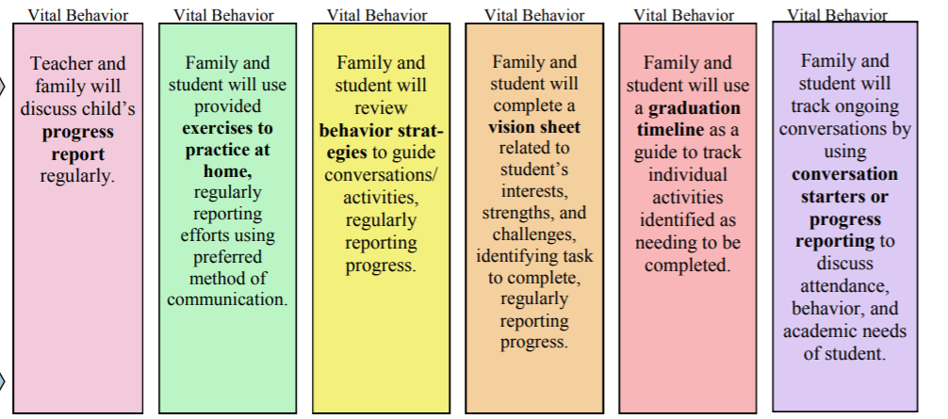
VB Vital Behaviors
Help you ensure families are actively practicing the things you are teaching
Vital Behaviors – Actions that are ongoing and promote the success of families and students when put into practice. Parent Mentors promote and support these actions during trainings and while giving support to families.

Slide 8
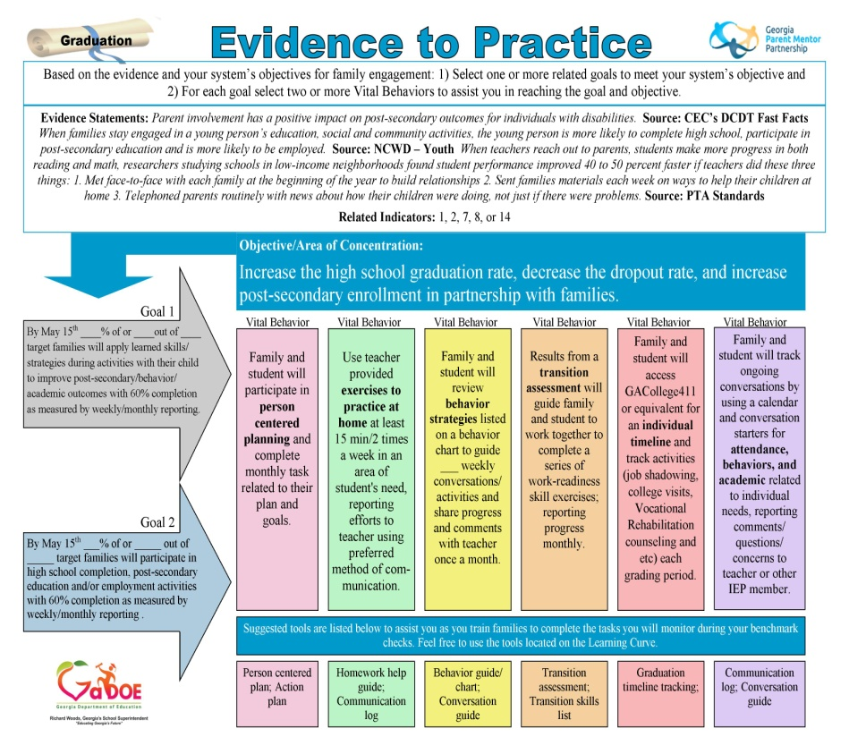
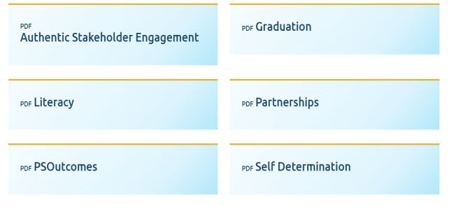
E2P Evidence to Practice
Category name
1.Go to the Learning Curve and look for this tab
2.Choose a category
Evidence to Practice (E2P) – Research based guides to assist Parent Mentors select target goal, vital behaviors, and tools for target work with families. Best utilized as a planning tool with district administrator and partners in target work.

Slide 9

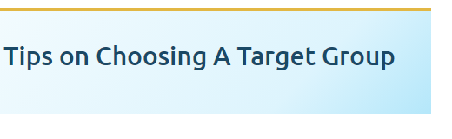
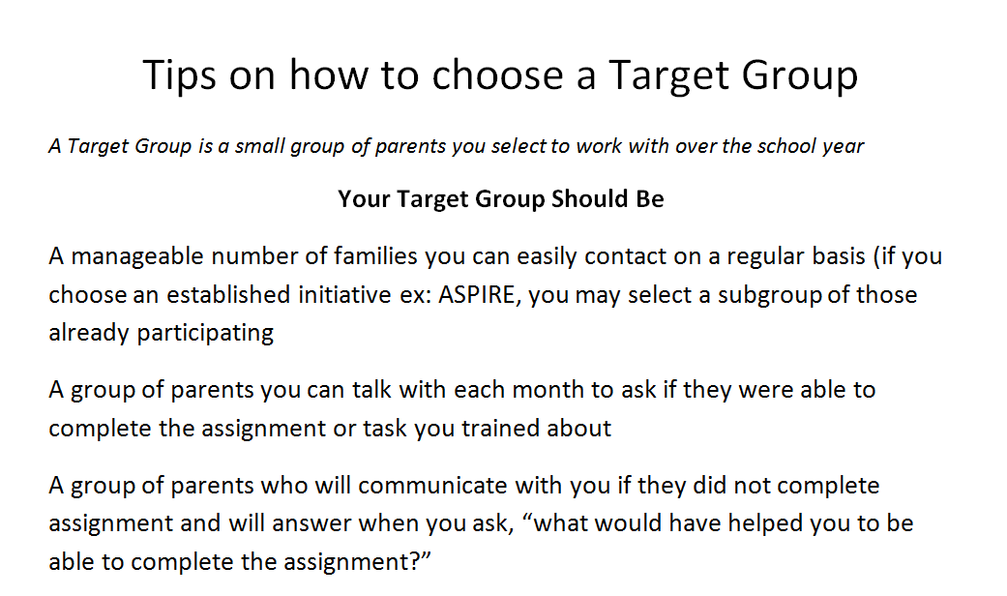
Target Groups
These are the families you have chosen to collect data on:
You will need:
  Pre Surveys
  Choose big topic
  Select VBs
  Plan Trainings
  Collect data
  Post Survey
1.Go to the
2.Choose

Slide 10
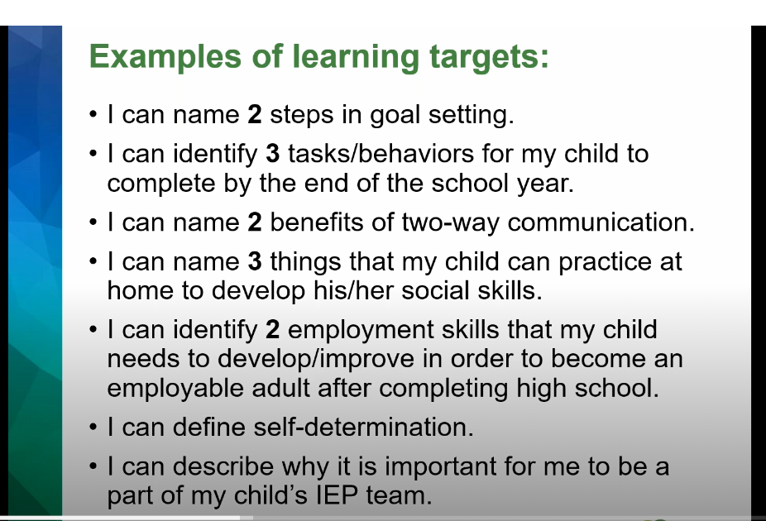


Learning Targets
“I Can” statement for what the family can expect to learn during a learning session tied to the target work and vital behaviors they will be asked to complete. Measured at time of initial training, before family members are asked to do the vital behaviors.
Ask another parent mentor if you get stuck
1.Go to the
2.Choose

Slide 11
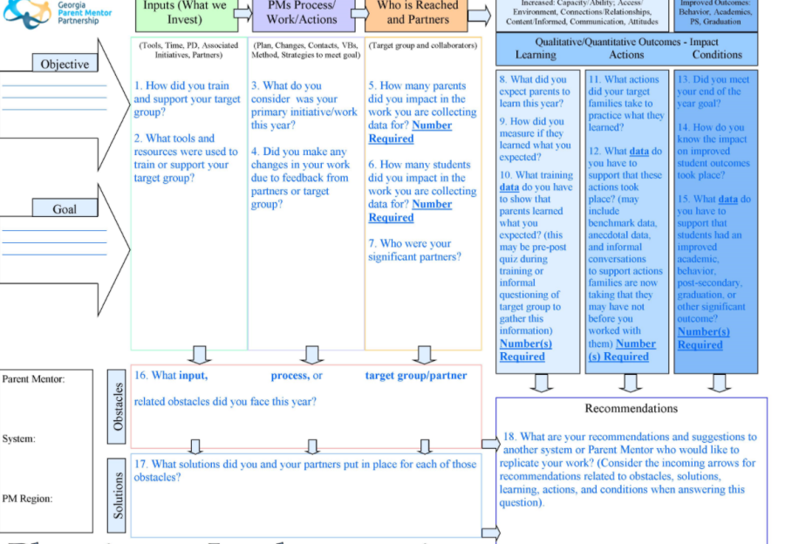
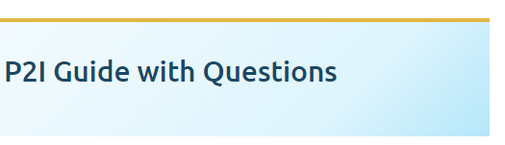
PTI Planning to Implementation Guide
1.Go to the
2.Choose
3.Choose
Planning to Implementation (P2I) – Visual tool to look ahead while planning, reviewing the guiding questions
Use this during the year to keep you on track

Slide 12

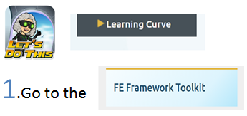
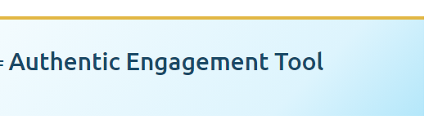
Authentic Stakeholder Engagement Tool
We use research-based strategies for family engagement
A step by step action with guiding questions
Questions related to informing, networking, collaboration, and transforming levels of engagement as part of our use of Leading by Convening Framework for authentic stakeholder engagement practices. Use this for peer and personal review of target work.
Leading by Convening is one of the tools we use
2.Choose

Slide 13

The Standards
We use research-based strategies for family engagement
The PTA developed national standards for successful family school partnerships
Measure your family engagement work by asking yourself how your trainings are:
Welcoming families to partner with schools
Promoting and insuring effective Communication
Supporting student success
Are the activities Speaking Up for every child
Are you training families so they can become advocates to Share Power
Are you Collaborating with the community and agency partners

Slide 14
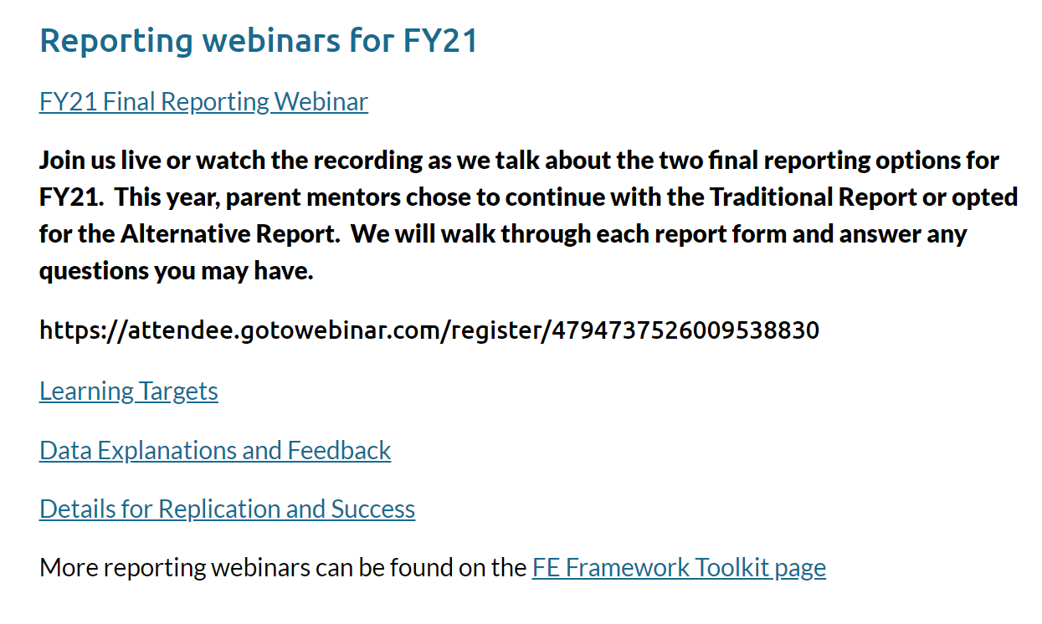
Other stuff
Updates and trainings are added all the time to help support you in your ongoing work and get you ready for reporting deadlines
Get stuck?
info@parentmentors.org

