Slide 1
The Georgia Parent Mentor Partnership (GPMP)
New Mentor
Training
A Training Tool for New Parent Mentors & Administrators

Slide 2
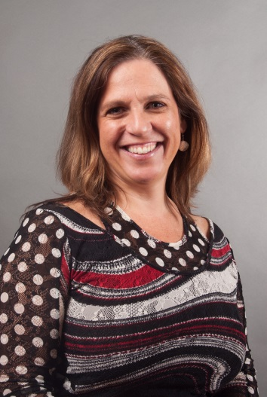
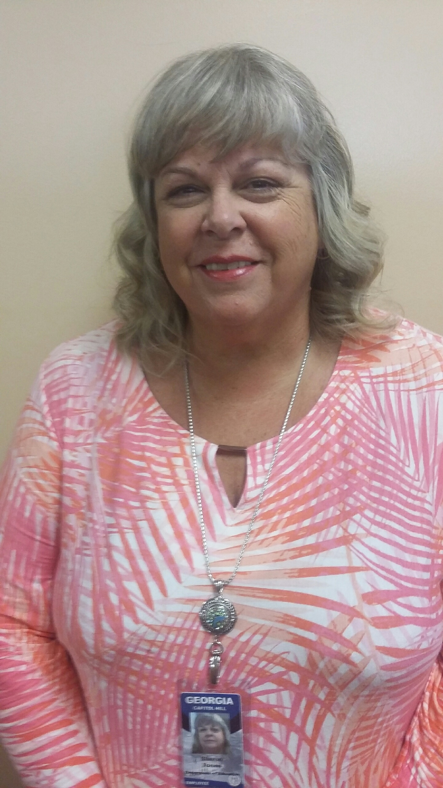
Getting Started
Anne Ladd, Family Engagement Specialist
404-657-7328
aladd@doe.k12.ga.us
Sharon Jones, Family Engagement
Specialist
404-844-8741
sjones@doe.k12.ga.us

Slide 3
GPMP Led by the Georgia Department of Education, (GaDOE) Division for Special Education Services and Supports
Mission: To Build Effective Family, School and Community Partnerships that Lead to Greater Achievement for All Students, Especially those with Disabilities.
Objective: To Impact Student Achievement through Family Engagement Strategies
Vision: Parent Mentors and special education administrators will lead the way in Georgia to bridge the gap between home, school and community partnerships.

Slide 4
Learning Targets
I can identify 2 people who can help me with questions about my work.
I can identify 2 departments within my school district to partner with for family engagement.
I can identify 2 outside agencies that I should partner with for collaboration.

Slide 5
Our Story
The GaPMP is supported by the Division for Special Education Services and Supports (DSESS). The parent leaders, moms and dads of children with disabilities, are hired by local school districts, state schools and the Department of Juvenile Justice to work with families, school teams, teachers, and the community.
The goal is to build a bridge of communication between home and school that leads to more successful outcomes for students. Parent Mentors partner with families to increase their engagement in education and address individual concerns.
Although the Partnership is under the leadership of the DSESS, the Parent Mentor agenda is locally driven.

Slide 6
What do we do?
Mentors do many things such as:
Build connections for families in the community
Concentrate on transition needs for students with disabilities
Head tasks involving special education issues
Provide training sessions for parents and educators
Serve on community boards and stakeholder’s groups
Create family engagement activities in schools
Collaborate with district personnel such as educators and Title I facilitators
Listen to the concerns of families of students with disabilities
Provide resources to help families navigate supports for their children

Slide 7
Other Names to Know:
Richard Woods
State Superintendent of Schools
Zelphine Smith-Dixon
Director, Division for Special Education Services and Supports
Jamila Pollard
Program Manager Senior
Scott Smith
Program Manager

Slide 8
Next Steps
Send all your contact information (name, title, email address, mailing address, office phone number) to jgrillo343@yahoo.com . That is the first step to getting Mentor access to the password protected section of the www.parentmentors.org website called the Learning Curve (Resource for Parent Mentor with tools and ideas for your new role).
If you sent in your contact information, you will have received a link to create your password. Your username will always be your name. IE: Jane Grillo .
You will also be asked to provide us with your office phone number, email address and a photo for the “Find A Mentor” page. That photo will also be included in your region’s Yearbook page.

Slide 9
Next Steps
Locate office space, set up the office, telephone, computer, email etc.
It is generally expected that there will be office space in the district for the Parent Mentor; it is helpful if it is near other staff who may be working with families. It is best if parents can call a private voicemail message box so parents may call you directly.
FY21 and COVID-19
Work with your Special Education Director/Supervisor for expectations and protocols during COVID-19.

Slide 10
Next Steps
Discuss professional protocols with your Special Education Director.
How are media contacts to be managed.
Who needs to approve letters, brochures, or other materials before they are distributed.
Who approves travel requests, how is time documented, the dress code, managing schedule changes, reporting deadlines, travel and expense reports, call-in procedures etc.

Slide 11
Mandatory Trainings
Orientation
Annual GaPMP Kick-Off Conference (Virtual for FY 21.) September 16 – 17, 2020.
Four Regional Meetings: scheduled throughout the school year-Your Region Rep will inform you about when and where
Parent Mentor Online Training and Webinars
Administrators have an open invitation to attend all Mentor trainings and meetings. Directors are strongly encouraged to attend Annual GaPMP Kick-Off Conference which will be virtual for FY21.

Slide 12
Introducing Yourself
Send in your completed Rookie Contact Form so you can be part of: Jane will discuss
GaPMP listserve If you are having difficulties, contact sjones@doe.k12.ga.us and ask that you be added to our listserve, parentmentors_georgia@yahoogroups.com.
The listserve is a professional communication tool. Parent to Parent of Georgia (GaP2P) leadership are also on our listserve to share information. We collaborate with GaP2P,our State’s Parent Information Training Center (PTI)

Slide 13
Introducing Yourself
Link www.parentmentors.org, the official web site, to your school district’s special education page.
Does the District have a Facebook Page and what are the protocols for friending parents and staff?
How has COVID-19 changed the way your District communicates with families?
Work with the district to promote the Parent Mentor on the district’s special education page, along with contact information and office hours.

Slide 14
Being a Professional
ALWAYS re-read texts, Facebook posts, emails and other correspondence. Make sure you spell check and read for continuity and clarity. It’s hard to take it back once it goes out there. Don’t share confidential information!!!
Parent Mentors are trained professionals working with families in their District. Confidentiality and trust are key.
You will also need to earn the trust of staff.

Slide 15
Where We Live and Work
The GaPMP consists of six regions served by a regional representative who will help Mentors with mandatory accountability reporting and quarterly contacts.
The Region Reps Are:
Northeast: Bonnie Morrison, Walton County
Northwest: Michal Jones, Walker County
Tracy Reynolds, Polk County
Metro: Antoinette Nichols, Cobb County
Middle: Jennifer Minter, State Schools
Yolanda Leduc, Henry County
Southeast: Amanda Locke, Evans County
Southwest: Rebecca Best, Grady County
The Region Reps Are:

Slide 16
Helpful Hints
Find your own “mentor” within your department, someone who can introduce you to key people in the district.
Focus on building the important relationships and partnerships, beginning with everyone in your department and moving out into the schools, the district, and the community.
Confidentiality safeguards are important to remember.
Boundary setting is critical. As a professional and a school district employee, you must also stay within the boundaries of your job. You can give advice and suggestions as a parent to other parents, but you are not a counselor, teacher, lawyer, or psychologist.

Slide 17
Helpful Hints
Respect co-workers by ensuring that you:
Are prepared for meetings with talking points and questions
Arrive on time for meetings and be sure your meetings begin and end on time
Wear district name tag
Dress appropriately
Communicate in an open and responsive manner
Respect different perspectives and learn from them
Honor each other’s expertise and experience
Maintain accountability at the local and state level
Reporting possible or suspected child abuse: Find out what your school district’s procedures are for reporting suspected child abuse. By state law you are a mandated reporter: http://oca.georgia.gov/mandated-reporter

Slide 18
Taking On Your New Role
Special Education Family Handbook/Manual
Your District may offer a special education manual to families. It explains how the Individuals with Disabilities Education Act (IDEA) and the State Board of Education Rules for special education are followed in your District. As a Rookie Parent Mentor, you should be very familiar with everything in this handbook/manual.
GaDOE Website
If your district does not have a handbook, then you may want to go to the GaDOE website to obtain generic information. Go to www.gadoe.org
Hint: The GaPMP website offers access to information about your region on the Learning Curve.

Slide 19
Taking On Your New Role
The Implementation Manual explains the State special education rules in parent friendly terms and also provides Districts guidance on how to implement them. It can be found on the GaDOE Website.
The GaDOE website (www.gadoe.k12.ga.us) also includes a wealth of information about education in general and about special education, including eligibility, services, IEPs, assessment, Parents’ Rights, discipline, rules, resources, training etc.
Consolidated Application/ Local Improvement Plan (CLIP): Your school district also has an annual plan called the Consolidated Application that includes a special education plan for meeting statewide Performance Goals and Indicators. A key part of the role of the Parent Mentor is to assist the school district in engaging parents in their student’s education

Slide 20
Taking On Your New Role
The Parent Survey
The Georgia Department of Education distributes an online Parent Survey annually to parents in order to raise success rates for students with disabilities. The GaDOE asks parents to answer the survey to help assist local schools find ways to better partner with families. All Parent Mentors are asked to assist with informing parents about the surveys. Surveys are available in English and Spanish.
*Tips on how to assist your district with survey collection and survey data are on the GaPMP website Learning Curve.
The PTA Family Engagement Standards
The PTA Standards are a list the six types of involvement for successful partnerships with families. There are standards for Welcoming, Communicating, Supporting all Students Speaking up for Each Child, Sharing Power, and Collaborating with the Community; they are the bedrock upon which you build your Family Engagement Initiatives and Activities.

Slide 21
Taking On Your New Role
Introductions at Central Office Staff meetings and Coordinator, Lead Teacher meetings.
Find opportunities to tell your individual story to central office staff so colleagues can understand the challenges a parent faces and feels raising a child with a disability.
Your local Special Education Director can send a letter of introduction to school administrators, counselors, teachers, therapists, psychologists, school district partners, etc., describing your role and providing your contact information.
Create or customize an existing Parent Mentor Brochure with your information.
With your Director’s approval, you may want some printed for distribution. (Check the Parent Mentor Learning Curve online for samples of existing introductory brochures).
Meet with principals, counselors, and social workers in each school. Plan visits based on your district’s goals and priorities.
Attend family and community meetings and listen. Make sure you introduce yourself at the meetings.

Slide 22
Taking On Your New Role
Meet with individual school PTA/PTO. Their newsletters are a great way to introduce yourself.
Call the GA P2P representative for your area and introduce yourself.
Build relationships and partnerships with leaders to work towards including ALL parents in their activities – especially Title I and English Language Learners programs.
Provide information about the Parent Mentor program to local newspapers, with prior approval from your Director and district Media Coordinator/Public Relations Director. Learn the approval protocol for any flyer, news item etc. and never distribute any information without first obtaining approval according to the local policy. You need to know what to do if a member of the media contacts you. You may need to refer the call to the Media Coordinator/Public Relations Director before responding to any requests for information or interviews.
You may want to send an introduction letter to families with a student who has an IEP and/or send a letter to every teacher. By now you know you need prior approval .
Distribute your contact information to intake staff, social workers, psychologists, counselors and diagnosticians to be given to parents at the time of referral or evaluation.

Slide 23
Taking On Your New Role
Partrtnerships Inside the School District
Career -Technical and Agriculture Education (CTAE)
Communities In Schools – connecting community resources with schools
English to Speakers of Other Languages (ESOL) program
High School Graduation Coaches
Media Specialists
PTA/PTO
Parent - Teacher Resource Centers (Often funded by Title I)
School Improvement
Title I Parent Involvement Program
Title I Parent Involvement Unit offers excellent resources to Parent Mentors and also extends invitations to its regional meetings.

Slide 24
Taking On Your New Role
Partnerships with Other Agencies within the Community
Parent to Parent of Georgia (GaP2P) – Georgia’s federally funded Parent Information and Training Center. This is a key partner and a great source of information for parents. Please spend some time on their website to familiarize yourself with GaP2P and the services and resources available. Begin by traveling on their Road Map to Services and Supports.
www.p2pga.org 1-800-229-2038
Parent Support Agencies: Sharing information and resources to create better outcomes for children
Bright from the Start - Georgia Department of Early Care and Learning, Childcare
Inclusion and Pre-K Coordinators
Babies Can't Wait, Georgia Department of Education, Division for Special Education Services and Supports and Title I Parent Outreach
Georgia Council on Developmental Disabilities (GCDD)
Georgia Department or Behavioral Health & Developmental Disabilities (DBHDD)
Georgia Family Connection Partnership
Institute on Human Development and Disability (IHDD)
Leadership Institute on Developmental Disabilities, Georgia State University
Statewide PTA

Slide 25
Parent Mentor Accountability
Each District and Parent Mentor are accountable for:
Identifying a Target Group and determining how progress data will be collected: You will want to review these with your director. It is best to start with a small number of parents (10 is good) and then determine a Vital Behavior that you will be training on and working with your parents to track progress. Vital Behaviors are identified on the Evidence to Practice Guides on the Learning Curve.
FY Pre and Post Surveys: Reporting survey results. These are accessed on the Learning Curve as well.
Quarterly Contact Tracking: Parent Mentors report their collaborative contacts related to family, school, and community engagement work each quarter. These are due on Oct. 15, Jan. 15, April 15 and May 30 or before you leave for the summer.
Progress Reporting: Parent Mentors report using links on the Learning Curve. This information is about your progress on Learning Targets, Vital Behaviors and trainings with parents. These are due on Oct. 15, Jan. 15, April 15.
**All of these forms are available on the website in the Learning Curve under the Accountability tab.

Slide 26
Collaboration and Tools
Parent Mentors are required to attend professional development opportunities once a quarter in their regions and once a year at the GaPMP Kickoff Conference in the fall.
Other opportunities to collaborate together may include online learning opportunities, webinars, and/or other system or state related conferences you may attend as part of your local school system.
Regional Reps and the Listserve are ongoing resources available to assist in your successful family engagement related work and reporting.

Slide 27
Collaboration and Tools
Evidence to Practice Guides:
The guides utilize family and community engagement research related to Parent Mentor initiatives. Data results will be demonstrated using goals and vital behaviors to reach positive outcomes related to improving graduation rates.
Parent Survey:
Data collection tool for end of year evaluation of target group. This will assist in validating the family engagement work during FY__.
Pre and Post Surveys:
Data collection tool for target group, administered prior to targeted activities and at the end of year, to assist in identifying impact of family engagement work during FY

Slide 28
Collaboration and Tools

Slide 29
Online and Ongoing Support
Connect with seasoned mentors to help you.
Attend regional meetings and trainings for professional development and reporting support.
All tools mentors need for fulfilling their contract requirements can be found on the Learning Curve under the Quarterly Reporting tab.

Slide 30
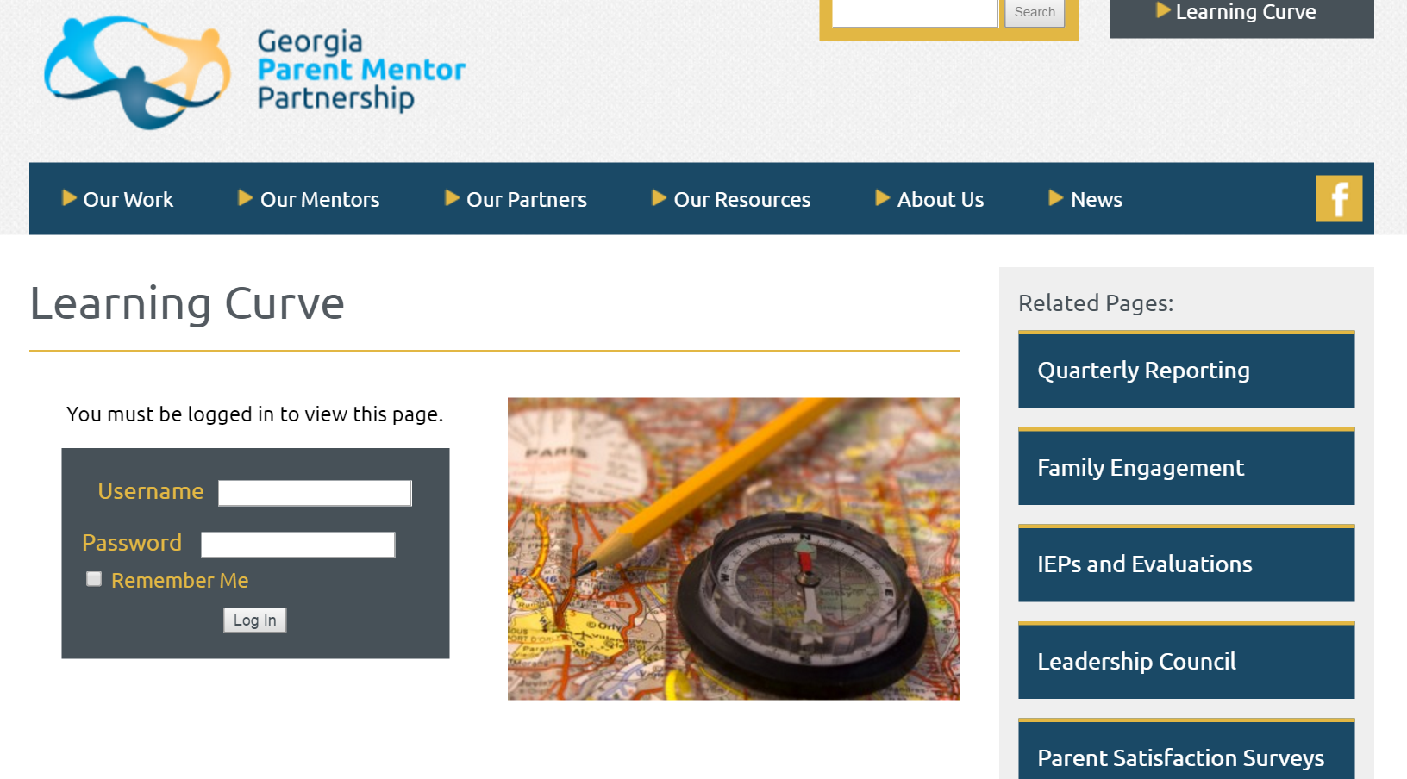

Slide 31
Parent Concerns
General Hints
Listening and communication skills are vital.
Collect all available background information.
If required, with guidance from the Director or supervisor, you can act as a liaison to assist in resolving the concern or dispute.
Ensure that the parent/guardian has a copy of the GaDOE Dispute Resolution Sheet. This can be found on the GaDOE website.

Slide 32
Parent Concerns
Informal Resolution/Local
Suggest that the parent talk with the child’s teacher(s). If necessary, request an IEP team meeting to discuss concerns.
If the concern is still unresolved, the parent can discuss it with lead special education teacher.
If the concern remains unresolved, the parent can discuss it with the principal.
If it is still unresolved, the parent can discuss the concern with the special education director/supervisor.

Slide 33
Parent Concerns
Formal Resolution/GaDOE
If the issues are still unresolved after every effort to correct the problem locally, parents may elect to use the formal IDEA dispute resolution options. It is always recommended to first try to resolve the problem with the teacher, school or school district.
The three formal dispute resolution options are:
Filing a Formal Complaint
Requesting Mediation
Requesting a Due Process Hearing

Slide 34
Parent Concerns
The procedure to follow for each of these Dispute Resolution options can be found on the GaDOE website at: https://www.gadoe.org/Curriculum-Instruction-and-Assessment/Special-Education-Services/Pages/default.aspx
Be sure to notify your immediate supervisor and/or the special education director if a parent intends to file a complaint, request mediation or a due process hearing.
There are Parent Fact Sheets and videos on the website that offer explanations on special education issues that are helpful.

Slide 35
What is CADRE?
CADRE is the Center for Appropriate Dispute Resolution in Special Education
www.cadreworks.org
Support the prevention and resolution of disputes through partnership
and collaboration.

Slide 36
What is IEP Facilitation?
IEP Facilitation is a “collaborative dispute prevention and resolution process used when members of an IEP Team agree that the presence of a third party would help facilitate communication and problem solving.”
IEP Facilitation can be especially useful when there is a history of difficult interactions or a meeting is expected to be particularly complex or controversial.

Slide 37
Leadership Council FY 21
Executive Board
Chairperson Missy Sullivan, Carrollton County
Chairperson Elect Karen Tharpe, Appling County
Recorder Sirena Graves, Rockdale County
Immediate Past Chair Edith Abakare, Atlanta Public Schools
Region Representatives
Northeast Bonnie Morrison, Walton County
Northwest Michal Jones, Walker County
Tracy Reynolds, Polk County
Metro Antoinette Nichols, Marietta City
Middle Jennifer Minter, State Schools
Yolanda Leduc, Henry County
Southeast Amanda Locke, Evans County
Southwest Rebecca Best, Grady

Slide 38
Participation & Leadership
Advisors
Alecia Segursky, Gordon County
Charity Roberts, Pioneer RESA
Family Engagement Specialist Anne Ladd, GaDOE
Family Engagement Specialist Sharon Jones, GaDOE
Communications Coach Jane Grillo, White County
Data Coach April Lee
Sunshine Committee Lori Bonds, Emanuel County
Amy Ambrose, Effingham Co.
Phil Pickens Chair Amy McCollum, Oconee Co.

Slide 39
Learning Targets
I can identify 2 people who can help me with questions about my work.
I can identify 2 departments within my school district to partner with for family engagement.
I can identify 2 outside agencies that I should partner with for collaboration.

Slide 40
Congratulations!
Notes and Questions

