Slide 1
Mentoring Matters www.parentmentors.org
How to Get Started

Slide 2
The goal is to build a bridge of communication between home and school that leads to more successful outcomes for students.
The GaPMP is currently supported by the Ga DOE Division for Special Education Services and Supports (DSESS).
Local School Districts hire the parent leaders, moms and dads of children with disabilities, to work with families, school teams, teachers, and the community.

Slide 3
Our To Do List
Intro to website
Find a Mentor pages
The Learning Curve
Finding Your Region Rep
Reporting Tools
Rookie Training Guide
Parent Mentor 101/online training tools

Slide 4
“I need help for my special needs child”
“Is there a parent mentor in my school district?”
“What does a parent a mentor do?”
parentmentors.org

Slide 5
3 Learning Targets
1. After this session I will be able to share My Find a Mentor page with on the GaPMP website with families and staff in my district.
2. After this session I will know what region I am in and who my region rep is.
3. After this session I will be able to log or have started the process for getting a user name and password for the Learning Curve on the GaPMP website.

Slide 6
Putting Your Program on the Map
Contact Anne Ladd to be put on the listserv
sjones@doe.k12.ga.us
aladd@doe.k12.ga.us
Get your name and contact on your “Find a Mentor” page by sending it to Jane Grillo:
jgrillo343@yahoo.com
*Also… don’t forget to include District Director name and contact info

Slide 7
The Learning Curve
Send an email to info@parentmentors.org to request a link to set your password.
Your user name will be your name
Your password will be your own (there is a quick link in case you forget it)

Slide 8
The Learning Curve Top 3
Reporting
The“Toolkit” which contains all the tools you need to do your reporting.
Webinars, Parent Mentor Training Guide and Learning Modules

Slide 9
A Tiny Reports Overview
3 reports
Pre and Post Surveys are completed at the beginning and the end of the year
Progress Reporting (this is about your plan) Submitted Oct. 15, Jan. 15, April 15
Quarterly Contacts (this is who you connected with) Submitted on Oct. 15, Jan. 15, April 15 and May 30
wo are submitted on Oct. 15, Jan. 15, April 15 and May 30^{t}

Slide 10
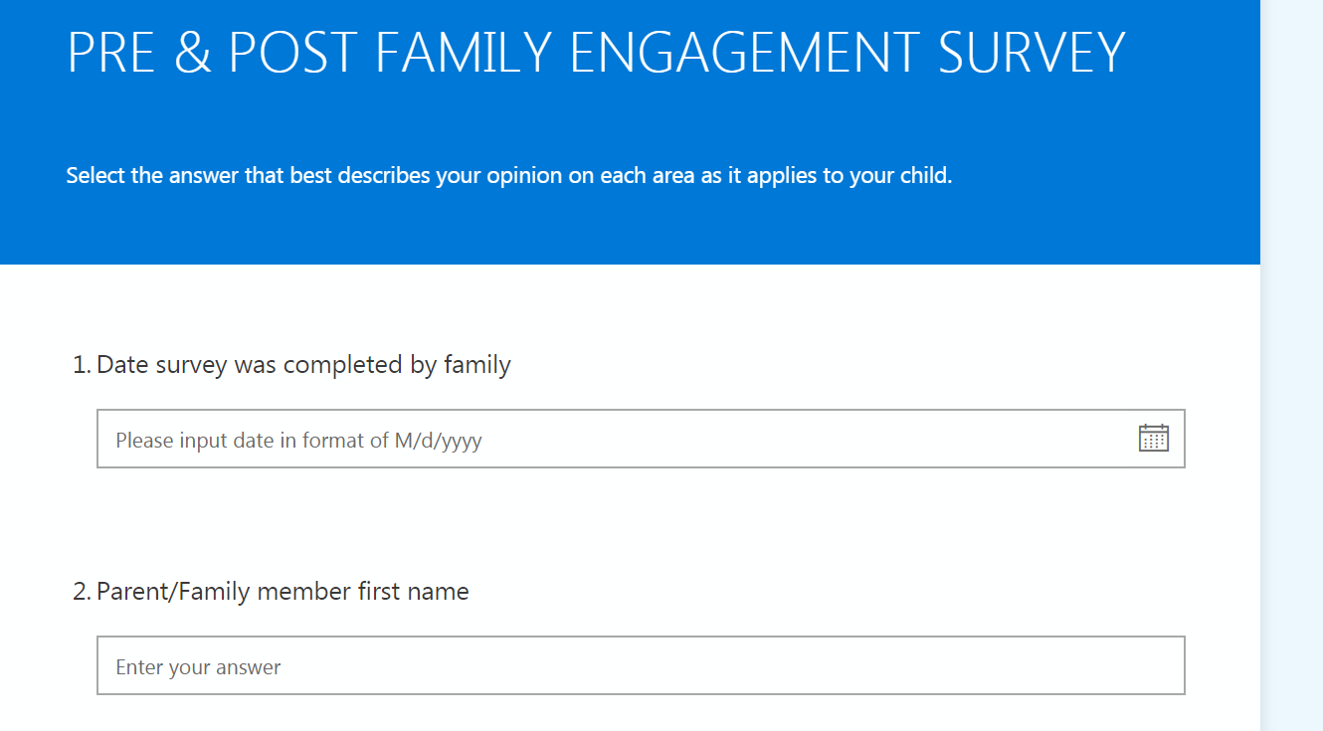
Pre and Post Surveys
This is a great way to introduce yourself to families and, discover what family engagement work needs to be done in your district.

Slide 11
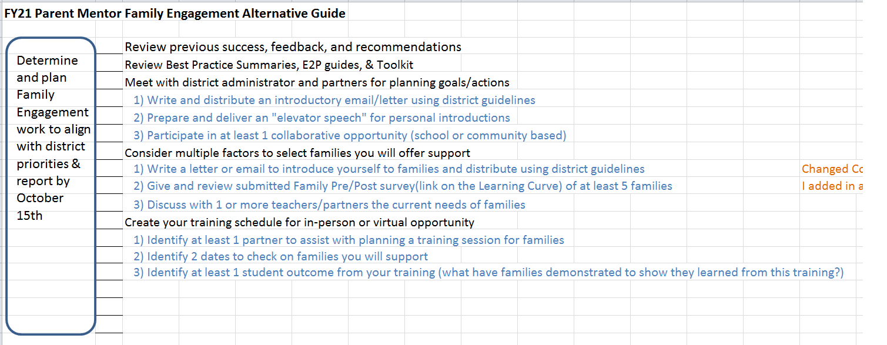
Progress Reporting for Rookies
Use the checklist
You don’t need to have all the answers.
This is a learning year.

Slide 12
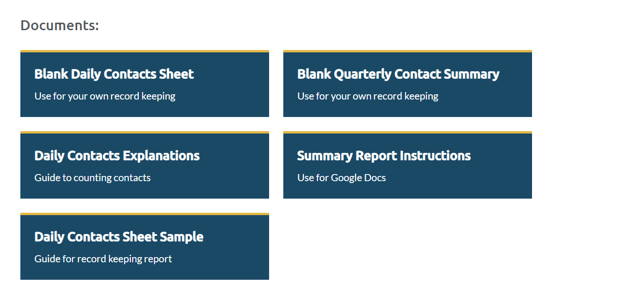
Quarterly Contact Resources

Slide 13
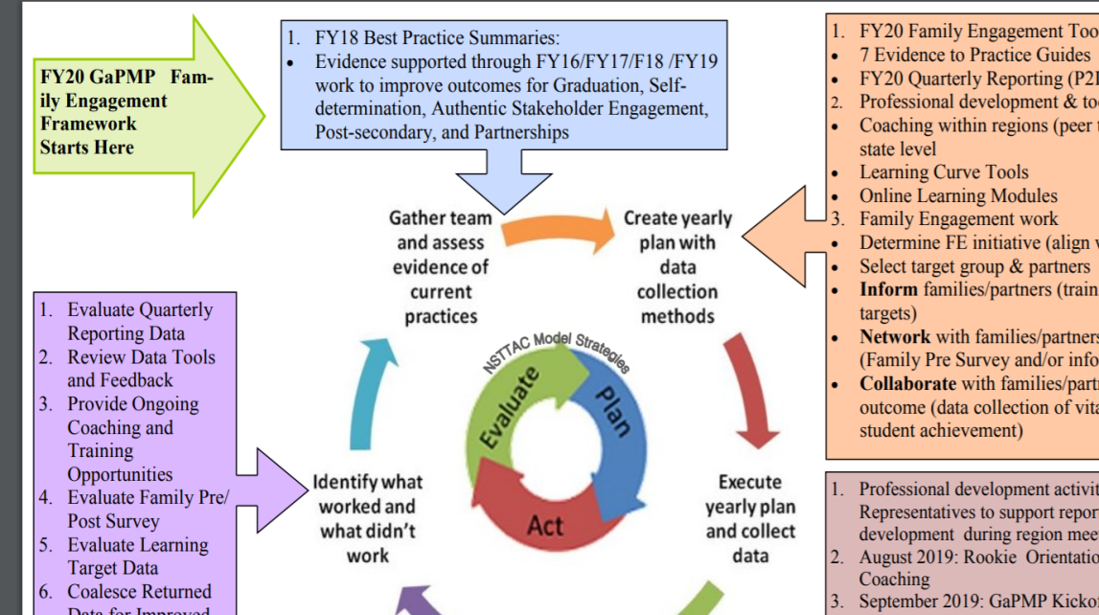
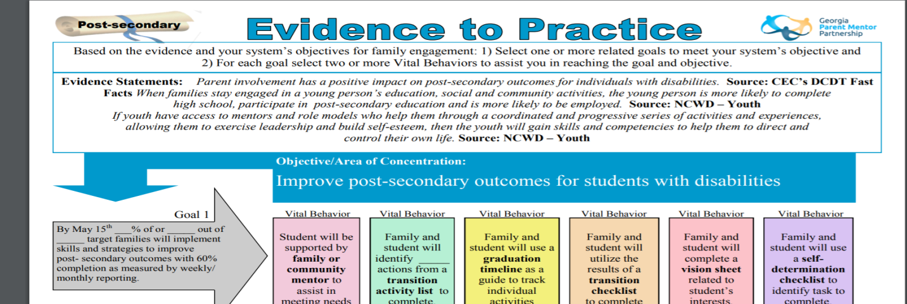
Evidence to Practice and what what?
Other tools:
Best Practice Summaries
Target Group tips

Slide 14
Region Reps ARE YOUR FRIENDS
Northeast Region Rep Bonnie Morris - Walton County
Northwest Region Reps Michal Jones - Walker County & Tracy Reynolds Polk County
Metro Region Rep Antoinette Nichols - Cobb County
Middle Region Reps Jennifer Minter - Ga Academy for the Blind & Yolanda Laduc – Henry County
Southeast Region Rep Amanda Locke - Evans County
Southwest Region Rep Rebecca Best - Grady County
To find a region map and other info go to the Learning Curve: http://parentmentors.org/learning-curve/region-meetings-and-info/

Slide 15
Promoting your program
Job 1 – Let people get to know you and get to know people in your district
Review other GaPMP district websites… this will help you develop your own way to introduce yourself and the GaPMP and… you can help your supervisor see what other districts have done to promote and support their parent mentor.

Slide 16
Introducing Yourself
Make sure everything you create or host is approved and vetted
Social media – clarify what the expectations are
Host a virtual meeting for Staff and for Families *It’s a good idea to invite supervisors to these events in the beginning so they can see what you are working on and how you work to support the district and families.
Ask to be invited
Community organizations
Dept meetings
School events

Slide 17
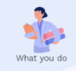
Mentor-ductions
You are a parent, but you work for the district… sometimes it is hard for people to understand what you do.
PRACTICE
You need to be comfortable and natural when introducing yourself
1. 2. 3. 4.
* When possible, find a connection between yourself and the group or person you are speaking with. Some examples might be, My child went or goes to that elementary school… or your children are on the same rec league team, or… your child’s eligibility for services…

Slide 18
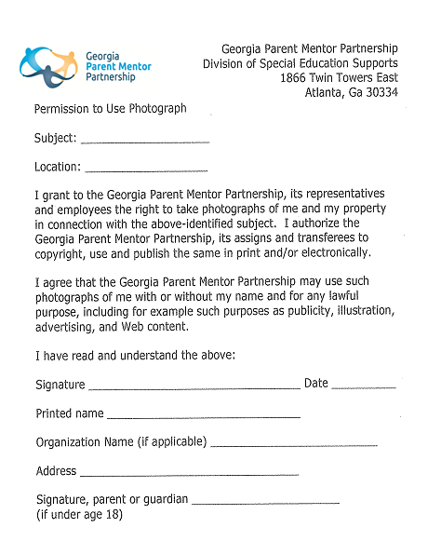
Media Releases
Need one for you
Download off the Learning Curve every time you submit a photo or written content relating to individuals in your district. Email to info@parentmentors.org

Slide 19
Accountability and Professionalism
This is from the White County Schools Ethics Compliance Module training. All district employees must complete this every year.

Slide 20
More about this…

Slide 21
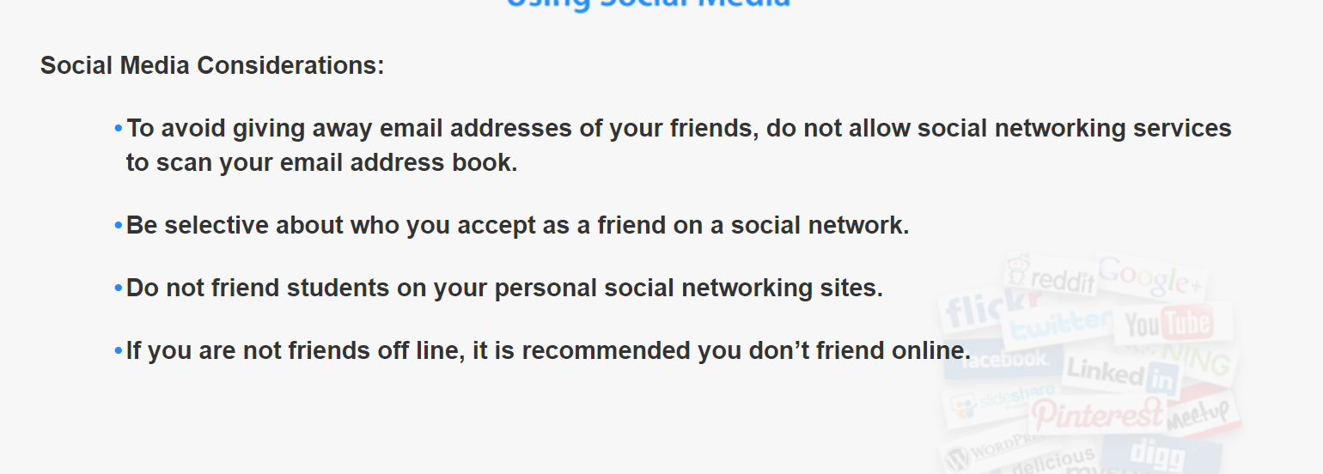
And this…

Slide 22
I Need More Info
Rookie Resources Tab on the Learning Curve

Slide 23
More Learning Tools

Slide 24
Checklist
I have a Find A Mentor page
I know who my Region Rep is
I have access, or requested access to Learning Curve

Slide 25
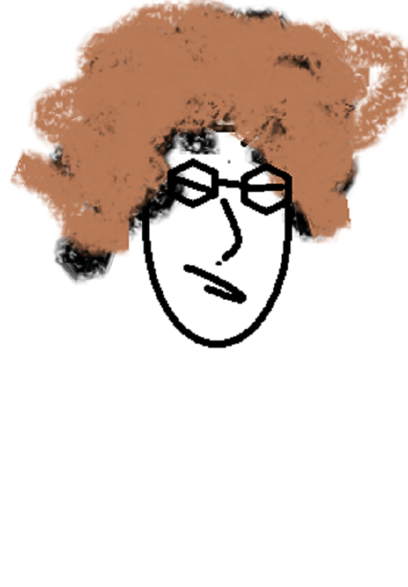
Still have questions?
Jane Grillo’s contact info:
Email: jgrillo343@yahoo.com
Office: 706-865-2315 ext 1410
Best Contact: (cell) 706-201-0483

