Slide 1
Sharing The Vision
Teamwork to Improve Parent Survey Results
Amy McCollum & Suzanne Korngold Oconee County Schools

Slide 2
Learning Targets
I can identify one strategy for partnering with teachers to improve parent survey participation.
I can name two tools for increasing parent participation in the Parent Survey.
I can describe one way that information from the Parent Survey can be used in my district.

Slide 3
Parent Survey – Special Education
An Important Tool for Gathering Parent Input
Mandated by GaDOE, Special Education Services and Supports
Survey of parents of students with disabilities throughout Georgia
Results give important information on how families are engaged in their child’s education
Results can guide decision-making in local school systems

Slide 4
IDEA Indicator 8:
Increase the percentage of parents of children receiving special education services who report that schools encourage parent involvement to improve results for students with disabilities.
U.S. DOE, Office of Special Education Programs requires that this information be reported every year in GA’s State Performance Plan, Annual Performance Report (SPP/APR)
School district data are also publicly available on the GaDOE website
Notes:
Some of the reasons GaDOE mandates this survey…

Slide 5
In other words… this is important!

Slide 6
In the past:
Paper surveys, mailed in to the UGA Center for Assessment
Systems/schools randomly selected to participate
Not all parents had opportunity to give input
Now:
Online (paper only as last option)
All districts in Georgia participate every year
Every parent has an opportunity to give input

Slide 7
All students who have an IEP
Including “speech only”
Including preschool
Ten questions
English or Spanish
Online survey open from January - May

Slide 8
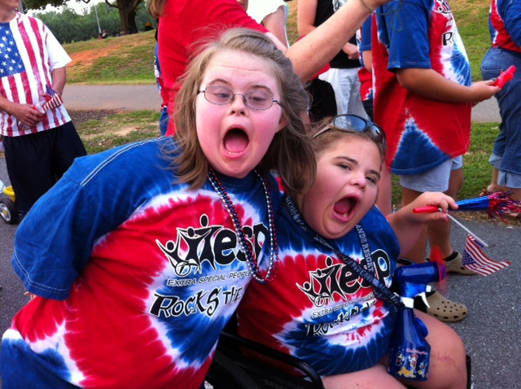
Responses:
Very strongly agree, Strongly agree, Agree
Disagree, Strongly disagree, Very strongly disagree
Questions designed to address three areas:
School
Teacher
Process

Slide 9
Parent Survey – Special Education
Here’s Our Process!
Share information about the survey with school board, school leadership
Encourage buy-in and support at the district level from the start
Share the importance of reaching all families of students with IEPs
Encourage each school to develop their own incentives to improve their survey returns

Slide 10
Parent Survey – Special Education
Here’s Our Process!
Meet with special education department chairs and review the plan
Each school had a goal to reach for
Schools follow the guidelines we’ve developed, tailoring it to their school’s population
Teachers receive monthly updates on results – allows them to address issues
Notes:
Will begin discussing at the December meeting
Last year’s goal was a 5% increase

Slide 11
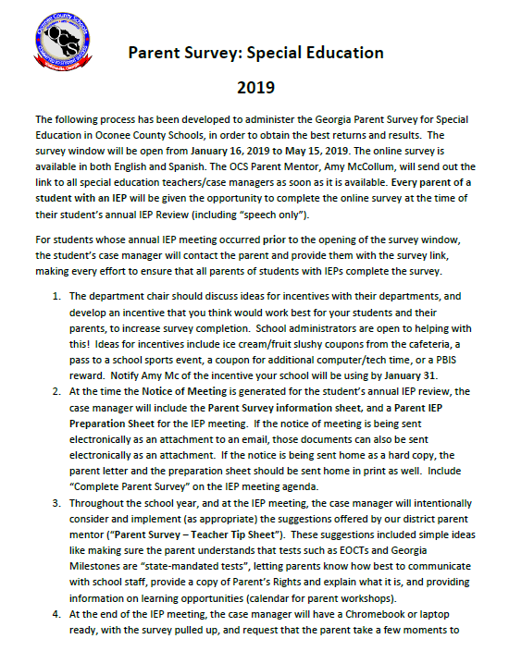
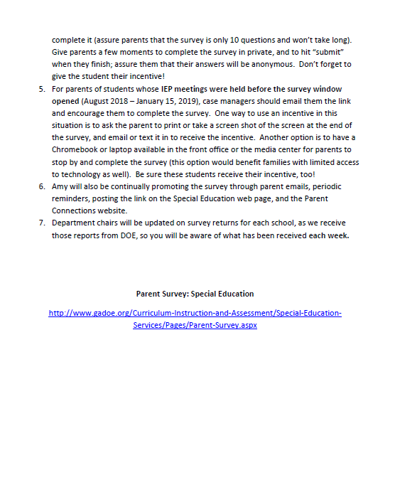
Notes:
The protocol is given to department chairs at each school, to share with staff.

Slide 12
Parent Survey – Special Education
Here’s Our Process!
Parents of students whose IEP meetings are held while the survey window is open (January – May) will be asked to complete it at their student’s annual IEP meeting – personal contact is a priority!
A survey brochure will be provided to parents with the Notice of Meeting for the IEP, along with an IEP Prep Guide

Slide 13
Parent Survey – Special Education
Here’s Our Process!
Teachers use the ideas provided on the “Survey Tip Sheet” to promote parent involvement, and help parents to be familiar with the wording of the survey – use the vocabulary!
Put “complete Parent Survey” on the IEP meeting agenda!

Slide 14
Parent Survey – Special Education
Here’s Our Process!
Teachers will have a laptop available, with the survey link pulled up & ready to go, at the IEP meeting

Slide 15
Parent Survey – Special Education
The Parent Mentor will…
create a Parent Survey brochure
create the IEP Parent Prep Guide tool
meet with each school’s special education department to talk with teachers about the survey protocol, & brainstorm incentive ideas
Notes:
Attending a sp ed department meeting at each school helps to keep the survey fresh in their minds.

Slide 16
Parent Survey – Special Education
The Parent Mentor will…
send updates on survey numbers to each department chair (which Director pulls from the survey dashboard)
send email reminders to parents
provide year-end data summary for each school
Notes:
I sent updates once every two weeks while the survey window was open (Jan – May).

Slide 17
Notes:
This year, instead of a trifold brochure, which is less useful to send electronically (per teacher feedback), I made a colorful flyer.

Slide 18
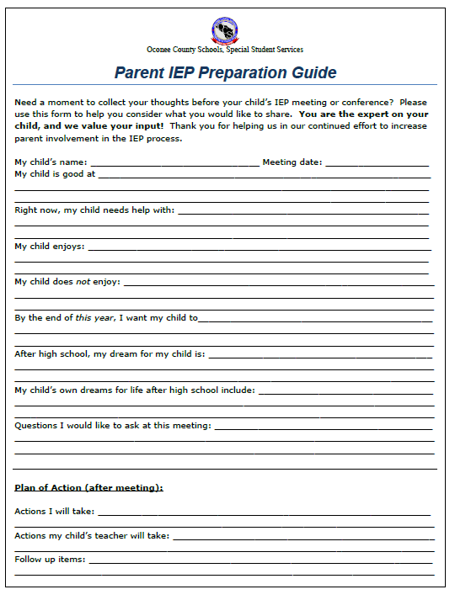
Prep guide for parents to use to prepare for an upcoming IEP meeting:
A tool to give them some structure to contribute to the “Parental Concerns” section of the IEP!
Notes:
We’ve used this parent prep flyer for a number of years now, adapted from one on the Learning Curve.

Slide 19
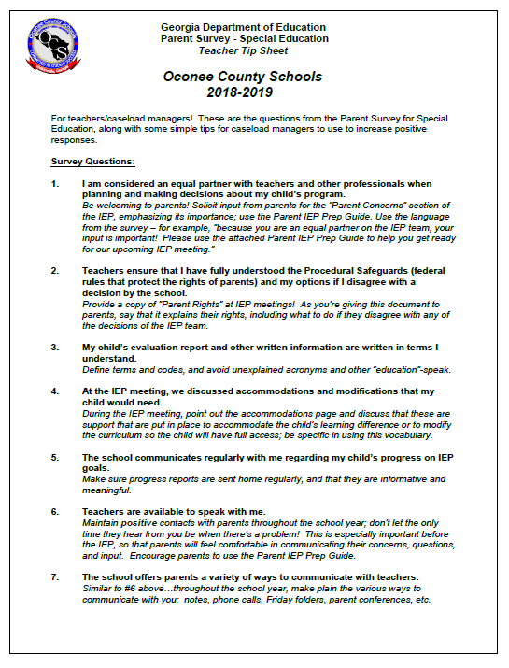
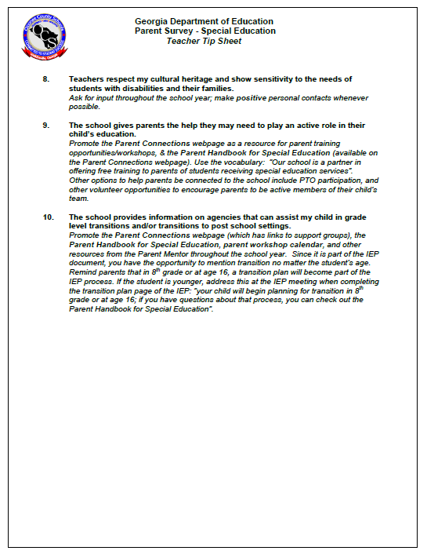
Notes:
At the district department chair meeting in January, sped department heads for each school received a packet with the parent survey protocol, the prep guide, and these teacher tips, as well as discussing the goal for returns for their schools (to inspire a little competitiveness!), and ideas for incentives.

Slide 20
I am considered an equal partner with teachers and other professionals when planning and making decisions about my child’s program.
Be welcoming!
Be intentional about asking for input from parents for the IEP.
Use the language of the survey: “Because you are an equal partner, it’s important that we have your input written into the IEP.”
Notes:
These are the tips listed for each survey question (again, adapted from tips that are on the Parent Mentor’s Learning Curve).

Slide 21
Teachers ensure that I have fully understood the Procedural Safeguards (federal rules that protect the rights of parents) and my options if I disagree with a decision by the school.
Provide a copy of the Parents Rights at the IEP meeting.
Explain that the Parents Rights document outlines the laws that protect their rights – and what to do if they disagree.

Slide 22
My child’s evaluation report and other written information are written in terms I understand.
Explain terms and codes
Define acronyms!
Avoid “education speak” – use plain language to describe testing procedures, grading, reporting, etc.

Slide 23
At the IEP meeting, we discussed accommodations and modifications that my child would need.
At the IEP meeting, be specific in pointing out the accommodations page.
Use the language from the survey; explain that these supports are what the child needs to be successful.
Explain the difference between accommodations and modifications if necessary.

Slide 24
The school communicates regularly with me regarding my child’s progress on IEP goals.
Make sure progress reports are sent home regularly
It is recommended that you communicate with your student’s families on a regular basis, not just at grading periods.

Slide 25
Teachers are available to speak with me.
Make sure parents on your caseload are aware of all the ways they can talk with you (email, phone, text, meeting before or after school)
Communicate with parents often, and share positive stories – don’t let the only time they hear from you be when there’s a problem!

Slide 26
The school offers parents a variety of ways to communicate with teachers.
Make sure parents on your caseload are aware of all the ways they can talk with you (email, phone, text, meeting before or after school)
Communicate with parents often, and share positive stories – don’t let the only time they hear from you be when there’s a problem!

Slide 27
Teachers respect my cultural heritage and show sensitivity to the needs of students with disabilities and their families.
Ask for input from families with differing cultural backgrounds, & incorporate activities that highlight them.
Share resources and information (Parent Mentors can help!) that support the needs of families.
Notes:
You could do research too, but asking families for direct input involves them in the process!

Slide 28
The school gives parents the help they may need to play an active role in their child’s education.
Share information and resources that support families (Parent Mentor can help!)
Work with parents in scheduling IEP team meetings, to be as convenient for them as possible – and use that vocabulary! “We want to schedule this meeting to enable you to have an active role in your child’s education planning”.

Slide 29
The school provides information on agencies that can assist my child in grade level transitions and/or transitions to post school settings.
Promote the resources from the Parent Mentor throughout the school year.
Since there is a page of the IEP specifically for transition, use this opportunity to suggest resources to parents.
Notes:
For example, in Oconee we have a Parent Connections webpage (which has links to support groups), a Parent Handbook for Special Education, a parent workshop calendar, and links to other resources such as Parent to Parent.
Also, since it is part of the IEP document, you have the opportunity to mention transition no matter the student’s age. Remind parents that in 8th grade or at age 16, a transition plan will become part of the IEP process. If the student is younger, address this at the IEP meeting when completing the transition plan page of the IEP: for example, say “your child will begin planning for transition in 8th grade or at age 16; a good resource for learning more about that process is (Parent Mentor, P2P, websites)”.

Slide 30
What about parents whose student had their IEP meeting before January?
Teachers/case managers and the Parent Mentor team up to follow up with those parents, emailing them the survey link and encouraging them to participate.
One way to use an incentive in this situation is to ask the parent to print or take a screen shot of the screen at the end of the survey, and email or text it in to receive the incentive!
Notes:
This can be a challenging…

Slide 31
What about parents whose students had their IEP meeting before January?
Another option is to have a laptop available in the front office or the media center for parents to stop by and complete the survey (this option would benefit families with limited access to technology as well). Be sure these students receive their incentive, too!
Encourage schools to develop their own incentives
Notes:
Incentives are most effective when they’re tailored to the population of students…maybe an ice cream won’t be as effective as athletic passes for high school students, for example.

Slide 32
Partner with principal or
PTO to offer a coupon for a
fruit slushie from the cafeteria
Ideas for Increasing Survey Returns
Piggyback on other
events: STEM Night,
8th Grade Night, PTO
events
Offer “Tech Time” – additional
computer time for students
(no cost!)
“Hat Day” or other special
clothing day
Partner with restaurants
to get coupons donated
(Chick-Fil-A, Zaxby’s,
Barbaritos)
Offer “Lightning Bucks”
(PBIS incentive – ties the
survey completion to positive
behavior rewards
Personal call/contact
with parents
“Braves Pass”: two passes to
school athletic events – one adult,
one student
Notes:
When we were brainstorming ideas, one incentive that was suggested (because I saw it on a list of incentives!) was a Homework Pass – but our teachers shot that one down, because so many students have an issue with turning in homework – it seemed counter-intuitive to allow them to not do homework as a prize!
We also had teachers from one school who objected to giving (or denying) a prize to students for something that the PARENT had to do…so they came up with piggybacking on a STEM Night, and had one of the highest rates of completion!

Slide 33
Number-crunching time!

Slide 34
41%
40%
27%
Notes:
We haven’t received our official results from DOE yet, but we know the return numbers from the portal.
In 2017 we had 252 responses
In 2018 we had 372 responses (47% incr),
In 2019 we had 409 responses (10% incr)
The percentage of the total caseload has increased each year as well (from 27% in 2017 to 41% in 2019).

Slide 35
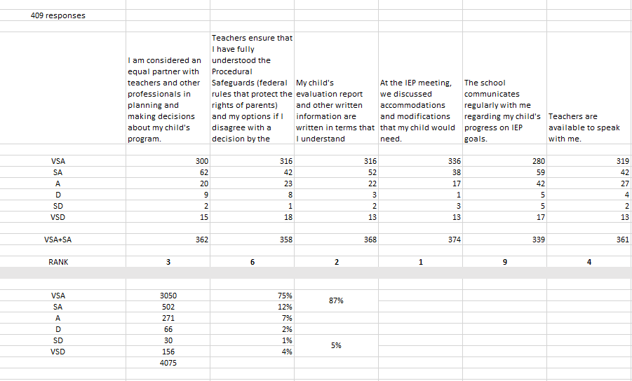
Notes:
Screenshot from the survey dashboard:
Explain numbers…
Also rank the questions – top 5, bottom 5
Separated out by individual school, gives them great information on communication, parent perceptions, creating a welcoming environment, and more!

Slide 36
Notes:
We also feel good about the concomitant increase in positive responses; it’s important to survey as high a percentage of the total caseload as possible, because statistical accuracy, but for positive responses to go up as well is nice!

Slide 37
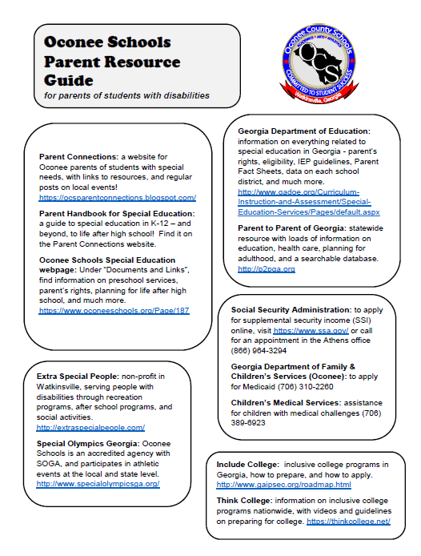
Something new - to address the low score on question 10:
A “Parent Resource Guide” with contact info on applying for SSI, Medicaid, important websites, recreation
opportunities…with a copy of the parent
workshop schedule on the back.
(it has the word “RESOURCE” in the title!!!)
Notes:
Question 10: The school provides information on agencies that can assist my child in grade level transitions and/or transition to post-school settings.
While question 10 is still the lowest ranked question, we still had an 80% positive response, and after using this tool we did have a 2% increase from last year.

Slide 38
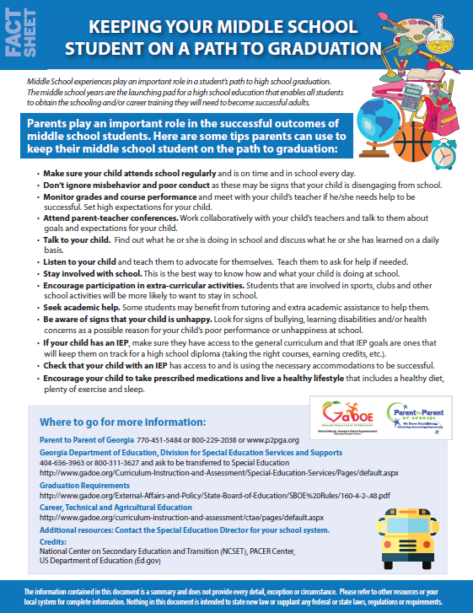
Notes:
Another tool we are using to address Question 10 is the transition fact sheets developed by GaDOE and P2P; these are on the Learning Curve too, and can be provided to parents using the survey vocabulary: “Here’s some information to help you plan for the transition to middle school…”

Slide 39
Learning Targets
I can identify one strategy for partnering with teachers to improve parent survey participation.
I can describe one way that information from the Parent Survey can be used in my district.
I can name two tools for increasing parent participation in the Parent Survey.
Notes:
Tools to increase parent participation: personal contact, offer surveys at IEP meetings, piggybacking on other school functions, incentives, IEP prep tool
Partnering with teachers: assist by creating flyers/brochures, assist by helping with advertising, assist by working to inform administrators & getting by-in
Using the data: creating a more welcoming school environment, improving home-school communication, addressing parent perceptions

Slide 40
Thanks for sharing the vision!
Amy McCollum
amccollum@oconeeschools.org
Suzanne Korngold
skorngold@oconeeschools.org

