Slide 1

GaPMP FY17 Toolkit
USING THE LEADING BY CONVENING FRAMEWORK FOR ENGAGEMENT TO EVALUATE FAMILY ENGAGEMENT PRACTICES IN FY17 PLAN AND REPORTS

Slide 2
GOAL FOR FY17 REPORTING EVALUATION FEEDBACK:
TO IDENTIFY LEADING BY CONVENING FAMILY ENGAGEMENT PRACTICE EXAMPLES WITHIN THE PARENT MENTORS’ WORK

Slide 3
AFTER REVIEWING POWERPOINT:
PARENT MENTORS WILL GAIN KNOWLEDGE THAT CAN BE APPLIED WITHIN THE WORK THAT THEY REPORT ON IN FY18.

Slide 4
LEARNING TARGETS
I CAN NAME THE DEPTH OF INTERACTION ELEMENTS.
I CAN LIST THE DEPTH OF INTERACTION ELEMENTS.

Slide 5
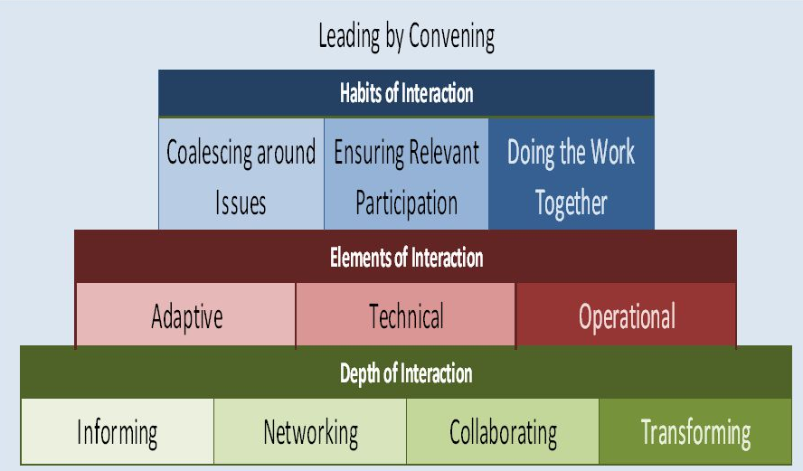

Slide 6

Depth of Interaction
Informing – Sharing or disseminating
information with others who care about the issue.
Networking – Asking others what they think about this issue and listening to what they say.  Collaborating – Engaging people in trying to do something of value and working together around the issue.
Transforming – Doing things The Partnership Way (leading by convening, cross-stakeholder engagement, shared leadership, consensus building).
1/11/2018
6

Slide 7
THANK YOU
CYNTHIA CRISS
GaPMP DATA COACH
ccriss@pulaski.k12.ga.us
478 783-7487 office
229 313-2538 personal cell

