Slide 1

Self-Determination: A Family Affair
Michael L. Wehmeyer, Ph.D.
Ross and Marianna Beach Distinguished Professor in Special Education
Chair, Department of Special Education
Senior Scientist and Director, Beach Center on Disability
University of Kansas

Slide 2
Inherent Dignity
Article 3-General Principles, United Nations Convention on the Rights of Persons with Disabilities
a. Respect for inherent dignity, individual autonomy including the freedom to make one’s own choices, and independence of persons;
inherent [in-heer-uh-nt]
adjective
existing in someone or something as a permanent and inseparable element, quality, or attribute.
Synonyms
innate, native, inbred, ingrained
dignity [dig-ni-tee]
The state of being worthy or honorable, elevation of mind or character, true worth;
Elevated rank; honorable station; high office;
Quality suited to inspire respect or reverence; loftiness and grace, impressiveness; stateliness.
From dignus [Latin] meaning worthy

Slide 3
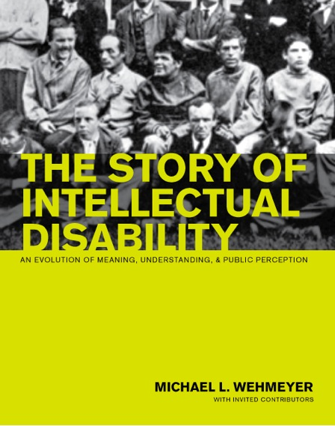
Historic Understandings of Disability
Historically, disability was understood within a model that was an extension of the medical model, which viewed health problems as an individual pathology; a problem within the person.
Within such a context, disability was understood as a characteristic of the person; as residing with the person.
  The person was seen as broken, diseased, pathological, atypical, or aberrant; as outside the norm.
  Perhaps unavoidably, people with disabilities were, consequently, associated with numerous negative stereotypes.
  The advent of intelligence testing, particularly with the introduction of ‘Mental Age’ estimates, led to “infantilization” of people with disability.

Slide 4

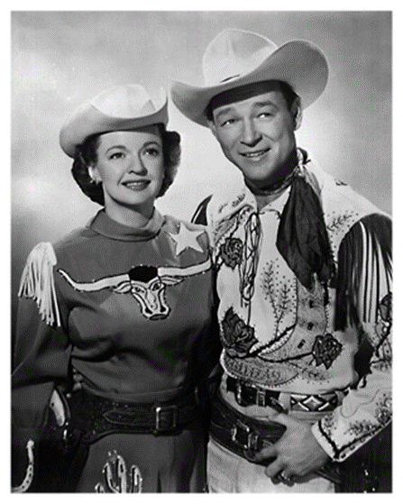
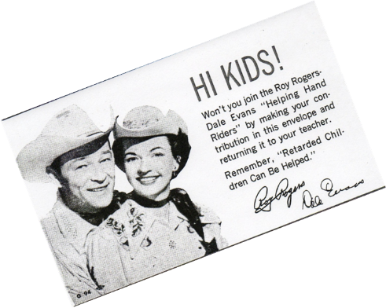

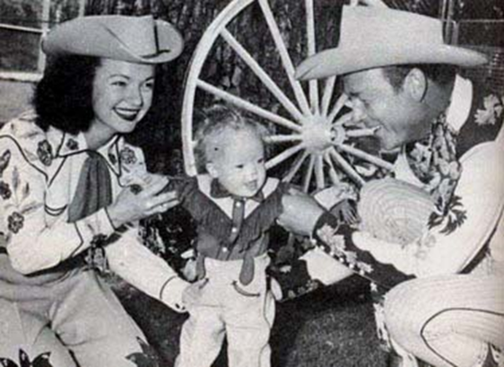
The Parent Movement
1950 to 1990
Earlier stereotypes of disability were replaced with more humane, though still in many ways debilitating, stereotypes.
People with disabilities were seen as objects to be fixed, cured, rehabilitated and, at the same time pitied; as “victims” of their disabling condition, worthy of charity.
  Holy innocents; eternal children
Increased emphasis on the community as where people belonged.
Fundamentally, though, how disability was understood (e.g., as a problem residing within the person) did not change.

Slide 5

Historic Understandings of Disability
Understanding people as different soon becomes construed as inferior, leading to discrimination and maltreatment.
Separate is never equal.
We are constrained by our own lack of imagination.
We have always been wrong about what we believe people with disability can achieve.
The injustice committed against people with disability throughout time has been to deny them the dignity afforded to persons simply by their status as human beings.

Slide 6

The Emergence of Strengths-Based
Models of Disability
1980- International Classification of Impairments, Disabilities, and Handicaps (ICIDH)
2001- International Classification of Functioning, Disability and Health (ICF)

Slide 7
Changing Understandings of Disability
Disability
Personal
Incompetence

Slide 8
Changing Understandings of Disability
Environment
Personal
Competence

Slide 9
Changing Understandings of Disability
Disability
Environment
Personal
Competence

Slide 10

Implications of Changing Understandings of Disability
Strengths-based
Part of, and not apart from, typical human functioning
Focus on environment/context, not fixing the person;
Emphasizes supports, not programs
Emphasis on promoting/supporting self-determination.

Slide 11
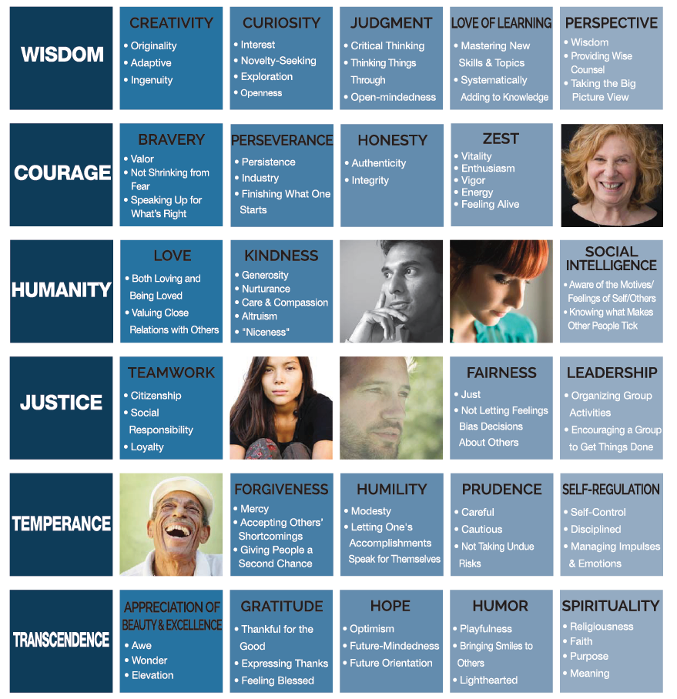
VIA Classification of Strengths
© Copyright 2011-2015 VIA INSTITUTE ON CHARACTER. ALL RIGHTS RESERVED.

Slide 12

Supports are resources and strategies that…
promote the interests and causes of individuals with or without disabilities;
enable them to access opportunities, information, and relationships inherent within integrated work and living environments;
result in enhanced interdependence, productivity, community inclusion, life satisfaction, and human functioning.
  In other words, anything that enable a person to live a self-determined life.
Specialized Services
Generic Services
Nonpaid Supports
Family & Friends
Person

Slide 13
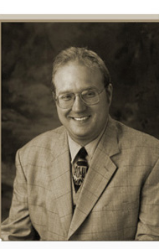

Dignity, Respect, Equality…
"People with autism should
be treated with the same dignity,
respect, and equality as people
without autism.”
Jean-Paul Bovee
"We don't have to be told what self-
determination means. We know it is just
another word for a life filled with rising
expectations, dignity, respect and
opportunities.“
Robert Williams

Slide 14
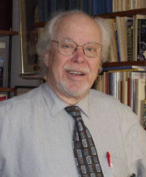
The Right to Self-Determination
Bengt Nirje (1972)
One major facet of the normalization principle is to create conditions through which a disabled person experiences the normal respect to which any human being is entitled. Thus, the choices, wishes, desired, and aspirations of a disabled person have to be taken into consideration as much as possible in actions affecting him. To assert oneself with one’s family, friends, neighbors, co-workers, other people, or vis-à-vis an agency is difficult for many persons. It is especially difficult for someone who has a disability or is otherwise perceived as devalued. But, in the end, even the impaired person has to manage as a distinct individual, and thus has his identity defined to himself, and to others, through the circumstances and conditions of his existence. Thus, the road to self-determination is indeed both difficult and all-important for a person who is impaired.

Slide 15
The Right to Self-Determination
Bengt Nirje (1972)
clearly articulates the importance of this personal self-determination to all people, not excluding people with intellectual and developmental disabilities;
equates self-determination with the respect and dignity to which all people are entitled;
recognized that people define themselves, and others define them, by the circumstances and conditions of their lives.
This recognition that self-determination is fundamental to attaining respect and dignity and to perceiving oneself as worthy and valued is a major reason people with disabilities have been unequivocal and consistent in their demand for control in their lives.

Slide 16
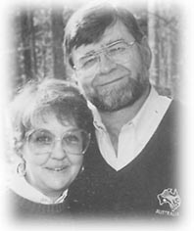
The Dignity of Risk
Robert Perske(1972)
The world in which we live is not always safe, secure and predictable.... We must work to develop every human resource within us in order to prepare for these days. To deny any person their fair share of risk experiences is to further limit them for healthy living. (p. 199)

Slide 17
self-determination: noun
(sèlf´dî-tûr´me-nâ´shen)
Determination of one's own fate or course of action without compulsion;
Freedom of the people of a given area to determine their own political status; independence.
self-determined, adj.-- self-determining, adj.
The American Heritage Dictionary of the English Language, Third Edition (1992). Houghton Mifflin Company.

Slide 18
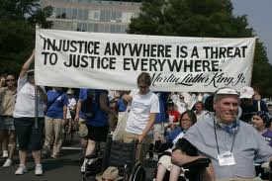
Self-Determination and Disability
Within the context of the disability rights and advocacy movement, the construct as a personal characteristic has been imbued with the empowerment and “rights”
orientation typically associated with
the sense of the term as a
national or political construct.
Empowerment is a term usually
associated with social movements,
and the struggle of marginalized
people for equal rights.

Slide 19

Self-Determination and Determinism
The philosophical doctrine of determinism posits that actions are caused by events or natural laws that precede or are antecedent to the occurrence of the action. Behavior, then, is governed by these other events or natural laws.

Slide 20
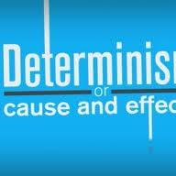
Self-Determination and Determinism
Self-determinism, or self-determination, implies that individuals cause themselves to act in certain ways, as opposed to someone or something else ‘causing’ us to act in certain ways
People who are self-determined embody the characteristic or quality of ‘self-determination,’ a noun referring to the degree to which that person acts or behaves in ways that are self- (instead of other-) caused.

Slide 21

What is Self-Determination?
Self-determined behavior refers to volitional actions that enable one to act as the primary causal agent in one’s life and to maintain or improve one’s quality of life.
Causal agency: To make or cause something to happen in one’s life.
Volitional action: Making a conscious choice or decision with deliberate intention.

Slide 22
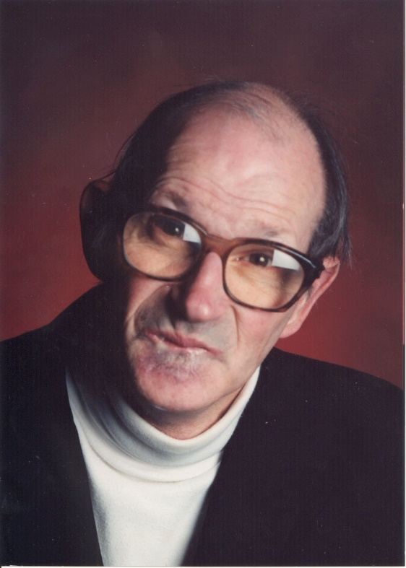
Why is Self-Determination Important?
“When I moved to New Bedford, I wanted to open a checking account. I went over to the bank and gave the $10 to open the account and asked them if there would be a problem. They said no. But, when I went back a couple of days later, they said they couldn’t understand my signature.”

Slide 23
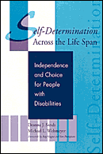
Why is Self-Determination Important?
“I thought about this and realized that I had a checking account before I moved, and that had worked fine. The next morning, I put on a suit and tie and went down to the main branch. I asked to see the bank president. They told me he was in a meeting. I told them I would wait.”

Slide 24
Why is Self-Determination Important?
“I waited for about 2 minutes and he came out. He brought me into a room and asked me what the problem was. I told him. I also brought my canceled checks and showed him that I had an account before. He apologized and I got my checking account.
That is why self-determination is important to me.”
Raymond Gagne

Slide 25
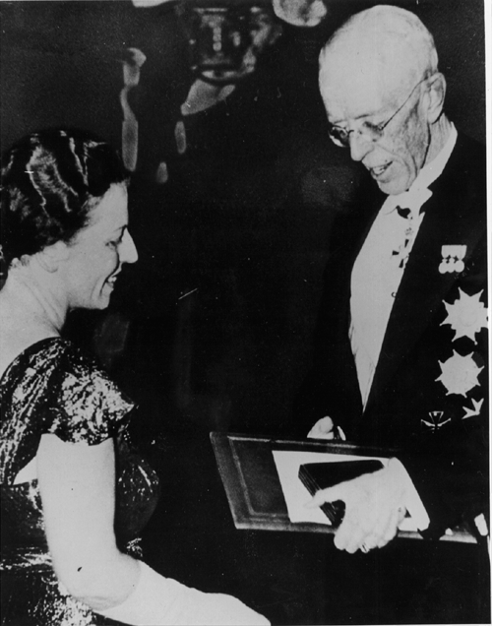
Pearl S. Buck,
1932 Pulitzer Prize, 1938 Nobel Prize
"none who have always been free can understand the terrible fascinating power of the hope of freedom to those who are not free."

Slide 26

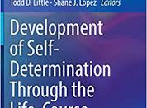
Promoting Self-Determination
Choice-making
Decision-making
Problem-solving
Goal setting and attainment
Self-advocacy
Self-management and self-regulation
Autonomous motivation
Self-awareness
Self-knowledge

Slide 27
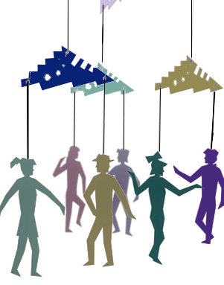
Self-Determination:
The Importance of Family

Slide 28
Self-Determination:
The Importance of Family
Walk
Walk the tightrope between protection and independence. Allow your son or daughter to explore his or her world.
Encourage
Encourage your child to ask questions and express opinions. Involvement in family discussions and decision-making sessions is one way of providing this opportunity to learn.
Recognize
Recognize the process of reaching goals, don’t just emphasize outcomes.

Slide 29
Self-Determination:
The Importance of Family
Schedule
Schedule opportunities for interactions with children of different ages and backgrounds.
Don’t leave
Don’t leave choice-making opportunities to chance. Take every opportunity to allow your child to make choices; what she wears, what is served for dinner, or where the family goes for vacation.
Have
Have high expectations for your child and don’t be afraid to hope!

Slide 30
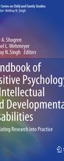
Positive Approaches
Self-Determination
Mindfulness
Positive-Behavior Supports
Quality of Life
Friendships
Well-Being
Character Strengths
Technology Supports
High Expectations

Slide 31
http://wehmeyer.pbworks.com/ http://www.ngsd.org

