Slide 1
Georgia Parent Mentor Partnership
Family Engagement Framework
Planning, Implementation, Evaluation, and Building Capacity
April Lee – E2P Framework Coach

Slide 2
Start Planning for Success
Using the Toolkit and Learning Curve
Building Partnerships
Finding a Target Group
Finding an initiative or area of focus
Training and support
Timeline and benchmarks for goals
Additional tools and professional development

Slide 3
Learning Targets
I can list one or more tools that will assist my administrator and I select a target group or partners for the work I will report on this year.
I can define learning targets related to the actions I will train and support families to do this year.
I can describe how I plan to work with families during this year.

Slide 4
Questions
List two tools that may help you (with your administrator and partners) select a target group or additional partners.
T or F : A learning target will help me measure if I have informed my families so they can use the materials when working with their child and/or partners.
List two actions you will take while working with families.

Slide 5
Toolkit and Learning Curve
Tools for planning
  Pre/Post and Parent Satisfaction Surveys
  E2Ps (Evidence to Practice Guides)
  P2I (Planning to Implementation)
  Best Practice Summaries
  Webinars
  Learning Modules
  Quarterly reports

Slide 6
FY20 Planning Tools You Can Use
Jane Grillo – Tool and Website Guru

Slide 7
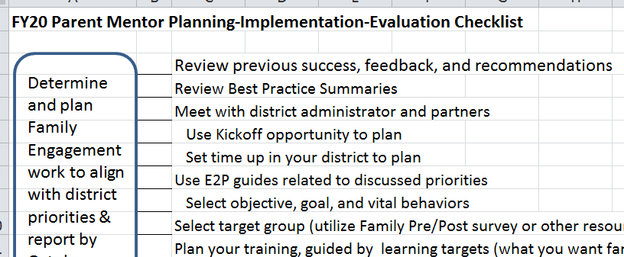
Where to Start…

Slide 8
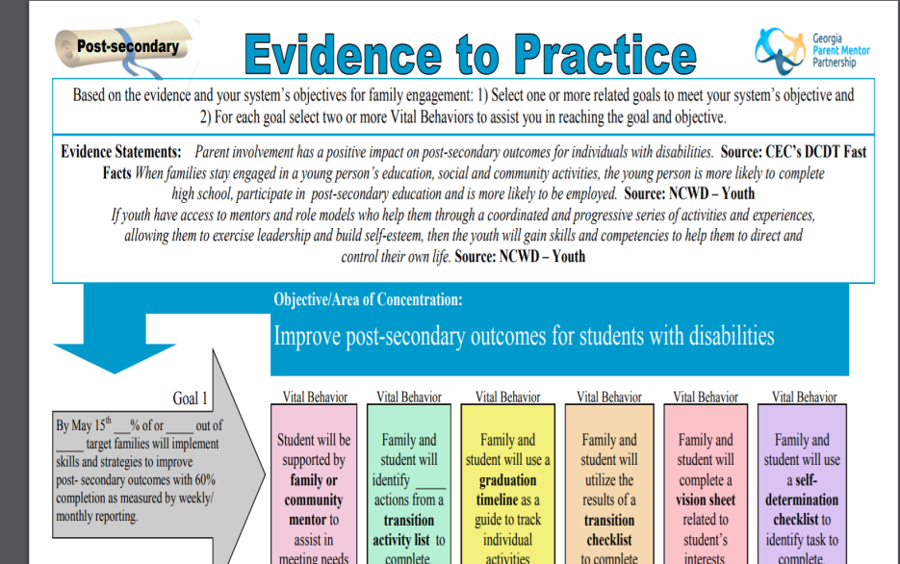
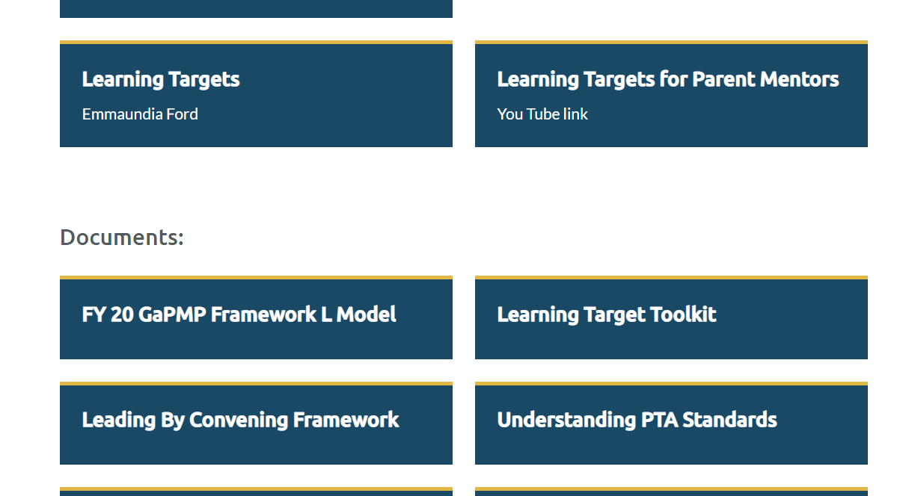
Toolkit on the Learning Curve
Evidence to Practice Guides (E2P)
Best Practice Summaries
Webinars/ Powerpoints/ Trainings

Slide 9
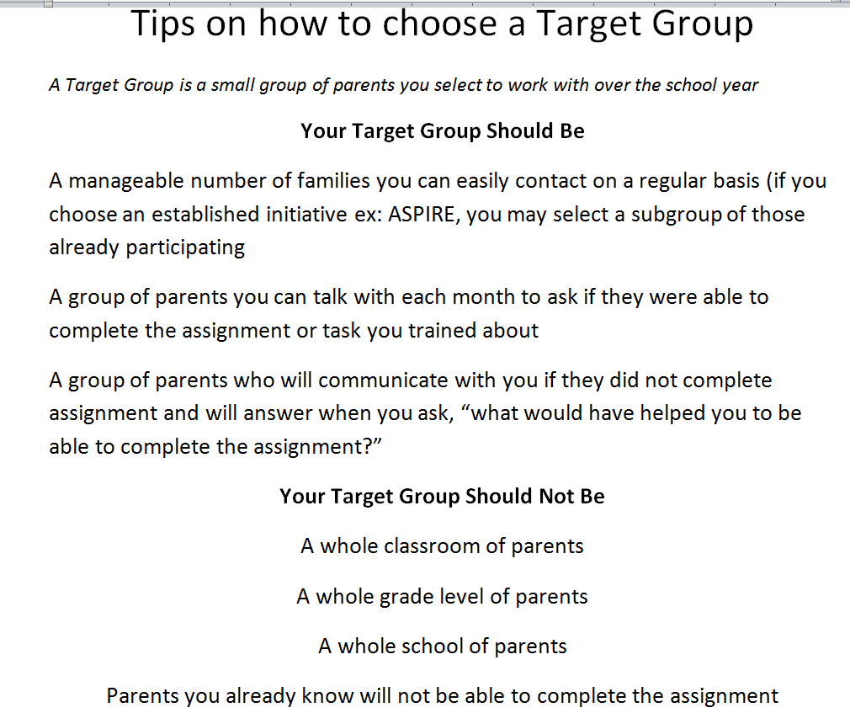
Target Group Jitters?
Here is a brief list of Target Group tools on the LC
Data Collection Tab
How to Choose a Target Group download
Reporting Tab
Learning Targets Webinar
Learning Targets for Parent Mentors YouTube Link
Learning Target Toolkit

Slide 10

Learning Target Jitters?
Here is a brief list of Learning Target tools on the LC
Homepage
Best Practice Summaries
April Lee’s Learning Target PPT

Slide 11
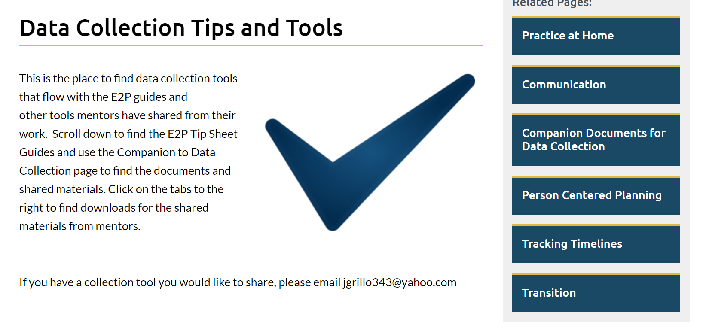
Other tools

Slide 12
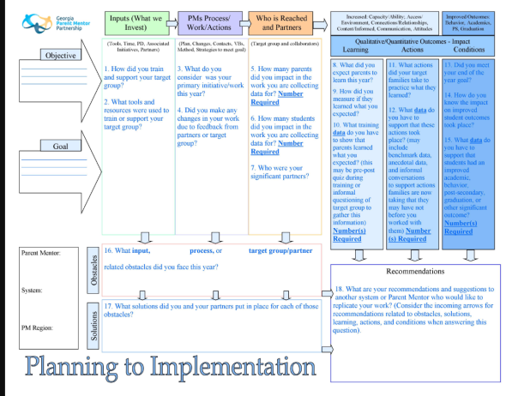
The End is the Beginning

Slide 13

Building Partnerships
In your region
  Seasoned Mentors
  Mentors working on similar work
  Communities of Practice
In your district
  School staff and teachers
  Community partners
  Parents and family members

Slide 14

Finding a Target Group
Small group of families to work with more closely for target work and data collection
Should be 5 to 20 families (most pick 10 or more)
Consider your partners and what families need
  Teachers and other community partners
  Your conversations with families
  Survey results

Slide 15
Finding an Initiative or Area of Focus
What needs improving?
What initiatives are already in place?
Where are your possible partners?
Review the E2P Guides with your administrator:
  Graduation
  Partnerships/Stakeholder Engagement
  Self-determination/IEP Participation
  Post-secondary
  Literacy

Slide 16
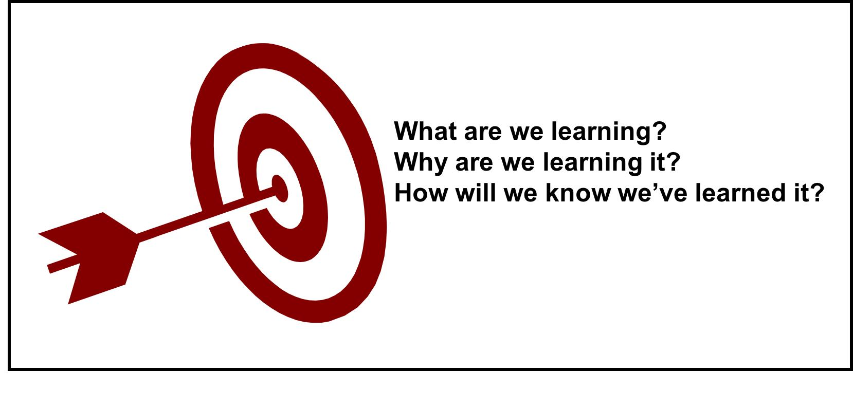
Training Families
What topics will you train on and why?
What will parents do with the new information?
How will you know they learned something from you?

Slide 17
Learning Targets
If my goal of training is to make sure my
Families are better informed on the topic of: Self-determination
I might present a 30 min presentation to include:
  Benefits of self-determination skills
  Ideas for teaching the skills at home
In order to measure what they know on these topics before I train (Pre)I will show them what I expect them to learn through I CAN statements:
  I can list 2 reasons my child needs to be more self-determined.
  I can describe 2 actions my child will work on to build his/her self-determination skills

Slide 18

Learning Target Data
The questions I will use to measure their Pre and Post learning could be:
  Which of these are likely to improve if your child is more self-determined?
    Self-advocacy
    Independent skills
    Goal setting is important
    They talk more
    All of the above
  My child can work on these two skills at home to be more self-determined:
    _________________
    _________________

Slide 19
Ongoing Support of Families
To ensure they use the new information I might:
  Use a self-determination checklist (tool) during the training and show them how to use it to identify and complete skill-building at home
  Offer to check on them throughout the year (benchmark checks) by phone or in person to share new ideas and support skill-building
  Gather feedback from families to change or offer new supports so more families benefit from what is learned during the year.

Slide 20

Timeline to Reach Goals
Be aware of reporting dates
  October 15th
  January 15th
  April 15th
Set benchmarks to check on current status
  2-3 that are asked about during reporting

Slide 21

Other Resources and Professional Development
Region meetings/other Parent Mentors
Local and region trainings/conferences
Local or district teams/boards
Other agencies

Slide 22
Questions
List two tools that may help you (with your administrator and partners) select a target group or additional partners.
T or F : A learning target will help me measure if I have informed my families so they can use the materials when working with their child and/or partners.
List two actions you will take while working with families.

Slide 23
Learning Targets
I can summarize the importance of benchmark checks during the work with partners and families this year.
I can describe the link between learning outcomes, action outcomes, and student outcomes.
I can list at least one student outcome that relates to the initiative I will work on this year.

Slide 24
Questions
A benchmark can help me to decide how I might need to _________ my work to better meet the needs of the families I am supporting.
When I know my families have learned what they need to know, I can __________ them to complete __________ intended to assist their child succeed.
What is an example of a student outcome you will look for when working with families to improve graduation rates?

Slide 25
Reporting Your Success
Anecdotal Details
Benchmark Checks and Changes to the Work
Obstacles and Solutions
Linking Outcomes
  Learning
  Action
  Student
Building Capacity

Slide 26
Your Story Telling
How did this come about?
What/who were some of the contributors?
Tell me more about that?
Why was that important?
Explain how you made that work?
Pick a Partner
Build a Story

Slide 27
Asking Yourself Questions to Reflect and Ensure Replication
Authentic Stakeholder Engagement Tool

Slide 28

Benchmark Checks
What can I ask myself about the work?
What are families telling me?
What does the data say?
Not Just
A Date

Slide 29
My child’s current performance and progress toward graduation are clearly communicated.
Pre-survey
Post-survey

Slide 30
Changes to the Work
Listening to feedback, data, and partners
Go a different direction
Use a different tool
Change partners; add partners
Change in timeline
Change of focus area

Slide 31
Measuring the Impact
Sharing Outcomes

Slide 32
Learning Outcomes
New knowledge + Old knowledge
Measured prior to learning and after learning session
Easiest outcome to get 100%
May occur individually or in large groups
Select learning targets that go along with the two vital behaviors you will support families complete
  VB – Use a transition checklist to complete task….
  L.T. – I can identify 2 transition task to complete with my child
  Pre/Post Question – What is one example of a task your child needs to complete before he/she exits high school?

Slide 33
Action Outcomes
Once you know they have the KNOWLEDGE now you can ASK them to do something with it
The Action = The Vital Behaviors
What repetitious task will they complete to help them realize the importance of what they learned that you have specifically linked to their student’s success?
  Benchmark data
  End-of-the-year data

Slide 34
Student Outcome Research
When families are equipped with tools/skills to interact with school teachers and staff, then they can address their concerns about student performance, help student prepare for assessments, and interpret assessments information to improve student achievement. Appleseed
When youth are exposed to a range of experiences, they are better able to identify and attain career goals. NCWD-Youth

Slide 35
Student Outcomes
What will the actions that families and students take together do for the student in the short term or long term?
  Improve academics, behaviors, or attendance
  Improve transition outcome
  Improve graduation/grade outcome
  Acquired job, skill, mentor, or accomplishment
Consider the pre-data and how you will acquire post-data

Slide 36

Obstacles and Solutions
Families struggling to complete the vital behaviors responded positively to the training they received from families successful in completing vital behaviors
While seeking buy-in of partners it was important to provide feedback often to keep everyone informed
Low expectations were replaced with empowerment as students gained new skills

Slide 37
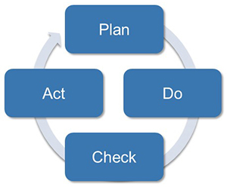
Obstacles and Solutions
Families struggling to complete vital behaviors were offered extra practice sessions
Families who were not able to attend the trainings were trained by contacting parent by phone or home visit
Students were not educated about their disability so talking in terms of strengths and challenges helped families understand how they could start conversations with their child about why they had an IEP team

Slide 38

The End Result Leads the Work
What RESULTS do you plan to see due to what you have
  Learned
  Taught
  Supported
  Partnered with others on
  Collected data for

Slide 39
Best Practice Summaries
Graduation
IEP Participation/Self-determination
Post-secondary Success
Partnerships

Slide 40

Building Capacity
Go Beyond current Target Group
Go Beyond Limited Partners
Go Beyond Individual Initiative
Go Beyond One Year Plan

Slide 41
Building Capacity
Improving communication and information sharing
Improving engagement of volunteers and partners
Shared leadership
Effective use of technology and media outlets
Improving how team measures outcomes
Improved skills, strengths, and knowledge
Greater impact and success

Slide 42
Questions
A benchmark can help me to decide how I might need to _________ my work to better meet the needs of the families I am supporting.
When I know my families have learned what they need to know, I can __________ them to complete __________ intended to assist their child succeed.
What is an example of a student outcome you will look for when working with families to improve graduation rates?

