Slide 1



Quarterly Reporting Guide
Step by Step instructions for completing your Quarterly Contact and Quarterly (Plan) Reports

Slide 2
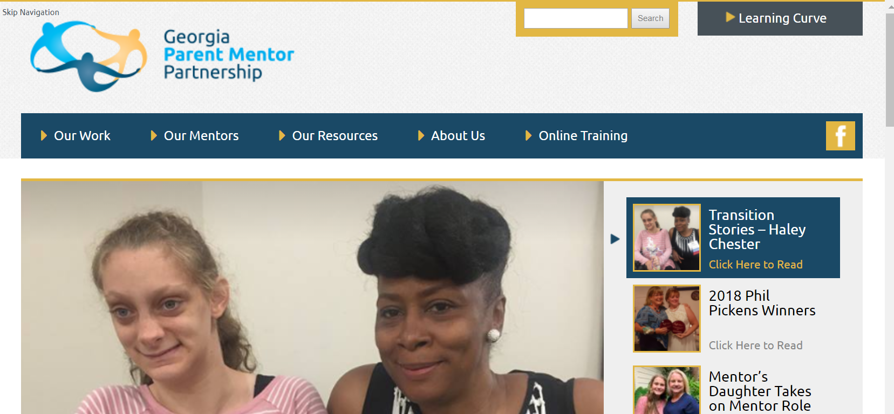
Step 1 http://www.parentmentors.org

Slide 3
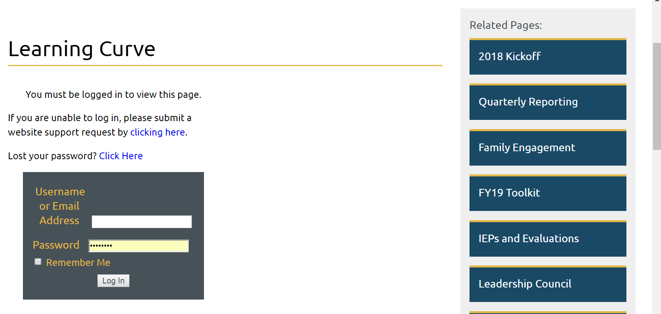
Step 2 Login
Hint:
Your login is your name Jane Doe
Your password is your choice. If you click the Remember Me box, you won’t have to look for the password every time you login.

Slide 4
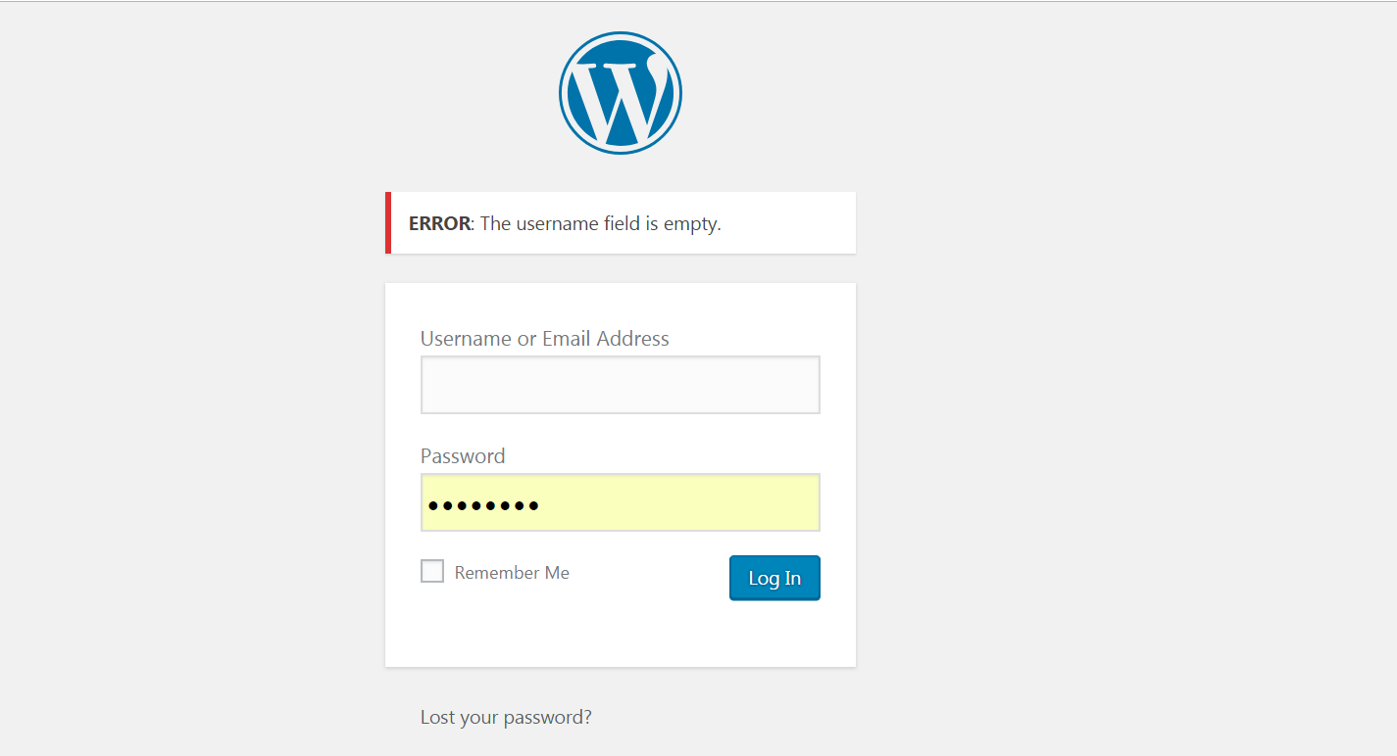
Uh Oh! Login Troubleshooting
I didn’t put in my user name so, the error message pops up and shows me why I can’t login.
This will also happen if you type in your username incorrectly .
If you type your password incorrectly or, if you forgot your password, you will get an error message.
Click the Lost your password link and you will be emailed a temporary password
Hint: recent updates in software will remind you of which username and passwords are linked.
Hint: Great advice on managing passwords: https://bigthink.com/ideafeed/cant-remember-all-your-complicated-passwords-try-these-tricks-instead

Slide 5
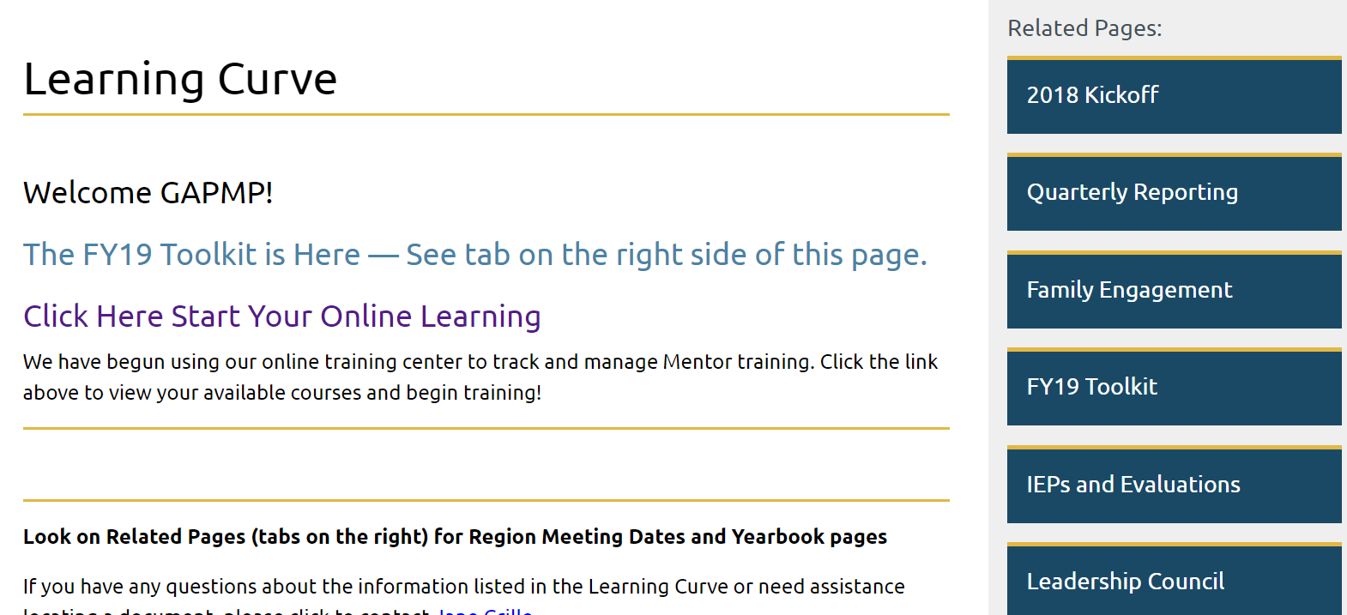
Step 3 Choose the report

Slide 6
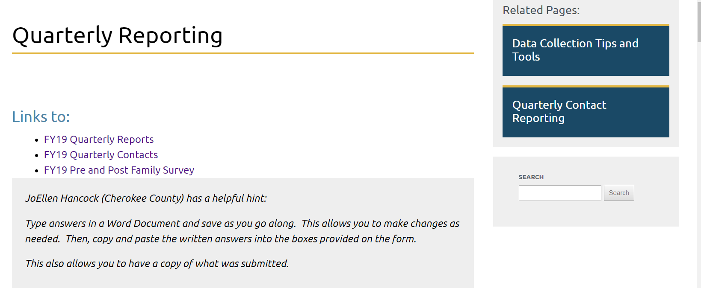
Which will you do first?
Helpful information for completing and managing reports is at your fingertips.

Slide 7
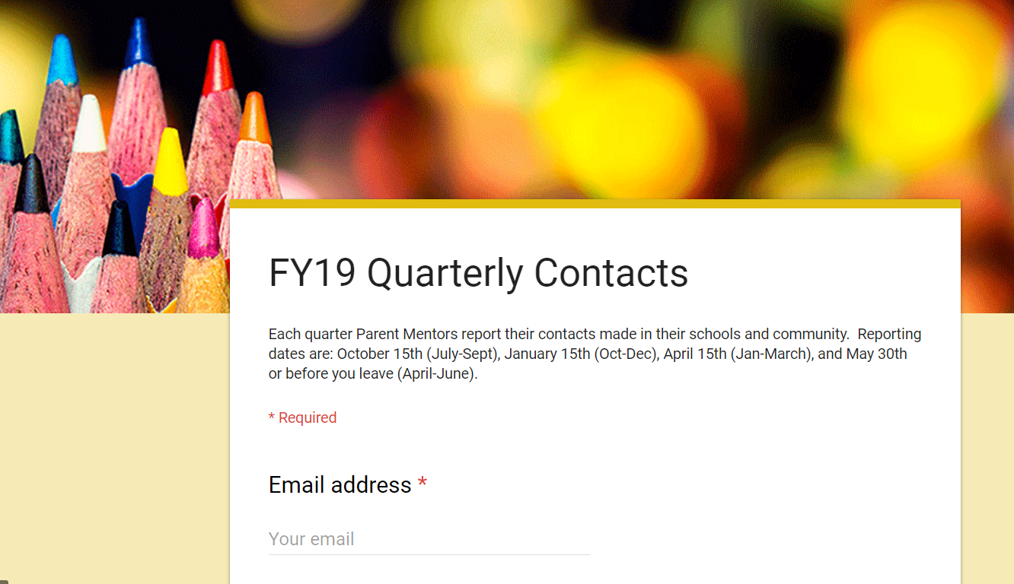
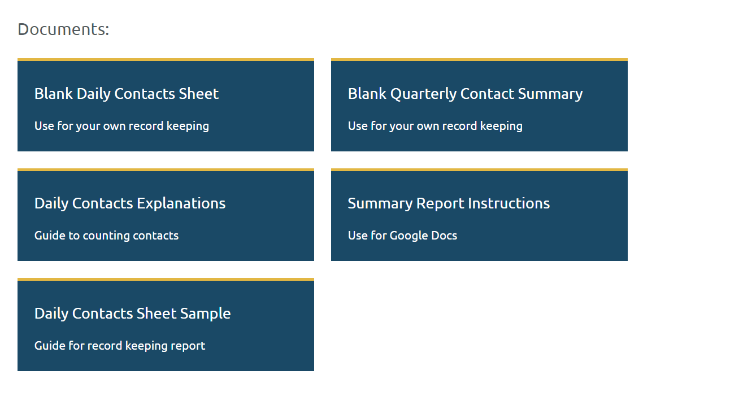
Step 4 Quarterly Contact Reporting
Hint: Not sure how to count your contacts? There are several tools on the Quarterly Contact page or… ask another mentor…

Slide 8
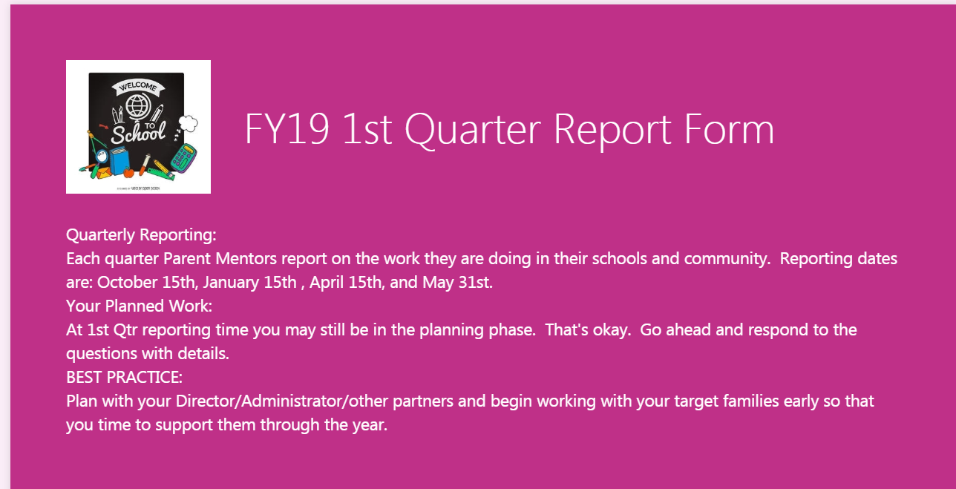

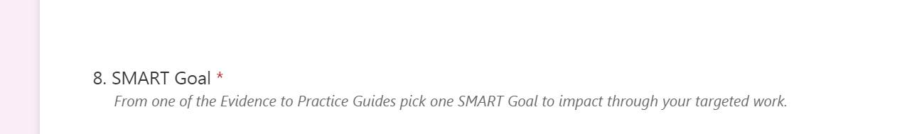
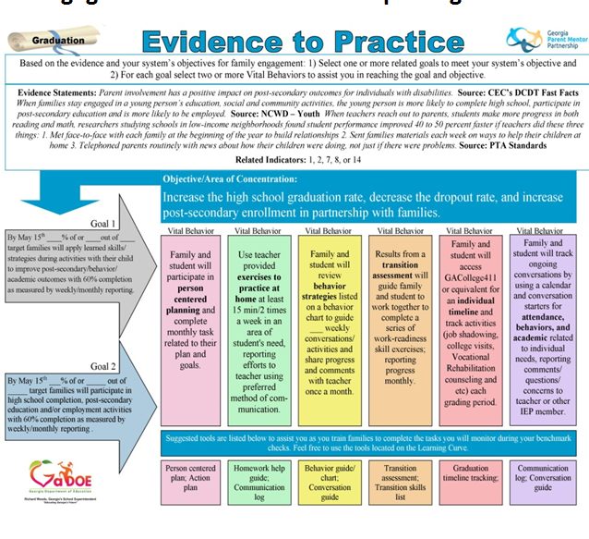
Step 5 Quarterly Reports
Click on the link and you will see the report form. There are many tools on the Learning Curve to help guide you through the reporting process.

Slide 9
Questions?
For technical support for website access
  Jane Grillo jgrillo343@yahoo.com
For reporting data questions
  Your region rep

