Slide 1
Leveraging Assets to Enhance Community-Based Programming for Youth with Disabilities
Dr. Gavin Colquitt, CAPE, CSCS
Associate Professor

Slide 2
Benefits of Physical Activity
Wellness
Psychological
Neurological
Social
Physiological

Slide 3
Benefits of Physical Activity, cont.
Exceptional children and young people, including those with the most complex needs, take part in sport and physical activity
Improving the lives of children
Sport and physical activity providers are informed, trained and enabled to include exceptional children and young people
Sport and physical activities provide natural short breaks for exceptional children and young people at times when these are most needed
Exceptional young people contribute to sport and physical activity and have leadership opportunities
Aspirations and expectations of exceptional young people and sport and activity providers are raised

Slide 4
Individuals with Disabilities Act (IDEA)
34 C.F.R.300.39(b)(2) IDEA defines "physical education" as the development of:
Physical and motor skills
Fundamental motor skills and patterns
Skills in aquatics, dance, and individual and group games and sports (including intramural and lifetime sports)
Includes special physical education, adapted physical education, movement education, and motor development

Slide 5
20 U.S.C. 1401(29) Special Education
The term 'special education' means specially designed instruction, at no cost to parents, to meet the unique needs of a child with a disability, including -
(A) instruction conducted in the classroom, in the home, in hospitals and institutions, and in other settings; and
(B) instruction in physical education.

Slide 6
IDEA and PE Interpretation by USDOE
1. Physical education must be made available equally to children with disabilities and children without disabilities.
2. If physical education is specially designed to meet the unique needs of a child with a disability and is set out in that child’s IEP, those services must be provided whether or not they are provided to other children in the agency.

Slide 7
Every Student Succeeds Act (ESSA) and IDEA
Provides a framework for elementary and secondary education in the U.S.
Includes health and physical education as part of a well-rounded education.
Provides funding for health, physical education, and physical activity programs.
Encourages development of community learning centers, school and community partnerships, and after school programs.

Slide 8
Section 504 of the Rehabilitation Act
Section 504 of the Rehabilitation Act of 1973, 29 U.S.C. §794 et seq. (Rehabilitation Act, 1973) (Rehab Act); first civil rights law for persons with disabilities.
No otherwise qualified individual with a disability in the United States shall, solely by reason of her or his disability, be excluded from the participation in, be denied the benefits of, or be subjected to discrimination under any program or activity receiving Federal financial assistance.

Slide 9
New Developments
2008. Congress issues charge to GAO to assess current status of SWD in physical education and sports. 2010 GAO Report to Congress
2011. As a result of the GAO findings, U.S. Department of Education charges Office of Civil Rights (OCR) to issue
2013. The Dear Colleague Letter

Slide 10
US DOE, Office for Civil Rights (OCR)
“Extracurricular athletics—which include club, intramural, or interscholastic (e.g., freshman, junior varsity, varsity) athletics at all education levels—are an important component of an overall education program.”

Slide 11
US Department of Education, OCR, cont.
OCR recommendations based on Section 504 requirements
Do Not Act On Generalizations and Stereotypes
Ensure Equal Opportunity for Participation
Offering Separate or Different Athletic Opportunities

Slide 12
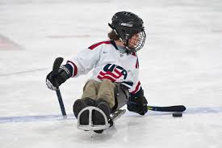
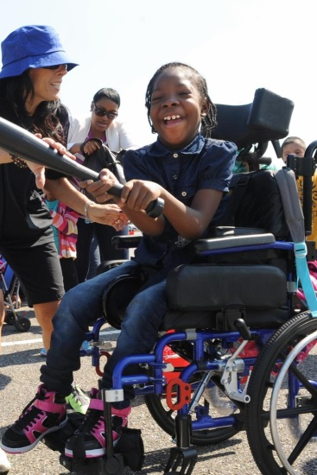
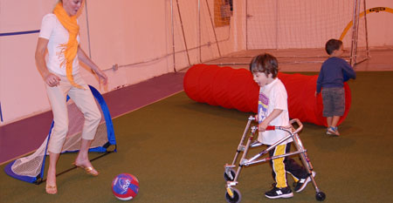
US Department of Education, OCR, cont.
When the interests and abilities of some students with disabilities cannot be as fully and effectively met by the school district’s existing extracurricular athletic program, the school district should create additional opportunities for those students with disabilities.

Slide 13
Key Recommendations
OCR urges school districts, in coordination with students, families, community and advocacy organizations, athletic associations, and other interested parties, to support these and other creative ways to expand such opportunities for students with disabilities.

Slide 14
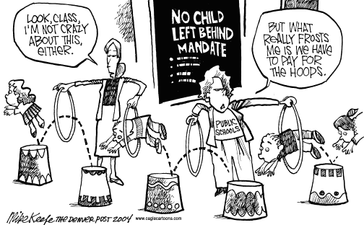
US GAO Report to Congress
“Lack of information and budget constraints may prevent schools from providing more athletic opportunities to students with disabilities.”
“Education has provided states and schools little support regarding PE or athletics for students with disabilities, and many districts we visited said more would be useful.”

Slide 15
What’s next
Advocacy and collaboration?
What does that look like?

Slide 16
Campus-Community Partnerships
Effective techniques in developing public health interventions.
Increase the likelihood that programming will be community-based, instead of ‘placed’
When a campus shares resources with a community in need (Bringle & Hatcher, 2002):
It provides the necessary resources to address the critical issues assessed within the community
It will move beyond data-driven initiatives to ignite a greater social and civic engagement to improve the community’s quality of life

Slide 17
Why a Community-Based Approach?
Bridges are created between campus and communities
Programming and research is authentic to the community
Program and research design is both culturally and educationally appropriate
Informs action
Based on an Ecological Perspective
Promotes sustainability

Slide 18
The 9 Principles of Community Partnerships (Seifer & Maurana 2000)
Partners have agreed upon the mission, goals, and outcomes for the partnership
The partnership is based upon trust, respect, and commitment
The partnerships not only examines the need for improvement but builds upon strengths and assets
A balance of power between partners must exist and resources should be shared
Communication is clear and open

Slide 19
9 Principles (cont.)
Roles and processes of the partnership are established and agreed upon by all partners
Feedback is provided to all stakeholders with the goal to continuously improving the partnership
Partners share credit for the accomplishments
Partnerships take time to develop and evolve over time

Slide 20
Living Well Together
Living Well with a Disability is an innovative, consumer-directed, goal-focused health promotion program that helps individuals develop foundations for lifestyle change (Ravesloot, Seekins, & White, 2005; www.livingandworkingwell.org).
Adapt the Living Well in the Community peer led health promotion program to address the needs of families caring for adolescents living with a disability in rural, southeast Georgia.
Implement the adapted Living Well in the Community program in southeast Georgia.
Evaluate the adapted Living Well in the Community program.

Slide 21
Current Status of Living Well Together
Program has been adapted
First cohort (n = 10) of pilot study completed
Parent facilitators
Trained, matched, and
Weekend workshops
Data Sources
Pre/post surveys
Pre/post focus groups of the curriculum
Focus groups at each workshop evaluating the adapted curriculum
Next: bring Living Well to Savannah

Slide 22
CAMP RAD
What:
A unique experience for young people with disabilities. The program will offer fun, safe opportunities for youth to get active and learn how to live a healthier lifestyle.
Who
Young people ages 10-23 with intellectual or developmental disabilities.
Staffed by adapted physical education, child and family development, and pre-PT/OT students as well as local therapists.
Where
Georgia Southern University Statesboro and Armstrong Campus
When
Monday through Thursday, 1:00-4:00 pm, May 28th through June 20st.

Slide 23
Super Eagles
What
An adapted physical activity program that that promotes fitness and motor skills for young people with disabilities.
Who
Young people ages 10-23 with intellectual or developmental disabilities.
Staffed by adapted physical education, child and family development, and pre-PT/OT student.
Where
Hanner Fieldhouse Rehabilitation Center at Georgia Southern
When
The Super Eagles will train 2 days a week from 4:00-5:15 PM

Slide 24
Leveraging Assets
Benefits of Physical Activity
Foundation for Physical Medicine and Rehabilitation ‘Rx for Exercise’
Legislation
IDEA and Section 504
Educate and advocate!
Seek Partners and Collaborate
Schools
Universities
Parks and Recreation
Private sector (gyms, wellness clinics, etc.)

Slide 25
References
Bringle, R. & Hatcher, J. (2002). Campus-community partnerships: The terms of engagement. Journal of Social Issues, 58(3), 503-516.
Seifer, S. & Maurana, C. (2000). Developing and sustaining community-campus partnerships: Putting principles into practice. Partnership Perspectives, 1(2), 7-12.

