Slide 1
Implementation Manual Revisions
Jamila C. Pollard, Esq.
Program Manager Senior/Legal Officer
Family Engagement and Dispute Resolution
Division for Special Education Services and Supports

Slide 2
Implementation Manual
(on GaDOE website)
This manual is meant to serve as a practical guide for implementing the Individuals with Disabilities Education Improvement Act of 2004 (IDEA) and its regulations. It is not intended to state new law or supplant any federal or state laws, regulations, or requirements. Nothing in this manual should be seen as having the force of law. This manual should not be cited as law or as imposing any additional requirements or obligations outside the requirements of existing law. Districts, schools, and parents are not required to adhere to this manual, but only to the requirements of the IDEA as codified in 20 U.S.C. § 1400 et seq., its regulations promulgated in 34 C.F.R Parts 300 and 301, and the rules of the State of Georgia promulgated by the State Board of Education.
The Implementation Manual is being updated. As each chapter is updated, it will be posted. Please continue to check back for additional updated chapters.
Updated Implementation Manual Chapters
Child Find
Evaluation and Reevaluation
Special Education Eligibility
General Supervision and IDEA Implementation Training
August 2018 PowerPoint Presentation

Slide 3
CHILD FIND (34 C.F.R. § 300.111; Georgia Rule 160-4-7-.03)

Slide 4
Child Find (34 C.F.R. § 300.111)
(a) General. (1) The State must have in effect policies and procedures to ensure that—
(i) All children with disabilities residing in the State, including children with disabilities who are homeless children or are wards of the State, and children with disabilities attending private schools, regardless of the severity of their disability, and who are in need of special education and related services, are identified, located, and evaluated;
(c) Child find also must include—
(1) Children who are suspected of being a child with a disability under §300.8 and in need of special education, even though they are advancing from grade to grade; and
(2) Highly mobile children, including migrant children.

Slide 5
Does Child Find apply to home-schooled children?
Yes. If the child is a resident within the jurisdiction of the LEA, then the Child Find responsibility rests with the LEA in which the child resides. In addition, as a home-schooled child, a child who is determined eligible for special education and related services must also be considered for proportionate share of federal funds for private school children. In Georgia, home-schooled children are treated as private school children in regard to special education. See Georgia Rule 160-4-7-.13(3)(a)(1).

Slide 6
If an LEA charter school and a traditional LEA serve the same demographic area, who has the Child Find responsibility?
Both of them. The LEA charter school’s Child Find responsibility extends only to children enrolled in the LEA charter school. The traditional LEA’s Child Find responsibility extends to all other children within their jurisdiction.

Slide 7
If an LEA charter school only serves a designated population, such as grades six through eight, should the LEA charter school’s Child Find procedures address children outside of the designated population, such as children in grades kindergarten through fifth grade?

Slide 8
Yes. As a matter of best practice, an LEA charter school’s Child Find procedures should include children age 3-21. However, an LEA charter school’s Child Find procedures must address the currently designated population of the LEA charter school. Since LEA charter schools may decide to expand their designated population, LEA charter schools should consider developing Child Find procedures to include children ages 3-21 or update their Child Find procedures as the LEA charter school expands their designated population.

Slide 9
Child Find for Incarcerated Youth
Considering the above guidance for LEA charter schools, what are the Child Find responsibilities for Georgia Department of Juvenile Justice (DJJ) and Georgia Department of Corrections (DOC)?
Georgia DJJ and Georgia DOC must implement Child Find duties for the youth enrolled in their respective facilities.
Who has the Child Find responsibility for youth incarcerated in facilities operated by the local sheriffs or other municipalities?
The LEA where the facility is located must implement Child Find duties for youth incarcerated in jails or other correctional facilities operated by local municipalities.

Slide 10
Child Find – Interventions Prior to Referral
IDEA requires that children who are suspected of being a child with a disability and in need of special education are identified, located, and evaluated. 34 C.F.R. § 300.111.
IDEA does not require that a child receive scientific, research, or evidence-based interventions before being referred for consideration for eligibility for special education and related services. See 34 C.F.R. § 300.111.
However, per our State Child Find Rule, the implementation of a multi-tiered system of supports, including the use of scientific, research, or evidence-based interventions are required before referring a child for an initial evaluation for special education. See Georgia Rule 160-4-7-.03(2)(b).

Slide 11
Child Find – Interventions Prior to Referral
The use of interventions before referring a child for an initial evaluation for special education can have a positive impact on reducing the disproportionate representation of racial and ethnic groups in special education and related services.
In addition, if a parent or teacher requests an evaluation and interventions have not been provided prior to the referral, interventions may be provided while the child is being evaluated (within the 60-day timeline requirement).
Although a child’s receipt of interventions can provide a critical piece of information in helping to determine eligibility for special education, the lack of interventions must not be a reason for determining that a child is not eligible for special education services.*

Slide 12
Can a parent request an evaluation without prior documentation of interventions?
Yes. Parents maintain their right under the IDEA to request an evaluation. See 34 C.F.R. § 300.301(b). LEAs may not refuse to conduct an evaluation nor delay an evaluation due to the absence of information about prior interventions. Interventions and documentation of such may be developed during the evaluation period to support the other information the evaluation is gathering.
If a LEA does not suspect that the child has a disability, and denies the request for an initial evaluation, the LEA must provide written notice to the parent explaining why the LEA refuses to conduct an initial evaluation and the information that was used as the basis for the decision, in accordance with 34 C.F.R. § 300.503(a) and (b).
The parent can challenge this decision by filing a formal complaint or requesting a due process hearing to resolve the dispute regarding the child’s need for an evaluation. See Memorandum from the U.S. Dep’t of Educ., Office of Special Education Programs (OSEP), Memo 11-07, January 21, 2011.

Slide 13
Evaluations and Reevaluations (34 C.F.R. §§ 300.301-300.311); Georgia Rule 160-4-7-.04

Slide 14
Initial Evaluation
Before an evaluation can begin, the LEA must obtain a signed, informed parental consent for evaluation. The LEA has 60 calendar days after receiving parental consent to complete the initial evaluation. 34 C.F.R. § 300.301(c)(1)(i); Georgia Rule 160-4-7-.04(b)(1)*
LEAs are not required to make the eligibility determination during the 60-day initial evaluation timeline.
Completion of the initial evaluation is defined as completion of the evaluation report(s).

Slide 15
Initial Evaluation
The eligibility decision should be made within a reasonable period of time following the completion of the evaluation. See 71 Fed. Reg. 46637 (2006).
As a matter of best practice, within 10 calendar days of the completion of the evaluation report(s) 60-day initial evaluation period, an eligibility meeting should be held.
Development of the Individualized Education Program (IEP) can take up to 30 additional days. See 34 C.F.R. § 300.323(c)(1); Georgia Rule 160-4-7-.06(13)(a).

Slide 16
Evaluation Report(s)
A comprehensive evaluation report may include combined reports; however, the timeline will be based on the most recent date.

Slide 17
Reevaluation Process
Each LEA must ensure that a reevaluation of each child with a disability is conducted at least once every 3 years, unless the parent and the LEA agree that a reevaluation is unnecessary. 34 C.F.R. § 300.303(b)(2); Georgia Rule 160-4-7-.04(3)(b).

Slide 18
Reevaluation Process - Review of Existing Data
As part of the reevaluation process, the IEP Team, including the parent and other qualified professionals must review evaluation data, including but not limited to the current full eligibility on the child that is already available. This review may include evaluations and information provided by the parent, current classroom-based local or state assessments, classroom-based observations, and observations by the teacher and related service providers.
The team will, on the basis of that review, and considering how long it has been since a comprehensive evaluation of the child last occurred, identify additional data needed, if any, to determine the following:
the present levels of academic achievement and related developmental needs of the child;
whether the child continues to have a disability or additional areas of need due to a disability;
whether the child continues to need special education and related services;
whether the child needs any additions or modifications to the special education and related services to meet the measurable annual goals set in the IEP; and
whether the child needs any additions or modifications to special education and related services to enable participation, as appropriate, in the general education curriculum.

Slide 19
Reevaluation Process
OSEP Letter to Anonymous, February 6, 2007

Slide 21
May a review of extant data alone, with the finding that no additional data are needed, constitute a reevaluation?

Slide 22
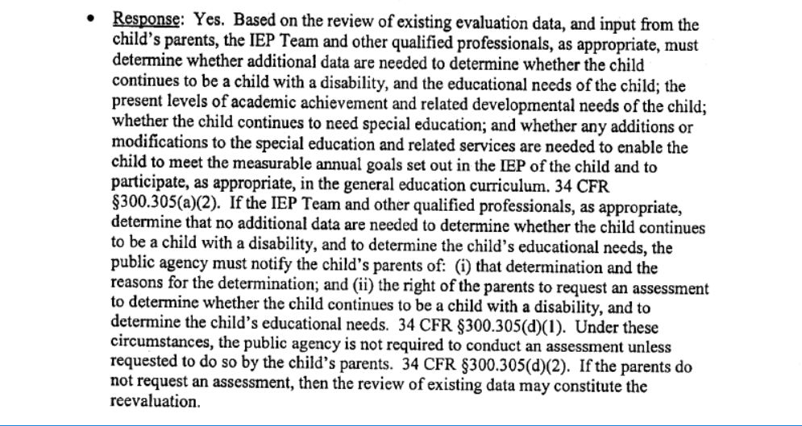

Slide 23
Reevaluation Process – Review of Existing Data
After reviewing the existing data on the child, if the IEP Team determines that no additional information is needed to determine whether the child continues to be a child with a disability and to determine the child’s educational needs, then the LEA must
notify the child’s parent of that determination,
the reasons for the determination, and
the parent’s right to request assessments for the determination of eligibility and the child’s educational needs.
If no additional information is needed, the date of this decision completes the reevaluation process and the last eligibility date does not change. In no more than three years from that date, the need for a reevaluation must be considered again.

Slide 24
Reevaluation Process – Determination of Eligibility and Educational Needs
After reviewing the existing data on the child, if the IEP Team determines that additional information is needed to determine any of the following:
the present levels of academic achievement and related developmental needs of the child;
whether the child continues to have a disability or additional areas of need due to a disability;
whether the child continues to need special education and related services;
whether the child needs any additions or modifications to the special education and related services to meet the measurable annual goals set in the IEP; and
whether the child needs any additions or modifications to special education and related services to enable participation, as appropriate, in the general education curriculum.
Then, the Team will determine which assessments are needed, provide written notice to the parent and receive written informed parental consent before conducting any additional assessments.

Slide 25
Reevaluation Process – Determination of Eligibility and Educational Needs
After the assessments are complete, the Team reviews those assessments and determines the child’s continued eligibility and educational needs.
Once this determination is made, this completes the reevaluation process and the date of this determination is the child’s reevaluation date and current eligibility date. In no more than three years from that date, the need for reevaluation must be considered again.

Slide 26
Will Georgia continue to implement the Redetermination Process? No, the Redetermination Process is no longer an option.

Slide 27
Reevaluation Process
Step 0
Step 1
Step 2

Slide 28
SPECIAL EDUCATION ELIGIBILITY REQUIREMENTS (34 C.F.R. § 300.306; GEORGIA RULE 160-4-7-.05)

Slide 29
An eligibility report doesn’t expire every three years!

Slide 30
Does a child’s eligibility for special education expire after three years?
No. A child’s eligibility for special education does not expire. However, the data used in the child’s last eligibility report may have expired, be outdated, and no longer valid. In such case, a comprehensive reevaluation is warranted. Additionally, a reevaluation, which can include only a review of existing evaluation data, must occur at least once every three years, unless the parent and the LEA agree that a reevaluation is unnecessary.

Slide 31
If a child is being considered to be dismissed from special education, must an evaluation and eligibility form be completed?
Yes. An LEA must conduct a comprehensive evaluation of a child before determining that the child is no longer a child with a disability. See 34 C.F.R. § 300.305(e)(1). This does not apply to children whose eligibility is terminating due to graduation with a regular diploma or due to exceeding the age eligibility for FAPE.

Slide 32
Any Questions???
Jamila C. Pollard, Esq.
jpollard@doe.k12.ga.us
(404) 657-7329

