Slide 1
Facilitated IEP (FIEP) Team Meeting
Parent Mentor Partnership Kick-Off
September 5 - 7, 2018
Savannah, Georgia

Slide 2
Welcome to Our Collaborative Partners
Welcome and Introduction of GaDOE staff
Introduction of District Collaborative Teams
Purpose of Meeting
  Define IEP Facilitation
  Define Role of Facilitator
  Share Benefits of Facilitation
  Share Participant Survey Results
  Discuss Benefits of Parent Mentors in Promotion

Slide 3
What is IEP Facilitation?
IEP Facilitation is a “collaborative dispute prevention and resolution process used when members of an IEP Team agree that the presence of a third party would help facilitate communication and problem solving.”
IEP Facilitation can be especially useful when there is a history of difficult interactions or a meeting is expected to be particularly complex or controversial.

Slide 4
What is IEP Facilitation?
IEP Facilitation is an optional process, not required by the Individuals with Disabilities Education Act (IDEA).
At any time in the process, a mediation or due process hearing may still be requested, as well as the filing of a formal complaint.
A Facilitated IEP (FIEP) Team meeting is the same as any other IEP Team meeting, except that a neutral facilitator joins the meeting.

Slide 5

Who are the Facilitators?
Our facilitators represent a diverse group of individuals with backgrounds including:
parents of students with disabilities
attorneys
mediators
former special education
teachers and administrators
college professors
Notes:
(15 facilitators) All facilitators participated in an intense three day professional training on conflict prevention and resolution through the IEP Team Meeting Facilitation process developed and facilitated by Key2Ed, Inc in December 2015; a one-day advanced skills training by Key2Ed in December 2016; and a one day cultural competency training by GaDOE and GSU on June 2017.
IEP Facilitators also participated in additional days of training in January 2016 on the following topics: IEP process and development, GaDOE required assessments, Georgia Standards of Excellence, Individuals with Disabilities Education Act (IDEA), and Georgia’s Special Education Implementation process.

Slide 6
What is the role of the facilitator?
Helps IEP Team members develop ground rules, an agenda, and expected outcomes for the meeting
Guides discussions by asking student-focused questions
Keeps the IEP Team on task and the meeting on schedule
Notes:
The role of the facilitator is to facilitate communication among the IEP team members
and assist them to develop an effective IEP for the student. The facilitator models
effective communication skills and offers ways to address and resolve conflicts in the
development of the IEP. Facilitators are trained in effective communication and methods for
addressing and resolving conflicts. The members of the IEP team are the decision-makers.

Slide 7
What is the role of the facilitator?
Asks questions to clarify points of agreement and disagreement and helps identify workable solutions
Does NOT make decisions or determine if team members are right or wrong
Does NOT address issues unrelated to the IEP and does NOT draft the IEP

Slide 8
What are some benefits of using IEP Facilitation?
May build and improve relationships among IEP Team members
Team members may feel better heard when a facilitator is involved
Allows all members of the IEP Team the chance to participate fully

Slide 9
What are some benefits of using IEP Facilitation?
The IEP Team may work together more effectively and efficiently to create an IEP that benefits the student and is supported by all IEP Team members.
Keeps decision-making with the IEP Team members who know the student best
Helps resolve disagreements more quickly than other dispute resolution processes (and is less costly – free to parents and districts)

Slide 10
FIEP Team Meeting Program
Began in March 2016 in 4 pilot districts (Bartow, Fulton, Greene, and Union)
In August and October 2016, we added White and Turner
In January and August 2017, we added Bryan, Butts, Catoosa, Clayton, DeKalb, Evans, Gainesville City, Ivy Prep at Gwinnett and Kirkwood, Jackson, Lowndes, Pierce, Rome City, and State Schools

Slide 11
FIEP Team Meeting Program
During the 2017-2018 school year, we received 64 FIEP requests and 56 FIEP Team meetings have been held
We provide at least 1 facilitator at each FIEP Team meeting
242 participant surveys returned
48 facilitator surveys returned

Slide 12
FIEP Team Meeting Project
As of May 2018, we have 37 participating districts:
Atlanta Public Schools
Bartow County
Bryan County
Butts County
Cartersville City
Catoosa County
Charlton County
City Schools of Decatur
Clarke County
Clayton County
Cobb County
Columbia County
Cook County
Coweta Charter Academy
DeKalb County
Evans County
Fulton County
Gainesville City
Georgia Cyber Academy
Gordon County
Greene County
Ivy Prep at Gwinnett
Ivy Prep at Kirkwood
Jackson County
Lamar County
Lowndes County
Miller County
Muscogee County
Oconee County
Pierce County
Richmond County
Rome City
Scintilla Charter Academy
State Schools
Turner County
Union County
White County
Notes:
Need to update

Slide 13
37 Participating FIEP Districts
Dade
Catoosa
*Dalton
Fannin
Towns
Rabun
Walker
City
Union
*Chickamauga
Whitfield
Murray
Gilmer
White
Habersham
City
Lumpkin
Stephens
Chattooga
Gordon
Pickens
*Trion
*Calhoun
City
City
Dawson
*Gainesville
Banks
Franklin
Hart
* Rome
Bartow
Cherokee
City
City
*Cartersville
Forsyth
Hall
*Commerce
Floyd
City
*Buford City
City
Jackson
Madison
Elbert
Polk
Cobb
*Jefferson
City
Clarke
Paulding
*Marietta
Gwinnett
Barrow
Oglethorpe
Haralson
City
DeKalb
Walton
O
c
o
n
e
e
Wilkes
Lincoln
*Breman
Fulton
*Decatur
*Social Circle
City
Douglas
City
o
c
k
d
a
l
e
City
Morgan
*Carrollton
*Atlanta
R
Newton
Greene
Taliaferro
City
City
l
C
M
c
D
u
Columbia
Charter Schools – Ivy Prep Academy at Gwinnett; Ivy Prep Academy at Kirkwood (DeKalb); Scintilla; Coweta Academy; GA Cyber Academy
State Schools – AASD, GSD, GAB
Carroll
a
Henry
Warren
f
f
i
e
y
Fayette
t
o
Heard
Coweta
n
Jasper
Putnam
Hancock
Richmond
Spalding
Butts
G
l
a
s
c
o
c
k
Troup
Meriwether
Pike
Lamar
Monroe
Jones
Baldwin
Washington
Jefferson
Burke
Upson
Bibb
Wilkinson
Jenkins
Harris
Talbot
Crawford
Twiggs
Johnson
Screven
Muscogee
Taylor
Peach
*Dublin
Emanuel
Houston
Bleckley
City
Treutlen
Candler
Chattahoochee
Marion
Macon
Pulaski
Laurens
Bulloch
Effingham
Schley
Dooly
Dodge
M
Toombs
Evans
Wheeler
o
Stewart
Webster
t
n
g
*Vidalia City
Sumter
o
Wilcox
m
Tattnall
Bryan
Chatham
e
r
Crisp
Telfair
y
s
Quitman
i
Terrell
Lee
Ben Hill
J
e
f
f
D
a
v
Long
Liberty
Clay
Randolph
Turner
Appling
Calhoun
Dougherty
Worth
Irwin
Coffee
Bacon
Wayne
McIntosh
Tift
Pierce
Early
Baker
Mitchell
Berrien
Atkinson
Glynn
Miller
* Pelham
Colquitt
Cook
Ware
Brantley
City
Lanier
S
Decatur
Grady
Thomas
Clinch
Camden
e
m
Brooks
Lowndes
Charlton
i
n
o
e
l
*Thomasville
*Valdosta
Echols
City
City

Slide 14

What does the data show us?
95% of participants indicated that they had an appropriate level of input in determining the content of the IEP.
89% of participants indicated that they had sufficient time to express their issues and concerns.
94% of participants indicated that the IEP Facilitation provided strategies for future IEP Team meetings.
99% of participants felt that the facilitator was neutral and favored neither party.

Slide 15
What does the data show us?
92% of participants indicated that the facilitator was very helpful in facilitating discussion to generate and consider options for resolving disputes.
85% of participants indicated that the IEP facilitation prevented the need for other dispute resolution processes.
90% of participants indicated that they were very satisfied with the outcome of the IEP Facilitation.
95% of participants indicated that they would recommend IEP Facilitation to others.

Slide 16
FIEP Process and Procedures
Either the parent or the school district may initiate the request for a Facilitated IEP Team meeting.
Parents or district personnel can access the FIEP Team meeting request form from a participating school district’s website.
  Links to participating school district’s websites can also be accessed on the GaDOE IEP Team Meeting Failitation
Complete and submit the FIEP Team meeting request form to the special education director in the district.
Since both parties must agree, a parent and the special education director’s signature must be on the FIEP Team meeting request form prior to submission to the GaDOE.

Slide 17
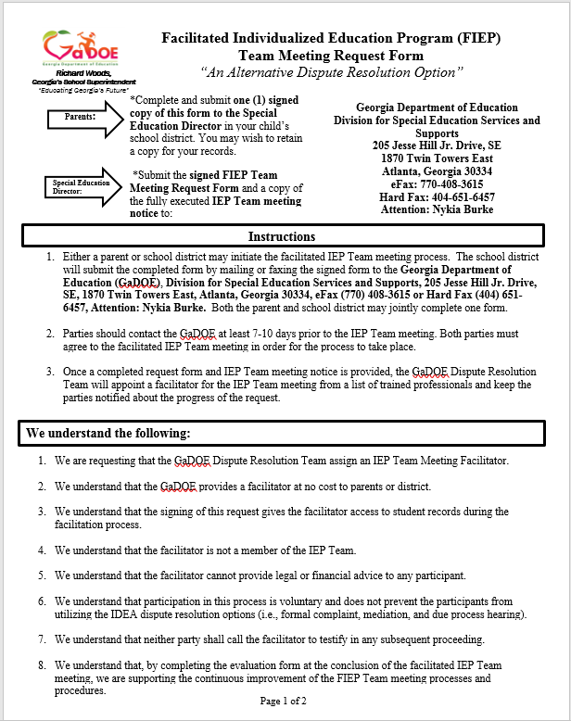
FIEP Request Form

Slide 18
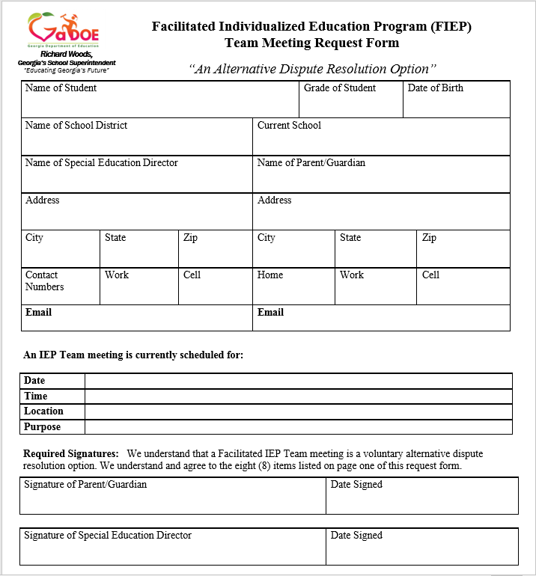
FIEP Request Form

Slide 19
FIEP Process and Procedures
The district will submit the signed FIEP Team meeting request form and a copy of a fully executed IEP Team meeting notice to the GaDOE at least 7-10 days prior to the meeting date.
  Please indicate whether the FIEP Team meeting was a request from the parent or the district.
The GaDOE will notify parties via email of whether their request has been approved or denied. If approved, the GaDOE will provide the parties with the name of the assigned facilitator.

Slide 20
FIEP Process and Procedures
The assigned facilitator will contact the parent and district within 2 business days in order to get an understanding of the issues/concerns, and assist the parties in creating an agenda, expected outcomes, and group norms for the meeting.
Facilitators will not receive draft IEPs, evaluations, etc. before the meeting.

Slide 21

What to expect in a FIEP Team meeting
At the FIEP Team meeting, parties will sign an Agreement to Facilitate form.
The IEP Facilitator will help facilitate communication and problem solving among the parties using a visual record (chart paper) of:
  Group norms
  Agenda
  Expected Outcomes
  IEP-content (e.g. strengths & challenges, annual goals, placement, etc.)
  Action Plan, if appropriate
At the end of the meeting, parties will be asked to complete an evaluation form.

Slide 22
Sample Agenda
Start Up
  Welcome, Purpose, Introductions/Roles, Desired Outcomes, Agenda overview, Parent rights, Decision making process, Group Norms
Present Levels of Academic Achievement and Functional Performance
  Recent Evaluations, State/District Testing, Strengths, Needs, Parent Concerns, Impact of Disability, Consideration of Special Factors, Review of current goals and objectives, review of progress monitoring data
Goals and Objectives
Placement/Services
  Transition Service Plan, Student Supports, Assessment Determination, Special education and related services, Explanation of extent, if any, not participating with peers without disabilities, Extended School Year (ESY)
Ending
Notes:
Explain how the strengths and challenges discussion will differ from traditional meetings.

Slide 23
Let’s Discuss . . . .
What have you done to promote the use of FIEP Team meetings in your district and what can be done differently?
How can the parent mentors be an asset to the use of FIEPs in your district?
How can the GaDOE help promote the use of FIEP Team meetings in your district?

Slide 24
Helpful Guide
The Role of an IEP Facilitator is to . . .
IEP Facilitation is . . .
GUIDE the discussions during the IEP Team meeting by asking student-focused questions
ASSIST Team members in the thoughtful, productive construction of a quality IEP
Help CREATE an agenda, group norms, and expected outcomes for the meeting
ENCOURAGE full participation of all members of the IEP Team
A COLLABORATIVE dispute prevention and resolution process
VOLUNTARY for all parties
A process to HELP IEP Teams overcome the pressure and anxiety of complex or controversial meetings
The SAME as any other IEP Team meeting, except that a neutral facilitator joins the meeting

Slide 25
Resources
WEBSITE
http://www.gadoe.org/Curriculum-Instruction-and-Assessment/Special-Education-Services/Pages/IEP-Facilitation.aspx
PARENT GUIDE
http://www.gadoe.org/Curriculum-Instruction-and-Assessment/Special-Education-Services/Documents/Dispute%20Resolution/IEP%20Facilitation/IEP%20Facilitation%20Parent%20Guide%209-9-2016.pdf
PARENT GUIDE – Spanish
http://www.gadoe.org/Curriculum-Instruction-and-Assessment/Special-Education-Services/Documents/Dispute%20Resolution/IEP%20Facilitation/ES_IEP%20Facilitation%20Parent%20Guide%202-18-2016%20(2).pdf
PROMOTIONAL FLYER
http://www.gadoe.org/Curriculum-Instruction-and-Assessment/Special-Education-Services/Documents/Dispute%20Resolution/IEP%20Facilitation/FIEP%20Flyer%202%20updated%209-9-16.pdf
PROMOTIONAL FLYER – Spanish
http://www.gadoe.org/Curriculum-Instruction-and-Assessment/Special-Education-Services/Documents/Dispute%20Resolution/IEP%20Facilitation/ES_FIEP%20Flyer%202.pdf

Slide 26

Contact Information
Jamila Pollard, Program Manager Senior/Legal Officer
  jpollard@doe.k12.ga.us
  Office: (404) 657-7329
  Cell: (404) 670-2683
  eFax: (770) 344-4477
Paula Gibson, Program Specialist
  pgibson@doe.k12.ga.us
  Cell: (404) 710-2808
  Fax: (404) 651-6457

