Slide 1
GaPMP KICKOFF CONFERENCE 2018

Slide 2
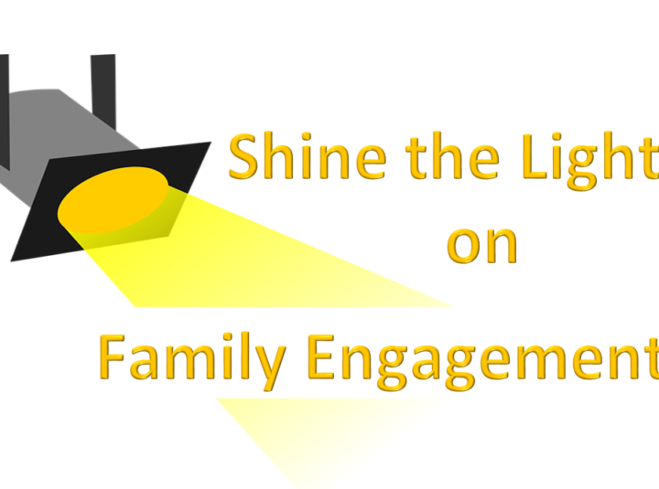
Engaging Families through Developmental Relationship Framework

Slide 3
Welcome This parent session was developed by Search Institute based on the framework of developmental relationships.

Slide 4
Whose in the room? I am ____ and I love to ____with my family.

Slide 5
Learning Targets:
Participants can identify the 5 key elements in the developmental framework.
Participates can define 8 of the 20 actions that are tied to building powerful relationship as related to the 5 key elements.
Participants understand that parent–child relationship are key to students’ success.

Slide 6
Who made a difference for you?
Let’s talk about positive impact.
Who was this person?
What positive thing did they do that made a difference for you?

Slide 7
May 2017
The Developmental Relationships Framework
Young people are more likely to grow up successfully when they experience developmental relationships with important people in their lives.
Developmental relationships are close connections through which young people discover who they are, cultivate abilities to shape their own lives, and learn how to engage with and contribute to the world around them.
Search Institute has identified five elements—expressed in 20 specific actions—that make relationships powerful in young people’s lives.

Slide 8
video
https://www.youtube.com/watch?v=n5Y9k
wCOF7I

Slide 9
Relationships are at the heart of what youth need to learn, grow, and thrive.
Relationships are developmental when they help (young) people
Discover who they are
Develop abilities to shape their own lives, and
Learn how to engage with and contribute to the world around them.

Slide 10
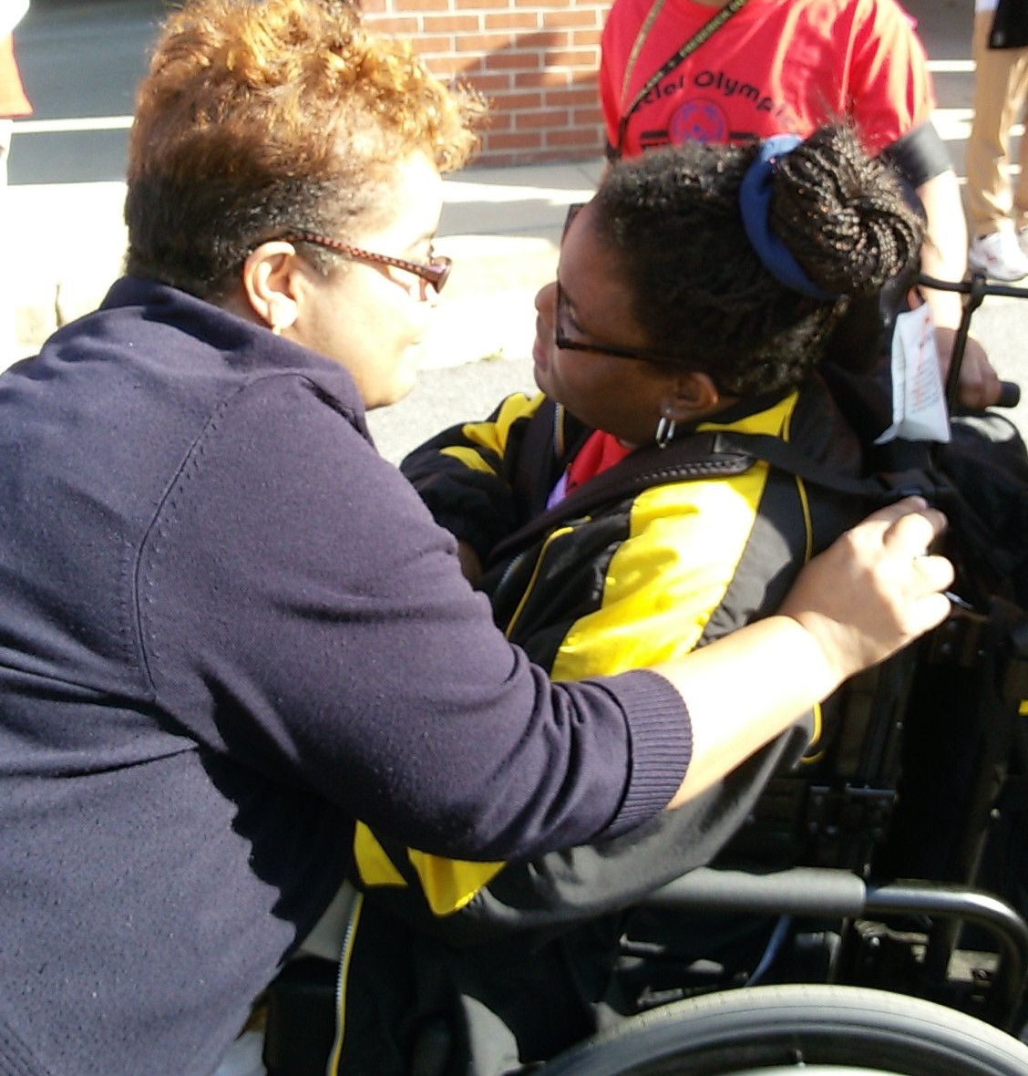
Express Care
What actions do you see in this picture?

Slide 11
Express Care
Be dependable
Listen
Believe in me
Be warm
Encourage
Be someone I can trust
Really pay attention when we are together
Make me feel known
Show me you enjoy being with me.

Slide 12
Biosphere 2 is a research experiment that recreates earth’s ecosystem, including plants and trees. Through Biosphere 2’s research, scientists found that although trees grew faster in the indoor environment than they did outdoors, they would collapse under their own weight before they’d reach maturity. This happened, they concluded, because there was no wind in the biosphere to produce “stress wood” in the trees. This type of wood makes the tree more resilient and allows the trees to be strong enough to live to maturity.
Trees are not alone in needing challenges to become strong. Young people also need strength and resilience to become thriving adults. We all need to be able to withstand stress to survive. That’s why “Challenge Growth” is one of the five elements of a developmental relationship.

Slide 13
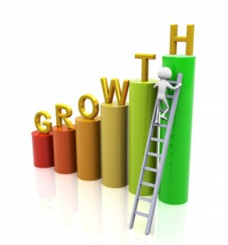
Challenge
Expect my best Expect me to live up to my potential.
Stretch Push me to go further.
Hold me accountable Insist that I take responsibility for my actions.
Reflect on failures Help me to learn from my mistakes and set backs.

Slide 14
Maintaining Balance
Challenging growth calls for a balance of several factors. Getting this balance right—and adjusting when needed—is key young people’s success. Challenges that fit with kids’ interests and abilities are more likely to trigger growth or learning.
Maintaining Balance
CHALLENGING GROWTH CALLS FOR A BALANCE OF SEVERAL FACTORS. GETTING THIS BALANCE RIGHT—AND ADJUSTING WHEN NEEDED—IS KEY YOUNG PEOPLE’S SUCCESS. CHALLENGES THAT FIT WITH KIDS’ INTERESTS AND ABILITIES ARE MORE LIKELY TO TRIGGER GROWTH OR LEARNING.
Challenge Is | Interest/Ability Is | The Likely Result Is
Low | + Low | = Apathy
Low | + High | = Boredom
High | + Low | = Anxiety
High | + High | = Growth

Slide 15
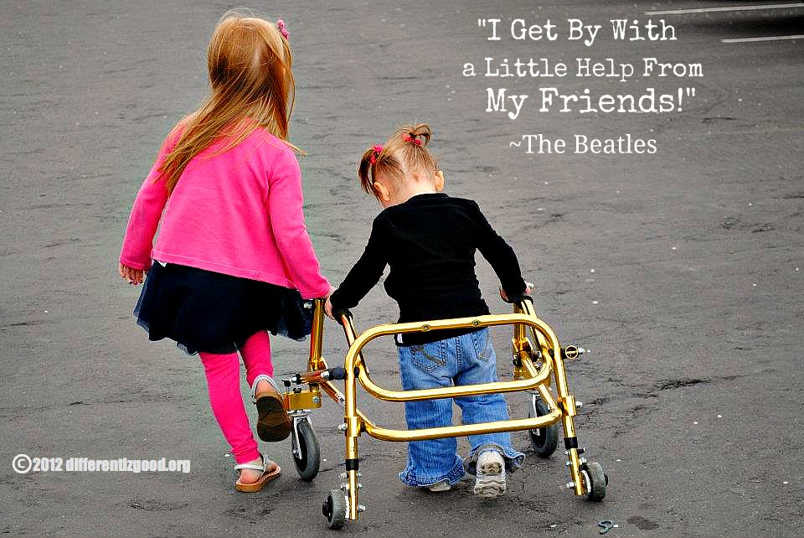

Slide 16
Provide Support
Help me to complete tasks and achieve goals
• Navigate ........................ Guide me through hard situations and systems.
• Empower ...................... Build my confidence to take charge of my life.
• Advocate ....................... Stand up for me when I need it.
• Set boundaries ............. Put in place limits that keep me on track.

Slide 17
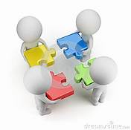
Share Power
Treat me with respect and give me a say
• Respect me ................... Take me seriously and treat me fairly.
• Include me .................... Involve me in decisions that affect me.
• Collaborate ................... Work with me to solve problems and reach goals.
• Let me lead ................... Create opportunities for me to take action and lead.

Slide 18
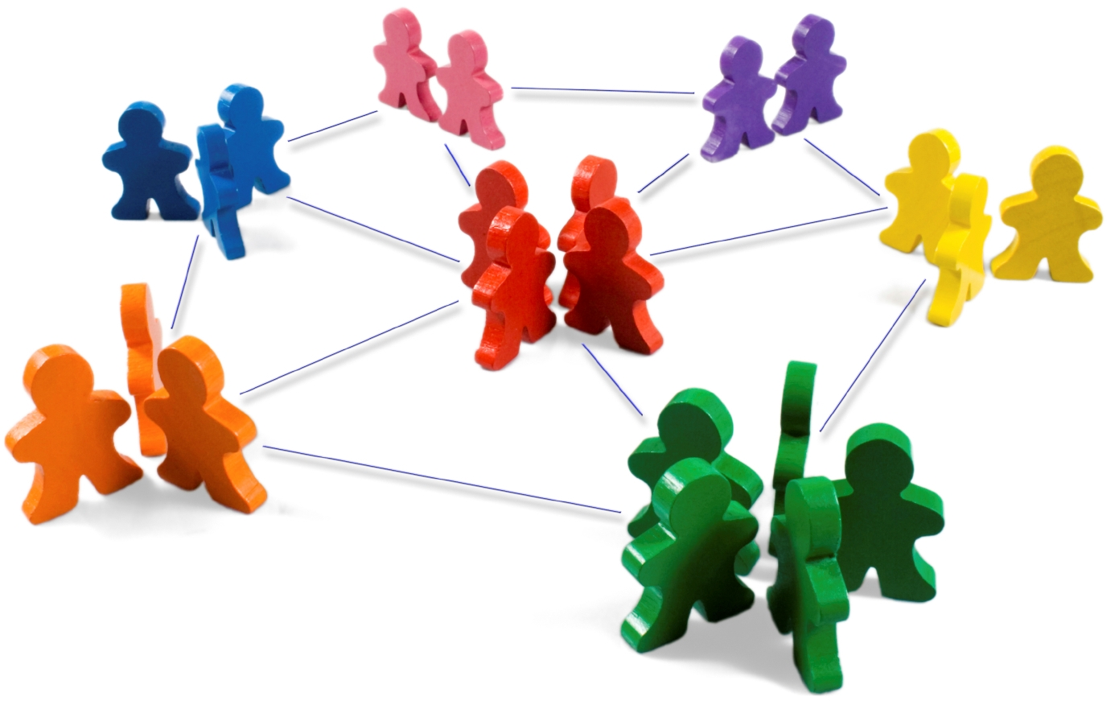
EXPAND POSSIBILITIES
Connect me with people and places that broaden my horizons.
Actions
Inspire
Broaden horizons
Connect
Definitions
Inspire me to see possibilities for my future.
Expose me to new ideas, experiences, and places.
Introduce me to more people who can help me grow.

Slide 19
Research on the 5 keys
Which key do you think was most common?
Which do you think was least common?

Slide 20
What finding from the study was most encouraging to you as a parent? Why? What finding is most important for parents to hear?
You may download the whole study from www.search-institues.org/dff

Slide 21
Stories of Positive Parent–Child Relationships
Express Care Share Power
Provide Support Expand Possibilities
Challenge Growth

Slide 22
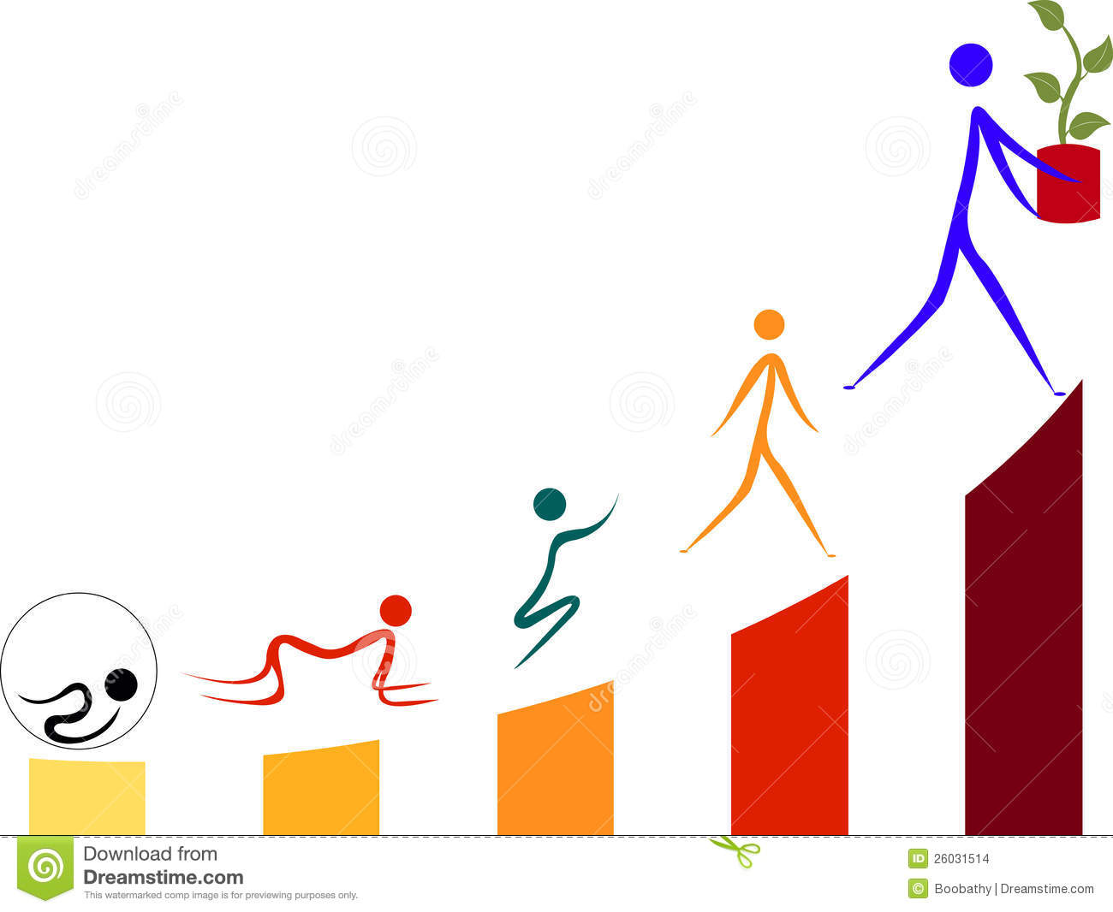
Gg
Growth: “Supportive relationships are critical ‘mediums’ of development. They provide an environment of reinforcement, good modeling, and constructive feedback for physical, intellectual, and social growth.” — National Research Council15

Slide 23
Video
https://www.search-institute.org/developmental-relatio
nships/learning-developmental-relationships/

Slide 24
Resilience: “Whether the burdens come from the hardships of poverty, the challenges of parental substance abuse or serious mental illness, the stresses of war, the threats of recur-rent violence or chronic neglect, or a combination of factors, the single most common finding is that children who end up doing well have had at least one stable and committed relationship with a supportive parent, caregiver, or other adult.”— National Scientific Council on the Developing Child17

Slide 25
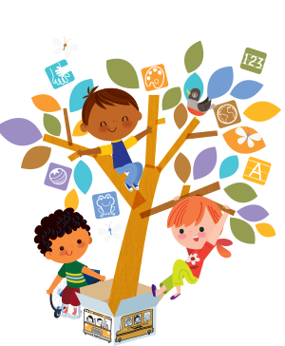
15Social-emotional skills: “Relation-ships are the soil in which children’s SEL [social-emotional learning] skills grow.”— Jones & Bouffard12

Slide 26
Can you: identify the 5 key elements in the developmental framework.
Can you: define 8 of the 20 actions that are tied to building powerful relationship as related to the 5 key elements.
Do you understand that parent – child relationship are key to students’ success ?

Slide 27
Thank you, if you would like to dig deeper into this study go to www.search-institute.org
Edith Abakare
Atlanta Public Schools
DSE Parent Mentor
404-802-3607
eabakare@atlanta.k12.ga.us

