Slide 1
Super Couper!
Griffin Couper and Paige Couper
Paige Case and Allyn Case
Jenkins High School

Slide 2
http://bit.ly/28RYAWQ

Slide 3
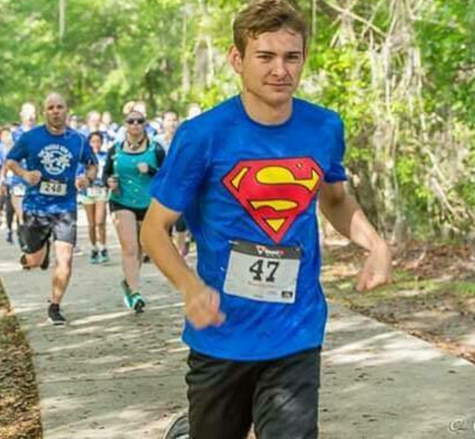
Raised over $3,000 for Autism Puzzle Run

Slide 4
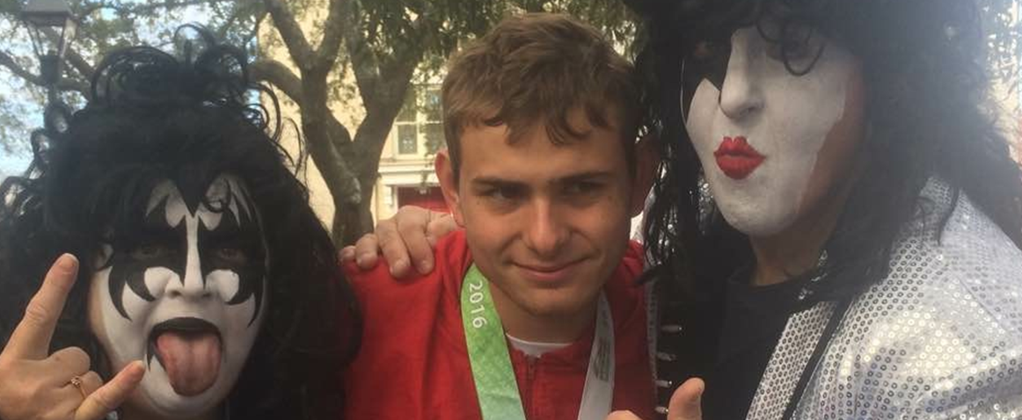
Meet Rock Stars!!!

Slide 5
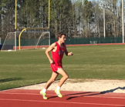
Griffin’s Thoughts about being on JHS Track Team

Slide 6
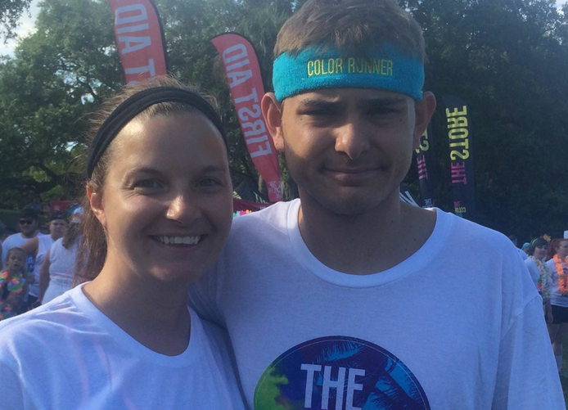
Color Run

Slide 7
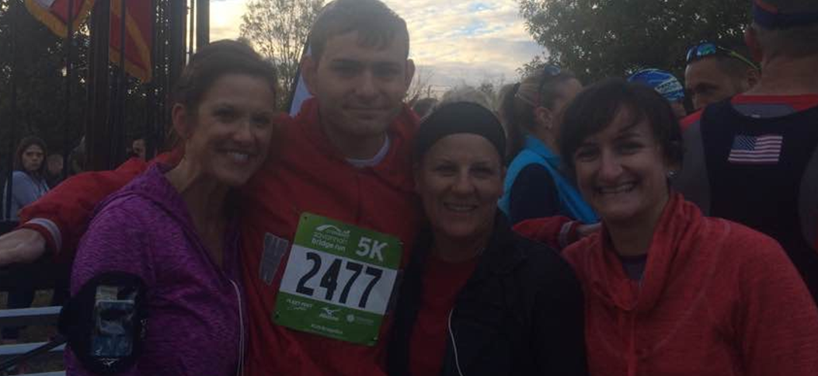
The Bridge Run

Slide 8
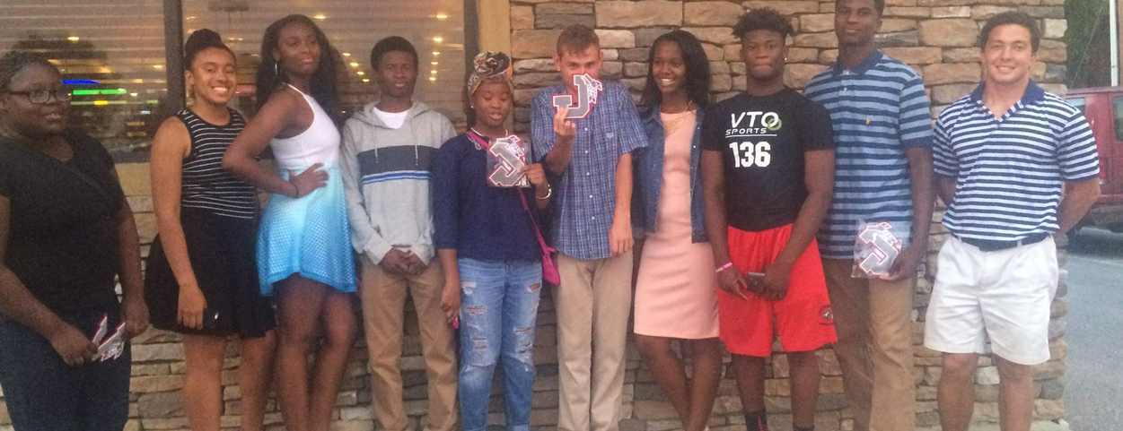
Lettered in High School Sport

Slide 9
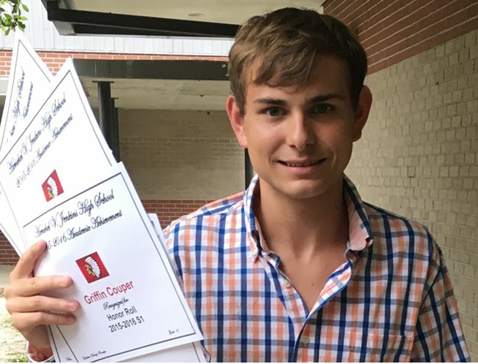
Honor Roll Student at Jenkins High School

Slide 10
Parent Thoughts

Slide 11
The How…
Staff Recognizing Student’s Potential Talent and Interests
Student Commitment
Parents Willing to Participate
Staff Relationships

Slide 12
The Why...
Because there are many advantages of Athletics/Fitness Programs for Students with Disabilities and research to prove it.
Builds Self-Esteem
Health Benefits
Behavioral Improvement
Improves Focus
Develops Relationships

Slide 13
The What...
Fitness
Daily Walk/Run Program through Achilles International
Students Accessing Elliptical, Weights and Other Fitness Equipment
Monitor Caloric Intake/Conduct Fitness Assessments
Starting a Yoga Class
Athletics
Students Participating in Track and Field, Tennis, Swimming, Wrestling, Football

Slide 14
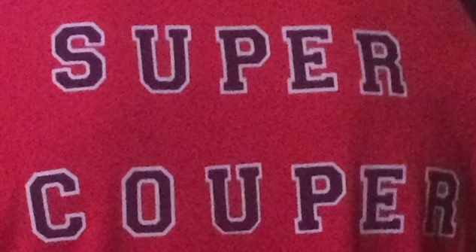
Questions????

