Slide 1
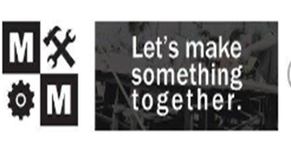
Presented by the Savannah Chatham Community

Slide 2
https://youtu.be/XnXZ6nDFch0

Slide 3
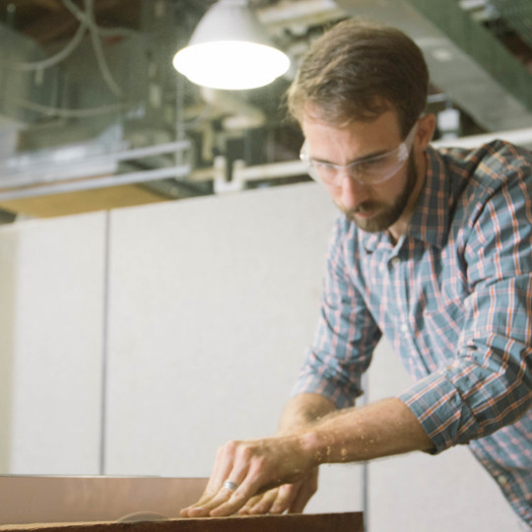
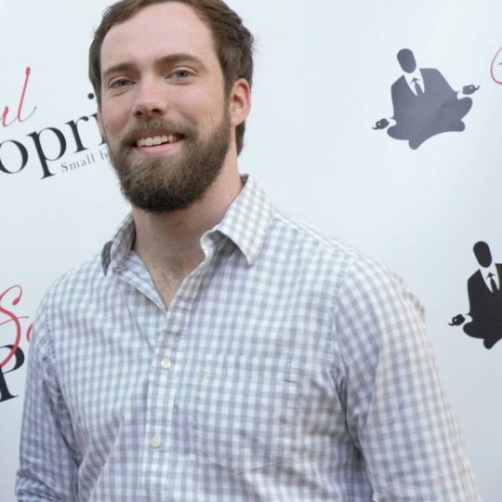
Meet the Mavens!
Ty Donaldson and Tim Cone

Slide 4
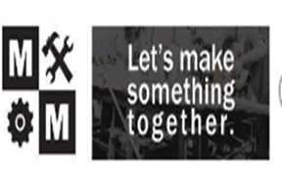
A Word From the Mavens
Maven Makers mission is to create a maker movement which fosters a community of making vs. consuming.
Collaborate with other local groups and organizations to teach the value of making vs. consuming to those of a younger age.
Collaboration with SCCPSS to work with SWD high school students to provide a hands-on approach to help develop our workforce.

Slide 5

A Word from Willie
Teach hands-on life skills using everyday tools
Started from a relationship with people who enjoyed a common purpose –The Mavens
Student pride and satisfaction in being able to create something with your own hands
Parent pride and amazement in their child’s accomplishments

Slide 6

Community Based Vocational Instruction
Unique CBVI site - teaches power tool safety, skills, and work behaviors
Follow multi-step directions to create beautiful handcrafted wood pieces
Increased attention to task & focus
Encourages team work and collaboration

Slide 7
District Implications
Creative alternatives for students
Increased engagement which positively impacts attendance and behavior
Employment implications directly connected to our community
Exercise in working backwards
Opportunity to build capacity for adulthood for students and community relationships

Slide 8
Student Implications
Blaine’s focus has improved greatly
He has improved communication skills
He is able to self regulate
Self Determined/Self Advocacy

Slide 9
Parent Perceptions
How Blaine has changed since he started high school to now ( Maven Makers)
Your Thoughts on this type of vocational opportunity

Slide 10
Next Steps for Blaine….
Blaine is participating in Project SEARCH this year
Participates in community farmer’s markets to sell his product
Supports the Islands High School football team

Slide 11
Questions

Slide 12

Thanks for Sharing our Story!

