Slide 1
Hats off to Student Success
Dr. Zelphine Smith-Dixon, State Director
Georgia Department of Education
Division for Special Education Services and Supports

Slide 2
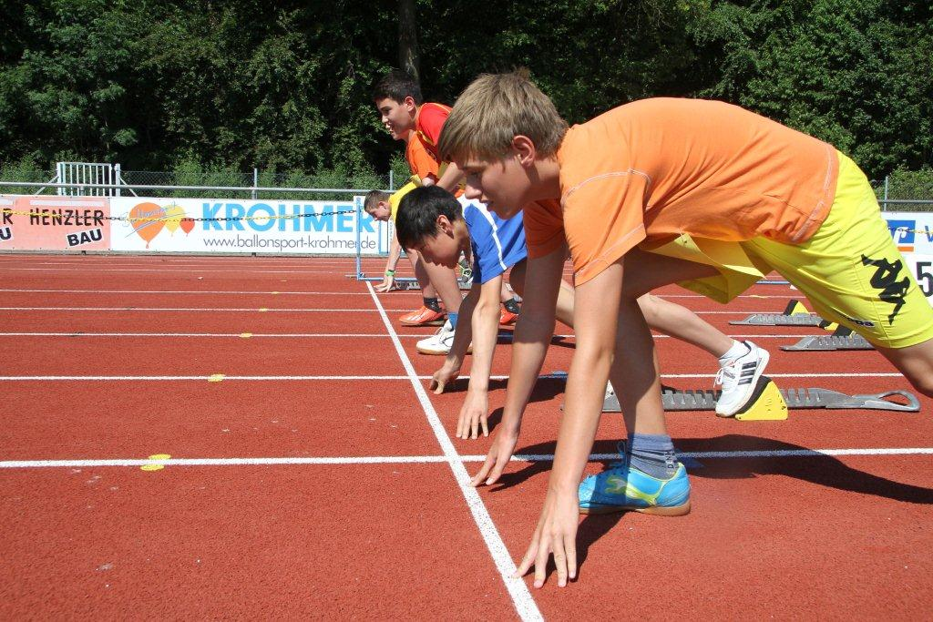
Hats off to Student Success…
Less like a relay more like a race!
DO ALL STUDENTS REALLY HAVE THE SAME ADVANTAGE?

Slide 3

Students with Disabilities
ELL
All Students
Multi-Racial
Asian/Pacific Islander
Hispanic Students
Economically Disadvantaged Students
Black Students
White Students

Slide 5
Students with Disabilities (58.9%)
ELL (59%)
All Students (80.6%)
Multi-Racial (81.5%)
Asian/Pacific Islander (91.2%)
Hispanic Students (73.6%)
Economically Disadvantaged Students (76.4%)
Black Students (77.8%)
White Students (84%)

Slide 6
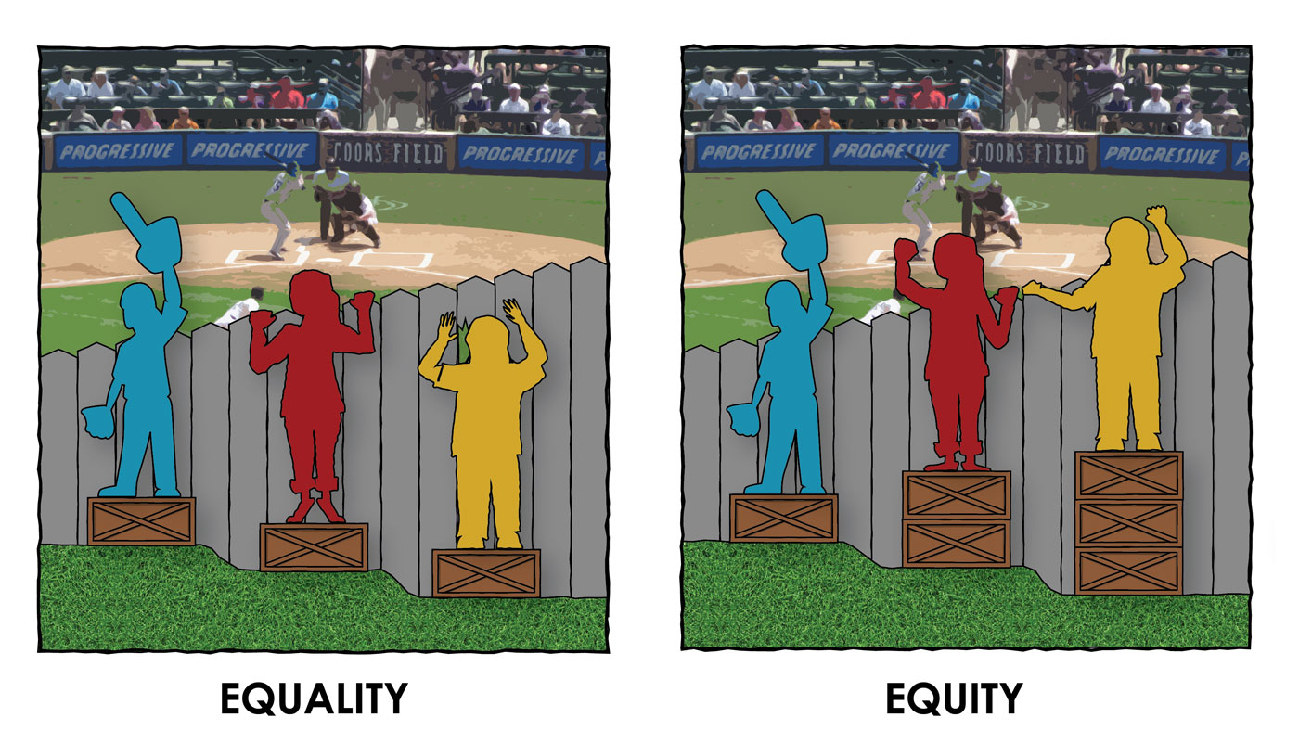

Slide 7
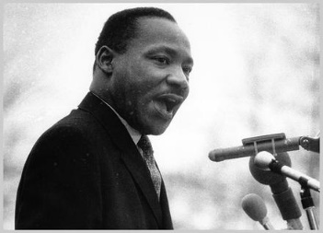
Injustice anywhere is a threat to justice everywhere. MLK

Slide 8
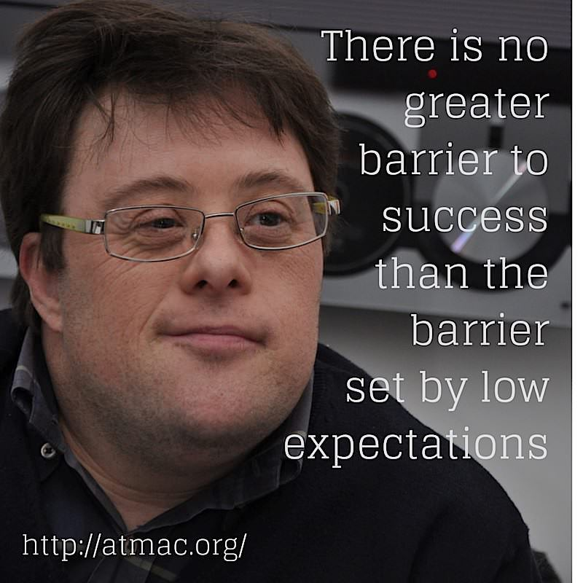

Slide 9


Slide 10
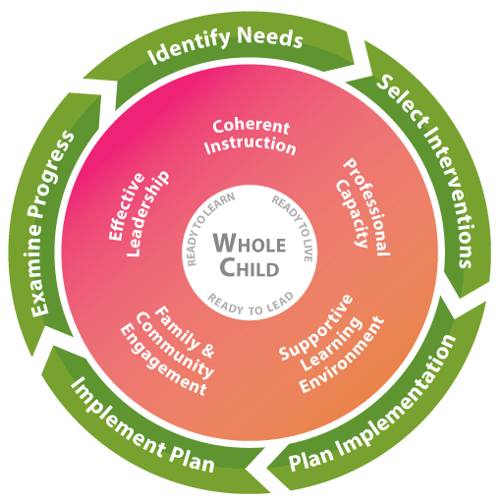

Slide 11
If Every Student Succeeds…this is not an act

Slide 12
If Every Student Succeeds, then All Students
Must Matter!
Zelphine Smith-Dixon

Slide 13
If All Students
matter, then we must give each student the tools necessary to run the race!
Zelphine Smith-Dixon

Slide 14
More importantly, we must shift the competition of the race and embrace a culture of a relay.

Slide 15
Culture of a Relay implies…
Coordination of Strengths
Collaboration of Efforts
Commitment of Resources
Consensus of Purpose

