Slide 1
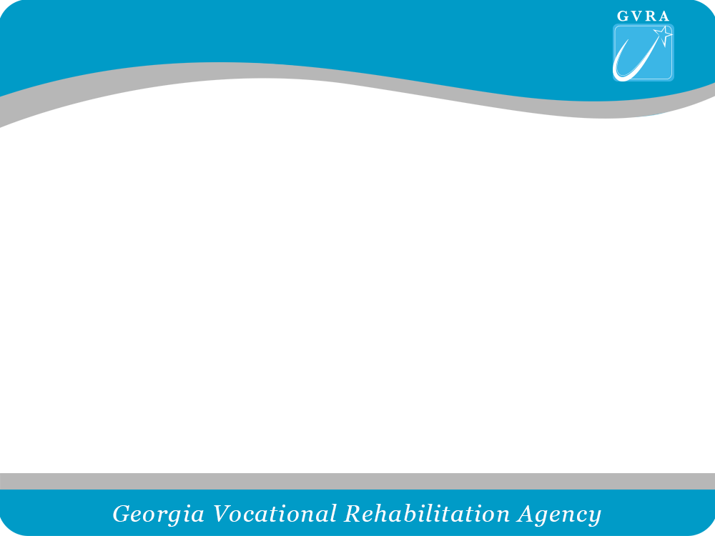
The Vocational Rehabilitation Process
Step by Step
Developed for the
Parent Mentor Network
August 2017

Slide 2
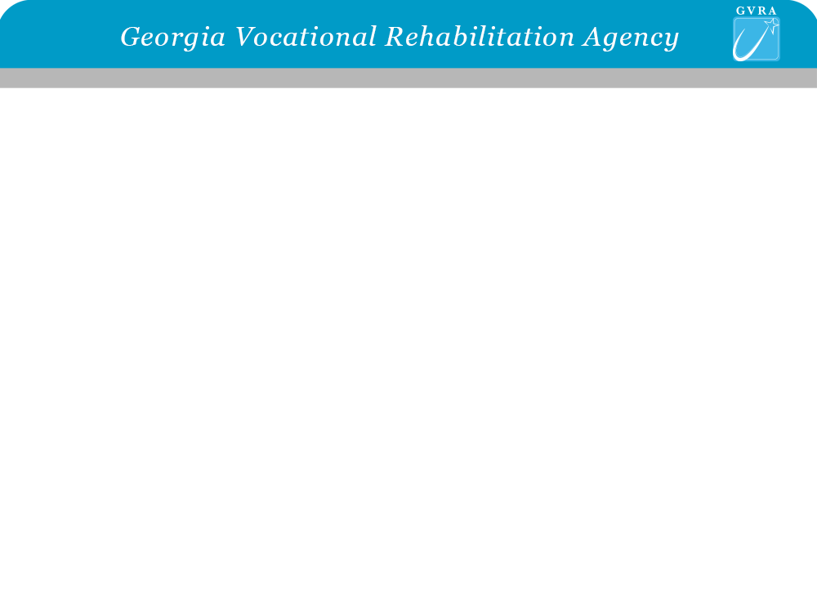



Slide Title
Mission: Employment & independence for Georgians with disabilities
5 Programs & 1,500 Employees:
Vocational Rehabilitation (VR)
Roosevelt Warm Springs Institute for Rehabilitation (RWS)
Business Enterprise Program (BEP)
Georgia Industries for the Blind (GIB)
Disability Adjudication Services (DAS)
Funding:
$20M state funds & $80M federal VR funds (VR, RWS, BEP)
$77M federal SSA funds (DAS)
$10M state & federal contract funds (GIB)
$15M other funds
Data:
National unemployment rate for PwD = 70%
1.2 million Georgia PwD
650,000 of working age
Georgia VR’s serves 30,000 & 5,000 employed
National VR decreased 11% in total served & employed

Slide 3


  Vision:
  Every Georgian with a disability can work
  and live independently
Opportunities:
Georgia’s low graduation rate for HS students with disabilities
W.I.O.A. – students & youth with disabilities (in/out of school)
W.I.O.A. – Pre Employment Transition Services mandate (15%)
Governor’s “Go Build Georgia” initiative
Governor’s “High Demand Career” initiative
Federal Career Pathways demonstration grant

Slide 4
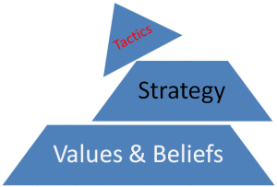
GVRA’s Belief we believe…
Everyone can work!
GVRA’s Values we value…
  Teamwork
  Differences
  Innovation
  Communication
  Performance
  Our clients, our people and our partners
GVRA’s Strategic Themes
  Employment focused, client-driven organization.
  Client-driven, employment focused processes.
  Employment focused, client-driven providers.
  High performance.
  Invest in our people.

Slide 5
Preparation for VR Services
When can a student begin receiving VR services?
Services can begin when a student starts high school or younger if at risk for dropping out
What documents can parents gather for VR?
IEP, school psychological, records from medical doctors are also helpful but, not required to begin the process.
Is VR always a part of your student’s transition planning?
Parents can request that a VR staff member attend the transition planning meeting.
Your son or daughter must be seeking work or a post secondary opportunity that will lead to work in order receive VR services.

Slide 6
Step 1: Referral/Application
How are transition age students referred for VR services?
A referral form is typically sent by the school to the parent to sign. This gives VR permission to begin the application process with the student.
What is the role of the VR staff person in the application process?
A VR staff person will meet with the student to discuss his/her vocational goals and complete the application process.
Parents can call the local VR office and request an application if the school does not make the referral.

Slide 7
Step 2:Eligibilty
What is needed to satisfy eligibility requirements?
The documentation needed will confirm the disability and originate from an appropriate specialist. Examples of documentation that may be utilized: IEP, school psychological, records from medical doctors.
How long does it take to be deemed eligible?
VR has up to 60 days to determine eligibility. VR may ask for an extension if more time is required to gather the needed documentation but would ask permission from the student/parent to extend the deadline.

Slide 8
Step 3: Order of Selection
What is order of selection?
Order of selection is the 2nd step in the eligibility process of qualifying a student for services. In this step, a priority category is assigned based on the severity of the disability. A “Notice of Change” letter is sent to the student informing the student of their priority category.
How does order of selection affect receiving services?
Order of selection is utilized when it has been determined by the GVRA Executive Director that services cannot be provided to all persons who apply and are eligible for VR services. In the unlikely event that this occurs, a VR staff person can be contacted for more detailed information.

Slide 9
Step 4: Work Needs Assessment
Who completes the work needs assessment?
An Assigned Professional, under the guidance of a VR Counselor, will gather relevant information- IEP, interviews with student, interests inventories, and begin to develop the Individual Plan for Employment with input from the student. The student participates in the decision making on his/her career goals.
What if my child is deemed “unemployable”?
If a students says they want to work, VR will provide services to assist the student in determining an appropriate career goal based on their abilities.

Slide 10
Step 5:
Individual Plan for Employment
Who helps develop the Individual Plan for Employment?
The student, VR staff and the VR counselor are all mandatory participants and it is recommended that the parent(s) or caregivers of the student also attend.
The components of the plan include the students vocational goal and the services needed to help the student reach that goal.
Is there a timeline for the plan?
The work plan is developed within 90 days after the determination of eligibility and priority category assignment are completed.

Slide 11
Step 6:Provision of Vocational Services
What are examples of job placement services?
Work readiness, resume support, interview skills, career exploration, transition services, work adjustment, social/soft skills development.
Who provides the services?
Services are provided in a variety of ways. It might be VR staff or a community provider.
What if my son or daughter does not have transportation to get to services?
VR encourages individuals to plan for transportation and can provide short-term support such as mileage reimbursement in some situations for a specified period of time.
How does VR connect my student to employers?
VR has staff (Employment Consultants) who develop relationships with employers that result in work experiences and/or employment for students. The Employment Consultant will work directly with the student to connect them with employers. VR may also refer a student to a job placement provider in the community to provide this service.

Slide 12
Step 7: Case Closure
How will someone know if the case is closed?
The student will receive a “Notice of Change” letter in the mail stating the case is closed and giving the reason for closure
Here are some of the most common reasons a case may close:
  A student is no longer interested in services and requests closure
  The student has gone to work, is doing well and working for 90 days or more
  The student moves out of state
  Student’s residence is unknown by VR
  Student fails to respond to efforts to contact
Once a case is closed can it be reopened?
Cases can be reopened if a job loss occurs and/or if a person requests services again.

Slide 13
Step 8: Post Employment Services
What are examples of post employment services and how long can a person receive?
Post employment services help a person keep their job after their case is closed successfully. The length of time a person receives post-employment services depends on their needs.
Examples:
  Personal social adjustment- soft skills training or coaching.
  Assistive Work Technology- recommendations for the individual or employer how technology can help a person perform at their best.

Slide 14
Concerns?
Start locally and contact the assigned VR Counselor or the Team Lead.
The Client Assistant Program(CAP) will help explain rights regarding the Federal Rehabilitation Act. 1-800-822-9727 or
  www.georgiacap.com
Contact GVRA Constituent Services at 1-866-489-0001 or GVRAcustomer-service@gvra.ga.gov

Slide 15
Additional Resources
Work Incentives, Planning and Assistant Program
Available for Social Security recipients with disabilities. Information can be provided on how employment will impact an individual’s disability benefits. 1-866- 489-0001
VR Policy Manual- Client Services Handbook
  http://gvs.georgia.gov click Policy Manual link

