Slide 1
IEP Scenario
Ms. Smith is holding an IEP meeting for her student, John. John has Down’s Syndrome and has good days and bad days. Ms. Smith is concerned because she has only met John’s parents once. She concludes, based on John’s behavior in class and failing grades, his parents must not care very much. At the meeting, Ms. Smith informs them that John isn’t making much progress in reading this year. She recommends changing his placement from team taught class to IRR. Ms. Smith tells his parents she believes John has autism and they need to have him tested. She says John would be doing better academically and behaviorally if mom volunteered more at school. John’s parents are upset. As two working parents, they work hard to pay the mortgage and put food on the table for their four kids while taking care of an ailing grandfather. John is reading well at home so why are they just now hearing about reading problems from Ms. Smith? Change his placement? And behavior issues? They had no idea. And autism? What is Ms. Smith talking about?

Slide 2
What do you mean?
Presented by
Patti Grayson, Parent Mentor
graysonp@fultonschools.org

Slide 3
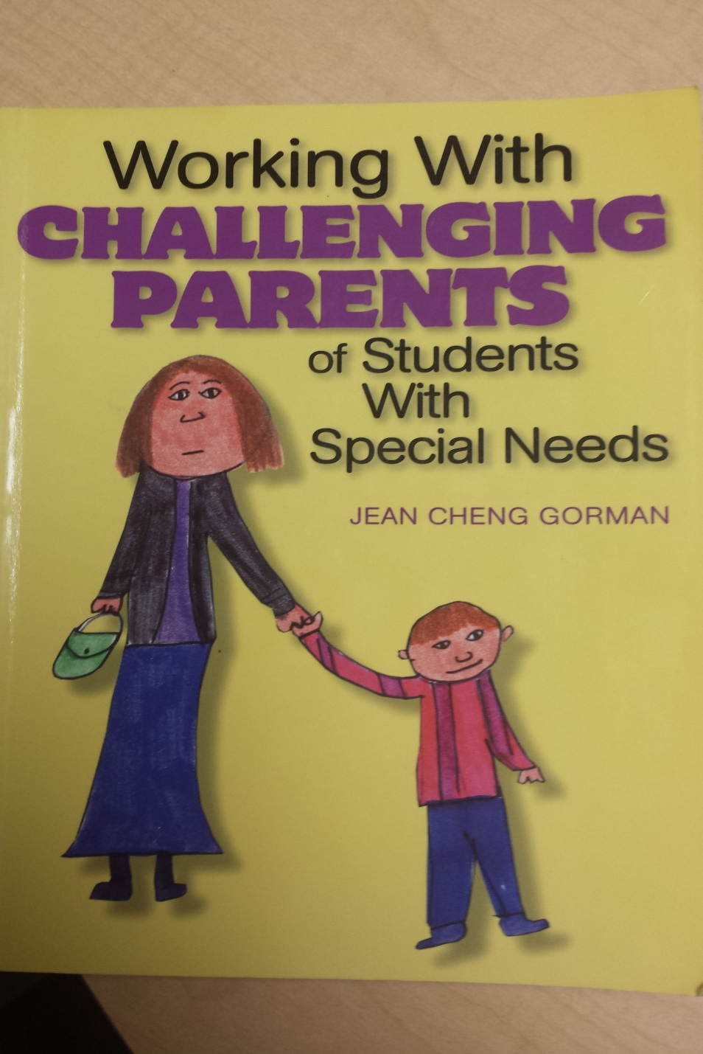

Slide 4
At the end of this session, you will be able to
1. Integrate three techniques to improve parent participation at school.
2. Identify three ways to prevent mistrust.
3. List three ways to establish a positive working relationship with parents.

Slide 5
Communication

Slide 6
Factors affecting successful parent-teacher communication
Alliances
Anger
Denial
Dissatisfaction
Nonparticipation
Mistrust

Slide 7
Alliances
Merriam Webster definition: “An association to further the common interests of the members”

Slide 8
Characteristics of effective parent-teacher alliances
Mutual respect
Clear understanding of your role
Clear understanding of other’s role
Opportunity for feedback
Openness to change or adjustments
Similar expectations
Defined common goals

Slide 9
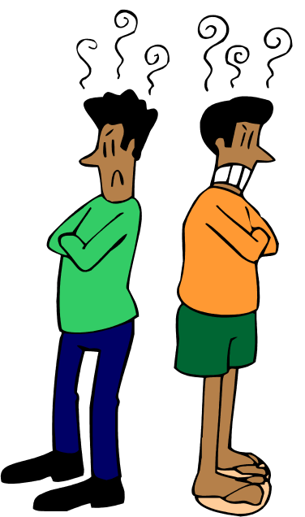
Factors affecting successful parent-teacher communication
Alliances
Anger
Denial
Dissatisfaction
Nonparticipation
Mistrust

Slide 10
Empathy
“The action of understanding, being aware of, being sensitive to the feelings, thoughts, and experience of another” – Merriam Webster

Slide 11
Main Principles of dealing with anger
Remain calm
Be specific
Agree
Be kind

Slide 12
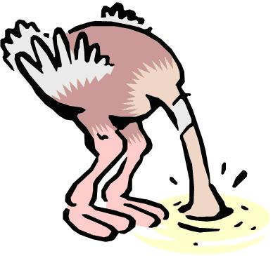
Factors affecting successful parent-teacher communication
Alliances
Anger
Denial
Dissatisfaction
Nonparticipation
Mistrust

Slide 13
Principles for dealing with denial
Wait
Ask why
Encourage and exhort

Slide 14
Factors affecting successful parent-teacher communication
Alliances
Anger
Denial
Dissatisfaction
Nonparticipation
Mistrust

Slide 15
Principles for dealing with dissatisfaction
Focus on the problem, not the person
Ask for parents’ solutions
Stay focused on the end goal

Slide 16
Factors affecting successful parent-teacher communication
Alliances
Anger
Denial
Dissatisfaction
Nonparticipation
Mistrust

Slide 17
Nonparticipation ≠ Noninvolvement

Slide 18
Discussion: How does your school encourage parents to participate?
How do you encourage parents to participate in your classroom?

Slide 19
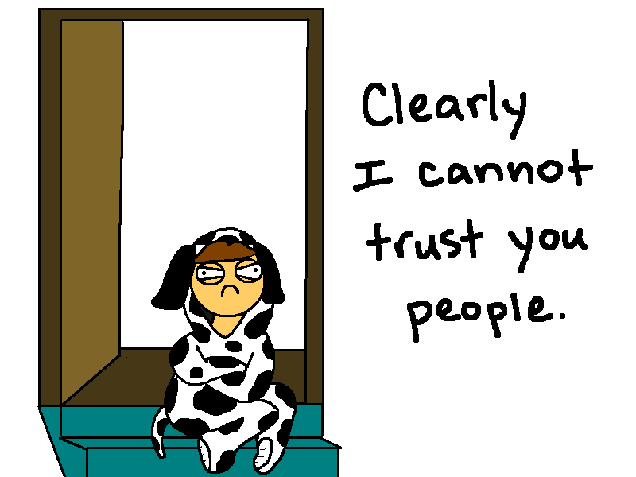
Factors affecting successful parent-teacher communication
Alliances
Anger
Denial
Dissatisfaction
Nonparticipation
Mistrust

Slide 20
Causes of mistrust
Minority overrepresentation in special education
Bureaucracy & hierarchy
Denied services for financial reasons
Perceived narrow-minded teachers
Teachers blaming home life
Transition planning
Resent school staff planning child’s future

Slide 21
Discussion: How can you prevent mistrust?

Slide 22
Ways to prevent mistrust
Parents are respected and valued
Try to understand parents’ perspective
Be honest as much as possible
Be upfront
Communicate often and clearly
Avoid using jargon
Be confident in your teaching and explain it

Slide 23
Cultivating Collaborative
Relationships

Slide 24
Start at the beginning
“You don’t get a second chance to make a first impression”

Slide 25
In the beginning
Establish credibility as a competent, caring educator
Be sensitive to parents’ cultural views and values
Motivate parents to desire collaboration
Define specific roles and responsibilities for teacher and parents

Slide 26
Helpful interpersonal skills for collaboration with parents of child with a disability
Friendliness
Optimism
Patience
Sincerity
Honesty
Tact
Responsiveness
Openness to suggestions
Respect for parents

Slide 27
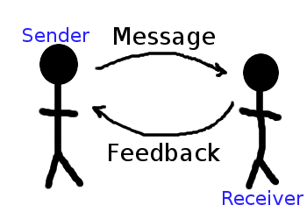
Maintaining the Relationship
Communication is the key

Slide 28
Parent-teacher conferences
Listen to the parent
Share specific information
Tell parents what they are doing right
Give specific examples of what parent can do to help child
Collaborate

Slide 29
Ending the relationship
Provide parents with positive feedback
Enlist parents as mentors for other parents

Slide 30
Discussion: How do you create and maintain a positive relationship with the parents of your students?

Slide 31
At the end of this session, you will be able to
1. Integrate three techniques to improve parent participation at school.
2. Identify three ways to prevent mistrust.
3. List three ways to establish a positive working relationship with parents.

Slide 32
Patti Grayson Parent Mentor
graysonp@fultonschools.org

