Slide 1
The Art of Family Support
Lynnette Bragg

Slide 2
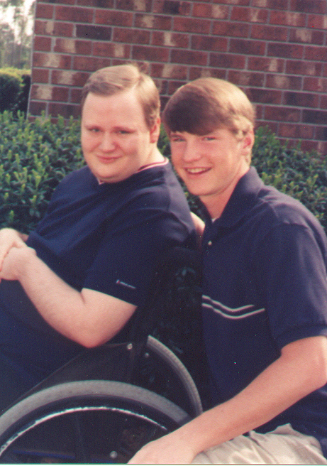
Scott and Matthew Bragg

Slide 3
Notes:
There is now a new fad activity going around that a lot of folks are enjoying and participating in. Wine and paint parties! This is a party where a bunch of friends gather, drink a little (or a lot) of wine and paint a picture... some do call this art! I am not quite sure where the painting ends and the art begins, but, the one thing I do is that there is a difference in the outcome of a wine paint party and a true artist painting a real picture.

Slide 5
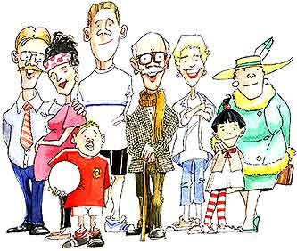

Slide 6
Notes:
All art begins with a vision of the end product. We begin with a blank canvas.. then .. We sit, we meditate, we contemplate.. we form a vision of what the end product will be. We begin to think about.. what would a perfect world look like.

Slide 7
FROM A DISTANCE

Slide 8
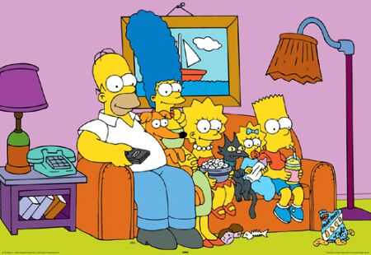
Notes:
From a distance, all families look perfect... all children are cute and precious, animals are all house trained. All relationships are loving and all members are supported and devoted to each other and to caring for the family.

Slide 9
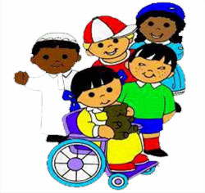
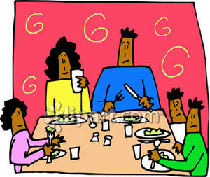

Slide 11
POSSIBILITY THINKING
By: Robert Schueller

Slide 12
Never reject a possibility because you see something wrong with it!
Notes:
Nothing is impossible if I will hold onto that it might be possible somehow, someway, and with someone's help.

Slide 13
Never reject a possibility because you won't get the credit!
Notes:
Tremendous things can be accomplished through the person who does not care who gets the credit. Decisions must be made on human needs!

Slide 14
Never reject an idea because it is impossible!
Notes:
Our goals should be based upon whether it would be a sensational thing to accomplish.

Slide 15
Never reject a possibility because your mind is already made up!
Notes:
People who never change their minds are either perfect or stubborn.

Slide 16
Never reject an idea because it is illegal!
Notes:
Listen carefully, and don't misinterpret. You should never violate the law, but don't reject an idea because it is illegal... you might get the law changed. Georgia citizens worked hard to pass the cannibas bill so that many people might have better seizure and pain control.

Slide 17
Never reject an idea because you don't have the money, manpower, muscle, or months to achieve it!

Slide 18
Never reject an idea because it will create conflict!
Notes:
I love vigorous, respectful debate. Out of this will come the best possible ideas and solutions!

Slide 19
Never reject and idea because it is not your way of doing things!
Notes:
It is always better to "do the right thing" than to "be right all of the time".

Slide 20
Never reject an idea because it might fail!
Winston Churchill said "Success is the ability to go from one failure to another with no loss of enthusiasm!"
Notes:
Winston Churchill said, "Success is the ability to go from one failure to another with no loss of enthusiasm.

Slide 21
Never reject an idea because it might succeed!
Notes:
One of my favorite phrases has always been "what if it works" said with amazement and in a whisper!! Always twitch your nose and gaze into the stars and say in a magical whisper..... "what if it works??? what if it works??" I did this when we started our business in 1999... what if it works... and we can keep other families from going through the things we went through... what if others do not have to send their loved one hundreds of miles away to live with strangers just because there is no one and no way to fund someone to provide 2 hours of supports 5 days a week when parents must work to have health insurance for an uncertain future.. .what if it works????

Slide 22
Bragg Family
It is the role of the professional to instill and reinforce to all parties that the FAMILY is the one in control, that the family is the one leading! it is up to us, as professionals, to develop leadership abilities and skills with families. Leadership cannot be surrendered to those who already "know everything and know what is best!"

Slide 23
Don't surrender leadership to outside forces!
Don't surrender leadership to faces!
Don't surrender leadership to farces!
Don't surrender leadership to fences!
Don't surrender leadership to frustrations!
Don't surrender leadership to your fantasies !

Slide 24
Don't surrender leadership to fears!
Don't surrender leadership to fatigue!
Don't surrender leadership to faults!
Don't surrender leadership to facts!
Don't surrender leadership to frenzies!
Don't surrender leadership to fates!

Slide 25
Don't surrender leadership to forecasts!
Don't surrender leadership to your foes!
Don't surrender leadership to your friends!
Don't surrender leadership to the fracturing experiences of life!
Don't surrender leadership to the flattening experiences of life!

Slide 26
Do surrender leadership to one thing FAITH!!!!

Slide 27
SIX POINTS TO UNDERSTAND AND KEEP IN MIND...
1. Every living human being has problems
2. Every problem has a limited life span
3. Every problem will change you
4. You can choose what your problem will do to you
5. Every problem holds positive possibilities
6. There is a negative and a positive reaction to every problem
Robert Schueller

Slide 28
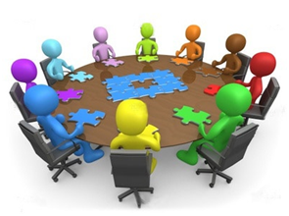
Schueller's Twelve Principles for Managing Problems Positively
Don't underestimate
Don't exaggerate
Don't wait
Don't aggravate
Illuminate
Motivate
Bait
Date
Sublimate
Dedicate
Communicate
Insulate

Slide 29
Impossibility thinkers are people who make swift, sweeping passes over a proposed idea, scanning it with a sharp negative eye, looking only for the distasteful aspects. They look for a reasons why something won't work instead of visualizing ways in which it could work. So they are inclined to say "no" to a proposal, never giving the idea a fair hearing.
Robert Schueller

Slide 30
Remember. When you have exhausted all possibilities: Remember this, you haven't!

Slide 31
John Donne
No man is an island, entire of itself; every man is a piece of the continent, a part of the main. If a clod be washed away by the sea, Europe is the less, as well as if a promontory were, as well as if a manor of thy friend's or of thine own were: any man's death diminishes me, because I am involved in mankind, and therefore never send to know for whom the bell tolls; it tolls for thee.

Slide 32
Toolbox
One of the many items in the toolbox of support to families is a magical program known as FAMILY SUPPORT

Slide 33
Family Support Priorities
Bridge for individuals on the planning list for DD Waiver Services
Individuals who meet DD Family Support Services eligibility but are not Medicaid eligible and documented absence of other supports
Eligible individuals with urgent, complex support needs and documented absence of other supports

Slide 34
FAMILY SUPPORT SERVICES
Respite
Maintenance
Emergency

Slide 35
FAMILY SUPPORT SERVICES
Community Living Support

Slide 36
FAMILY SUPPORT SERVICES
Accompanying individuals and facilitating participation in community

Slide 37
FAMILY SUPPORT SERVICES
Training and assistance in household duties

Slide 38
FAMILY SUPPORT SERVICES
Training and support in the areas of:
Social
Emotional
Physical
Intellectual Development

Slide 39
FAMILY SUPPORT SERVICES
Community Access

Slide 40
FAMILY SUPPORT SERVICES
Supported Employment

Slide 41
FAMILY SUPPORT SERVICES
Dental Services

Slide 42
FAMILY SUPPORT SERVICES
Medical Care

Slide 43
FAMILY SUPPORT SERVICES
Vision Care

Slide 44
FAMILY SUPPORT SERVICES
Specialized Diagnostic
Services

Slide 45
FAMILY SUPPORT SERVICES
Recreation and Social Community Integration Activities

Slide 46
FAMILY SUPPORT SERVICES
Arts and Culture

Slide 47
FAMILY SUPPORT SERVICES
Sports, Fitness, and Aquatics

Slide 48
FAMILY SUPPORT SERVICES
Social Enrichment

Slide 49
FAMILY SUPPORT SERVICES
Community Integration
Leisure Education

Slide 50
FAMILY SUPPORT SERVICES
Outdoor Adventures

Slide 51
FAMILY SUPPORT SERVICES
Ongoing recreational opportunities

Slide 52
FAMILY SUPPORT SERVICES
Environmental Modifications

Slide 53
FAMILY SUPPORT SERVICES
Non Structural Environmental Modifications

Slide 54
FAMILY SUPPORT SERVICES
Specialized Equipment
Assistive Technology Device

Slide 55
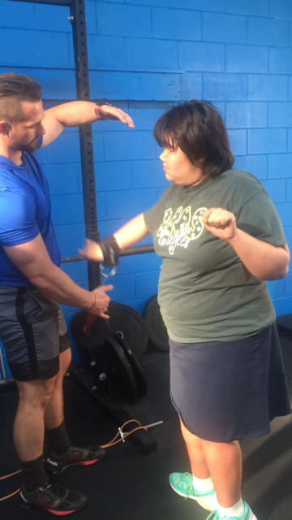
FAMILY SUPPORT SERVICES
Therapeutic Services
Audiology
Physical Therapy
Occupational Therapy
Speech Therapy

Slide 56
FAMILY SUPPORT SERVICES
Counseling

Slide 57
FAMILY SUPPORT SERVICES
Parent and Family Training

Slide 58
FAMILY SUPPORT SERVICES
Specialized Nutrition

Slide 59
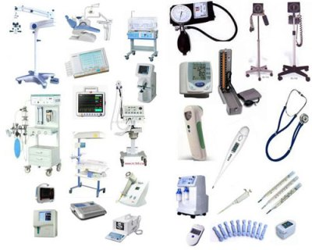
FAMILY SUPPORT SERVICES
Supplies

Slide 60
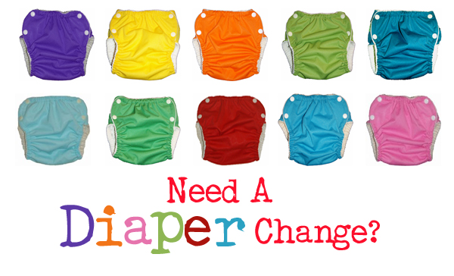
FAMILY SUPPORT SERVICES
Incontinent Supplies

Slide 61
FAMILY SUPPORT SERVICES
Behavioral Consultation and Support

Slide 62
FAMILY SUPPORT SERVICES
Financial and Life Planning Assistance

Slide 63
FAMILY SUPPORT SERVICES
Exceptional Disability Related Living Costs

Slide 64
FAMILY SUPPORT SERVICES
Transportation

Slide 65
FAMILY SUPPORT SERVICES
Vehicle Adaptations

Slide 66
FAMILY SUPPORT SERVICES
Child Day Care After School Services

Slide 67
FAMILY SUPPORT SERVICES
Budget Development with Prioritization of Wants and Needs

Slide 68
FAMILY SUPPORT SERVICES
Life is measured by SMILES!
FAMILY SUPPORT
KEEPING FAMILIES TOGETHER

Slide 69
THE ART OF FAMILY SUPPPORT
Thank you for allowing me to share my thoughts about the importance of "family first" and the concept that just a little bit of help can go a long way in keeping families together!

