Slide 1
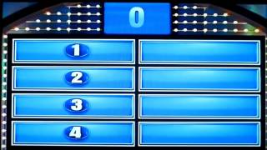
Let’s give them something to talk about:
SURVEY SAYS

Slide 2


Slide 3

Our return rates consistently exceeded the State rates
Cherokee County School District
Year | Return Rate- CCSD | Return Rate-State
2013 | 66.1% | 31.2%
2012 | 45.5% | 25.7%
2011* | 71.9% | 31.0%
Our efforts were focused on getting surveys returned; continuing to increase our return rate percentages.
*Indicated year Parent Mentors began limited involvement with surveys.

Slide 4

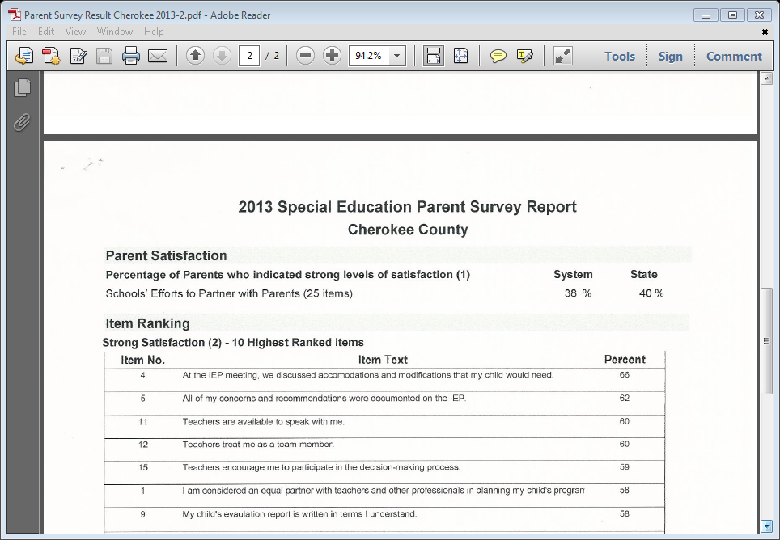
Our Satisfaction rate usually exceeded the State rate as well
Cherokee County School District
Year | Satisfaction Rate- CCSD | Satisfaction Rate-State
2013 | 38% | 40%
2012 | 41% | 39%
2011* | 34% | 39%
*Indicated year Parent Mentors began limited involvement with surveys.
However, they slipped slightly in 2011 & 2013

Slide 5

RE
Refocusing-drilling down
*Brainstorming with Director/PMs/Lead Fac
-Have PMs more directly involved
*We are doing a better job than percentage indicates
-how do we reflect that in our Satisfaction rates
*Analyze the data
-Lowest 3-5 satisfaction > where improvement is needed
-Top 3-5 satisfaction > where we are doing well
*Where to concentrate efforts
-Who/Where can we effect the most change in this area

Slide 6



The New Plan
*Develop materials for schools
-help school identify what is already in place-add missing pieces
*Compose previous years results in easy to read document form
Tie them to the National PTA Standards
-PTA Standards are our road map
*Define survey questions
-wording of some questions may be misleading/not clear what is being asked
-call attention/remind schools of continuing practices already established

Slide 7

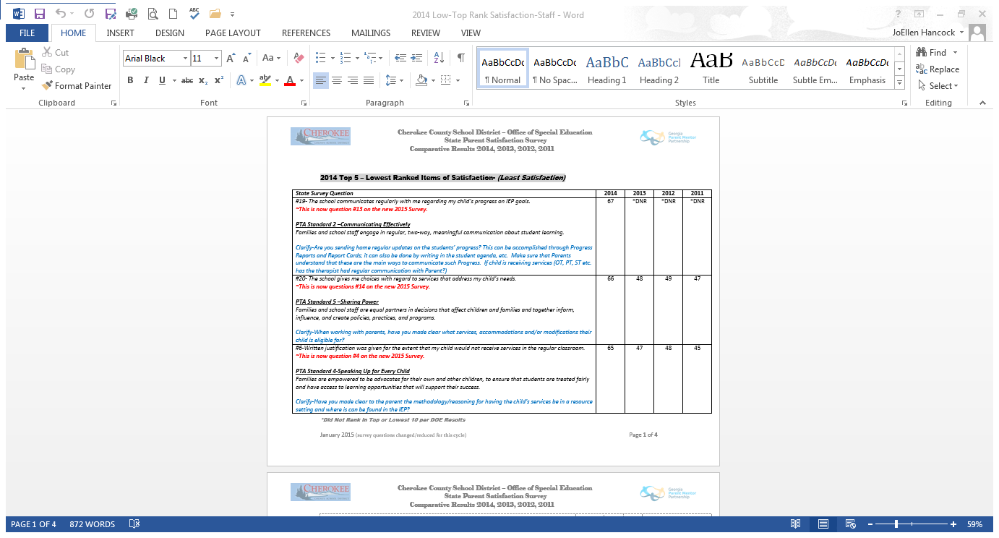
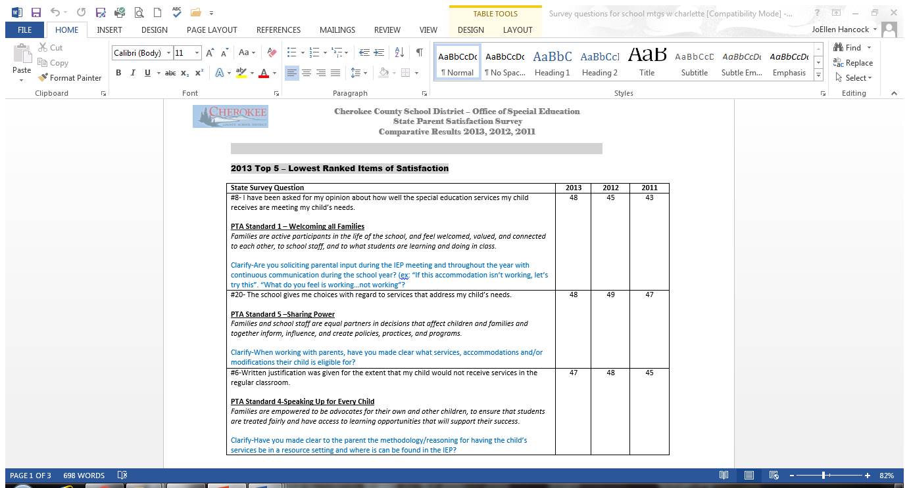
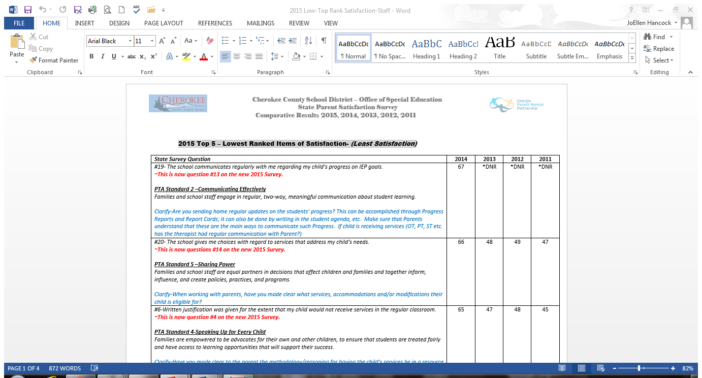
Examples of result comparisons

Slide 8

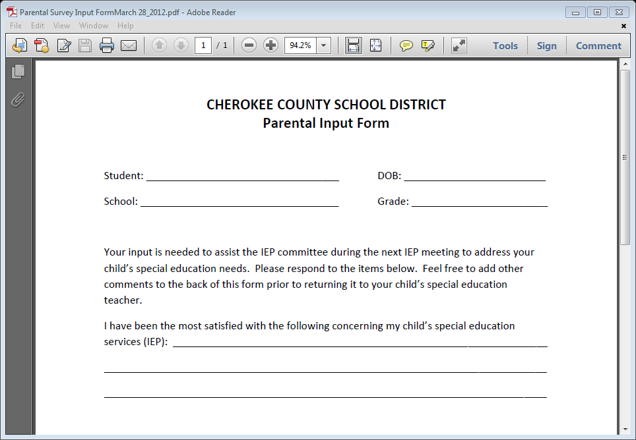
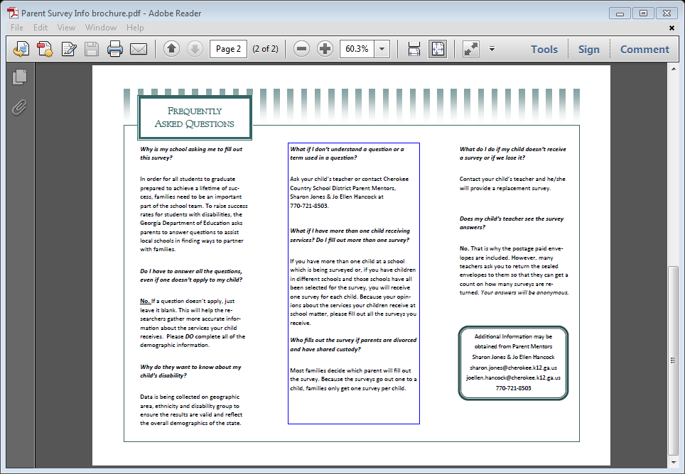
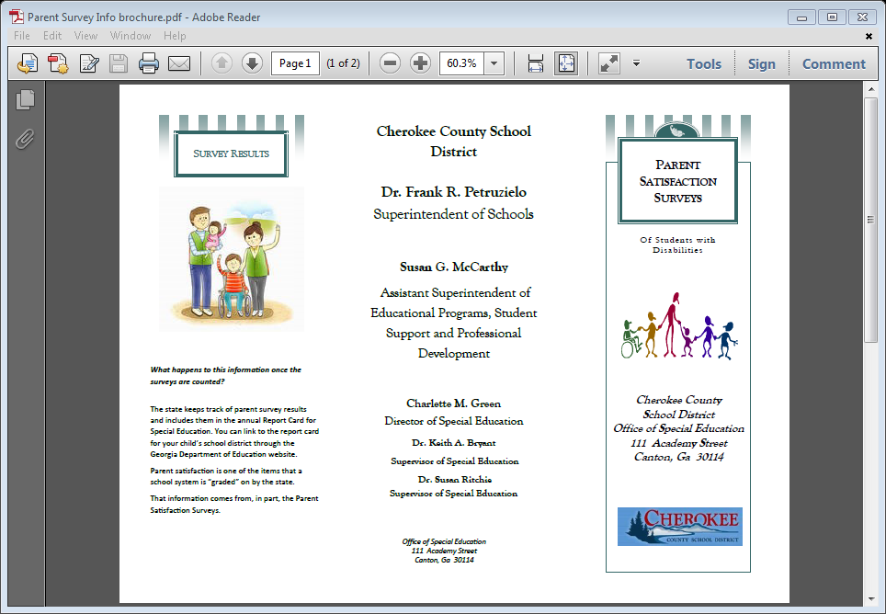

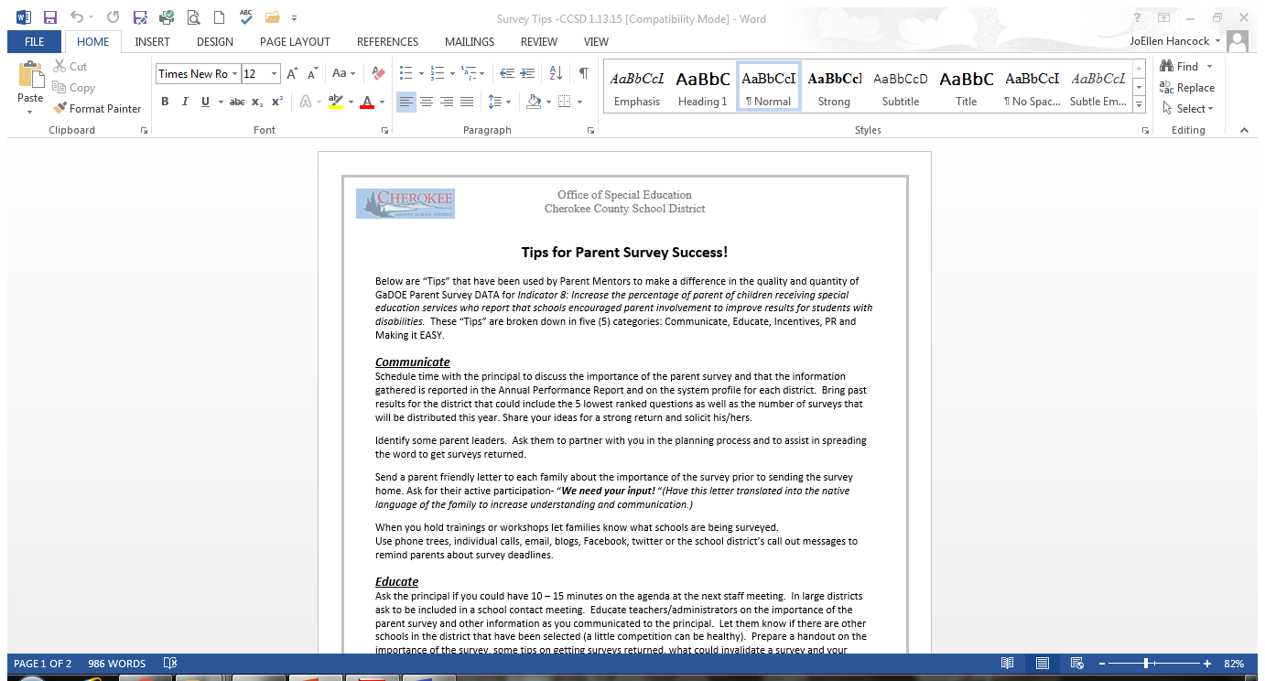
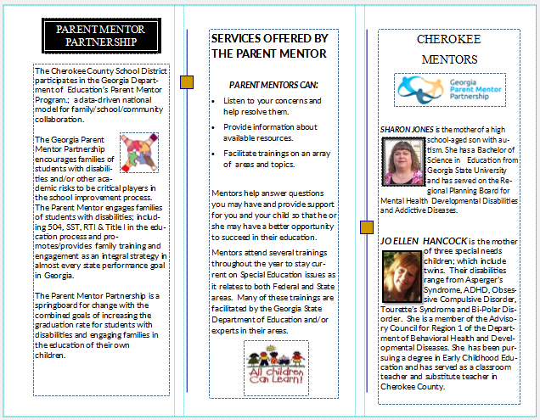
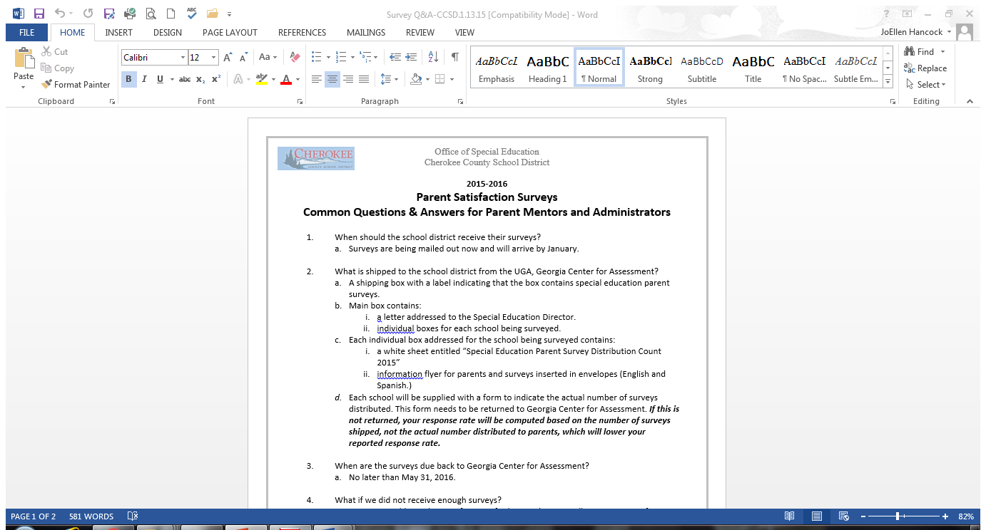
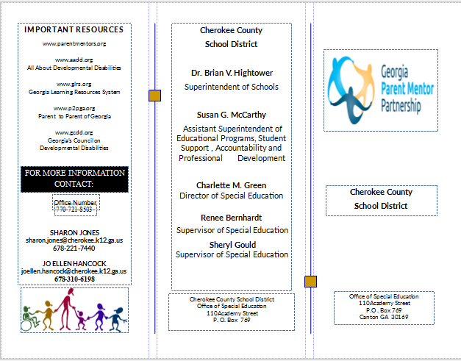
Examples of support materials created
FAQ survey brochure
Creation of Parent Input Form
Creation of CCSD Parent Satisfaction Survey district wide
Survey Tips
Q & A for Admins/Parents
Parent Mentor brochure

Slide 9

Best way to effect change
Surveys are asking:
Are the schools engaging their families
Are the schools getting important information into the hands of their families
Are the schools encouraging families to have a voice in their child’s education?

Slide 10



So, lets go help at the source
*On site visits with each selected school to be surveyed
(Dir/Admin/PMs met with Admin/Lead Fac/Lead Teachers)
*Provide packet of helpful materials
*Provide direct support/instruction for staff
-Parent Mentors went to Special Ed staff meetings
*Build an individual success plan
*Thank you incentives for staff given by Special Ed Director
Greatest Hits Tour
CCSD OSE

Slide 11


The results
Our Satisfaction rate increased by 18% in just the first year!!!
and continue upward
Cherokee County School District
Year | Satisfaction Rate- CCSD | Satisfaction Rate-State
2015 | 60% | 46%
2014** | 56% | 44%
2013 | 38% | 40%
Sustaining the results
**Yr implemented refocused efforts

Slide 12

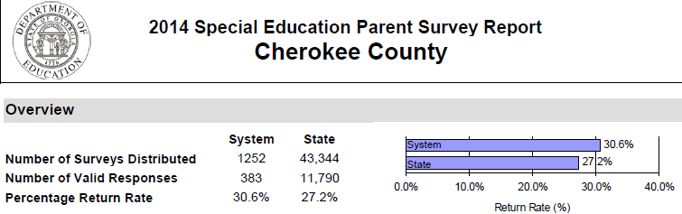
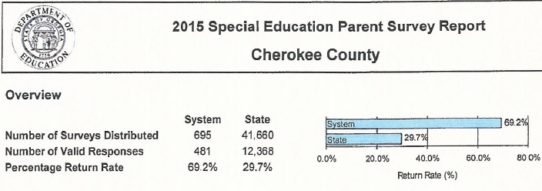
2014 - first refocus year Return rate exceeded State
However, as is common when shifting areas of focus, the Return rate did drop from the previous year.
Year | Return Rate- CCSD | Return Rate-State
2013 | 66.1% | 31.2%
Return rates rebounded upward the following year.

Slide 13

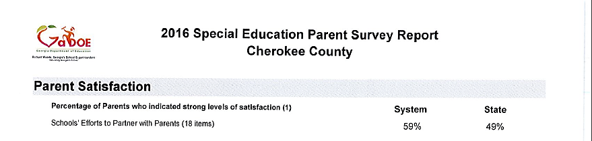
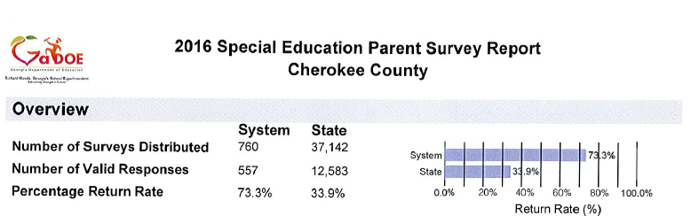
Current Results
Once again, we will drill down the Top 3-5 lowest satisfaction and work on ways to improve.
Our return rate held strong

Slide 14
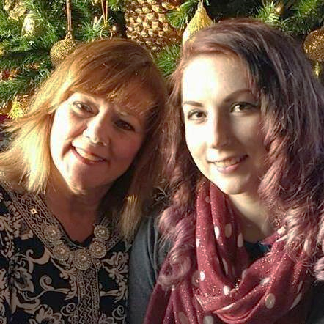
Power Point and all referenced materials will be posted on the PMP website under the Learning Curve
My contact info
Jo Ellen Hancock
Joellen.hancock@cherokee.k12.ga.us
687-310-6198
770-721-8503

