Slide 1
Self-Determination
A Bridge for Independence, Employment, College and Career
GaPMP Kickoff Conference
Savannah, Georgia
September 2016

Slide 2

The Interviewer

Slide 3
Why is this Important?

Slide 4
Independence
People with disabilities who are encouraged and supported to make their own decisions are more independent after graduation and thereafter.
  more likely to live somewhere other than where they lived in high school one year after graduation.
  significantly more likely to live independently three years after graduation.

Slide 5
Independence
Young adults with disabilities who took part in a program designed to increase their self-determination had greater access to their communities. (Shogren et al. (2013) and Powers et al. (2012))
There’s a link between people with disabilities’ self-determination and their perceived quality of life (McDougall et al. (2010))

Slide 6
Employment
Persons with disabilities are significantly more likely to be employed for pay at higher wages one year after graduation.
They are significantly more likely to be employed in a position that provides health care, sick leave, and vacation benefits three years after graduation.

Slide 7
College and Career
Students in higher education who had disabilities must have exhibited these characteristics to even begin the process of receipt of reasonable accommodations. They must be able to:
  communicate what their disability is,
  Communicate their strengths and weaknesses,
  Express how the disability impacts and functionally limits major life activities, and
  identify and justify any requested accommodations
Joseph Daniel Bryant, II, 2014

Slide 8
College and Career
The essential characteristics of self-determination existed in and was of some importance to both successful students with invisible disabilities who participated in higher education and their non-disabled peers.
Joseph Daniel Bryant, II, 2014

Slide 9
What Schools Need to Know
For students to acquire self-determination skills, they need instruction and safe settings in which to practice such skills (Gradoudas ,2014)
Becoming more self-determined is a critical milestone for adolescent development (Wehmeyer et al. ,2011)
Cognitive limitations does not hinder the development of self-determination skills (Wehmeyer et al., 2011)
The opportunity to make choices was the most significant variable predicting levels of self-determination (Wehmeyer et al., 2011)

Slide 10
What Schools Need to Know
For students to acquire self-determination skills, they need instruction and safe settings in which to practice such skills. (Gradoudas, 2014)
Active participation in IEP meetings will not occur without instruction (Hughes et al., 2013)
The relationship between self-determination skills support an increased focus on the teaching of self-determination skills

Slide 11
What Schools Need to Know
As increasing attention is given to college and career readiness for all students, schools should consider self-determination instruction alongside the academic curriculum and provide opportunities for students to exercise their self-determination skills (Erickson et al, 2015)
Teaching students to direct their own learning is critical to self-determination

Slide 12
What Schools Need to Know
All educators should encourage students to make personal and academic goals
Educators should maintain high expectations for students with and without disabilities
Active problem solving and choice opportunities are critical components of self-determination.
Partnerships with parents and communities need to be created and established for self-determination to be maintained

Slide 13
The Academic Connection
There’s a strong correlation between self-determination and academic achievement for adolescents with intellectual disabilities. Erickson et al. , 2015)
  positive correlations among self-determination, reading achievement and math achievement. (Zheng et al., 2014)
The potential for SWD to improve their academic achievement results in improved post-school outcomes. (Erickson et al., 2015)

Slide 14
What Does It Look Like?
(Hong et. al., 2011)
Capacity to make decisions and take action on one’s future plans
Choices made based on free will without interference
Proactively solve problems
Taking responsibility for oneself/Self-confidence to act with responsibility
Directing one’s life
Knowing ones strengths and weaknesses (challenges)/Accurate self-assessment of strengths

Slide 15
What Does It Look Like?
(Hong et. al., 2011)
Ability to be disciplined and solve problems
Engaging in self-reflection /self-evaluation
The ability to set your own goals and then accomplish them
Someone who has vision, short and long term goals, and a plan and the motivation to achieve these
The belief that achievements are under their control and they are willing to exert efforts to attain it

Slide 16
12 Components of SD
Denney and Daviso (2012)
Choice making
Decision making
Problem solving
Goal setting and attainment
Independence, risk taking, and safety skills
Self-observation, evaluation, and reinforcement skills
Self-instruction
Self-advocacy and leadership skills
Internal locus of control
Positive attributes of efficacy and outcome expectancy
Self-awareness
Self-knowledge
Notes:
did not directly borrow Wehmeyer’s (1995) definition
of self-determination, however they included 12 specific components of selfdetermination that Wehmeyer’s (1998) prior work essentially foreshadowed. These
components are included in Table 2.

Slide 17
Self-Determination Assessments/Measurement Tools
The American Institutes for Research (AIR): University of Oklahoma, Zarrow Center (Jim Martin): http://www.ou.edu/education/centers-and-partnerships/zarrow/self-determination-assessment-tools/air-self-determination-assessment.html
The Arc Self-Determination Assessment: http://www.thearc.org/document.doc?id=3670
University of Kansas, Self-Determination Inventory: http://www.selfdetermination.dept.ku.edu/wp-content/uploads/2016/03/SDI-Student-Report-Guide_small.Final_.pdf

Slide 18
The Vehicles
Choice-Maker Curriculum
Me! Lessons
Self-Determination Learning Model
Whose Future Is It Anyway
Dare to Dream
I’m Determined
Student-Led IEPs

Slide 19
Student-led IEPs
Students more involved in their Individualized Education Program show higher levels of self-determination (Gomez-Vela, Verdugo, Gil, Corbella, & Wehmeyer, 2012)
An empirical association has been established in the literature between indicators of self-determination and participation in the IEP process and positive post-school outcomes, such as employment (Martorell et al.,2008)

Slide 20
Student-led IEP Programs
District of Columbia: http://dc-transition_guide.frameweld.com/page/studentled_iep_toolkit_introduction_
  Self-Determination Resources: http://dc-transition_guide.frameweld.com/resources/english
  Parent Resources: http://dc-transition_guide.frameweld.com/page/studentled_iep_toolkit_for_families
Virginia, I’m Determined: http://www.imdetermined.org/
  Parent Resources: http://www.imdetermined.org/parents/
Washington, DC, Two Rivers Public Charter School: http://www.learnwithtworivers.org/contact.html
Mendocino County Ca: http://www.mcoe.us/District/Department/29-Special-Education-Local-Plan-Area-SELPA/1679-Untitled.html

Slide 21
ASPIRE
Active Student Participation Inspires Real Engagement
gaspdg.org/aspire
Notes:
The italicized notes in the presentation are useful as a script. Please adjust the wording so that it complements your personal presentation style. The notes in a regular font indicate additional information that may be helpful to the presentation.
The administrator PowerPoint is a condensed version of the Teacher Training . The goal of this presentation is to create “buy in”. That will be different for each administrator so emphasize the components that support their school improvement plan and any initiative they already have underway. Ensure they understand that self-determination is the foundation for ASPRIE and that you’re not asking the teachers to do additional work just work differently.
Have all meeting participants sign-in using the Administrator Meeting Sign-In Sheet.

Slide 22
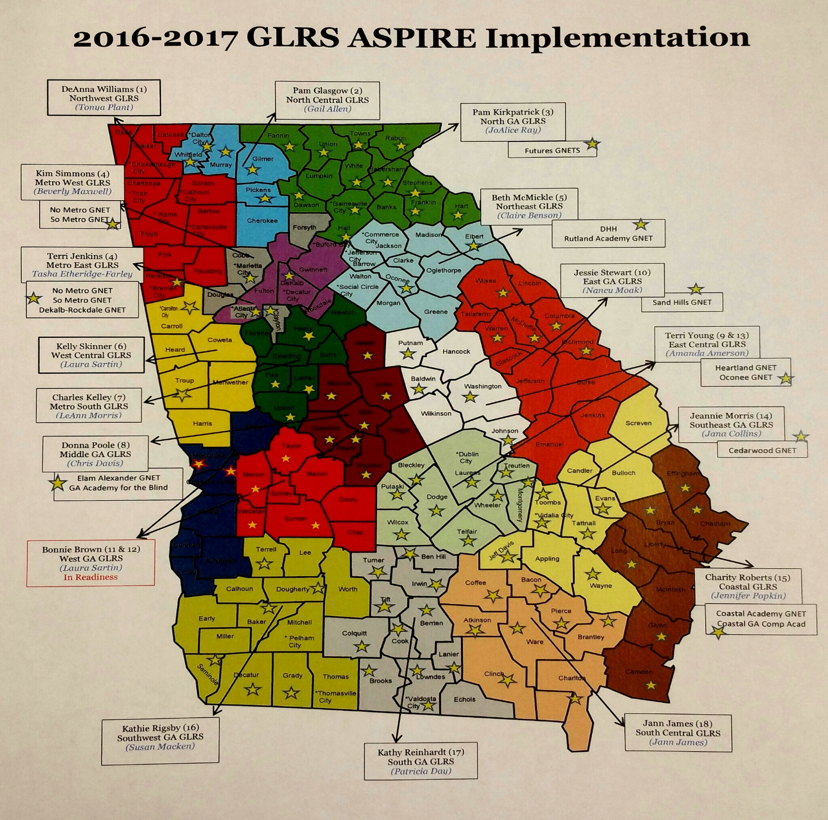

Slide 23
ASPIRE Data

Slide 24

Parents’ Perspective

Slide 25
Get Involved: Stay Involved!!
ASK:
  Special Education Director
  Contact your local GLRS Director
  Contact Elise James:
    ejame@doe.k12.ga.us
Join the ASPIRE Online Community
  www.gaspdg.org/aspire

