Slide 1

P2P & ME!
An Overview of
Programs
and
Services
Supporting Georgia families of children
with disabilities & special healthcare needs
Notes:
Note to Presenter: Please read the trainer notes PRIOR to the presentation to help you prepare. These notes are to be used as a guide and not a script. You will not have time to cover everything in the notes. Do not read the trainer notes to the audience. In preparation for the presentation, find out if that county has a Navigator Team in it. You will reference this later in the presentation.
This title slide should be showing as your audience is coming in. Try to get there early enough to set up the projector/presentation and have time to talk to the host before the audience arrives. Bring a sign in sheet so we can get the audience members on our email list and have a record of who attended. Greet each person as they come in and engage them in conversation about them (not you and not P2P). The more you can get to know your audience during this time, the better you can cater the presentation to meet their needs. Try to remember some names so you can work them into the presentation. People like to hear their names.
Keep these questions in mind as you are greeting people and getting to know them:
Parents or professionals or both?
Parent of children with disabilities?
What types of disabilities?
How old are their children?
What are their current challenges?
Be sure to start on time even if there are still people walking in. Pace yourself so that you end on time also. Keep in mind this is the 30 minute version of “P2P & Me” and you will not be able to cover all of the material in the trainer notes. Hit the highlights and keep in moving forward.
Welcome to “P2P & Me!” Let’s get started.
Note to presenter: Introduce yourself and your role at P2P. Thank the host for allowing you to present. Make eye contact. Smile. Speak from your heart about an organization you are passionate and proud to be a part of. You’re going to be fantastic!

Slide 2

Why Are We Here Today?
    Who we are
    What we do
    How we can help you
    How you can help us
WE want to partner with YOU
to help YOU and the parents in your community
Notes:
Let’s start with “why we are here today.”
We want you to leave this presentation knowing who we are, what we do, and most importantly, how we can work together. We want you to know that WE WANT TO PARTNER WITH YOU to help you and the parents in your community!

Slide 3

Who we are . . .
We are Georgia’s Parent Training and Information Center (PTI) – providing information to families so that they can be equal partners in the educational decision-making process.
We are Georgia’s Family to Family Health Information Center (F2F) – providing information to families so they can make better health-related decisions.
We are the Central Directory for Georgia’s Babies Can’t Wait (Part C) Program - assisting families of children in need of early intervention services with information and resources.
We are the State Affiliate of Parent to Parent USA – providing research-based best practice emotional support.
Notes:
P2P is a state wide organization! We have offices, staff, and volunteers across the state. Families can call us toll-free from anywhere in Georgia. We serve ALL disabilities and ALL special health care needs. We offer assistance to any parent or individual no matter how rare the diagnosis or how difficult the situation.
As Georgia’s Parent Training and Information Center, we work to make sure that families get training and information on their rights, responsibilities, and protections under the Federal Law called IDEA or the Individuals with Disabilities in Education Act. Every state is required to have a Parent Training Information Center (PTI). The school is responsible for educating children and we are responsible for educating parents.
Georgia’s health system is hard to figure out! Our Family to Family Health Information Center provides health information, training and support to families of children with special health care needs. We have information about services, resources and projects available to families across the state.
As the Central Directory for Babies Can’t Wait, the organization responsible for serving families of children from birth to 3 with special needs, we help families throughout the state of Georgia get connected with the BCW program in the county where you live. And we maintain a database of resources specifically for parents of children with special needs. We’ll talk more about this later in the presentation.
And as the State Affiliate of Parent to Parent USA, we help legitimize that emotional support is critical to families!
So, now that you know “Who We Are,” let’s talk about “What We Do” and what these services look like for families.

Slide 4

What we do . . .
We encourage families to work
with systems . . . not against them!
And we ARE Parents! We are not paid advocates or attorneys!
Notes:
We are Parents! All of the coordinators who answer the phone at Parent to Parent are also parents who have children with disabilities. We believe that parents are the best support for other parents. We respect that every parent is different and has different needs, and that’s why our services are unique based on what the needs are.
Our mission is to support Georgia families and individuals impacted by disabilities or special healthcare care needs. We are not paid advocates or lawyers. We help families learn how to work with school systems by better understanding the process and their rights. We help families learn how to work with medical professionals by understanding that all parents do have choices and should be involved. We do not write state complaints or file due process. We do not file insurance claims or fight insurance disputes. But, we DO encourage families and professionals to work together because research shows that this is indeed how you bring about the best outcomes!
We want parents to know and to believe that they can help their child have positive outcomes and that there are many choices available to help make this happen! Parent to Parent is here to help parents develop the knowledge, skills, and abilities to move beyond where they are today and become empowered to be a strong force in their child’s life.

Slide 5
What we do . . .
7 Core Services
Special Needs Database
Roadmap to Success
Supporting Parents
One-On-One Assistance
Navigator Project
Free Trainings
On-Line Opportunities
Notes:
At P2P, we have 7 core services that we offer parents. Let’s briefly take a closer look at each of these services. Let’s start with the P2P Special Needs Database….

Slide 6
1. Special Needs Database
Over 5,000 Resources in 140 Categories!
Access the Database
24 Hours Per Day
Visit our Website
www.p2pga.org
Call Toll Free 1-800-229-2038
Notes:
Our Database has over 5,000 resources and you can search it online at www.p2pga.org or call us and we’ll do a search and send you the results! Our coordinators can customize searches to meet the specific needs of the parent.
For example, --- (name someone from audience) may be looking for a provider that accepts Medicaid, maybe he/she wants to find a physical therapist that provides services in the home. Whether it’s a developmental pediatrician or a music therapist, we have choices for parents in our database. Or maybe it’s not a professional provider but a parent led support group. ---- (name someone else from audience) wants to find a support group meeting to attend. Support Groups is one of the categories in the database. Or Summer Camps.
This database is constantly being updated and is growing. If we do a search for you, once the results of your search have been completed, we can email the reports which provides a quick turn around time. We can also mail or fax them to you.

Slide 7
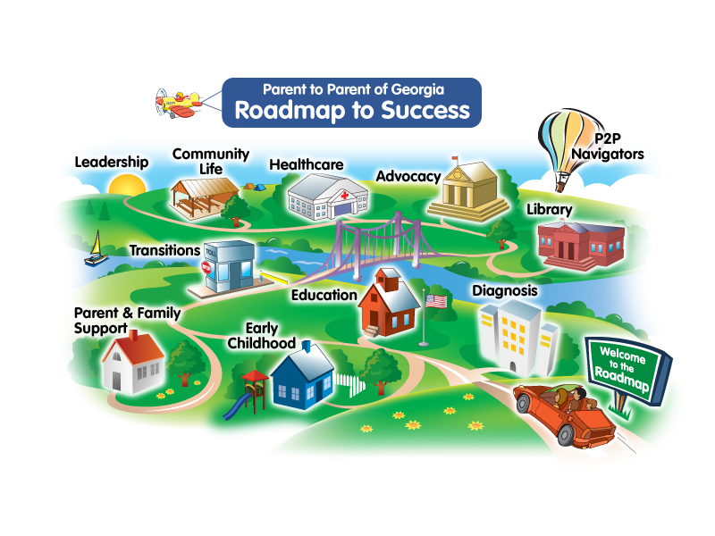
2. P2P Roadmap to Success
Tons of information!
All clickable…
Reading materials
Videos
Links to useful sites
Access the Roadmap 24 Hours Per Day
Visit our Website roadmap.p2pga.org
Call Toll Free 1-800-229-2038
Notes:
Our Roadmap is an easy to navigate online guide to major topics around disability, like child care, education, and insurance. It has colorful buildings and structures to help parents find the information they need. You can find articles, links to other resources, family stories and more on the Roadmap.
And, what’s best about our Roadmap is that it was designed ENTIRELY by families! And we update and change it based on the feedback we get from families. We are continuing to add information to the roadmap, in different formats, like videos! That way, families can get information in a variety of ways.
It’s available 24 hours a day, 7 days a week! If you’ve never visited it before, you absolutely should!

Slide 8
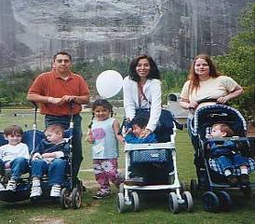
3. Supporting Parents
Trained Parent Volunteers across the state! Great source of Emotional Support!
We train caregivers to support other families when they need it…
We can match parents in a number of ways, including:
child’s disability
medical condition
specific educational issue
health issues
child’s age
Call Toll Free 1-800-229-2038
Notes:
Our supporting parent program is the HEART and SOUL of P2P and is designed to provide emotional support to families in need.
Supporting Parents are volunteers who are willing to talk to other parents. Our coordinators make those matches after talking to the parents. Sometimes, a parent will want to be matched on the child’s disability or medical condition. Sometimes, they’d like to talk to another parent who has experience with an educational or health issue. Maybe a child is having behavior challenges at school or is about to transition out of high school. Or maybe the parent wants to talk to another parent who has experience with navigating Medicaid Waivers or IEP meetings.
Note to Presenter:
If appropriate, insert personal story here. Make sure it’s concise and focused on the Supporting Parent Program. Here’s an example of a story you could share if you don’t have a personal one. This is an opportunity to emotionally connect with your audience.
When Becky’s son was diagnosed with Autism, she was devastated. He was two years old. She had lots of friends and a supportive family, but she didn’t know anything about Autism. She didn’t have ANY friends whose 2 year olds had no language or who beat their heads on the wall because it felt good. She felt very alone and scared. Babies Can’t Wait gave her the P2P brochure and she called us. She didn’t really know what she wanted when she called. One of our coordinators talked to her, and was able to send her some information to help her learn more about Autism. And the coordinator matched her with a mom in a nearby community for emotional support. The supporting parent had a 4 year old with Autism, and they immediately connected. Because of the match, Becky felt less alone. Less scared. She learned a lot from the supporting parent, and became a powerful advocate for her son and then for other parents in her community. One day, she decided she wanted to give back and she became a supporting parent herself. She’s been involved with P2P since.

Slide 9
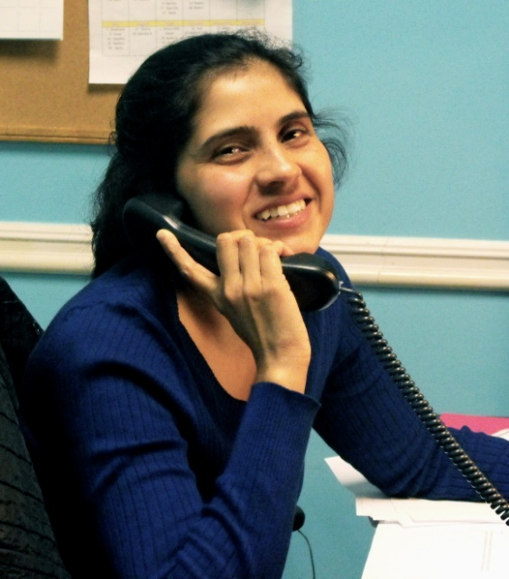
4. One-On-One Assistance
Help based on family needs, from simple to intensive assistance available!
      Talk to another PARENT, trained on latest practices, laws, and trends!
      Have access to Bilingual staff and resources!
      Receive individualized and customized help with:
      EDUCATION issues
      HEALTH issues
Call Toll Free 1-800-229-2038
Notes:
Note to presenter:
You are about half way through this presentation. Glance at the clock (not your phone) to determine how you are doing on time. Adjust your presentation speed accordingly. If you are behind, don’t panic and don’t start talking too fast. Just hit the highlights, leave out a few examples, and catch up.
There are many ways P2P offers 1-on-1 assistance to families. While our main office is in Atlanta, we have coordinators who are located all over the state. We have divided the state into regions so that parents can get assistance from a coordinator who lives in their region. That’s why if you call our 800 number, the staff will ask you what county you live in. They ask you that so they can make sure you get to the coordinator who handles your county.
When a parent calls P2P they will:
Talk to another PARENT. All of our coordinators are also parents of children with disabilities.
Have access to Bilingual staff and resources! Language should not be a barrier to reaching out to us.
Receive individualized and customized help with:
EDUCATION issues and questions
HEALTH issues and questions
Be matched with a supporting parent, if appropriate
Our coordinators have been trained on health and educational issues and they can give parents inside knowledge about navigating through the sometimes confusing disability-related world.

Slide 10
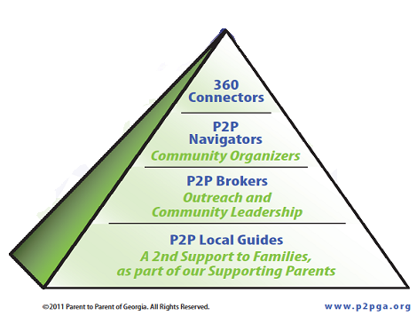
5. Navigator Project
Parent Leadership Training and Practice!
Volunteer Parent Leadership Program of P2P
Training and performance expectations at each level
Designed to build collaborative community leaders
Call Toll Free 1-800-229-2038
Notes:
At P2P, we have a goal to develop collaborative leaders who positively impact families at a local, state, and national level. The Navigator Project has volunteers all over the state doing some amazing things. This project is a step-by-step Volunteer Project that combines training and actual experiences to develop parent leaders across the state.
Local Guides (LGs) act as volunteer representatives of P2P to help a family learn about community resources. Much like a supporting parent, LGs can be matched to a family, but not based on diagnosis, but on the individual LG’s knowledge of area resources. For example, an LG may talk to parents about where to get a haircut or find a gluten free pizza.
Once an LG meets their performance standards, they can become Brokers where they will receive additional training and can begin to host P2P trainings and events. By the time a Broker completes the performance standards, they will have the training, leadership skills and contacts to begin to form or join a Navigator Team.
Navigator Teams are parent-led volunteer networks , or community organizers, that work with local partners to promote inclusion of special needs children or to create programs specific to disability. Navigator Teams target their activities towards the needs of the community and the priorities and programs are decided on by the volunteer leaders. For example, Floyd’s Navigator Team has a show choir. Pike’s has a fashion show. Bullock has Buddy Ball and a BIG dance every year. The Coweta Navigator Team has a “friendship club” to help kids learn social skills. Some teams focus on health and education training for parents. You see……the possibilities are ENDLESS.
Every Navigator Team might look a little different, but ALL teams consist of parents and professionals who work together to accomplish the goals they have identified for their community. You may already have a team in your area. IF SO, JOIN THEM!! To get connected with the Navigator Team Leader in your area, just call our 800 number and one of our Regional Coordinators would be happy to share with you how to do that!

Slide 11
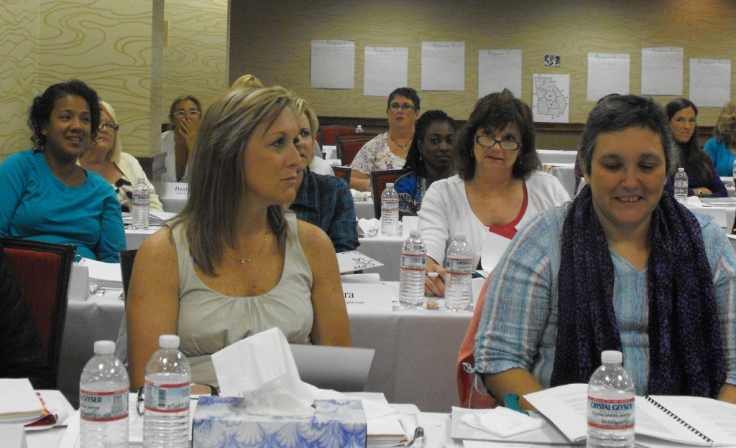
6. Free Trainings
Just pick up the phone and our trainers can come to you!
P2P Provides
The trainer/trainers
Full curriculum including PowerPoint and handouts
Fliers for the host to use
Advertising on our calendar of events
Call Toll Free 1-800-229-2038
Notes:
Did you know we provide 2- and 4- hour trainings on a variety of topics? All of our trainings are FREE of charge to parents and available in many languages. They are also offered anywhere in the state!
We continue to develop new curriculum for parents, and we update existing curriculum as information changes. Visit the training calendar on our website to see what is coming to your area. Register for our email list that sends out information monthly about the trainings and webinars that are occurring close to you. Trainings are listed by county, but families can attend any training regardless of the county they live in!

Slide 12




7. Online Opportunities
P2P Impact Awards
P2P Health & Education Email News Blasts
Visit us at www.p2pga.org
Notes:
In addition to online webinars and our website, there are many other ways you can connect with P2P online. If you have a Facebook page, you can “like us” or you can “follow us” on Twitter. And check out the information we are sharing on Pinterest.
The Impact Awards recognize individuals whose actions demonstrate, support, or lead to inclusion of individuals with disabilities so they can meaningfully participate in all aspects of life. Award winners exemplify respect and dignity for everyone, regardless of ability, and they work to ensure that others embrace these same ideas. Perhaps you know someone in your community that you would like to nominate. (Note to presenter: before your presentation, know whether the impact awards are in the nomination or voting stages so you can let you audience know. This info can be found on the website or by calling the office.)
If you are not already on our Email List, then please go to the website and sign up. Or you can add your email list to my sign in sheet, and you’ll be added. This will allow us to keep in touch with you. And you’ll find out about trainings, webinars, and community events through our Health & Education Email Blasts.

Slide 13
What we can do for you…
7 Core Services
Special Needs Database
Roadmap to Success
Supporting Parents
One-On-One Assistance
Navigator Project
Free Trainings
On-Line Opportunities
Notes:
Now, we have been through each one of our core services. I hope you can see that there really is something for everyone at P2P. Our services are varied because we realize that the needs of families we serve are diverse. We celebrate that diversity at P2P and strive to reflect diversity in our staff and in the families that we serve.

Slide 14

What you can do for us…
Call us & tell your friends to call us!
Visit www.p2pga.org!
Attend Trainings!
Become a Supporting Parent!
Become a Local Guide or Broker!
Join a Navigator Team!
Follow us on Facebook/Twitter!
Donate time, talents, or money!
Notes:
Collaboration and capacity-building serve as our guiding principals in everything we do. We firmly believe that if you really want the best for your child, you need to collaborate with others and build your capacity, build your skills and knowledge.
So, you’ve heard what we can do for you. What can you do for us? Now that you’re part of the P2P family, what can you do to get involved? How are we going to work together?
Note to Presenter:
Reviewing the points on this slide is your final opportunity for selling P2P to your audience. Be excited and make sure they feel your excitement. If you are passionate, you will inspire them to be. It’s contagious. You want them to catch it! You want to motivate them to get involved.
If time allows, you may ask for audience participation on this slide. Ask them what they plan to do now that they know about all of the opportunities at P2P. By now, you have gotten to know your audience and should know which way this discussion needs to go. You could ask them individually or ask for a show of hands for specific services. For example, “who’s going to attend a P2P trainings?” “Who’s going to follow us on Facebook?” Challenge them/Invite them to become part of our team. Make sure they know that we WANT them to be involved!

Slide 15
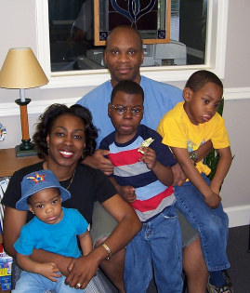
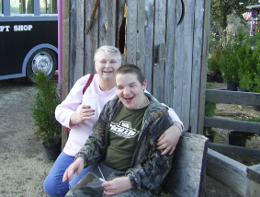
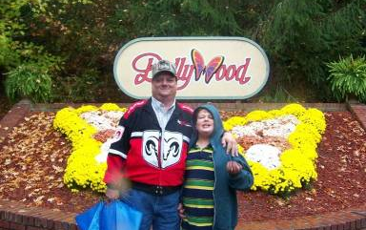
Why Are We Here Today?
WE want to partner with YOU
to help YOU and the parents in your community
Notes:
We’ve covered A LOT of material today. Hopefully, you learned something NEW today. Many people think they know about Parent to Parent of Georgia and they really only know one tiny piece of what we do. When they come to this presentation, they learn that P2P has A LOT going on and they want to be involved. I hope I’ve gotten you motivated to become involved in at least one aspect of P2P. There are MANY ways that you can be involved.
One point I want to make again is one about partnership. If I’ve been successful today, then you get it . You know and believe 100% that WE WANT TO PARTNER WITH YOU to help you and the parents in your community!
We want to help you but we also want you to help us. Because working together will be how we will be able to meet our goal of supporting ALL Georgia families who are impacted by disabilities or special healthcare needs.

Slide 16
P2P & ME!
Thank you for listening!
Remember,
help is just a phone call or click
away…
800-229-2038
www.p2pga.org
Notes:
Thank you (Host Name) for allowing me to share with you today. I’ve had fun! (Note to presenter: sound like you had fun!)
We have __ minutes left for your questions and I’ll be glad to hang around afterwards and answer any questions we may not have time for or you may not want to share with the group.
Note to Presenter:
It’s important to end on time. Pay attention to time during the presentation and adjust your speed accordingly. Remember you can always refer them back to the 800 number for answers to questions you do not have time to answer.

