Slide 1

Move On When Ready
Hard To Believe But It Is Really True!
Gary Mealer,
Transition Career Partnership Coordinator,
gmealer@doe.k12.ga.us
Benefits many people!!!!

Slide 2
SB 132 set MOWR requirements through the following definitions:
‘Eligible high school student’ means a student entering 9th, 10th, 11th, or 12th grade an at eligible high school.
‘Eligible high school’ means any private or public secondary educational institution located within Georgia and any home study program pursuant to Code Section 20-2-690.
‘Dual credit course’ means a postsecondary course taken by an eligible high school student at or through an eligible postsecondary institution for which the student receives secondary credit from his or her eligible high school.
Institutions are responsible for establishing their own dual enrollment/MOWR admission requirements. An ‘eligible high school student’ must meet the admission requirements set by the institution to be admitted to that institution.

Slide 3
What Did SB 132 Do?
Streamlined the 3 programs into one program.
Easier for students, parents, and K-12/higher education personnel to understand, promote, administer, etc.
Accel
HOPE Grant dual enrollment
Move On When Ready
Move on When Ready
X
Established a single program administered by GSFC.
Takes advantage of the online processes built for the Accel program.
X
Reduced out-of-pocket expenses for students and their families.
Increases access by removing financial barriers.
X
Expands course options.
Provides students with access to more courses provided through a single course list.

Slide 4
  MOWR Early Graduation Option
Earn a high school diploma (SB 2)
  Student must receive credit for all EOCT courses: two English, two math, two science, and two social studies, and the required PE and Health course
    Note: Course(s) may be taken through MOWR and/or at high school
    Take EOC exams
    Exams must count 20% of final grade
  Earn and complete one of the following:
    Associate degree
    Technical diploma
    Two certificate programs within one specific career pathway
  The high school must award a high school diploma

Slide 5
Three TCC Areas That Qualify For SB 2
Computer Programmer
Networking
Welding
Two technical certificate programs in a career pathway that TCSG currently offers

Slide 6
MOWR School Participation
Agreements
To participate, must submit an annual participation agreement to GSFC
  Eligible postsecondary institutions
  Georgia public high schools
  Georgia private high schools
  Home study programs operated in accordance with O.C.G.A. 20-2-690(c)

Slide 7
Required MOWR Forms
Required Permission Forms
MOWR Student Participation
MOWR School Participation
MOWR Postsecondary Participation

Slide 8
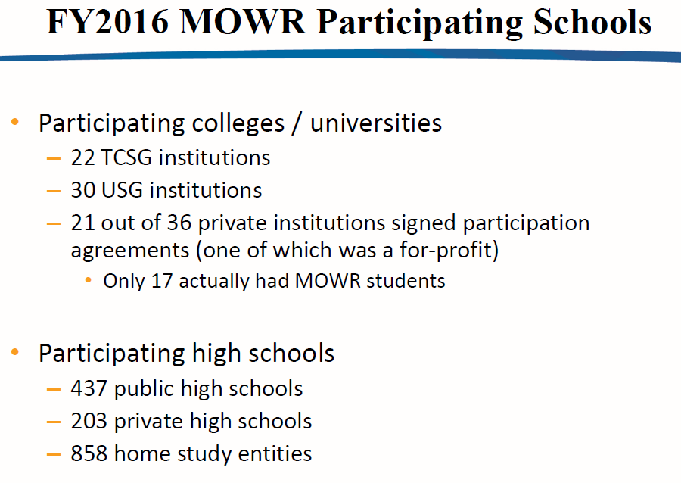

Slide 9
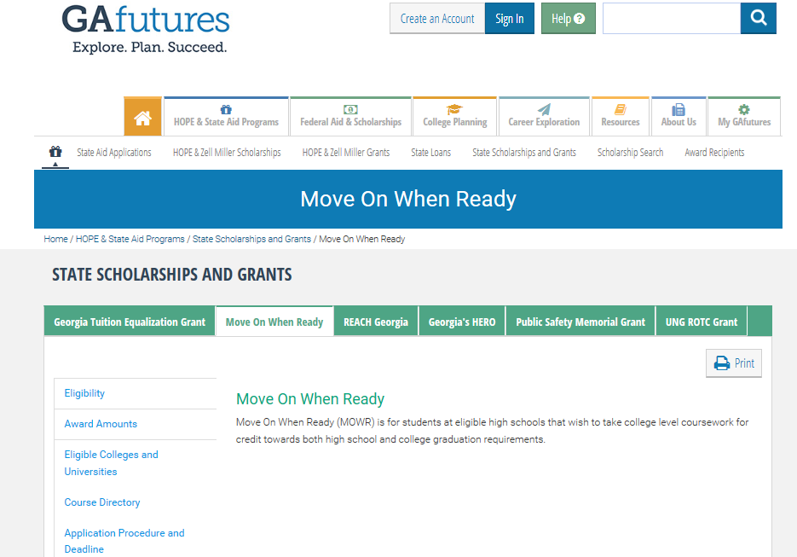
https://www.gafutures.org/

Slide 10
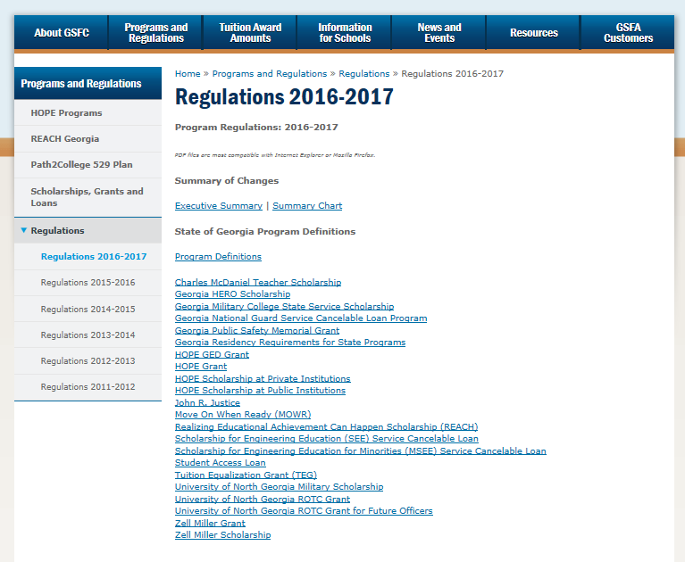
MOWR Regulations Link

Slide 11
School Counselor Responsibilities
Provide general Move on When Ready information by February 1 each year
Provide student advisement
Record grades on student’s transcript for dual enrollment credits earned
Assist students with meeting Move on When Ready Student Application deadlines
Establish a contact plan for full-time students to ensure graduation requirements are met
Notes:
These are some of the basic responsibilities counselor must provide for MOWR students.
Must be current and knowledgeable on MOWR information for your students and parents.
Ensure application is completed prior to for each semester of participation.
Contact plan is crucial so you can keep up with these students especially fulltime S’s.
GADOE is developing counselor advisement step sheet to help guide counselors through the process and defining proper sequence of action you should follow.

Slide 12
Application Process
  Student completes MOWR application and submits it to high school/home study
  Requires high school counselor and parent/guardian signatures
  Application must be completed each term
  A high school official will select courses only from MOWR directory. Courses outside the directory will not be covered under MOWR
  Applications will then be forwarded to postsecondary to complete
    Completes required post-secondary sexual assault awareness and prevention training under Title IX, 4 C.F.R.106 that will be provided at no cost to the student

Slide 13
MOWR FY 17
Tuition, mandatory fees and books are all paid
Summer school participation
February 1 is new notification date

Slide 14
MOWR FY 17
No GA residency requirement
MOWR online application and student participation form required each term of participation
15 hours per institution per semester-multiple can be attended

Slide 15
MOWR FY 17
High schools can remove students who are not following MOWR or high school guidelines
Maintain Satisfactory Academic Progress (SAP), per his or her Eligible Postsecondary Institution
Georgia Student Finance Commission is the fiscal agent

Slide 16
NEW MOWR Update
MOWR students can participate for 9th-12th grade years but not beyond
If graduation requirements are met early during 12th grade year they can continue participation the rest of that year
Only degree level MOWR courses can receive the .5 weight and meet the academic rigor course categories of the HOPE/Zell Scholarship
Biology taken again as MOWR can count as 4th science if not matched to same high school course number----For example,
26.0A324 Dual Enrollment Life Sciences TCSG (BIOL 2113 Anatomy and
Physiology I)
MOWR 2016-17 Guidelines are posted on Ga Student Finance Commission webpage-gsfc.org
Gafutures.org is where all other MOWR documents are located

Slide 17
MOWR Updates & Reminders
Math-first 3 required math courses (Alg. I, Geometry, Alg. II) are not available for any MOWR courses. MOWR approved mathematics courses are awarded core/elective credit for the fourth mathematics course requirement beyond Algebra II.
Questions--Sandi Woodall, Mathematics Program Manager
swoodall@doe.k12.ga.us
Brooke Kline, Mathematics Secondary Specialist
bkline@doe.k12.ga.us
2. Transportation grant application mail out by Sept. 30 due Nov. 30
3. July 26, 2016- GAcollege411 transitioned to GAFutures

Slide 18
MOWR Updates & Reminders
MOWR students are always high school students until high school graduation
Local system makes final decision on what, how, when, where and If MOWR courses are taught at their high school instead of colleges
High schools should be consistent with procedures, schedules, and expectations of MOWR students as non-MOWR students
School Participation Form changed from annually to 4 years beginning 2016- 2017 school year
Local systems earn and retain their FTE funding

Slide 19
MOWR Grades
Grade Conversion-local system determines conversion scale for the college letter grade.
Grade Weight-only degree level core courses receive a .5 weight and meet academic rigor course categories for HOPE GPA calculation.
Class ranking- local systems determine valedictorian, class rank, etc. eligibility for MOWR students.

Slide 20
MOWR Class Withdrawals
A grade must be posted on high school transcript, even if student withdraws from MOWR course and doesn’t
complete course at high school
2. MOWR regulation 1605.5f. The high school must record on the student’s high school transcript each approved course name, grade, and amount of credit hours and course unit credits earned for each course taken as a Dual Credit Enrollment student
Notes:
14. Must contact high school counselor
Counselor, student and parent must have communication about the effects of withdrawal
If withdrawal, the student will return to high school to make up that portion of the school day
Effects of withdrawals could be FTE reporting and funding, GHSA eligibility, NCAA eligibility, graduating on time,
G.P.A., etc.

Slide 21

Student Withdrawals
Should not withdraw without approval from high school counselor
Should be required to maintain full-time high school status
GHSA and/or NCAA eligibility could be affected
Be consistent as with regular non-MOWR high school student
Georgia attendance law

Slide 22
Most Common Questions
Can colleges set an age requirement? Yes, up to individual college.
How many terms can a student participate? Three per year, fall, spring, summer for semester, and fall, winter, spring and summer for quarter.
If a student is full-time at the high school can they still take courses through MOWR? Yes, there is no limit to the total number of courses taken except 15 hours per college institution.
Can they earn a full Carnegie unit of credit for only one semester of MOWR instruction? Yes, if the MOWR college course is a 3 or more hour college class.
Does a student have a certain time/date when they must announce they are pursuing SB2? No, it can occur anytime during the 9—12 grades.
When does a student become eligible? 9th grade officially begins the Fall of the student’s 9th grade year.

Slide 23
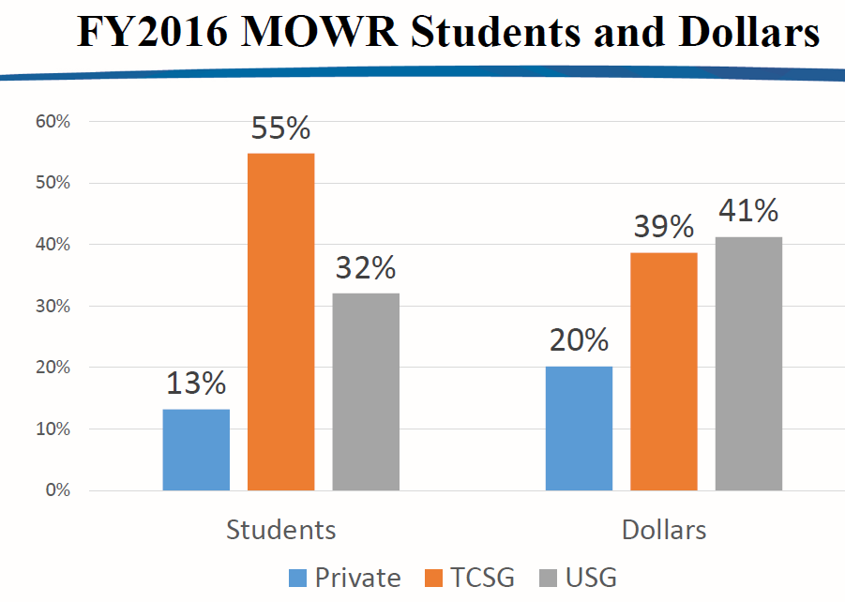

Slide 24
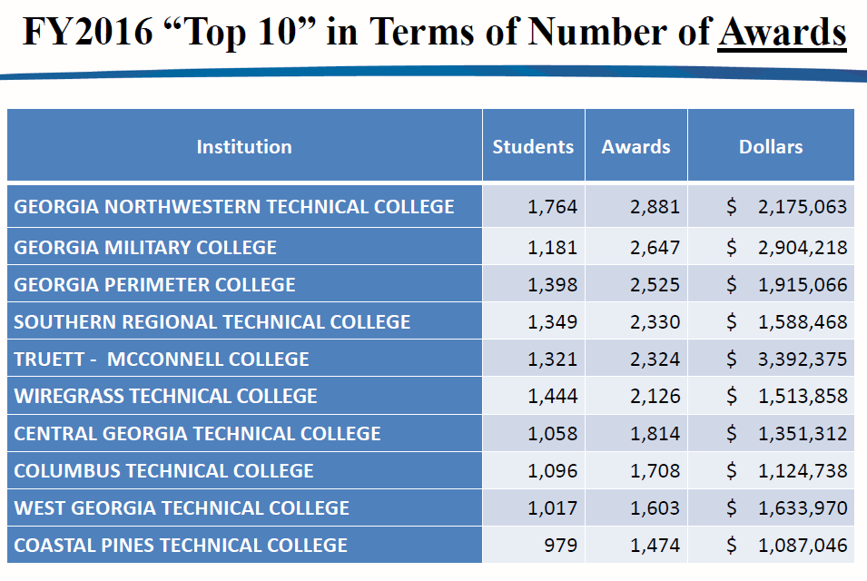

Slide 25
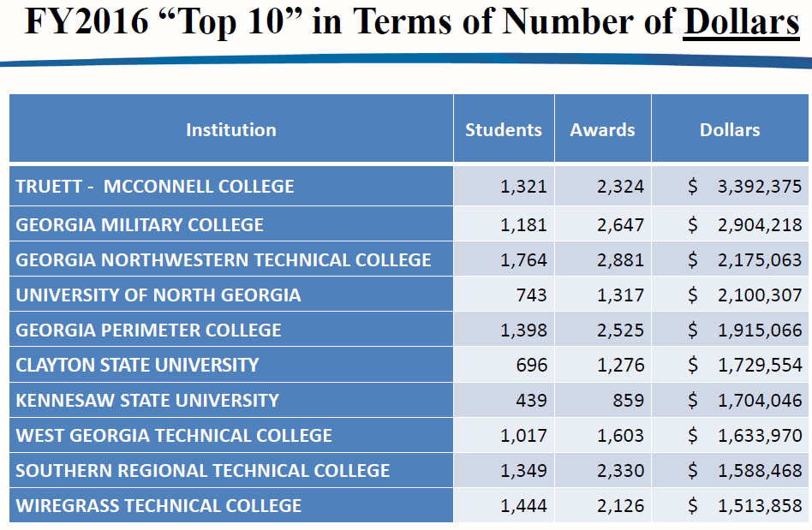

Slide 26
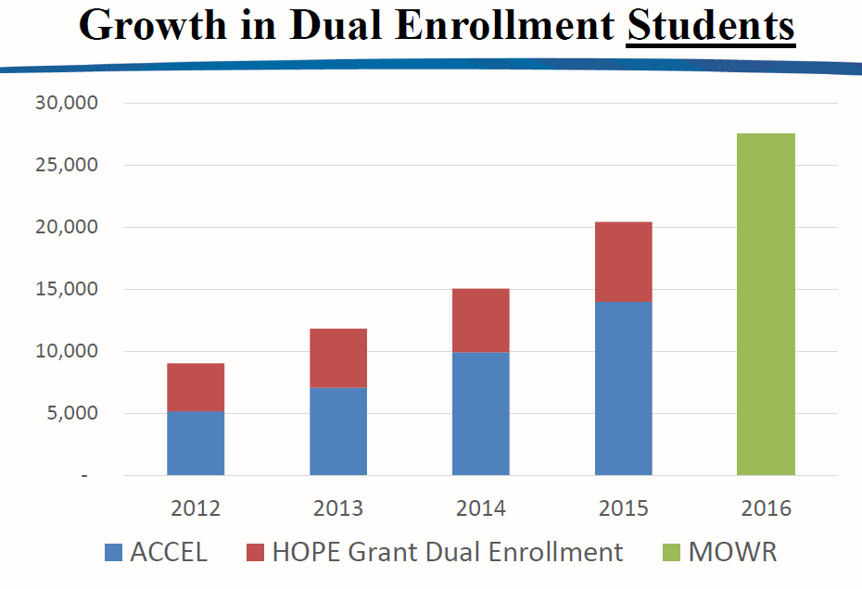
FY2016=27,512 students

Slide 27
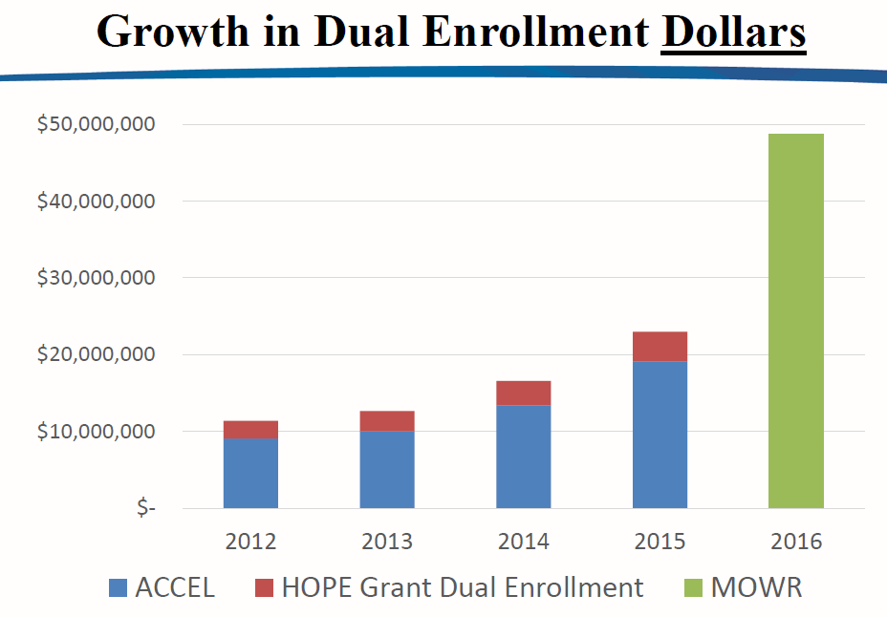
$48,732,785 = FY2016

Slide 28
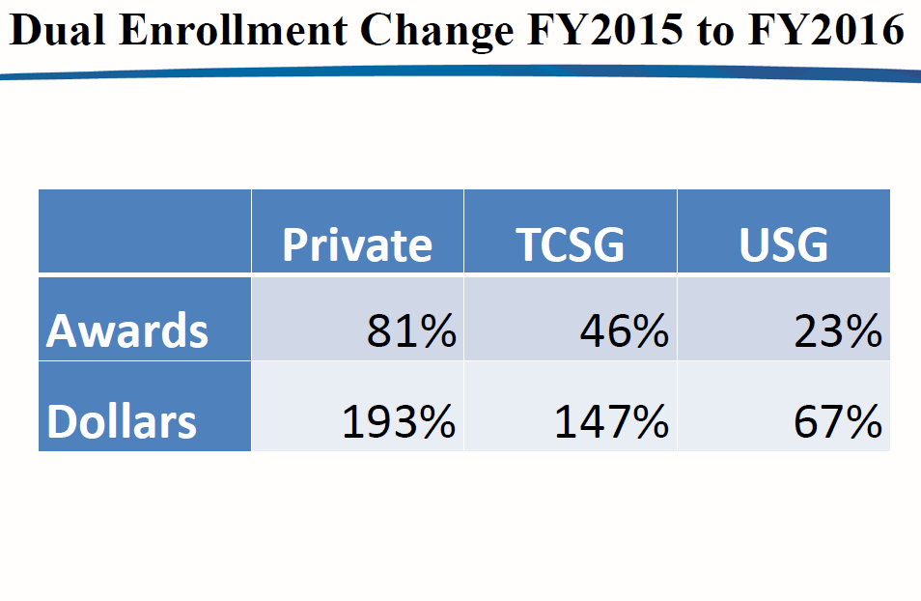
Percentage of increase
from 2015-2016

Slide 29
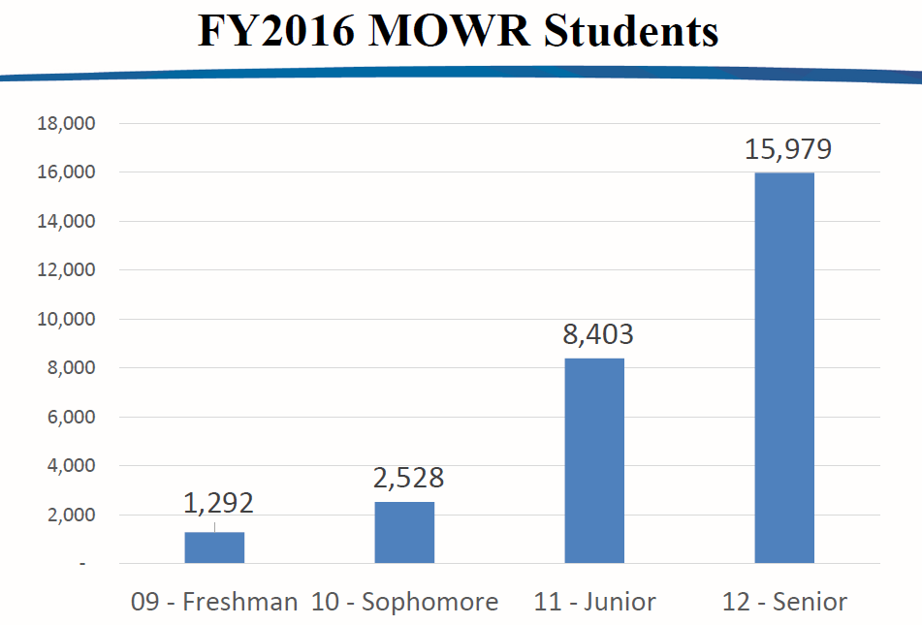

Slide 30
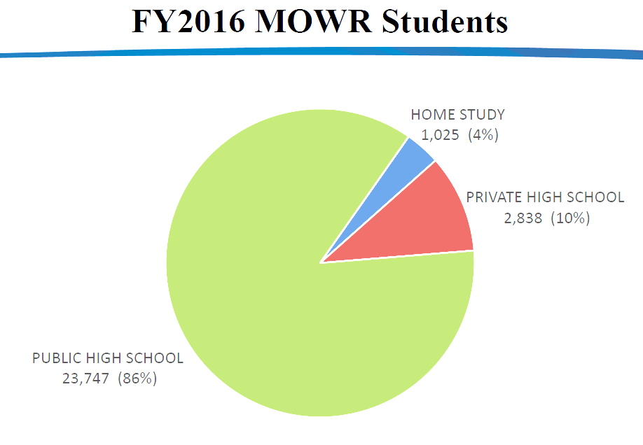

Slide 31
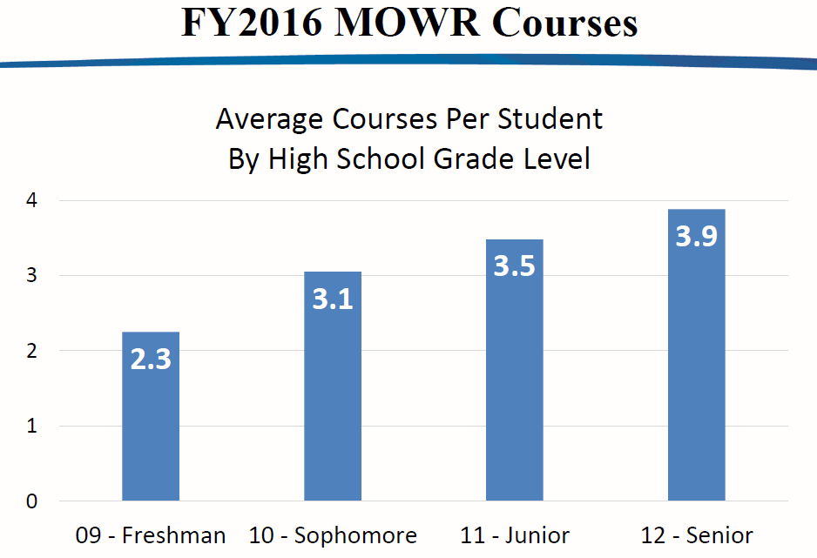

Slide 32
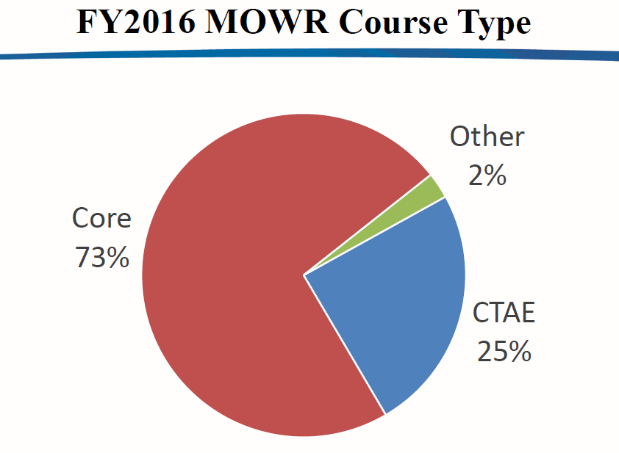

Slide 33
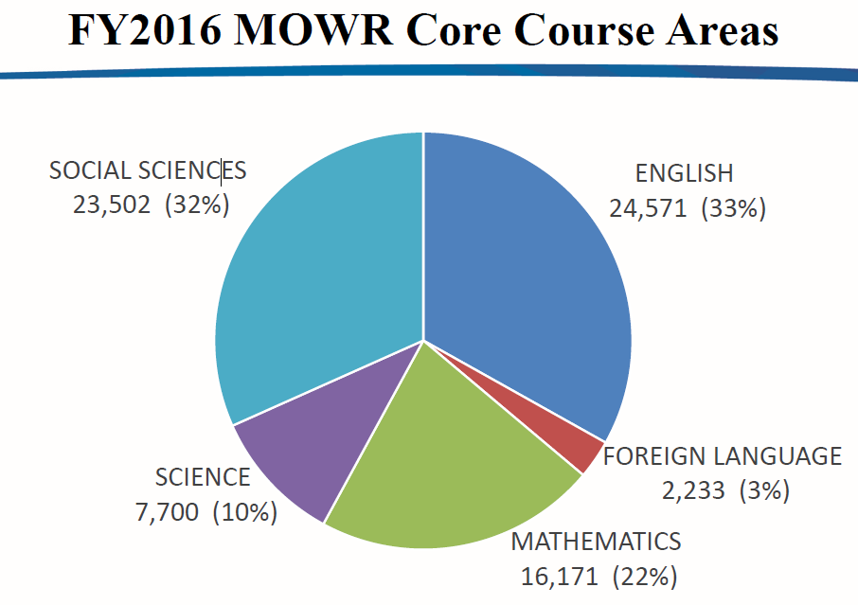

Slide 34
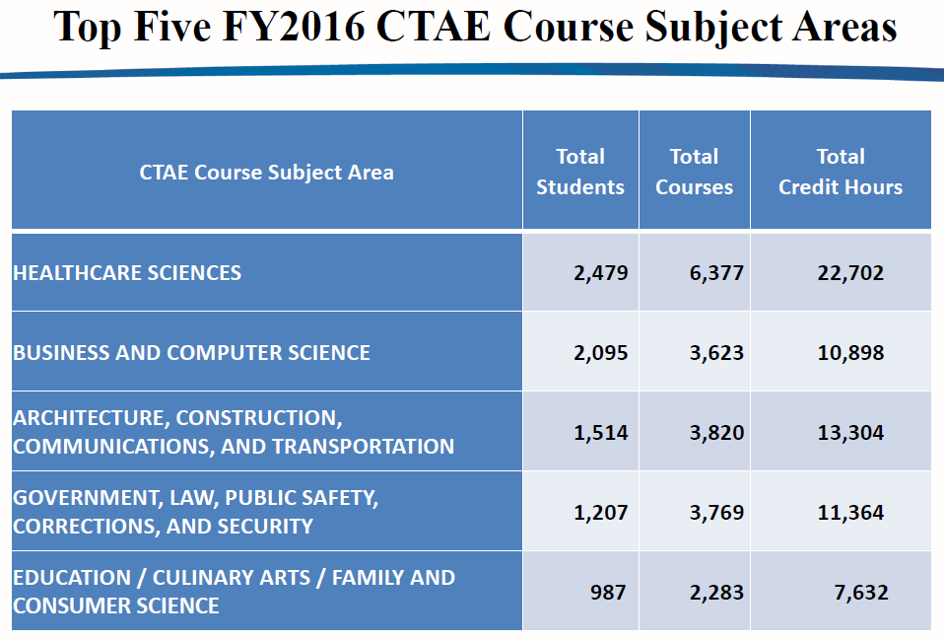

Slide 35
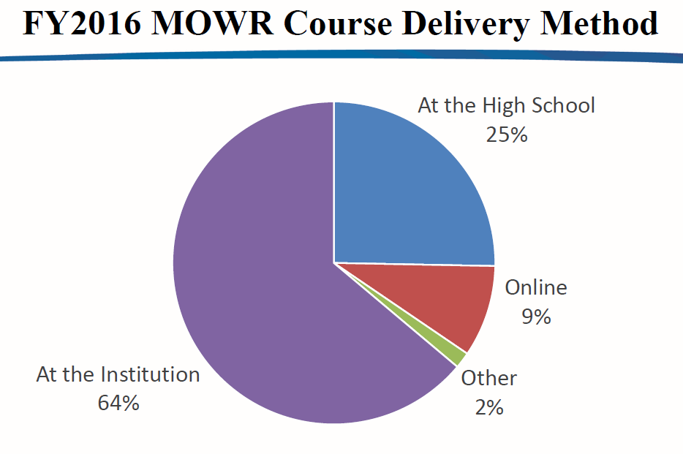

Slide 36
MOWR Guidance Links
2016-2017 Graduation Guidance Document: http://www.gadoe.org/Curriculum-Instruction-and-Assessment/Curriculum-and-Instruction/Documents/Mathematics/Georgia-High-School-Graduation-Mathematics-Requirement-Guidance-2016-2017.pdf
MOWR Math FAQs: http://www.gadoe.org/Curriculum-Instruction-and-Assessment/Curriculum-and-Instruction/Documents/Mathematics/FAQ-MOWR.pdf
Graduation Rule: http://www.gadoe.org/External-Affairs-and-Policy/State-Board-of-Education/SBOE%20Rules/160-4-2-.48.pdf
GaDOE Mathematics Program Webpage; http://www.gadoe.org/Curriculum-Instruction-and-Assessment/Curriculum-and-Instruction/Pages/Mathematics.aspx
HOPE Rigor List: https://www.gafutures.org/media/113414/rigor-course-list-july-2016.pdf
USG High School Curriculum Requirements – Staying on Course: http://www.usg.edu/assets/student_affairs/documents/Staying_on_Course.pdf

Slide 37
University System of GA MOWR
Each USG institution has a Dual Enrollment (DE)/MOWR coordinator to provide assistance. Contact information for each institution is available online. ww.usg.edu/institutions/directories/move_on_when_ready_contacts/
The DE/MOWR admission requirements and deadlines are also available online. www.usg.edu/student_affairs/students/mowr_dual_admission
There are a variety of DE options in the University System (online courses, residential academy at MGSU, honors dual enrollment programs)
AP vs IB vs DE – which options are viewed most favorably by college admission officers? www.usg.edu/student_affairs/documents/MOWR_Admissions_Guidance.pdf

Slide 38

College and University Contacts
Independent college and university contacts – http://www.georgiacolleges.org/media/mowr
Technical College System contacts – https://tcsg.edu/fordualcredit.php
University System Contacts - http://www.usg.edu/inst/directories/move_on_when_ready_contacts/

Slide 39
State MOWR Contacts
Gary Mealer-Georgia Department of Education
MOWR, Transition Career Partnership and JROTC Program Specialist,
Phone: (404) 463-8197 email: gmealer@doe.k12.ga.us
Dianne Lassai Barker-Technical College System of Georgia
Secondary Education Initiatives Coordinator,
Phone: (404)679-1688 email: dbarker@tcsg.edu
Sarah Wenham-Board of Regents
Director of Student Access,
Phone: (404) 962-3115 email: sarah.wenham@usg.edu

Slide 40

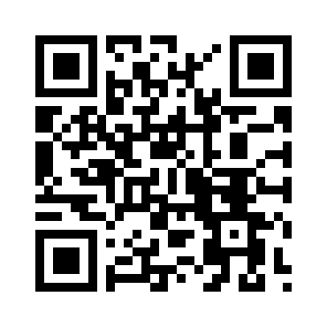
How Did We Do?
http://gadoe.org/surveys/CTAE-FP5Q7ND

Slide 41


