Slide 1
Increasing Student Success with Accessible Educational Materials and Technology

Slide 2
Notes:
None of the products and or services presented in this discussion and endorsed by the GaDOE.

Slide 3
Operations
Notes:
The GIMC is located
Twin Towers
Repository
Central State Prison

Slide 4
Activities
Notes:
Student Certification
Text Procurement and Production for textbooks and required academic materials
Braille*
Large Print*
Digital* accessible *.pdf
Resources to find books from other suppliers
APH Registration
APH Funds Dispersement

Slide 5
Notes:
Helping district provide accessible text to students.
This is where we are:
“The decisions have been made that the students require alternative formats
The students have a system or device to support digital materials
Now where do I go? ”
I just want to be sure that we are supporting the student the best ways possible while giving teachers the tools to follow through an manage the easiest way possible.
Thanks for your time Carson.
The purpose of this presentation is to provide you as parent mentors an overview of the materials (media types) and tools (assisitive technology) processes that should be in place to provide students access to educational materials.

Slide 6
14%

Slide 10
Notes:
Now let’s look at the process of getting books for students

Slide 11
1

Slide 12
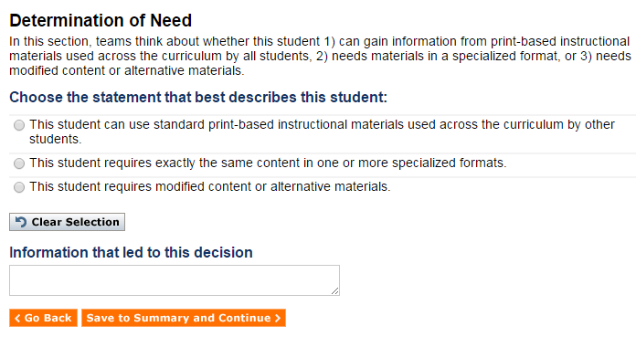
AEM Navigator
http://aem.cast.org/navigator/page/l32

Slide 13
PAR and uPAR
Notes:
This is a final resource for IEP teams or districts to research (again the GaDOE is not endorsing). The PAR is a framework that can help members of the IEP team choose reading accommodations for a student based on empirical data from that particular student.
In the PAR manual, according to Hehir (2008), teachers and parents need to make carefully chosen accommodation decisions. “There is evidence that accommodation decisions for students with disabilities are not done as thoughtfully as they could…. and further, the wrong accommodations may actually depress performance for some disabled students.”

Slide 14
Protocol for Accommodations in Reading

Slide 15
Notes:
Silent

Slide 16
Notes:
Text

Slide 18
2
Notes:
Document in written plan

Slide 19
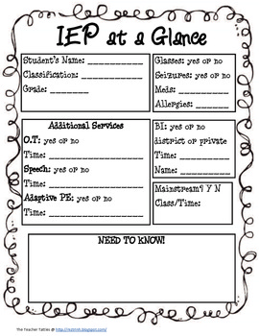
Document in Written Plan
Notes:
Consideration of Special Factors:
Does the student need assistive technology devices or services?
Does the student require alternative format for instructional materials?

Slide 20
3
Notes:
Certify students

Slide 21
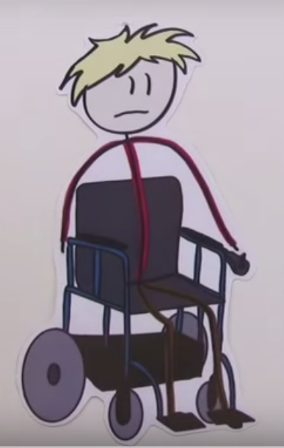
Certifications
Sample form
Notes:
Student Certifications
Blind/Visually Impaired
Look out Accessible Educational Materials Eligibility Certification.

Slide 22
4

Slide 23
Notes:
GIMC
Bookshare
Learning Ally
Change in Patron Registration
Look for Project Gutenberg

Slide 24
AEM (AIM) and AT
Content
Interaction
Access
Independence
Develop Literacy
Succeed Academically
Technology
Training
Accommodations
Special Instruction
Coordinated Services
Maintenance

Slide 25
Technology

Slide 26
Easy Reader
Notes:
A final TTS resource - it’s been a while since we talked about this – Dolphin Easy Reader is a TTS application available through the GIMC (at no charge) for students with blindness, low vision, dyslexia or print disabilities. Students must be registered with the GIMC and they must have an IEP documenting a print disability. Please use this link for additional information.

Slide 27
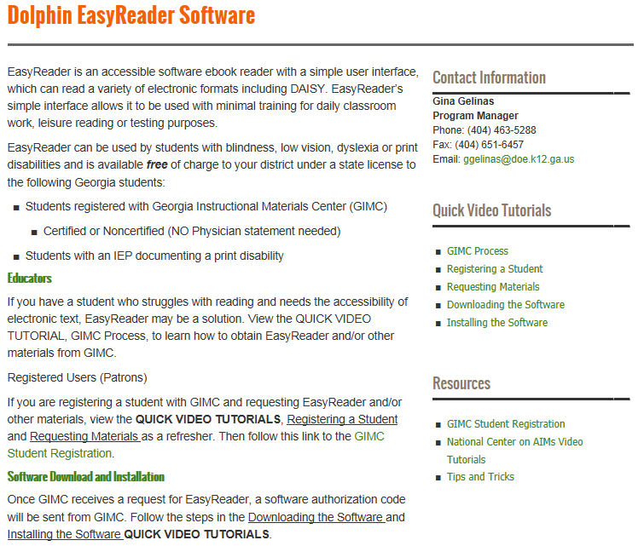

Slide 28
Assessment or Instruction
Notes:
Student Needs & instruction drive assistive technology decisions
Statewide assessment accommodations should be selected based on the student’s individual needs and should generally be consistent with the accommodations provided during instruction.
everyone involved in IEP meetings and in decision-making processes that statewide assessment accommodations should not / do not drive the AT decision-making process.
The student, student needs, tasks, environments, daily instruction drive the AT decision-making process.
IEP teams should not be saying – now we have picked this testing accommodation so now let’s look at providing it to the student during their instruction. That is backwards from what should be happening.

Slide 29
Read Aloud Assessment Questions
Resources
Accommodations Manual
Local Testing Coordinator
Melissa Fincher
Notes:
The next few slides are to discuss a question that has come to assessment regarding read to accommodation.
Before continuing, I want to encourage you, if you have assessment questions to continue to take those questions to the assessment division, Melissa Fincher and her team for answers. They are working to answer questions consistently as well as keep track of the types of questions that are being asked.
The question that has been presented to assessment is …

Slide 30
Consideration Questions
What has to be done?
Are the current aids providing the most independence?
What would technology look like that would increase independence?

Slide 31
Contacts
Georgia Instructional Materials Center (GIMC)
Carson Cochran (ccochran@doe.k12.ga.us)
Michael Silverman (msilverman@doe.k12.ga.us)
Georgia Project for Assistive Technology (GPAT)
Gina Gelinas (ggelinas@doe.k12.ga.us)
DeeDee Bunn (dbunn@doe.k12.ga.us)
Paula Gumpman (pgumpman@doe.k12.ga.us)
Notes:
If you have any questions about any of the information today, feel free to email me or Carson.
If you have specific assessment questions, please continue to direct those to Melissa Fincher and the assessment team.

