Slide 1

PEECE
Parents Engaging In Early Childhood Education
Presented by Dawn Albanese & Jackie McNair
Gwinnett County Parent Mentors

Slide 2
For Parents of Students in Grades PreK through Fifth
PEECE is a four week program that aims to nurture and develop engaged parents, helping them to positively support their child’s academic success, with an emphasis on increasing literacy skills.
Participants will learn how to:
• Be a team member in your child’s individual education program (IEP).
• Learn creative ways to make learning fun and engaging for your child.
• Support your child’s early literacy development.
Participants must attend All sessions.
Wednesday, September 7, 2016 9:30 – 12:30
Wednesday, October 12, 2016 9:30 – 12:30
Wednesday, November 2, 2016 9:30 – 12:30
Wednesday, December 7, 2016 9:30 – 12:30
Space is Limited to 30 participants
To Reserve your Spot, Contact Dawn by August 31, 2016 at
Dawn_Albanese@gwinnett.k12.ga.us
(678) 301-7212

Slide 3
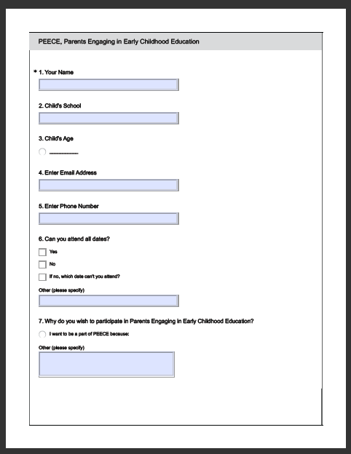
Survey Monkey Application

Slide 4
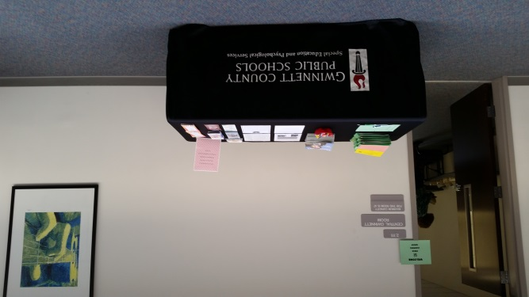
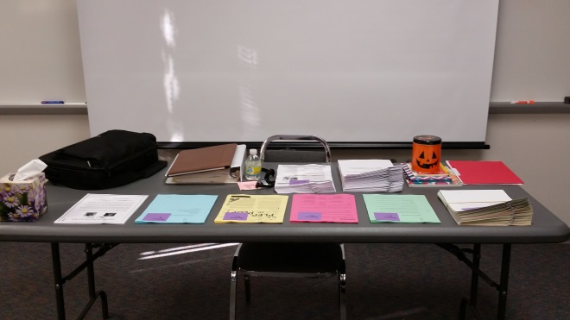
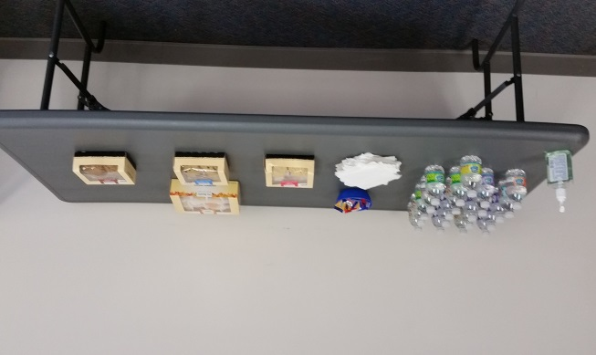
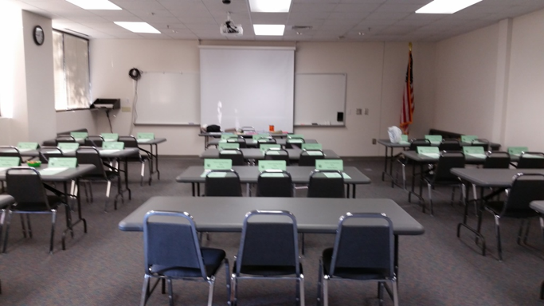
Session Set-Up
Sign-In Table
Presentation Table
Snacks
Classroom

Slide 6
Review of First Meeting
Homework
Main Goals of the IEP
Who can refer a child to be evaluated for services
What information is included in the IEP
How progress is reported

Slide 10

What Did You Take Away from PEECE?
“Knowledge, support, education, facts; I’m in a better place, armed to navigate the special education process.”
“How to communicate, where to look for help, resources, knowledge.”
“Knowledge, resources, strength, support; I’m not alone, in a better place.”
“Information, compassion, feeling empowered.”
“Information, inspiration, direction, understanding.”
“I’m not alone, I have a voice, know where to seek help, how to address people.”
“Opportunity to meet like-minded people, forum to address positives and negatives, learn where to draw support from.”
“Understanding, caring, sharing, healing, encouragement, support, how to be an information seeker.”

Slide 11
Resources
Center for Early Literacy Learning www.earlyliteracylearning.org
Parenting Special Needs Magazine www.parentingspecialneeds.org
US Department of Education www.ed.gov
Georgia Parent Mentor Partnership www.parentmentors.org
Parent to Parent of Georgia www.p2pga.org
Understood www.understood.org
Be There www.gwinnett.k12.ga.us

Slide 12
If you’re interested in duplicating or doing a similar training, feel free to contact either Dawn or Jackie, with any questions you may have.
Dawn Albanese Dawn_albanese@gwinnett.k12.ga.us
678-301-7212
Jackie McNair Jackie_McNair@gwinnett.k12.ga.us
678-301-7149

