Slide 1





Parent Engagement:
From Involvement to Leadership
Enhancing Your Skills
Learning Objectives:
Learn Key Concepts as Leaders in Family Engagement
Enhance advocacy skills using PTA Standards supported by state initiatives
Parent Mentors, Rose Calloway & Edith Abakare

Slide 2
Socio-Ecological Leadership Model
Where are YOU?
Policy
Community
Organizational
Interpersonal
Intrapersonal
The Social-Ecological Model encourages us to move beyond a focus on individual behavior and toward an understanding of the wide range of factors that influence outcomes.

Slide 3
Social Ecological Model ² |  |  |  | Self Assessment (L/M/H)
Level | Influences | Strategy | Prevention activities example
Individual | Factors such as biological, personal history, attitudes/beliefs that support sexual violence | Promote attitudes, beliefs and behaviors | Educational sessions that encourage individuals to challenge or support issues that are mutually beneficial to both partners. | H
Intrapersonal | Relationships with peers, intimate partners, family members | Promote healthy communication and behaviors by modeling relationships. | Peer or bystander projects that gives youth tools to change the climate of their social circles by rejecting or intervening when they hear or witness behaviors | H
Organizational | Level Five Leadership - respect towards people, selflessness by the leader, and a strong powerful commitment to achieve results, bring out the best in subordinates. | Applying humility and strong professional willpower to leadership | Without competion between personal ego and the greater cause, is consistent with Level-5 leadership. Presidents Abraham Lincoln and Barack Obama, Civil Rights Activist Dr. Martin Luther King, Jr. and General Colin Powell top the list of executives exemplifying the degree of humility that distinguish this class of leader. | M
Community | Factors that increase risk based on community and social environments, including an individual’s relationships with schools, workplaces, neighborhoods. | Promote a climate in the community that by targeting processes or policies. | Launching a social marketing campaign on a college campus . Corresponding workgroup | L
Societal | Larger, macro-level factors that influence inequality, religious or cultural belief systems, societal norms, and policies that create gaps in service. | Promote social norms, policies and laws | Targeting law makers to increase funding for prevention activities in schools. Creating a program that provides them with reasons to promote prevention: | L

Slide 4
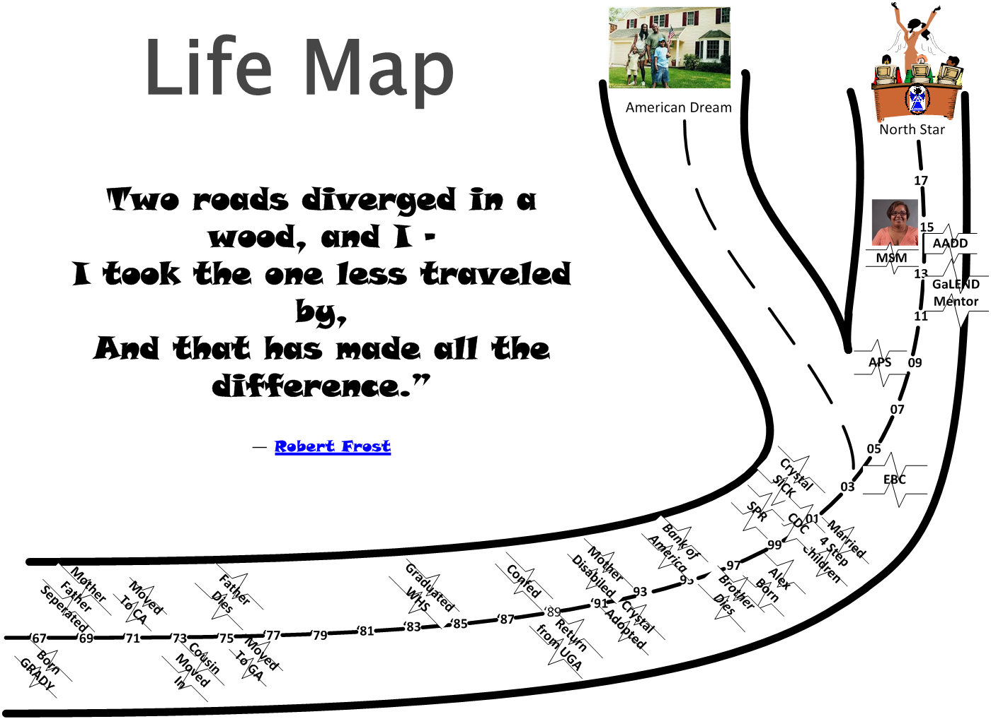
Intrapersonal – Parent/Guardian
Person Focused

Slide 5
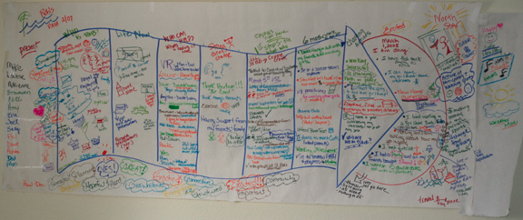
Intrapersonal – Person Centered planning
Intrapersonal factors — Characteristics of the individual such as knowledge, attitudes, behavior, self-concept, skills, and developmental history.

Slide 6
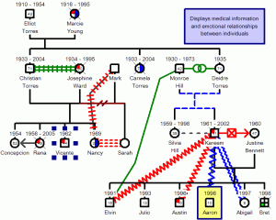
Interpersonal – GenoGram
A genogram is graphical representation of a person's family relationship and medical history. It is a unique type of family research diagram. It not only records family members and their relationships to each other, but also many of their physical and physiological attributes by utilizing an elaborate system of symbols.

Slide 7
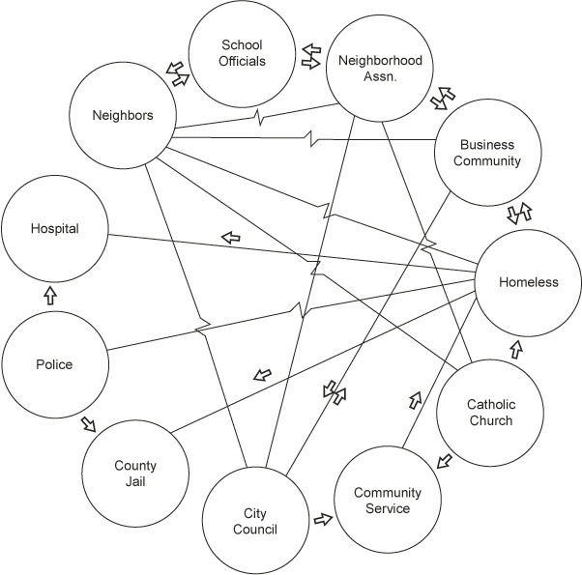
Interpersonal – ecomap
An ecomap helps visualize the social and personal relationships of an individual with everything in the individual's environment or ecosystem. With the individual at the center, it's a map of everything that may affect an individual including interactions with family, friends, business associations, religious community, and any other social or educational groups or clubs.

Slide 8
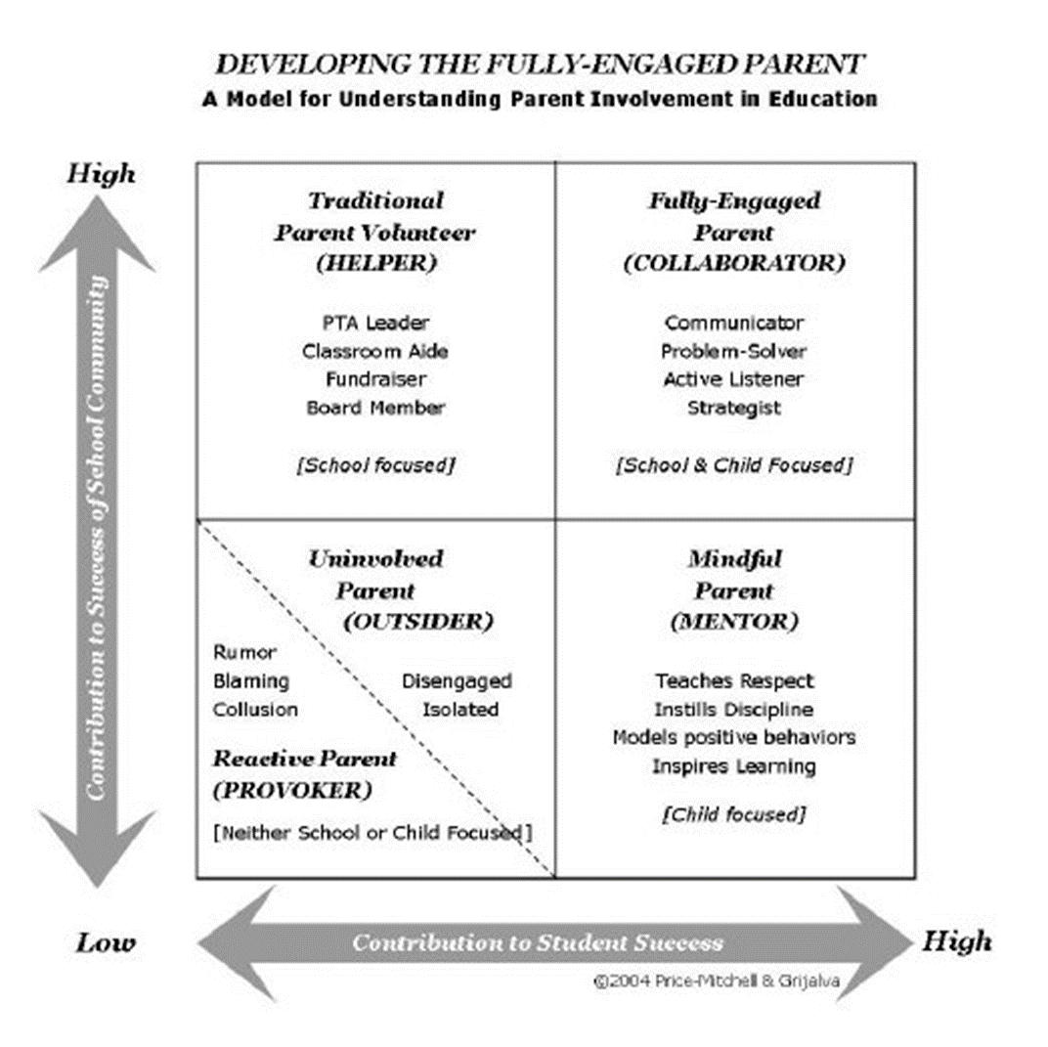
Organizational – Family & Self Advocacy
Level 1 – Highly Capable Individual

Slide 9
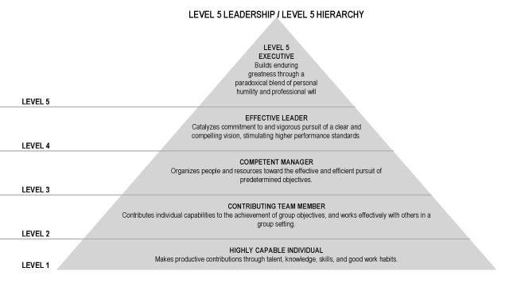
Policy
Organizational – Leadership Level
Community
Organizational
Interpersonal
Intrapersonal
Level 1 – Highly Capable Individual

Slide 10

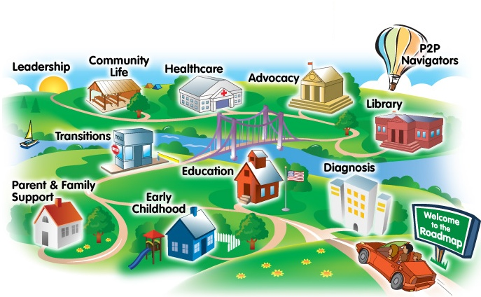
Organization – APS Parent Mentor
Mentor’s work is focused on enhancing communication and collaboration between families, schools, and communities in order to improve outcomes for students with disabilities and their families.
Families: Parent mentors provide information and resources to parents of students with disabilities on a variety of topics and issues related to home, school, and community.
Schools: Mentors also work with teachers, staff, and administrators to integrate family engagement into school and district activities and to build a culture in which family engagement is expected and valued.
Communities: Parent mentors also work to support integration of students with disabilities into the community by working with partners to build a community in which students with disabilities are included and valued.

Slide 11
Schools are:
Human Organizations (Develop Relationships)
Relationships matter
Organizational climate
  Shared goals of the organization
  Leadership style
  Group norms (values and “rules”)
  Behavioral Regularities
Sequential, Reciprocal, and Loose coupling
Bureaucracies (know the Systems)
Bureaucracies work best when:
  Tasks are divided by job role (factory).
  organizational goals are clear
    Group vs. Individualization vs. Budget
  Workers have clear roles & separate functions
  Standard Operating Procedures are understood
    outside classroom vs. inside classroom
    Hierarchical and Downward Communication
Bureaucracies resist change

Slide 12


Standard 1: Welcoming all families into the school community
Standard 2: Communicating effectively
Standard 3: Supporting student success
Standard 4: Speaking up for every child
Standard 5: Sharing power
Standard 6: Collaborating with community

Slide 13
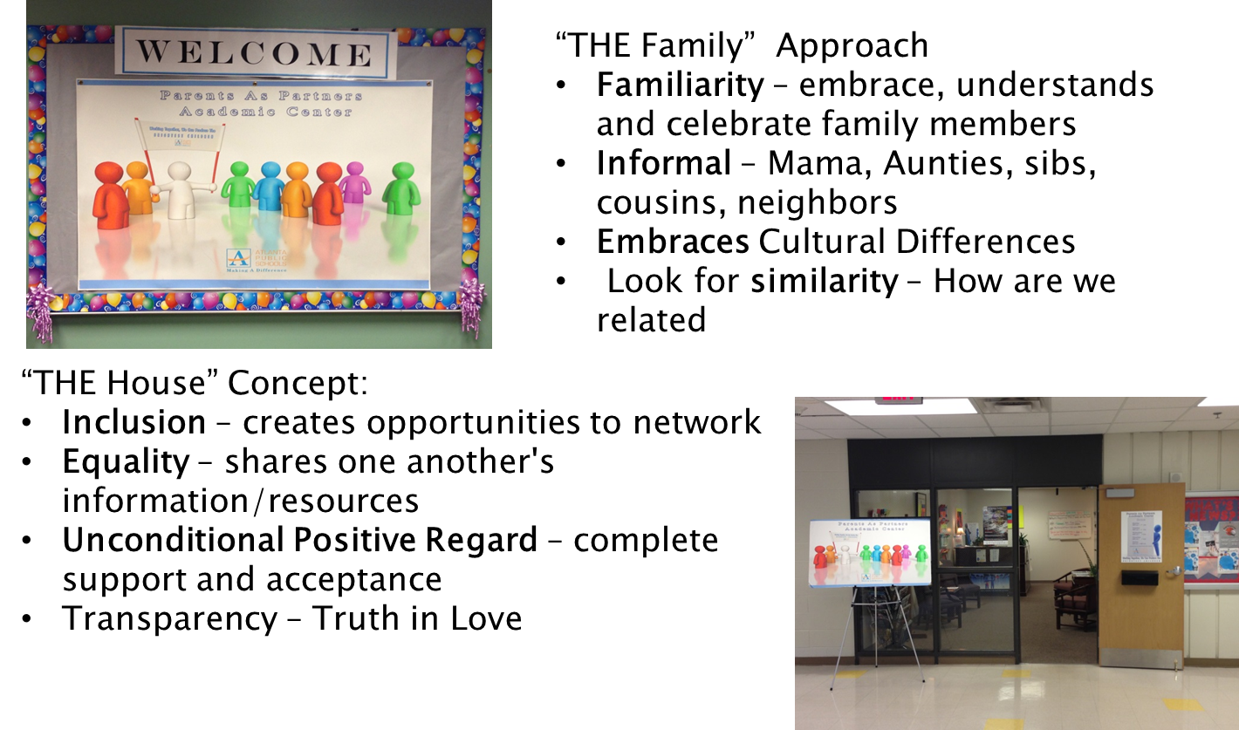
Welcoming All Families
Standard 1

Slide 14
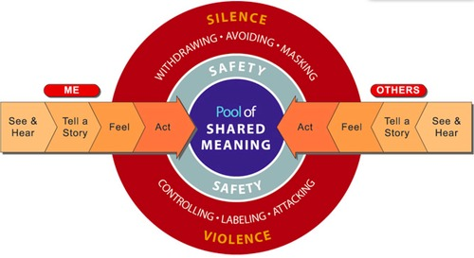
Communicate Effectively
Standard 2

Slide 15

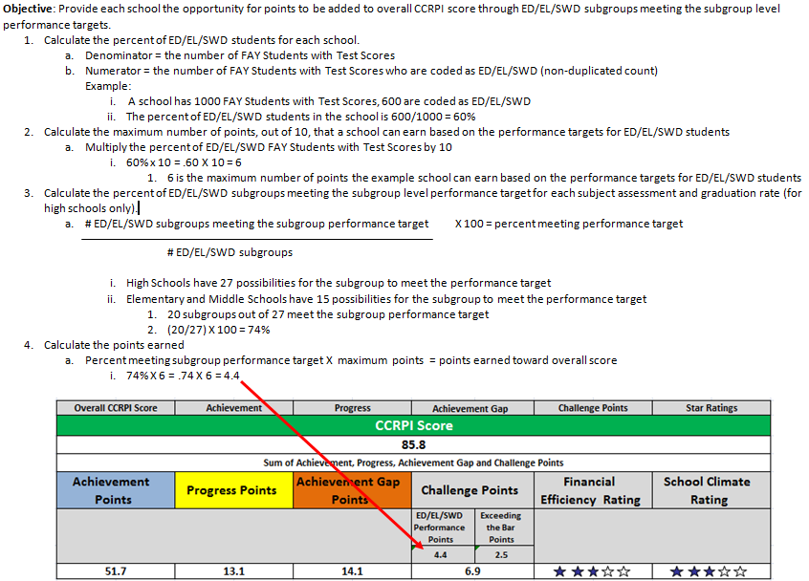
Three components to a school’s CCRPI score:
1. Achievement (60 points)
2. Progress (25 points)
3. Closing the Achievement Gap (15 points)
Challenge Points (Up 10 points)
Supporting Student Success
Standard 3
Notes:
There are three components to a school’s CCRPI score:
Achievement (60 points)
Content mastery on Georgia’s new standardized test called Milestones (which replaces the CRCT
Post-high school readiness and student progress on career pathways
School’s graduation rate over four years, and adjusts for certain populations that might take five years to graduate
Progress (25 points) A more nuanced measure of student progress based on a students’ past academic history and compares students with “like” score histories.
Closing the Achievement Gap (15 points) Looks at the bottom 25% of school’s student population compared to state averages. High-performing schools may earn more on the Gap size than on Gap change. Lower-performing schools may earn more on change than on size.
Challenge Points (Up 10 points can be awarded for indicators that a school is going above and beyond targets in its efforts to address achievement). This is an opportunity for high-poverty districts, schools with many English Language Learners and/or students with learning disabilities to earn additional points. Beginning in 2013-2014, schools received ratings based on their financial efficiency and school climate, but these ratings were for the public’s information only and were not factored into the school’s overall CCRPI score. School climate is not measured in online schools, and it is not know yet whether alternate challenge points could be measured for virtual schools.

Slide 16

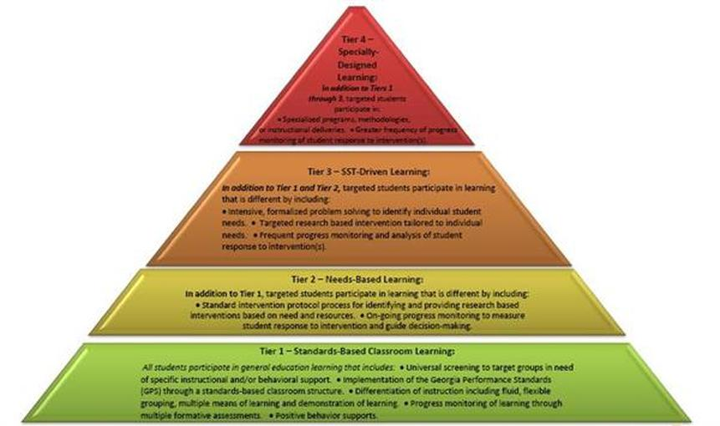
Speaking Up for Every Child Standard 4
College Program
  Four year College
  College specializing in disabilities
  Two-year colleges
  Technical schools
  Non-degree programs
Vocational Programs
  Supported Employment
  Competitive Employment (transition support)
  Competitive Employment (full self advocate)
Home and Community Based Programs

Slide 17
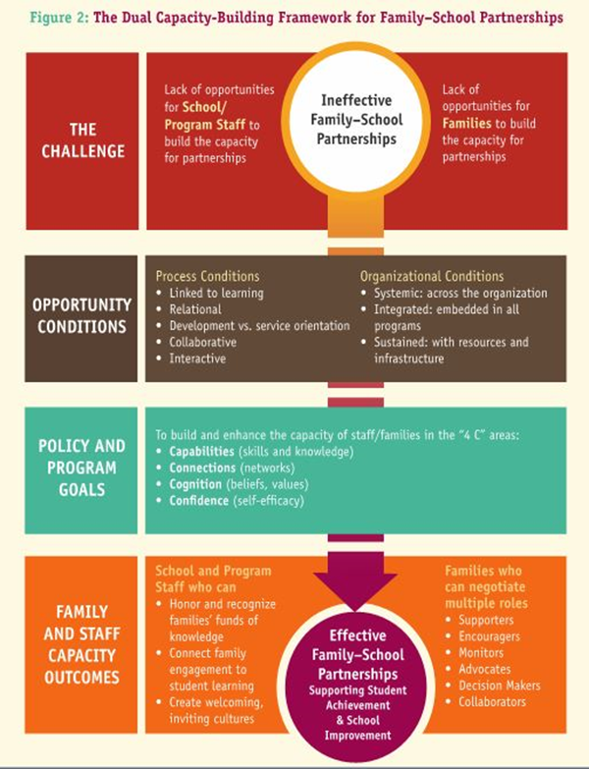
Sharing Power Sharing Power
Knowing your Power Base

Slide 18
Sharing Power
Standard 5
Collective Impact
Backbone Organization
Continuous Communication
Shared Measurement
Common Agenda
Mutually Reinforcing Activities

Slide 19
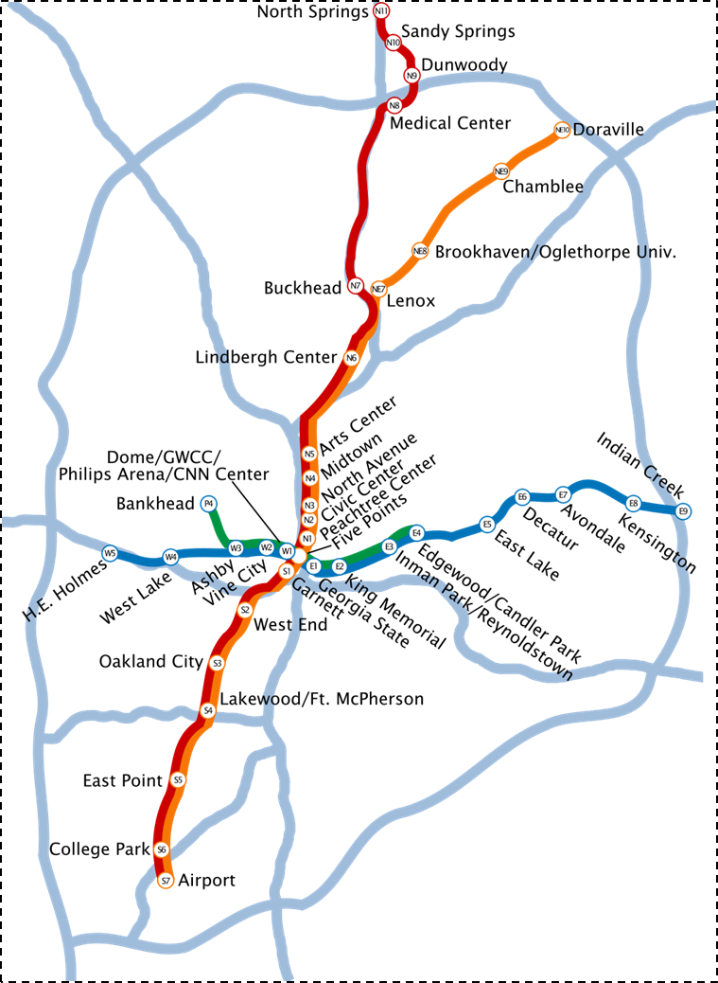
Collaborating with Community
Partners
Standard 6
School (100)
NPUs (25)
Cluster(10))
Cluster(10))
Region (4)
County
City
Subject to change – Must be aware of what is going on in your communities (rural, suburban, urban)
Notes:
Pass out Copy of District Map http://www.atlantapublicschools.us/cms/lib/GA01000924/Centricity/Domain/108/aps_locations_12_13.pdf

Slide 20
Community - Interdisciplinary Partners (State Level)
Standard 6
Georgia Parent Leadership Coalition (PLC):
  Babies Can’t Wait – Skilled Credentialed Early Interventionists
  Bright from the Start: Georgia Department of Early Care and Learning
  Center for Leadership in Disabilities at Georgia State University
  Georgia Council on Developmental Disabilities
  Georgia Department of Behavioral Health and Developmental Disabilities
  Georgia Department of Education, Division for Special Education Supports and Services; Parent Mentor Partnership
  Georgia Family Connection Partnership
  Institute on Human Development and Disability at the University of Georgia
  Parent to Parent of GA – Georgia’s Parent Training Information Center (PTI)
Community — Relationships among organizations, institutions, and informational networks within defined boundaries.

Slide 21
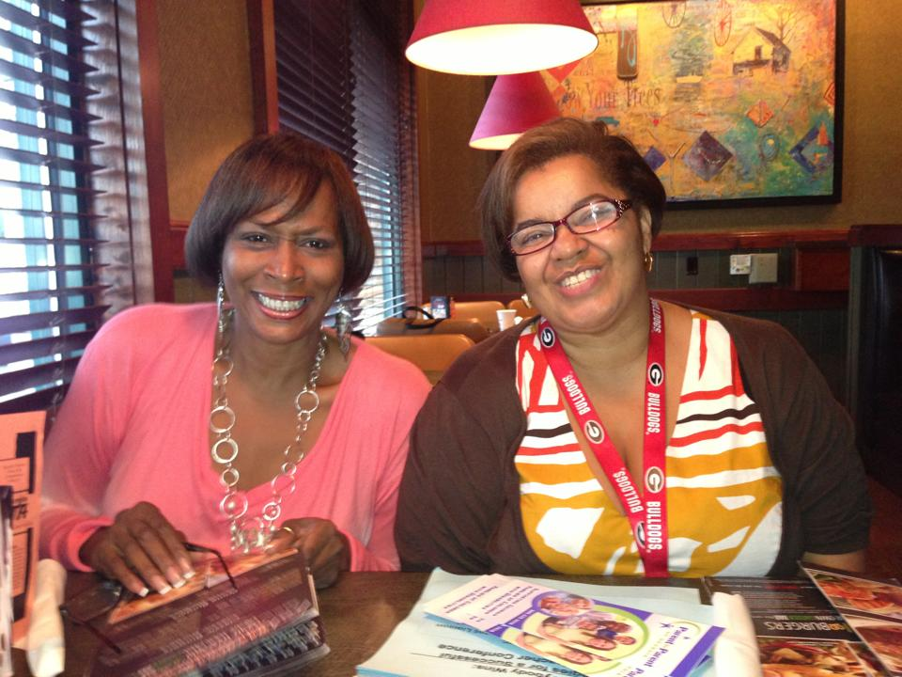
Collaborating with Community
Partners (District Level)
360 Family Engagement
Standard 6
We are the C.O.R.E. of Student Success
APS Parent Mentors,
Atlanta Council PTA,
Special Needs Committee
Title I Family Engagement Specialists,
Title I Local School Parent Liaisons,
District Homeless Liaison,
ESOL Regional Community Liaisons,
Truancy Intervention Specialist,
District-wide Family Involvement Liaisons
Local School Governance Team
http://www.youtube.com/watch?v=F72p7aByjcs

Slide 22
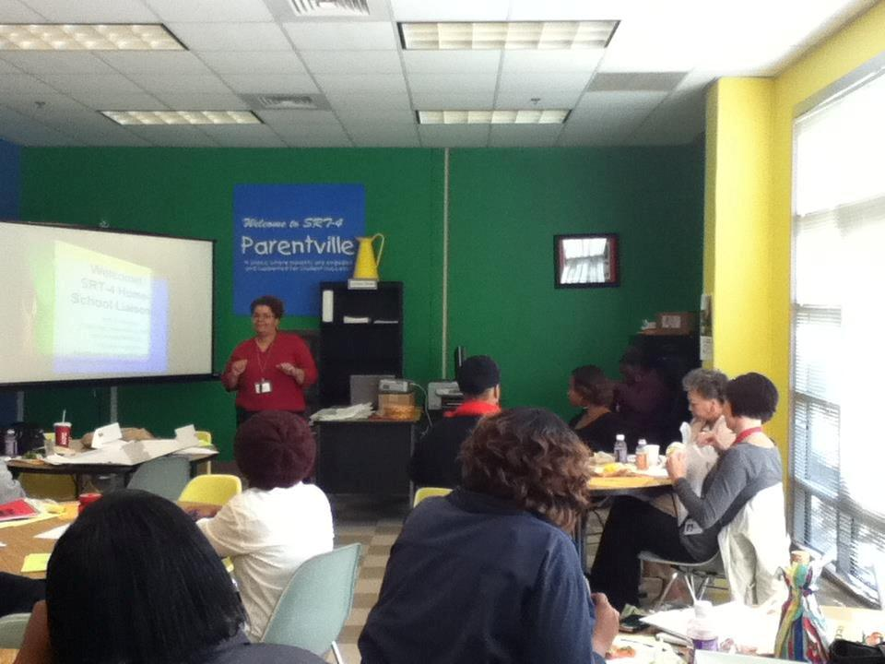

Collaborating with Community
Partners (Cluster Level)
Standard 6
Cluster Level - Provides on-going support as needed for Title I initiatives, such as Common Core, testing workshop, homework help, Parent 2 Parent Assistive Technology and fingertip technology techniques for parents and students. All other needs/requests are intended to address issues pertaining to Special Needs.

Slide 23

Public Policy — Local, state, national, and global laws and policies.
Unlock Original ASK for ICWP: | Gradually raise the ICWP Personal Support Services rate to $20/hr. beginning with a $3/hr. increase for FY 2016 | $7,975,490
Governor's FY 2016 recommendation: | No new ICWP increase | $0
House budget version: | $.50 per hour rate increase for Personal Support Services covered under the ICWP | $1,329,428
Senate budget version: | $1.00 per hour rate increase for Personal Support Services covered under the ICWP for Direct Support Professionals | $2,658,856
Conference committee: | $0.75 per hour rate increase for Personal Support Services covered under ICWP | $1,994,142
Unlock Original ASK for NOW/COMP: | 1,000 new NOW/COMP waivers for Georgians most in need | $16,493,000
Governor's FY 2016 recommendation: | No new DD waivers | $0
House budget version: | Increase funds for 75 additional slots for the NOW and COMP waivers | $1,124,226
Senate budget version: | Senate agreed with House | $1,124,226
Conference committee: | No changes from conference committee - 75 slot for NOW and COMP | $1,124,226

Slide 24
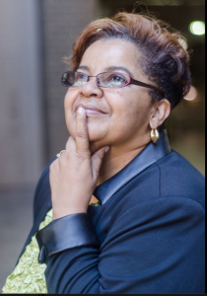
Public Policy — Local, state, national, and global laws and policies.
GaLEND is a leadership interdisciplinary training program that includes as one of the disciplines Family-Advocacy.

Slide 25
Edith Abakare
  Phone: 404-802-3607
  Email: eabakare@atlanta.k12.ga.us
Rose Calloway
  Phone:
  Email: rose@p2pga.org
http://www.parentmentors.org/
Anne Ladd, Family Engagement Specialist
GaDOE, Division for Special Education Services & Supports
aladd@doe.k12.ga.us
404-657-7328
Anne Dirden, Special Education Coordinator
Atlanta Public Schools
acdirden@atlantapublicschools.us
404-802-2633
Barbara Pitts, Special Ed Specialist
Georgia PTA
5805 Dunn Road
bpitts@georgiapta.org
678-478-2668
Mark Crenshaw, Director
Interdisciplinary Training
Center for Leadership in Disability
School of Public Health,
Georgia State University
mcrenshaw@gsu.edu
404-413-1385

