Slide 1
CPS-P:
Family Support through
Lived Experience
Cheryl Benefield
Family and Community Engagement Specialist
Project AWARE
Georgia Department of Education

Slide 2

Not My Kid
75%
20%
50%
70%
10
2nd
90%
www.nami.org
Notes:
20% of youth 13-18 live with a mental health condition
50% of all lifetime cases of mental illness begin by age 14
75% by age 24
8-10 years is the average delay between onset of symptoms and intervention
70% of youth in state and local JJ systems have MI
90% of those had an underlying mental illness
2nd leading cause of death 15-24 is suicide

Slide 3
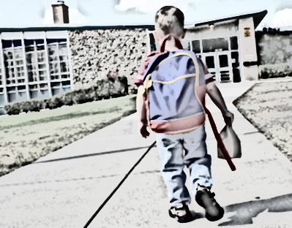
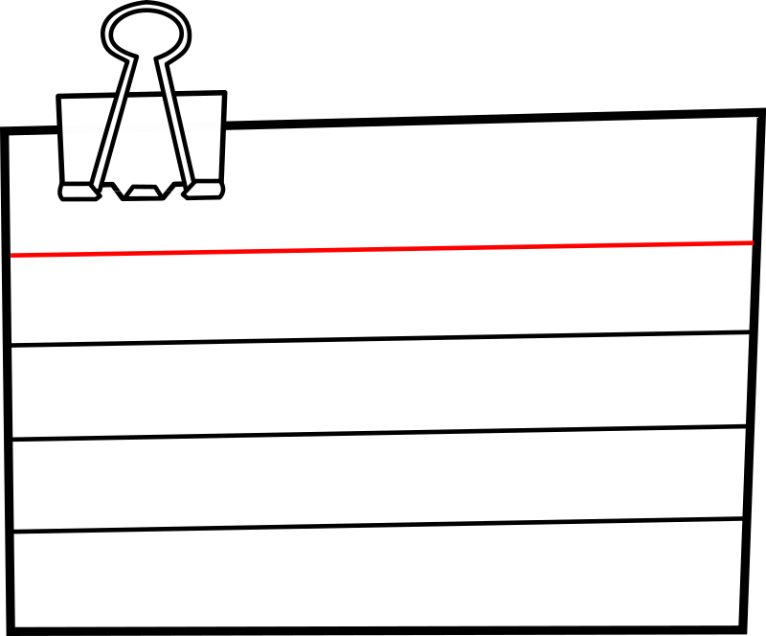


Educational
Impact
Unhappy
Distractibility
Inability to retain information
Poor Concentration
18-22 days
3 x
Schedule attendance meeting
14%
High Risk Behaviors
44%
10%
www.nccp.org
www.youth.gov
Notes:
Children and youth with MHD may miss as many as 18-22 days during any given year
Three times higher rates of suspension and expulsion
14% receive mostly Ds and Fs
44% drop out of high school
10% of dropouts were attributable to MHD
National Center for Children in Poverty

Slide 4
Certified Peer
Specialist – (CPS)
A Peer Specialist is an individual with lived recovery experience who has been trained and certified to help their peers gain hope and move forward in their own recovery.
The Power of Peers: A New Recovery Model
Georgia Certified Peer Specialist Project
Notes:
Video produced by DBHDD
Stop at 2:00

Slide 5
Certified Parent
Peer Specialist (CPS-P)
Peer Support is a direct service support to youth and families and promotes Family Recovery, Resiliency, Respect, and Wellness.
Parent Peer Support taps into the family’s inherent strengths, competencies, and healing capacity to empower the family recovery process.
Notes:
The goal is to similarly impact the youth-serving systems by supporting family journeys to recovery and wellness.
This lived experience workforce of Certified Peer Specialists for mental health and addiction has not only changed thousands of lives, it has impacted the culture of the behavioral health system, infusing respect, recovery, wellness and empowerment throughout the system.
Expands CPS to include Parents of youth living with Mental Health Conditions, Substance Use Disorder or Co-Occurring Behavioral Health (BH) Disorders.

Slide 6
CPS-P Criteria
Candidates must be the parent or legal guardian of a child living with mental illness, substance use and/or co-occurring diagnosis;
Currently employed doing Peer Parent Support ; or
Currently employed in the public sector Behavioral Health system as a paraprofessional and have the desire to distinguish themselves as a Parent CPS-P; or
Have related experience serving youth and families through participation in community volunteering, support groups, family organizations and/or advocacy.
Notes:
There is no “or” on the first bullet – non-negotiable

Slide 7
But they’re both support, right?
Parent Mentor | Certified Parent Peer Specialist
Parent or guardian of youth who has or had an IEP | Raising a child in a permanent relationship for at least three years who has a Serious Emotional Disorder, Substance Abuse Disorder or Co-Occurring Disorder
Education and Academic Achievement | Education, Wellness, Environment, Culture, Social Skills
Family Engagement and Support to Improve Outcomes | Family Support Based on Family Priorities
Funded by GaDOE (IDEA) and District | Medicaid billable
Notes:
How are CPS-P and PM different?
Foster parents are not eligible because they can decide to terminate. There has to be a commitment.
MH and DD are served in two very different systems.
If they’re all in the same pot, families don’t get served well.
Whatever is built and designed should be useful and helpful.
As we grow, it may include those families but not at this point.

Slide 8
Collaborate and Compliment
Parent Mentor | Certified Parent Peer Specialist
Connected to agencies and services, focus on school | Connected to all child serving agencies, focus on entire family’s educational and system navigation needs
No Medicaid billable services | Includes any services or supports that the child/family identifies Medicaid billable
Work with all families, focus on SWD | Working in High Fidelity Wraparound – youth qualify for PRTF level of care but parents opt out for community based services – may be SWD
Notes:
Whatever will help family care for child

Slide 9
Family
CPS-P
DJJ, DFCS, Community Agencies
Parent Mentor
School District, Agencies
Notes:
DFCS, DJJ, Community Agencies
Behavioral Health is not seen as an illness or disease but as willful behavior – Social Services

Slide 10
Cheryl Benefield
Family and Community Engagement Specialist
Project AWARE
Georgia Department of Education
404-657-1531
cbenefield@doe.k12.ga.us

