Slide 1
How
ASPIRE
Student led IEPs
And
Futures planning can be very useful tools in the transition planning process

Slide 2
What is ASPIRE?
The concept that eventually became ASPIRE was a grant funded project of the Georgia Council On Developmental Disabilities.
Today ASPIRE is recommended by GADOE

Slide 3
ASPIRE
When should we start?
Preschool
Elementary
Middle School
High School
YES

Slide 4
ASPIRE
Student Benefits:
Helps build self-confidence
Improved communication skills
Teaches self-advocasey skills
Goal setting
Learning about accommodations
The IEP is more meaningful

Slide 5
ASPIRE
Parent Benefits:
Child is more self-determined and motivated.
Increased communication between parents and teachers.
Parents have an increased knowledge of their child’s interest and desires.
Goals become more meaningful because the student and family have helped in the decision making process.
Students who participate in ASPIRE have more successful transition outcomes.

Slide 6
ASPIRE
Lets hear from Will Crain
ASPIRE participant for the last nine years

Slide 7
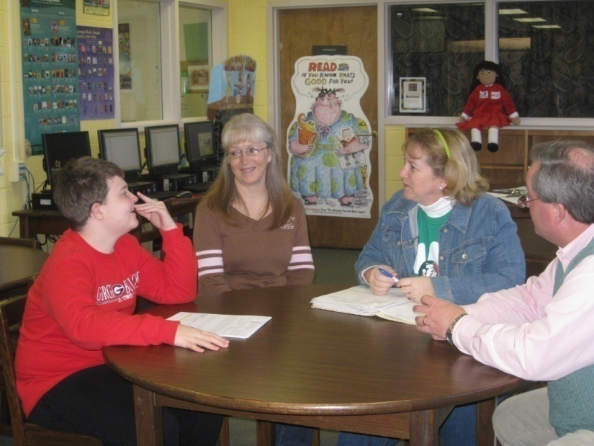



Slide 8
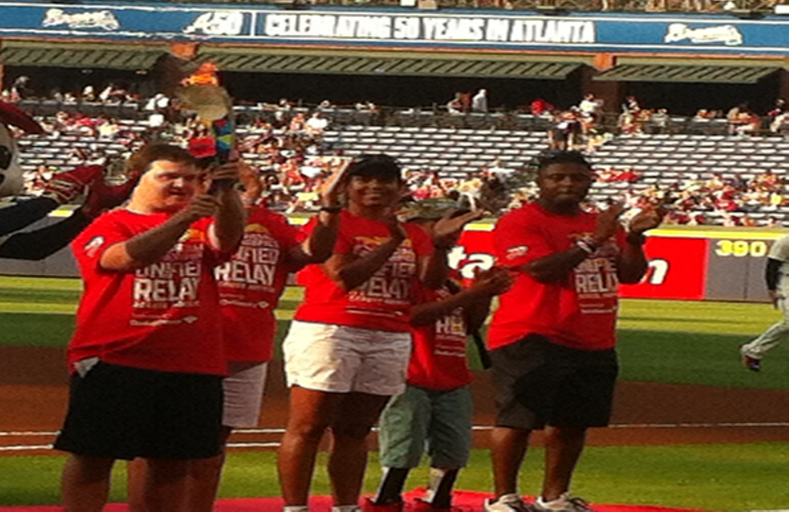
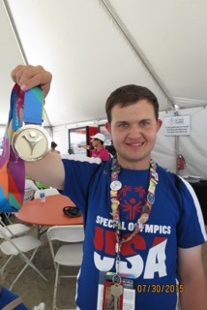
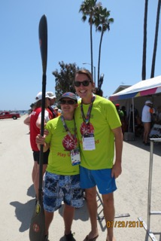

Slide 9
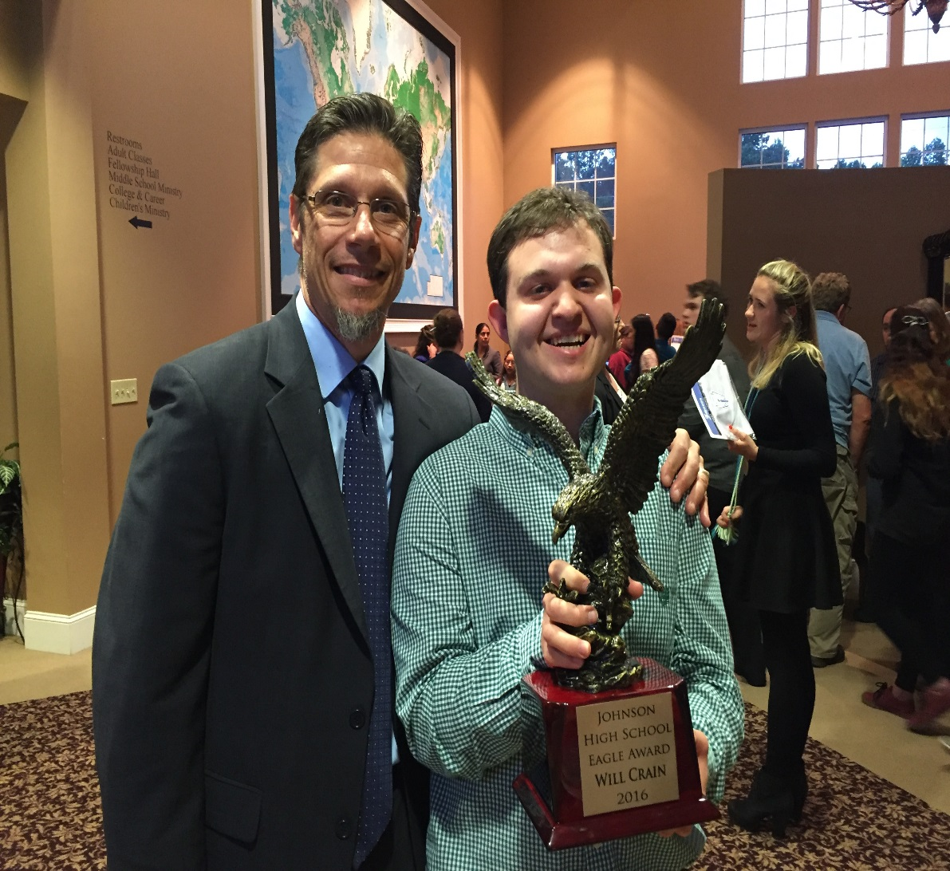
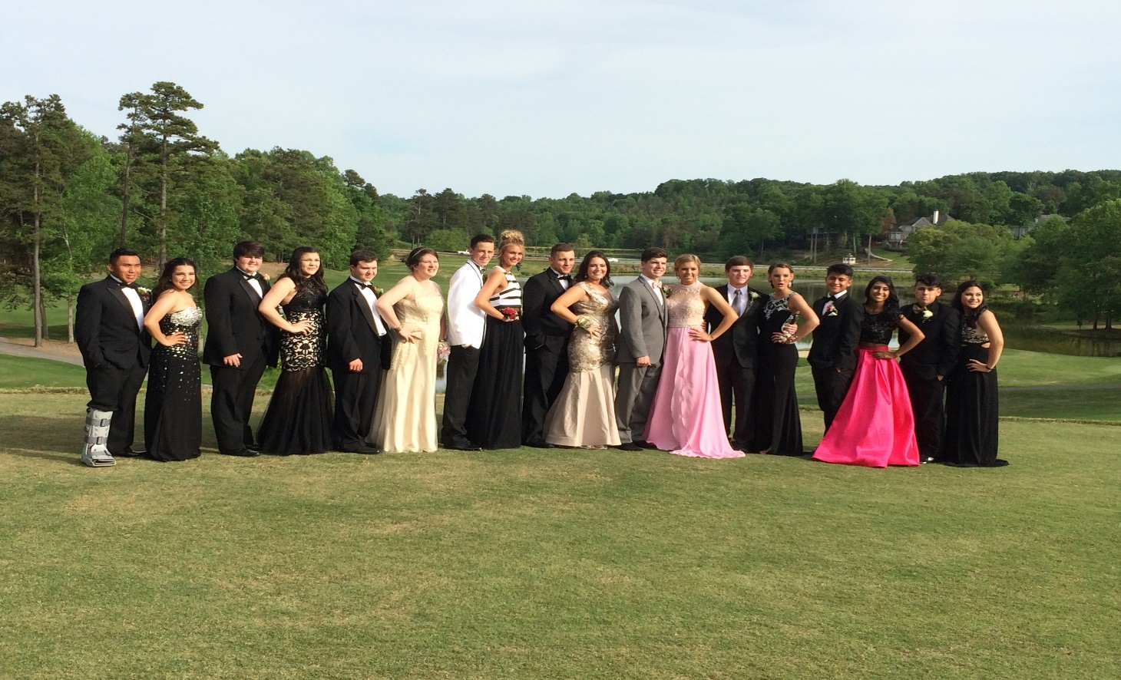
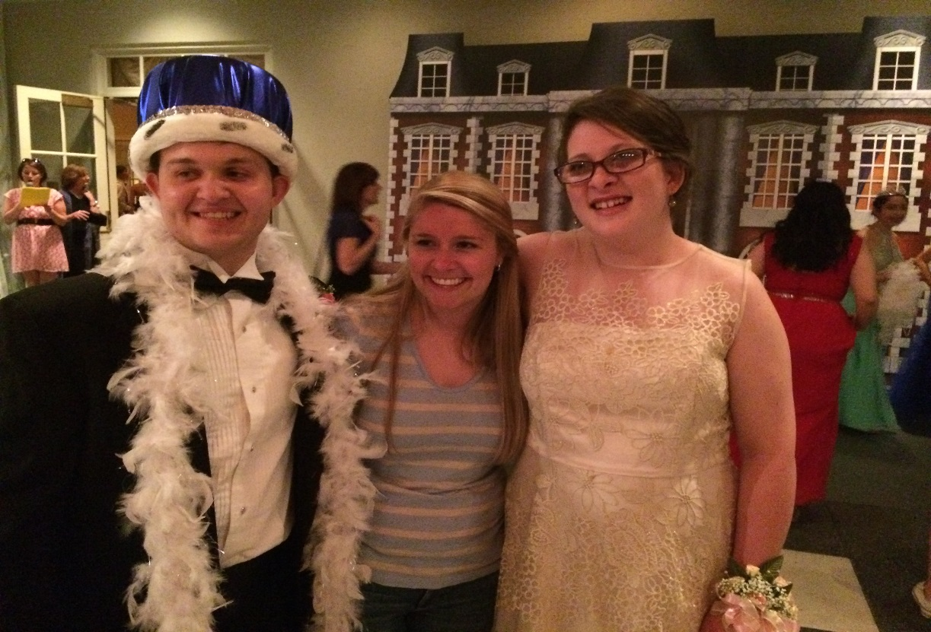

Slide 10
Futures Planning-PATH
Student Benefits:
Setting goals
Students are more likely to achieve their goals.
Creates a visual for achieving goals
More community involvement and employment opportunity
Better transition outcomes

Slide 11
Futures Planning-PATH
Parent benefits:
More focused goals
More likely to achieve their goals.
Visual for following progress
Increased employment
Better transition outcomes and a brighter future for the student and their family

Slide 12
Futures Planning-path
Let’s hear from Adriana and Gabby
Former Project Search Interns and PATH participants

Slide 13
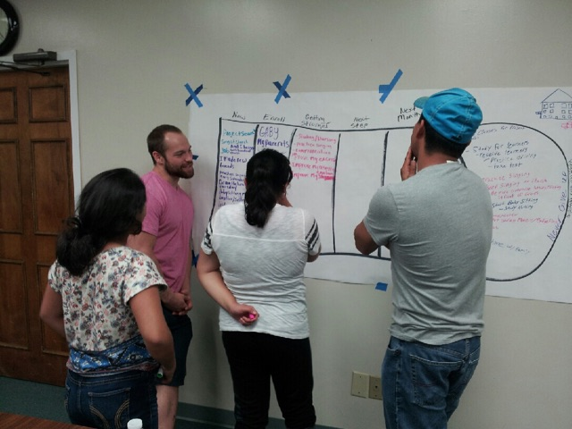
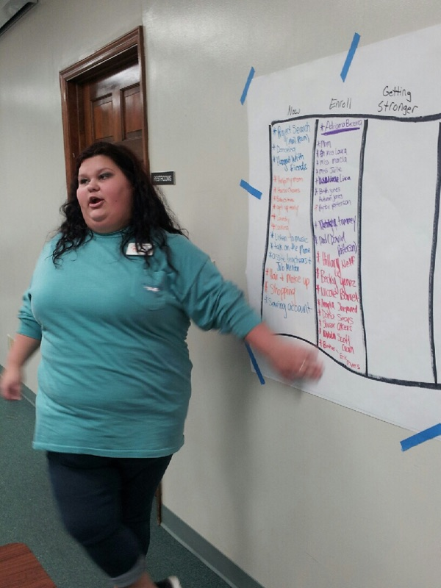
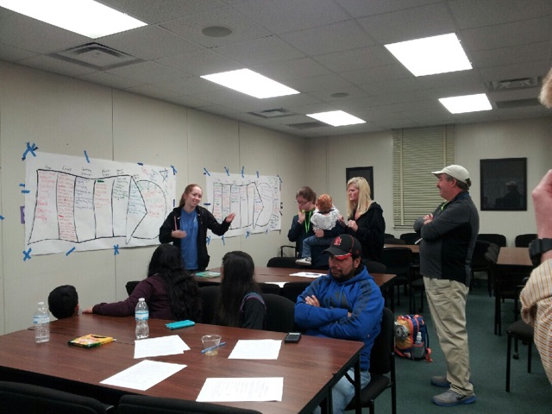

Slide 14
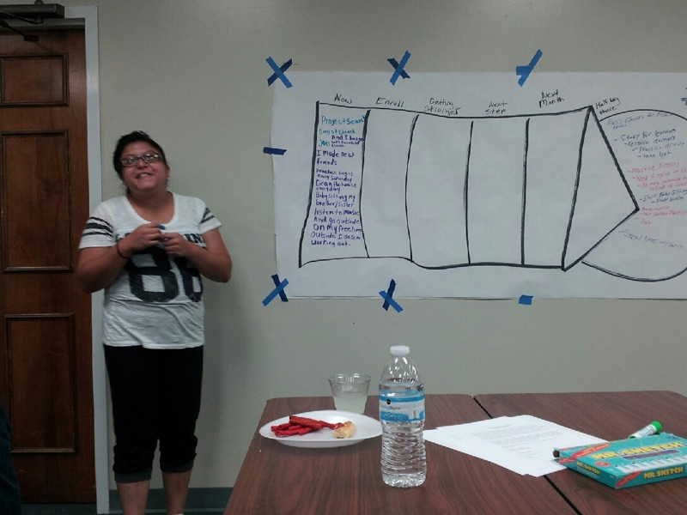
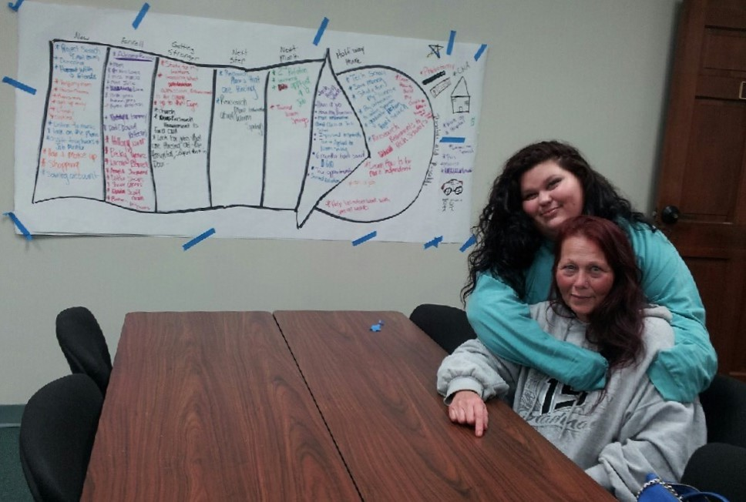

Slide 15
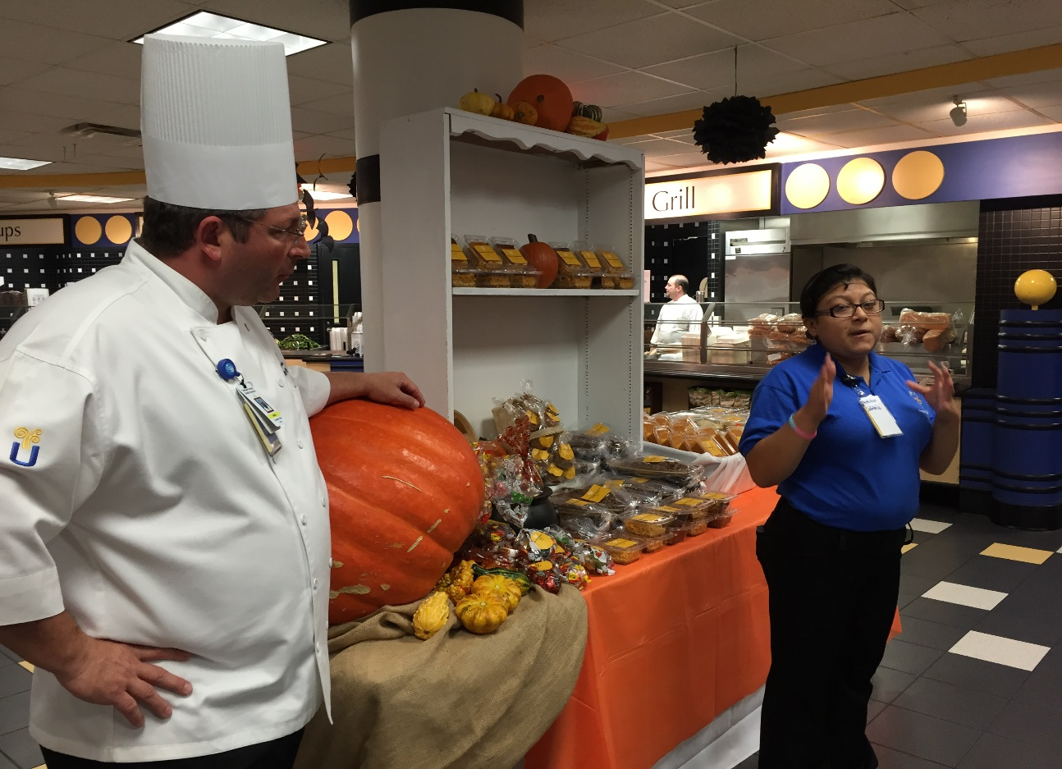
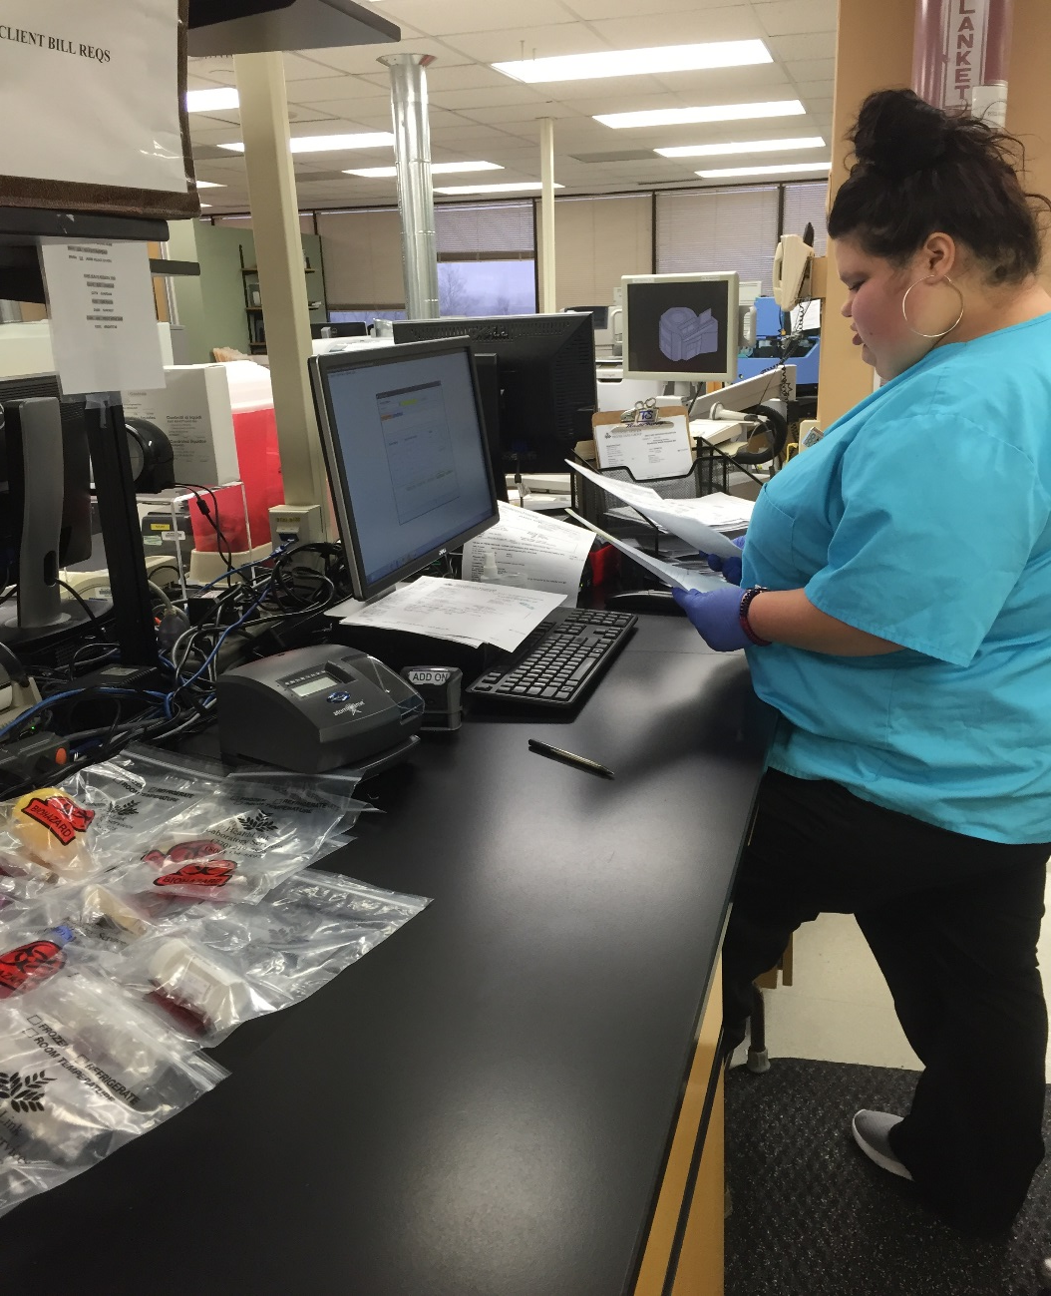
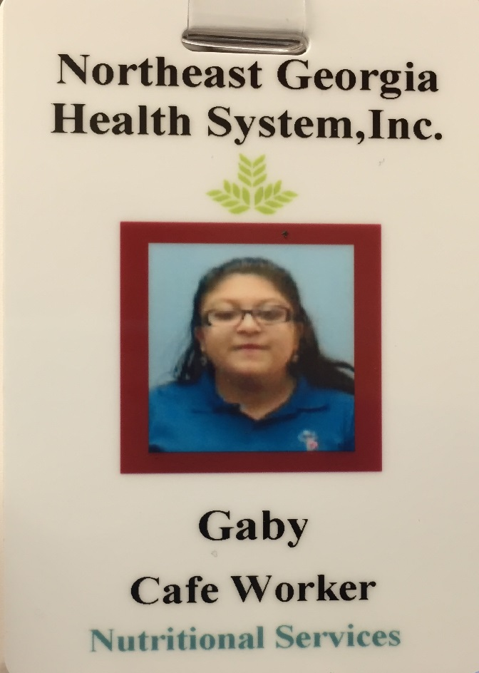

Slide 16
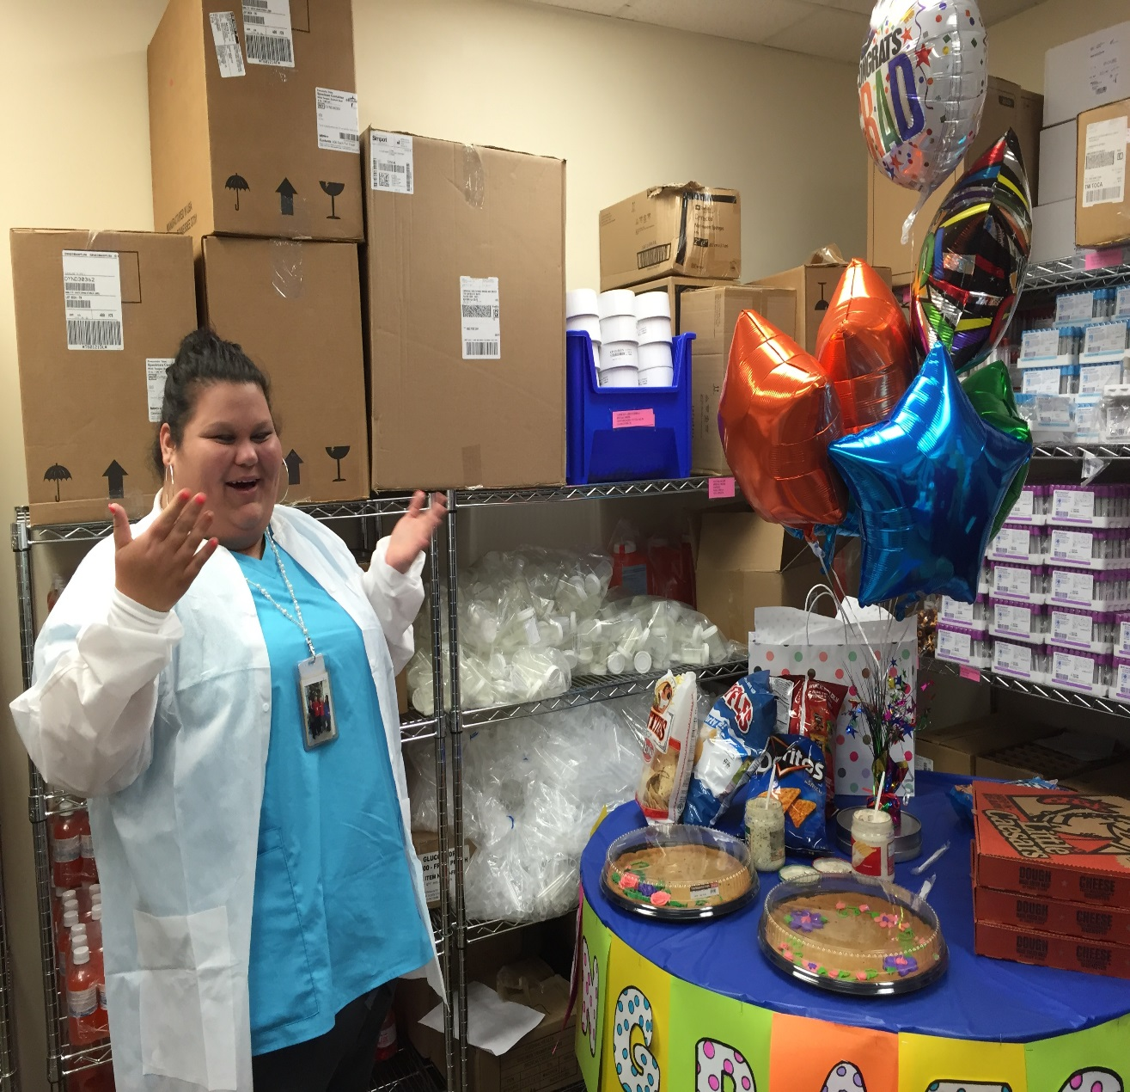
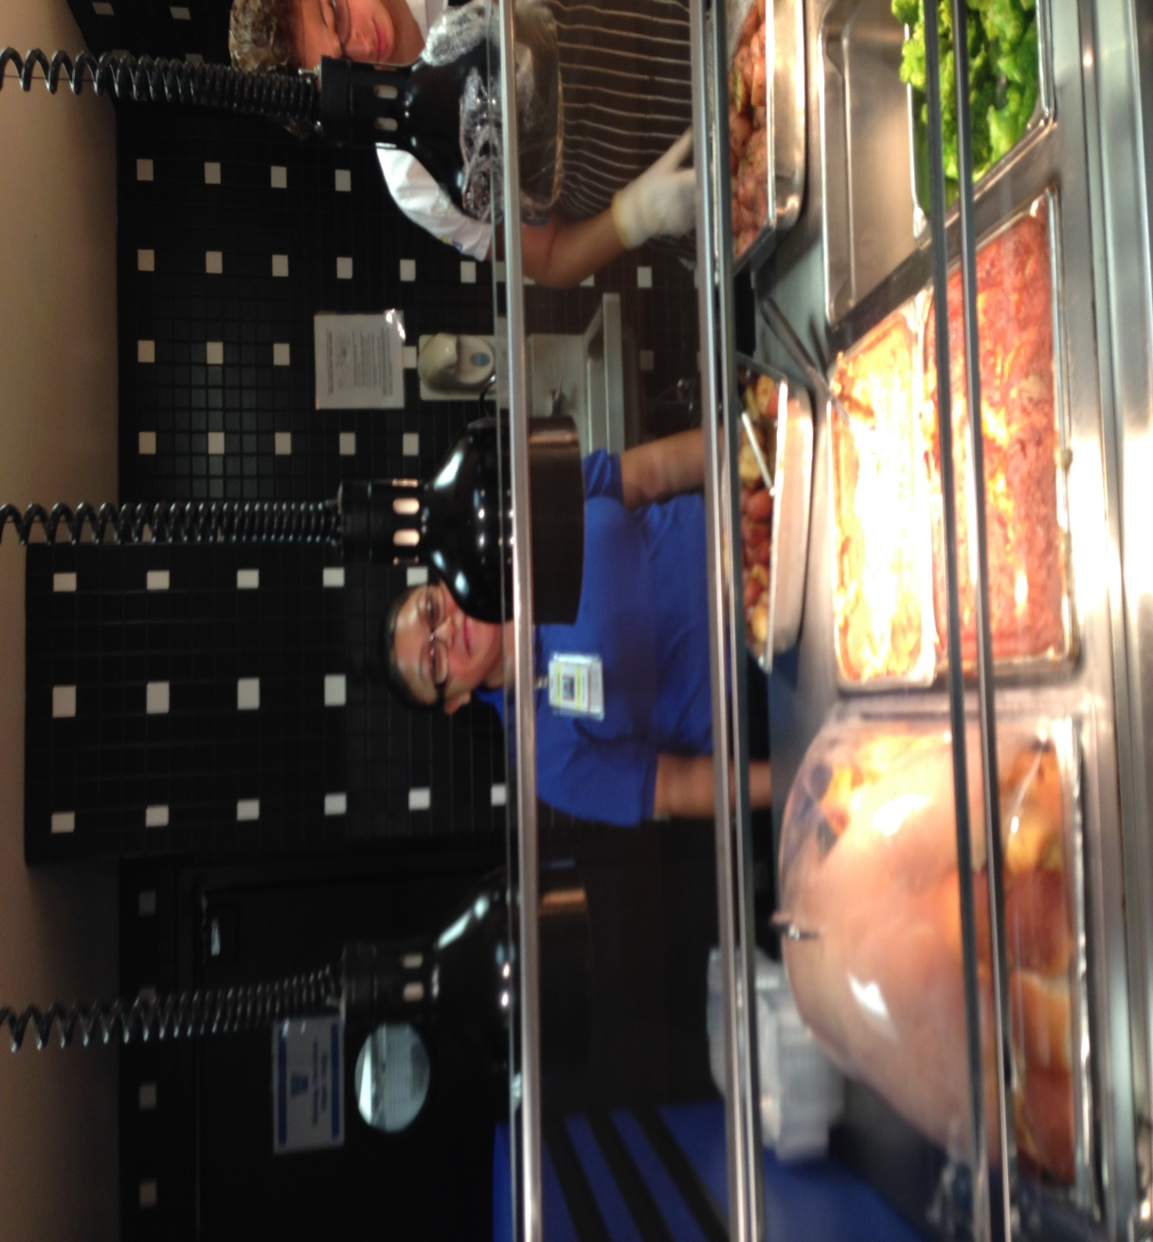

Slide 17
Contact Information
Scott Crain: scott.crain@hallco.org
Laura Stephens: lauras.Stephens@hallco.org

