Slide 1
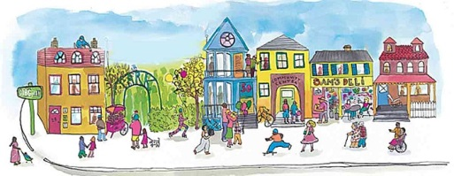
“The 7 Pillars of Community”
Georgia Family Connection
Individuals
Environment
Education
Political
Economic
Culture
Social
Notes:
Georgia Family Connection is the community collaborative table that encompasses the 7 Pillars of Community. These 7 Pillars are the foundation that our communities are built on. They will either grow and sustain, or weaken and starve each and every community. When one pillar is weak the foundation of the community is compromised and puts pressure on the surrounding pillars. Although it may not be realized quickly at first, the effect is eventually realized as the other pillars become so weakened due to the added stress that the foundation starts to buckle and eventually fall apart. Working together, we can build and sustain capacity in each pillar simultaneously ensuring a strong, prosperous, stable, safe, and sufficient community for all. This is the purpose of the Georgia Family Connection Network. We are leading by collaborating, creating, implementing, and pursuing a positive collective impact strategic plan for strong communities in Georgia.

Slide 2
Community Development
The practice of community development is not one focused solely on material resource development, nor is it devoted exclusively to systems for addressing community needs. It is an integrated model of community development that includes problem solving, community building, and systems interaction. A truly integrated approach to assesses the problem, go on to build community by building capacity, and organically addressing the problems.

