Slide 1
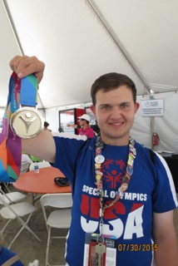
Will Crain
My Olympic Journey

Slide 2
It all began with a phone call

Slide 3
Practice Practice Practice

Slide 4
Practice some more

Slide 5
ESPN is coming

Slide 6
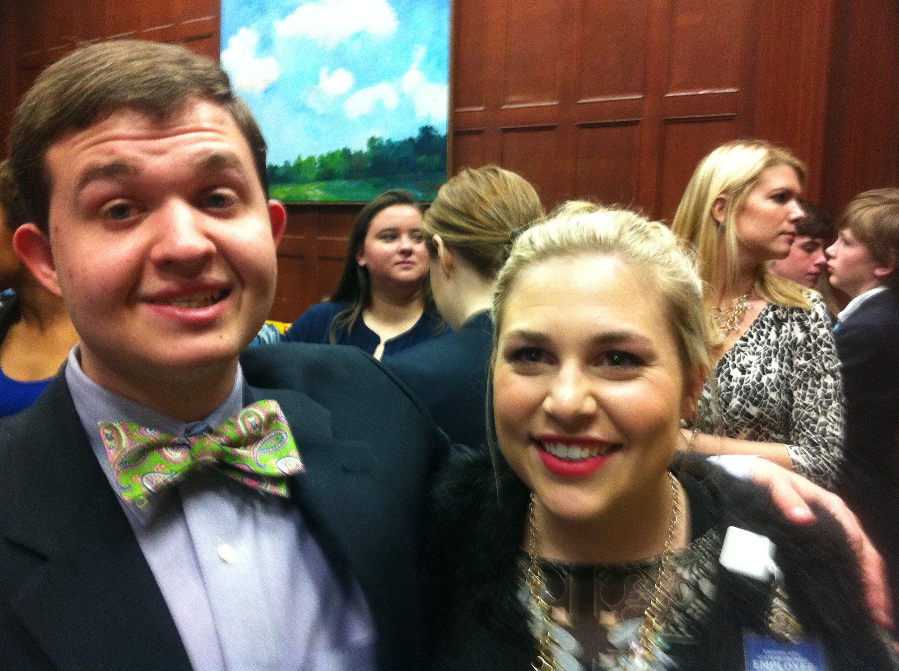
A day at the Capital

Slide 7
Will with state Representative Emory Dunahoo

Slide 8
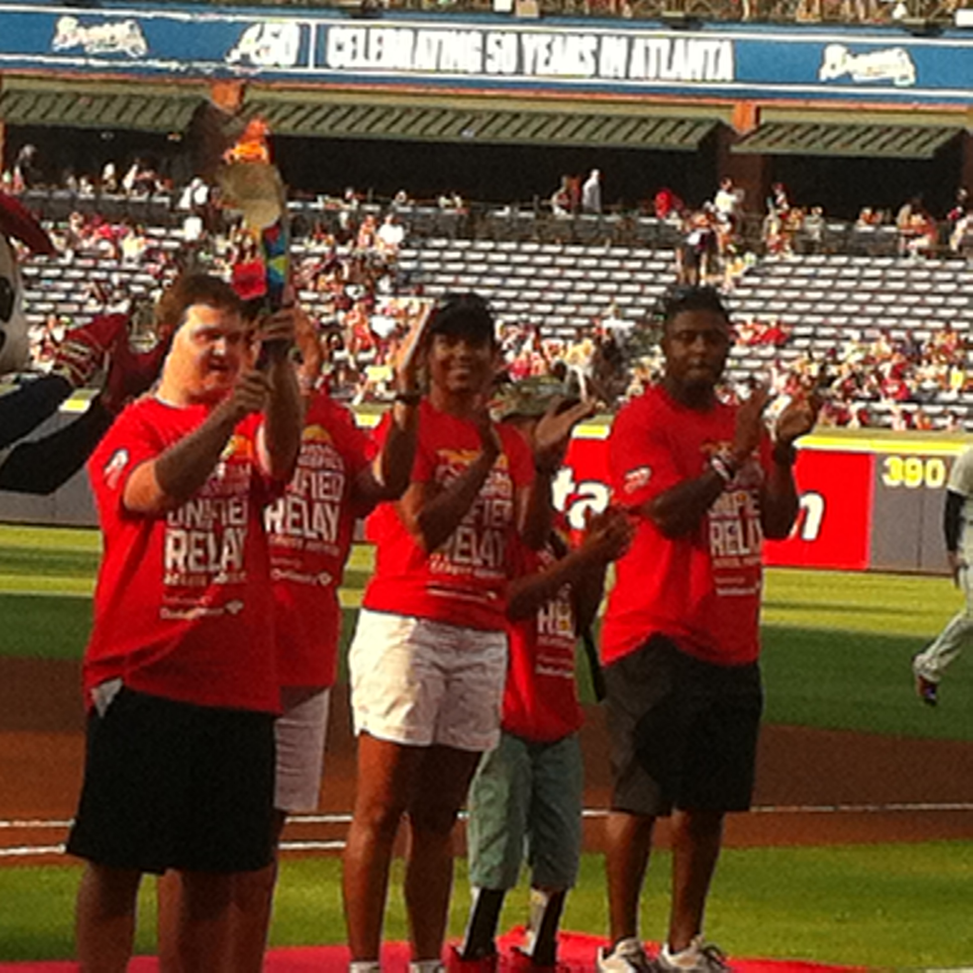
Carrying the Flame of Hope

Slide 9
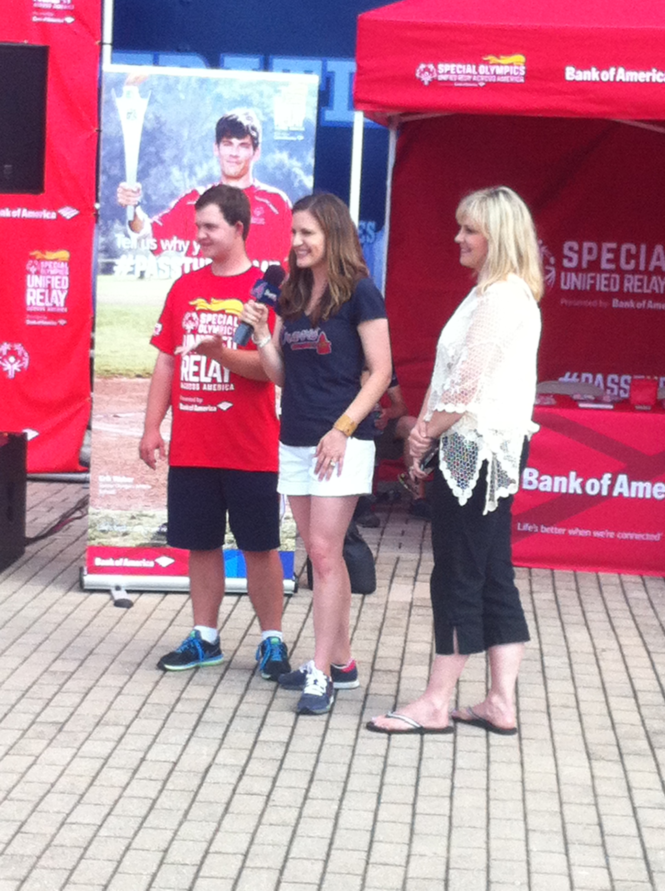
Torch Run Interview

Slide 10
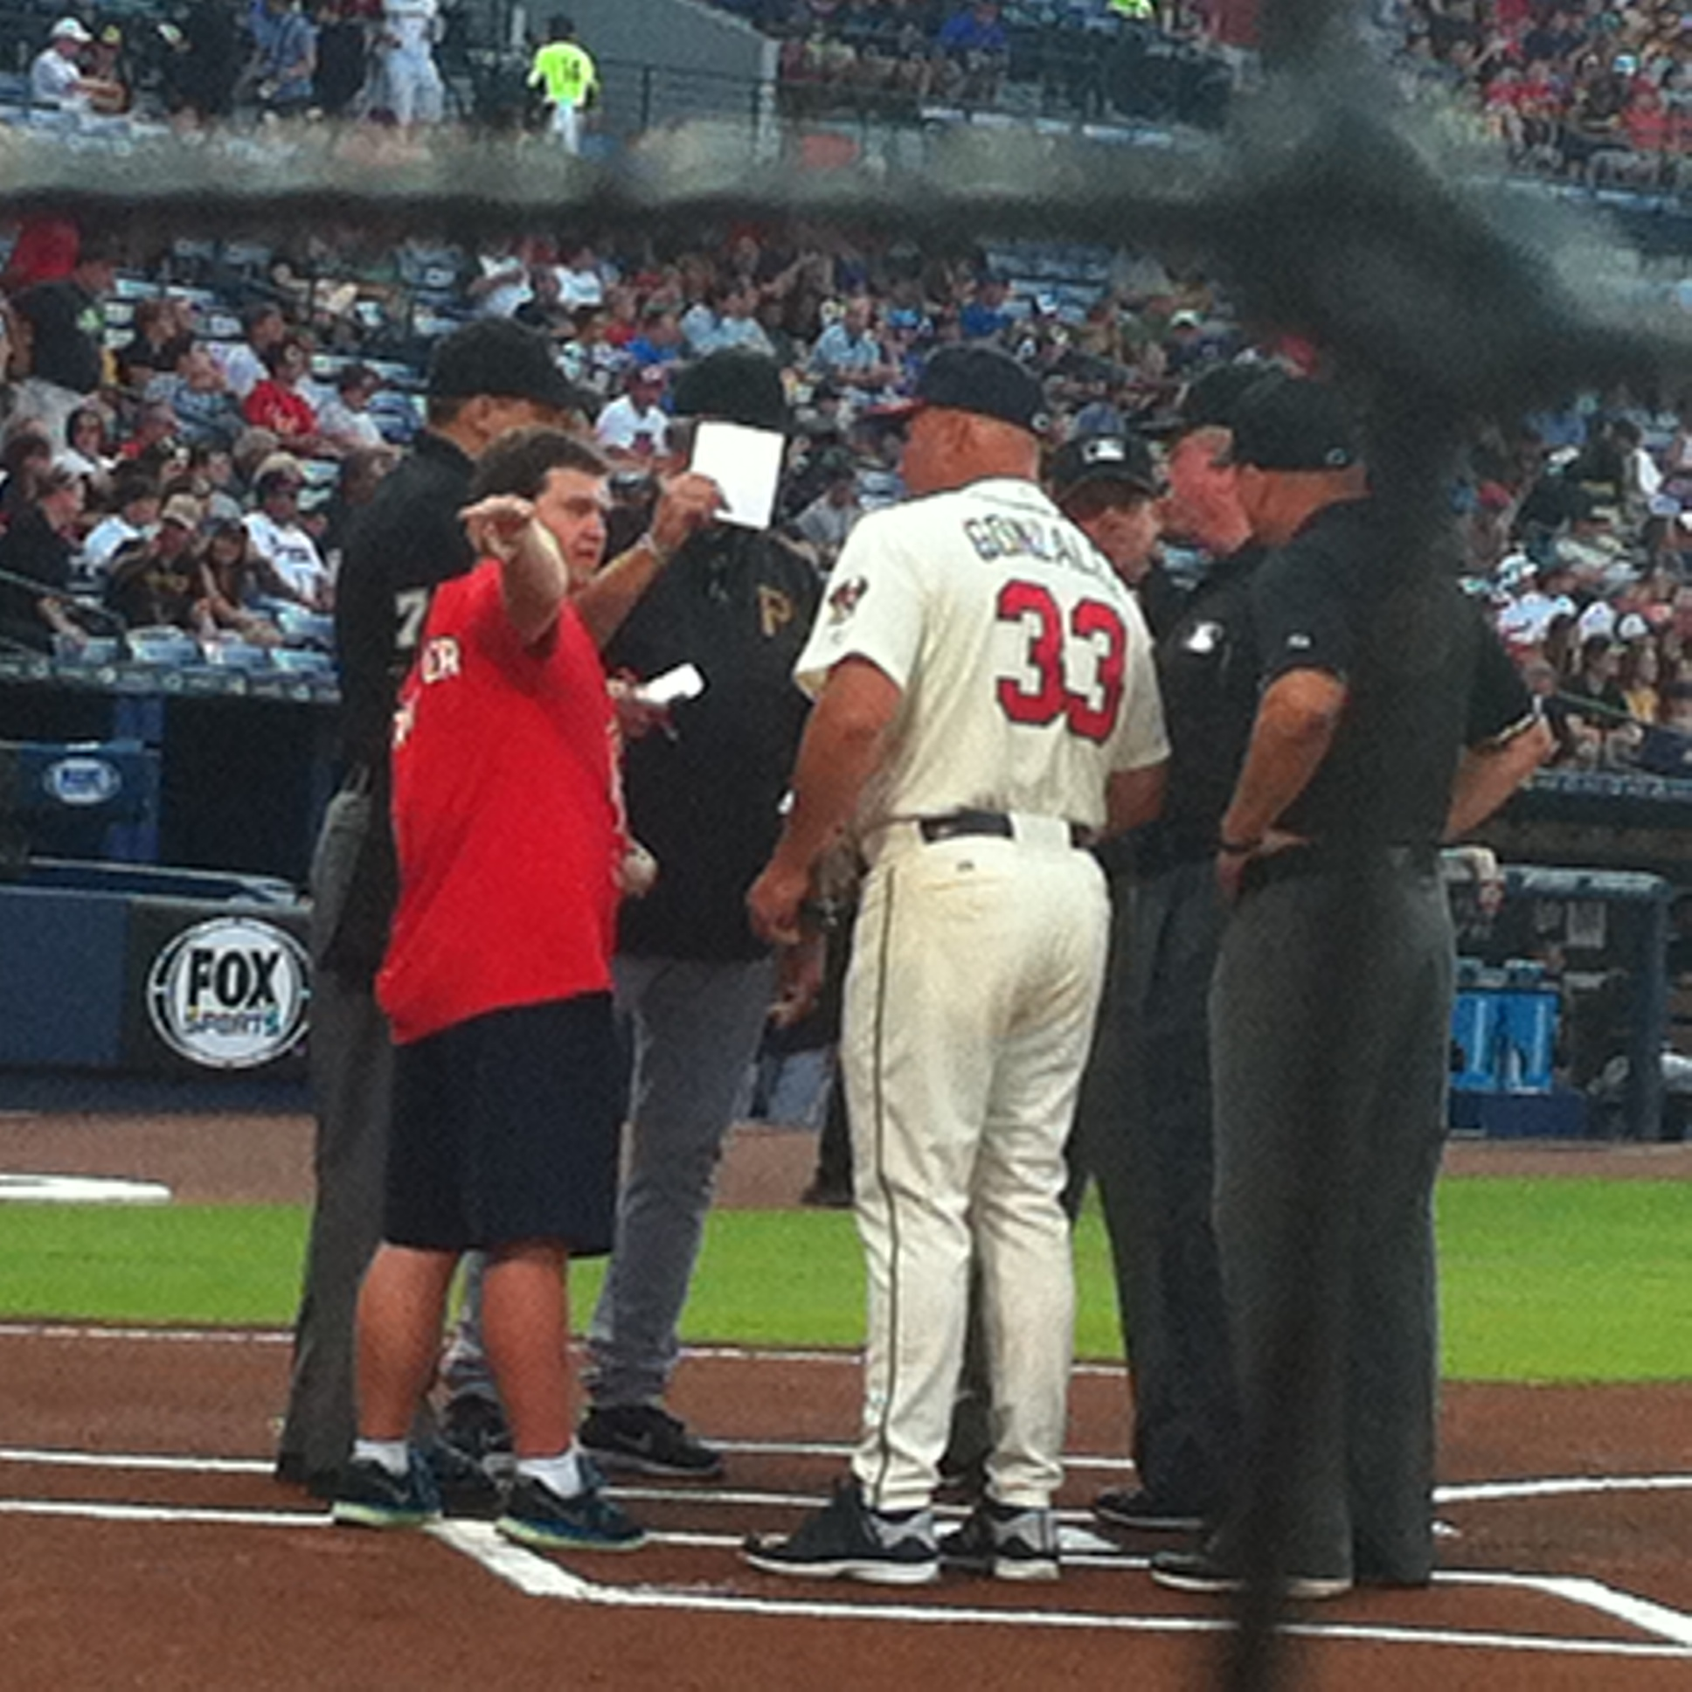
Torch Run at the Braves Game

Slide 11
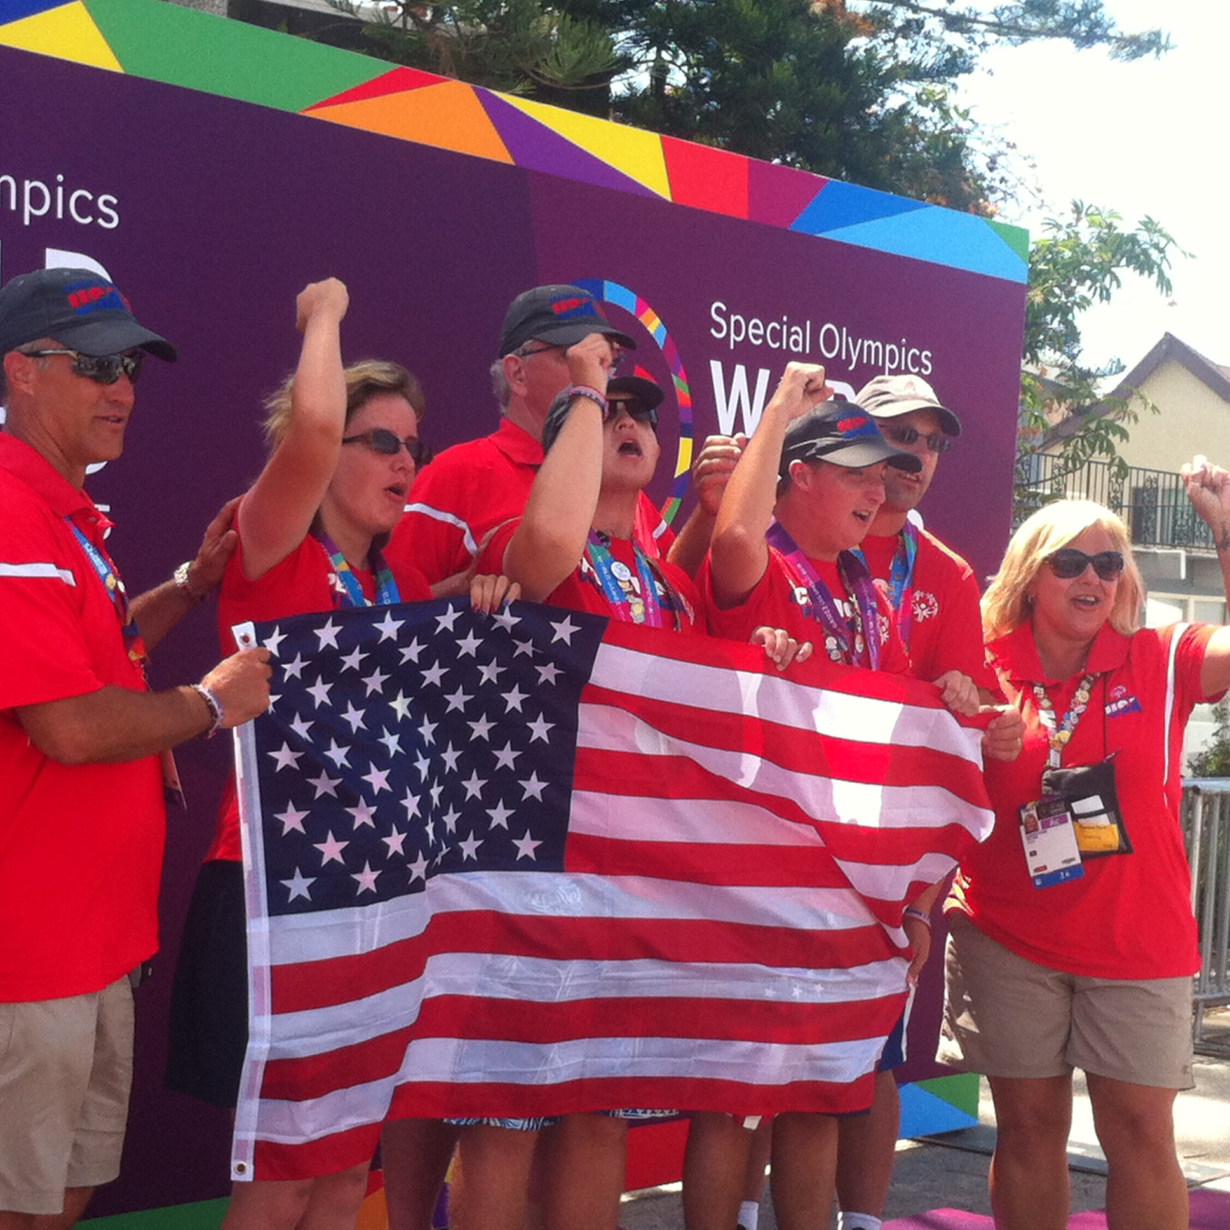
Kayak Team USA

Slide 12
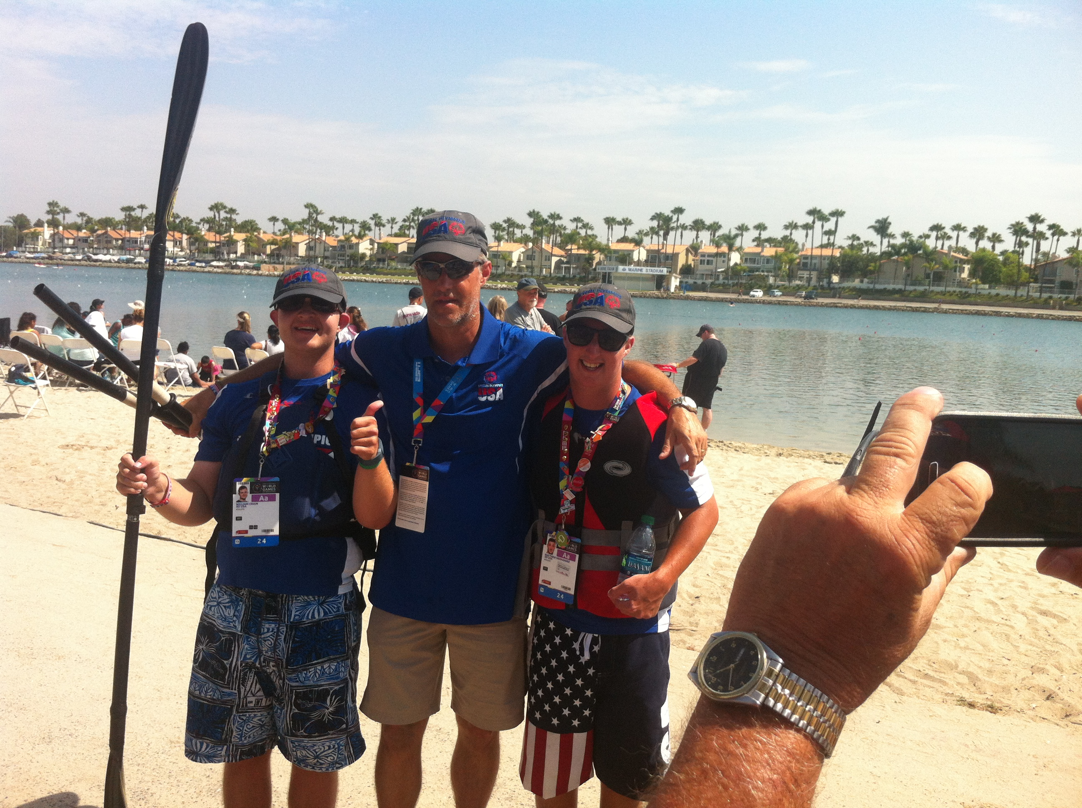
Will with Coach Bruce and team mate Matthew Hernandez.

Slide 13
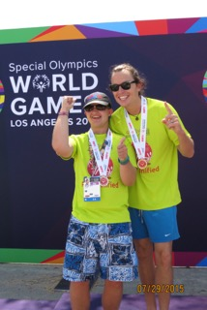
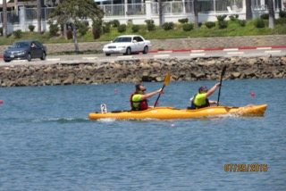
Will and his gold medal unified partner Matthew Wooters

Slide 14
Will receiving his Silver Medal

Slide 15
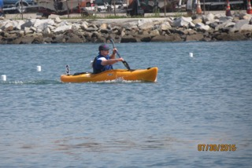
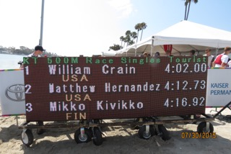
500 meter race

Slide 16
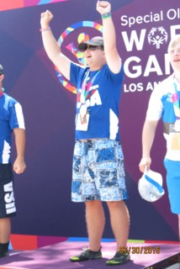
Will Crain receiving his gold medal

Slide 17
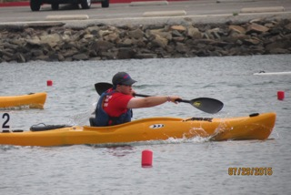
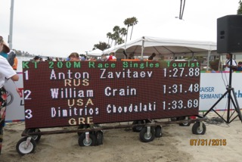
200 Meter Race

Slide 18
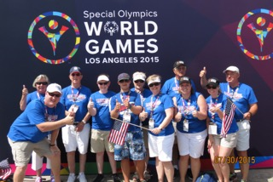

Slide 19
I got to meet Craig Lucy and be on the Channel 2 Action News

Slide 20
It Has Been A Great Ride

