Slide 1
Dispute Resolution
Jamila C. Pollard, Esq.
Program Manager/Legal Officer
Dispute Resolution
Division for Special Education Services and Supports
September 23, 2015

Slide 2

Learning Targets
I can compare and contrast the three legally-mandated dispute resolution processes and the upcoming dispute prevention process
I can assist parents in obtaining information regarding the dispute resolution processes
I can help guide parents toward the specific dispute resolution process or processes that would be most appropriate for their circumstance

Slide 3
Dispute Resolution Process
Goal: Provide resolutions in disputes between parents and districts over the rights and services afforded to students with disabilities and their families
First Recommendation: Utilize techniques and strategies at the school level to possibly prevent disputes
Second Recommendation: Contact the special education administrator in the district to assist in working out the differences
Final Recommendation: When a resolution cannot be worked out locally, utilize the IDEA dispute resolution processes
.

Slide 4
A parent’s experience with the Special Education System
Daunting
Jargon
Unequal
Heavy on paperwork
Confusion
Formal
Parents feel left out (Dad’s are the odd man out)

Slide 5
Common Sources of Conflict
Examples
Design of services
Delivery of services
Relationship issues
Constraints
Knowledge
Placement, eligibility, student’s needs
IEP goals, placement, educational practices, discipline
Communication, trust, reciprocal power, valuation, discrepant views of a child
Resource restrictions
Lack of educational training

Slide 6
What Can Educators Do?
• Communicate, communicate, communicate
• Build trust
• Listen
• Eliminate jargon
• Structure IEP Team meetings
• Understand perspectives
• Reduce power imbalance
• Support family engagement

Slide 7
What Can Parents Do?
Listen. Ask questions. Clarify.
Be clear about their goals.
Focus on the positives.
Keep the focus on meeting their child’s needs
Present options in a collaborative way (“we can” instead of “you should”)
Be mindful of their emotional pressure gauge as they work with their child’s school
From Steps to Success: Communicating with Your Child’s School from CADRE

Slide 8
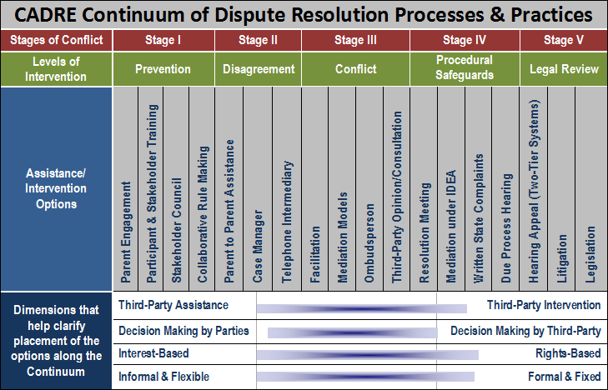
Center for Appropriate Dispute Resolution in Special Education (CADRE)
http://www.directionservice.org/cadre/

Slide 9
Mediation
What is it?
  A voluntary process that brings parents and school districts together to resolve their disagreements through the use of a skilled, impartial mediator.
Who can initiate it?
  Parents or districts
What is the time limit for requesting?
  None specified

Slide 10
Mediation
What issues can be resolved?
  Any matter under IDEA and the state special education rules
Who resolves the issues?
  Parent and districts with a mediator
How are the issues resolved?
  Solution must be in a written mediation agreement signed by both parties
  Legally binding

Slide 11
Formal Complaints
What is it?
  A written complaint to the GaDOE alleging violations by the district that need to be investigated
Who can initiate it?
  Any person or organization
What is the time limit for filing?
  One year from the date of the alleged violation

Slide 12
Formal Complaints
What issues can be resolved?
  Alleged violation of IDEA and state special education rules
Who resolves the issues?
  GaDOE Division for Special Education Services and Supports
How are the issues resolved?
  Contracted investigator conducts investigation and interviews all relevant parties
  The GaDOE issues a written decision containing findings of facts and conclusions within 60 days of filing unless extended for exceptional circumstances

Slide 13

Due Process Hearing Request
What is it?
  A written document used to request a formal hearing before an administrative law judge (ALJ)
Who can initiate it?
  Parents or districts
What is the time limit?
  Two years from when the parties knew or should have known of the alleged problem

Slide 14
Due Process Hearing Request
What issues can be resolved?
  Any matter related to the identification, evaluation, or educational placement , or provision of a free appropriate public education (FAPE) to the child
Who resolves the issues?
  An administrative law judge (ALJ)
How are the issues resolved?
  The ALJ issues a written decision within 45 days (unless extension granted) after considering pleadings and evidence (including witness testimony) in a formal, judicial hearing

Slide 15

Resolution Session
What is it?
  A meeting held between a parent and district to resolve issues listed in a due process hearing request.
Who can initiate it?
  District must hold the meeting with the parent unless both parties agree in writing not to have the meeting or to use mediation instead.
What is the time limit?
  Must occur within 15 days of the district receiving notice of the parent’s due process hearing request.

Slide 16
Resolution Session
What issues can be resolved?
  The issues listed in the due process hearing request
Who resolves the issues?
  The district and parent
How are the issues resolved?
  Solution must be in a written resolution agreement signed by both parties
  Legally binding after 3 business days

Slide 17
IEP Facilitation Coming Soon
IEP Facilitation is a “collaborative dispute prevention and resolution process used when members of an IEP Team agree that the presence of a third party would help facilitate communication and problem solving.”
IEP Facilitation can be especially useful when there is a history of difficult interactions or a meeting is expected to be particularly complex or controversial.
An impartial facilitator helps to keep members of the IEP Team focused on the development of the IEP while addressing conflicts and disagreements that may arise during the meeting.
At the meeting, the facilitator will use communication skills that create an environment in which the IEP Team members can listen to each member’s point of view and work together to complete the development of a high quality IEP.

Slide 18
Video from Pennsylvania on IEP Facilitation
http://odr-pa.org/alternative-dispute-resolution/iep-facilitation/

Slide 19
What is the role of the facilitator?
Helps IEP Team members develop ground rules, an agenda, and desired outcomes for the meeting
Guides discussions by asking student-focused questions
Keeps the IEP Team on task and the meeting on schedule
Asks questions to clarify points of agreement and disagreement and assists parties in identifying workable solutions
Does NOT make decisions and is NOT a member of the IEP Team
Does NOT address issues unrelated to the IEP and does NOT draft the IEP
Notes:
Does the facilitator make decisions?
No, the role of the facilitator is to facilitate communication among the IEP team members
and assist them to develop an effective IEP for the student. The facilitator models
effective communication skills and offers ways to address and resolve conflicts in the
development of the IEP. Facilitators are trained in effective communication and ways to
address and resolve conflicts. The members of the IEP team are the decision-makers.
Examples – desired outcomes – By the end of the meeting, we will have awareness of Jack’s strengths and challenges; understanding of Jill’s behavior analysis; agreement on Sarah’s placement and services;
Agenda – Welcome, Purpose, Introductions, Excepted Outcomes, Ground Rules, Present Levels, Goals/Objectives, Placement/Services
Ground Rules/Group Norms – Communicate clearly and listen carefully; Respect the views of others; share your views willingly; ask and welcome questions for clarification; be open to the ideas and views presented; honor time limits and stay on task
Recorder to complete group memory not minutes

Slide 20
What are some benefits of using IEP Facilitation?
May build and improve relationships among IEP Team members
Team members may feel better heard when a facilitator is involved
Allows all members of the IEP Team the chance to participate fully
The IEP Team may work together more effectively and efficiently to create an IEP that benefits the student and is supported by all IEP Team members
Keeps decision-making with the IEP Team members who know the student best
Helps resolve disagreements more quickly than other dispute resolution processes (and is less costly – paid by GaDOE)
Notes:
Helps participants reach “consensus” (general agreement by at least most members of the IEP team) – Can live with, support, and implement the decisions made by the team

Slide 21
Now that you know the three dispute resolution processes and upcoming dispute prevention process, where can you direct parents to find more information regarding those processes?

Slide 22
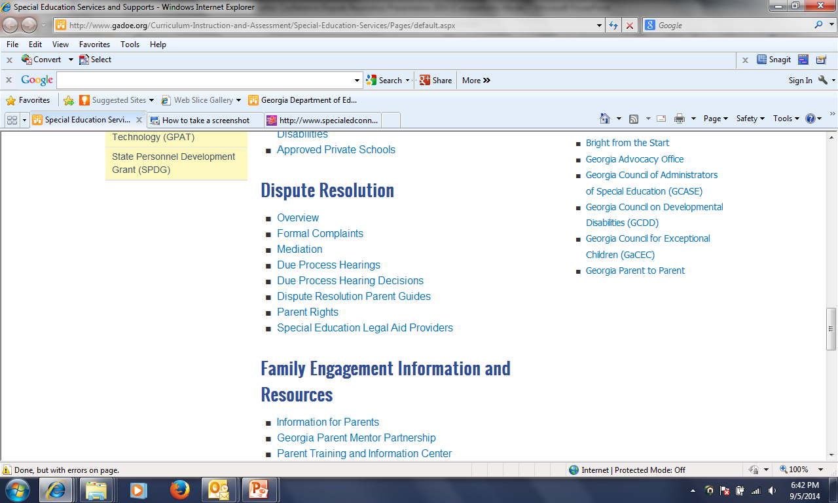
GaDOE Dispute Resolution Resources
http://www.gadoe.org/Curriculum-Instruction-and-Assessment/Special-Education-Services/Pages/default.aspx

Slide 23
What is available on the GaDOE website?
Overview Link
  Dispute Resolution Comparison Chart
Formal Complaints, Mediation, and Due Process Hearing Links
  Forms and FAQs
Due Process Hearing Decisions (FY 2001-2015)
Dispute Resolution Parent Guides (Mediation, Written State Complaints, Due Process Complaints/Hearings, Resolution Meetings)
  English and Spanish

Slide 24
What is available on the GaDOE website?
Parent Rights Link
  Parent Rights Videos (7)
    English and Spanish
    Parent Notice/Consent/Confidentiality
    Evaluations and IEEs
    LRE
    Private School Placement
    Discipline Procedures/Rights
    Dispute Resolution
    Surrogate Parent/Transfer of Rights
  Condensed Parent Rights
  Full Parent Rights
    Arabic, Chinese, English, Japanese, Korean, Spanish, Vietnamese
  Special Education Parent Supports and Legal Aid Providers

Slide 25
What is available on the GaDOE website?
  Parent Info Fact Sheets (18)
    Assistive Technology
    Discipline
    Due Process
    Extended School Year Services
    Evaluations
    Formal Complaints
    FBAs and BIPs
    GAA
    Helping your child with disabilities with homework
    IEP
    Mediation
    Person-Centered Planning
    Preparing your child with disabilities for kindergarten
    Reevaluations and IEEs
    Transition from Early Intervention to Public School
    Transition to Life after High School
    Understanding state and local testing
    Understanding statewide testing accommodations
Notes:
Includes “Facts you should know”, “Tips for Families”, and “Where to go for more information.”

Slide 26

Now that you know the three legally-mandated dispute resolution processes and one upcoming dispute prevention process, and where the information regarding those processes is located, how do you guide parents toward the most appropriate dispute resolution process?

Slide 27
Mediation
Benefits | Considerations
Mutually Developed and Agreed Upon Solution | Voluntary
Solution in short period of time | Less likely to reach resolution if not used early on
Flexibility in Solution | Can be emotional, tiring, and frustrating process
No cost | Complex situations may require more than one mediation session
Less Adversarial | No guarantees that mediation will lead to a written agreement
Confidential
Legally binding and enforceable
Helps everyone better understand differing points of view

Slide 28
Formal Complaints
Benefits | Considerations
External investigation | Takes 60 days for resolution
No cost; mediation also available | Cannot overturn an IEP Team decision
Mainly a procedural rather than substantive review | Mainly a procedural rather than substantive review
Requires no legal representation; easy to file | Remedies not as extensive as judicial remedies and limited by law
No face-to-face adversariness | No mutually developed or agreed upon resolution
Can result in remedies (e.g. compensatory education, declarative/injunctive relief) | Investigation limited to issues within 1 year of filing
Can result in district-wide change and awareness | Final decision issued and no appeal process

Slide 29
Due Process Hearing Request
Benefits | Considerations
Stay put mechanism | Adversarial
Broad range of relief allowed (“grant appropriate relief”) | Costly in time, emotion, and money; district will have attorney representation
More extensive relief (e.g. compensatory education, tuition reimbursement after unilateral placement) | Mainly a substantive rather than procedural review
If successful, can petition for attorney’s fees | Can place strain on relationships
Can look back 2 years or more in certain cases | Limited type of issues that can be raised
Required resolution session meeting unless both parties waive | Judge who does not know the child is making the decision (no mutually developed or agreed upon resolution)
Appealable decision | Takes a minimum of 45 days for resolution, but usually longer

Slide 30
Resolution Session
Benefits | Considerations
Required resolution session meeting unless both parties waive | Discussions are not confidential
Mutually Developed and Agreed Upon Solution | No guarantees that resolution session will lead to a written agreement
Solution in short period of time; may prevent having to go to a hearing | Either party may cancel the agreement within 3 days
No cost | Usually limited to issues raised in the due process hearing request
District can only bring attorney if parent chooses to bring an attorney
Helps everyone better understand differing points of view
Legally binding and enforceable

Slide 31
IEP Facilitation
Benefits | Considerations
Build and improve relationships among IEP Team members | Voluntary
Team members may feel better heard when a facilitator is involved | Facilitator will not address issues unrelated to the IEP
Allows all members of the IEP Team the chance to participate fully | Facilitator will not “take sides”
The IEP Team may work together more effectively and efficiently to create an IEP that benefits the student and is supported by all IEP Team members | Not available yet ☹
Keeps decision-making with the IEP Team members who know the student best
Helps resolve disagreements more quickly than other dispute resolution processes
No cost
Notes:
Helps participants reach “consensus” (general agreement by at least most members of the IEP team) – Can live with, support, and implement the decisions made by the team

Slide 32
Who am I?
If you use me, I can look back at certain issues that occurred at least 2 years ago.
  Due process hearing request
I allow the GaDOE to make the final decision regarding whether the district was out of compliance with the IDEA.
  Formal Complaint

Slide 33
Who am I?
I am voluntary and use a third party to help parties reach a binding, legal agreement.
  Mediation
I allow the parties to resolve their issues, but what you say to me is not confidential.
  Resolution Session

Slide 34

Who am I?
You cannot force the parties to use me, but I could help prevent the use of all the other dispute resolution processes.
  IEP Facilitation
Both of us result in an outside party making the final decision; one decides in 60 days and the other in 45 days, but usually longer.
  Formal Complaint and Due Process Hearing Request

Slide 35
Who am I?
I am the youngest one in the family, but the only one with exclusive access to the IEP Team meeting.
  IEP Facilitation
I am the only one that can be initiated by individuals/organizations other than parents or districts.
  Formal Complaint

Slide 36
Scenario #1
Student not receiving 1 hour per week of counseling services
Teachers not implementing student’s BIP
Student received multiple detentions, ISS, and OSS
Parental concerns not being addressed after repeated contacts with case manager, lead teacher, and administrators

Slide 37
Scenario #2
8-year student with ASD
Parents and district cannot reach agreement on placement for next school year
Student has received all special education and related services at home
Parents want to continue 1-on-1 program at home and not “experiment” by putting student in regular school setting
District believes student is ready to be in school with peers and concerned about LRE

Slide 38
Scenario #3
4th grade student with mild cerebral palsy and developmental delays
Receives instruction in resource setting
Parent believes student will learn best when educated with non-disabled peers and wants student in regular education classes
District believes the current placement is appropriate based on severity of student’s disability and need for individual attention and instruction

Slide 39
Scenario #4
5th grader found ineligible for special education for last 2 years
Parents feel strongly that student should be eligible and that eligibility is the only thing that will ensure that the school will be responsible for meeting the student’s needs
School psychologist said student’s academic performance is within normal limits for her age and grade; district maintains student does not need special education services

Slide 40
Can you hit the “bullseye”?
Can you compare and contrast the three dispute resolution processes?
Can you direct parents on how to obtain information regarding the three dispute resolution processes?
Can you help guide parents toward the specific dispute resolution process or processes that would be most appropriate for their circumstance?

Slide 41
Any Questions???
Jamila C. Pollard, Esq.
jpollard@doe.k12.ga.us
(404) 657-7329

