Slide 1
A quick guide to registering for the GaPMP 2015 Kickoff Conference
FAQs and Step by Step instructions

Slide 2
Links
The conference links can be found in two different locations on parentmentors.org
1. The Events page
2. The 2015 Kickoff Conference page
Here it is again: https://gael.ps.membersuite.com/events/ViewEvent.aspx?contextID=e386dc0a-0078-cc77-67f8-0b3a416e98bb

Slide 3
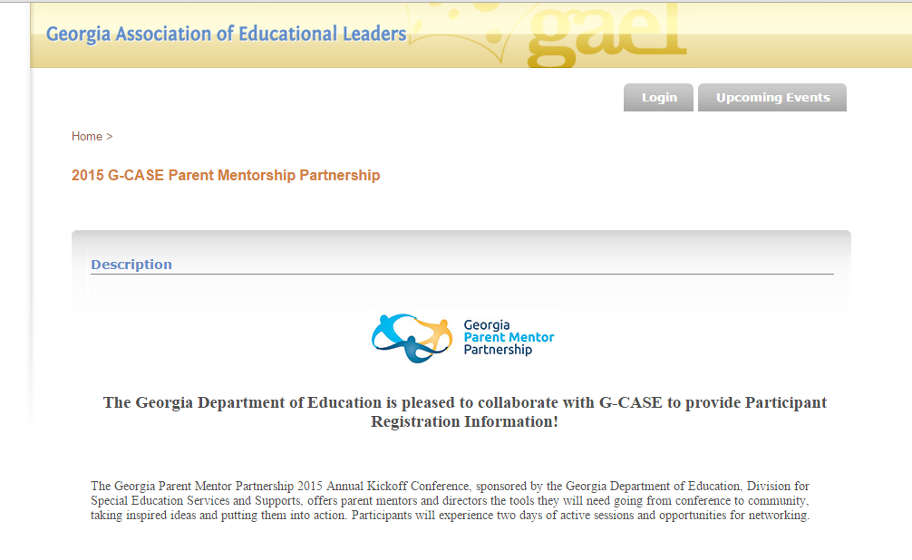
Registering for the Conference
Step 1 You must login

Slide 4
Registering for the Conference
If you are not sure if you have a login identity, create one. If you already have one, a menu item will show on screen to show you a similar name. If you have a login, just change your password to get in, do not make a new one for the conference. You might also review and edit your profile information as needed.

Slide 5
Registering for the Conference
Step 2 Once you are logged in, you will see your identity. Click on the Upcoming Events tab next

Slide 6
Registering for the Conference
Step 3 Find the listing on the events page
Step 4 Proceed to the registration and billing screen

Slide 7
Registering for the Conference
Step 5 You DO NOT have to select the GAEL Membership or G-CASE Memberships shown at the top of the Event Registration Screen. Simply Scroll down until you find the Conference window and complete the process. You will get a confirmation email.

Slide 8
Registering for the Conference
Step 6 Go back to the main registration page to find the link to the hotel/accommodations

Slide 9
More Conference FAQs
Do I have to have a credit card?
You can choose the Pay Later option and then create a PO number for your own reference and then submit appropriate paperwork for your system to pay or reimburse.
Do we have to choose which sessions we are attending?
There will be information available at check in to help you make the most of your conference experience.
Who can I contact if there is a problem with my registration, or, if I have to make a change?
Tonya Moore can help at 404-656-3963.

