Slide 1

2015 GaPMP Kickoff Conference
Inform. Imagine. Inspire.

Slide 2
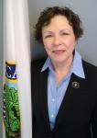
Tuesday, September 22, 2015
7:30 – 8:30 am Registration
8:30 – 9:15 am Welcome & Opening Remarks
Ruth Ryder, Deputy Director of the Office of Special Education Programs (OSEP), U.S. Department of Education.
Featuring!

Slide 3
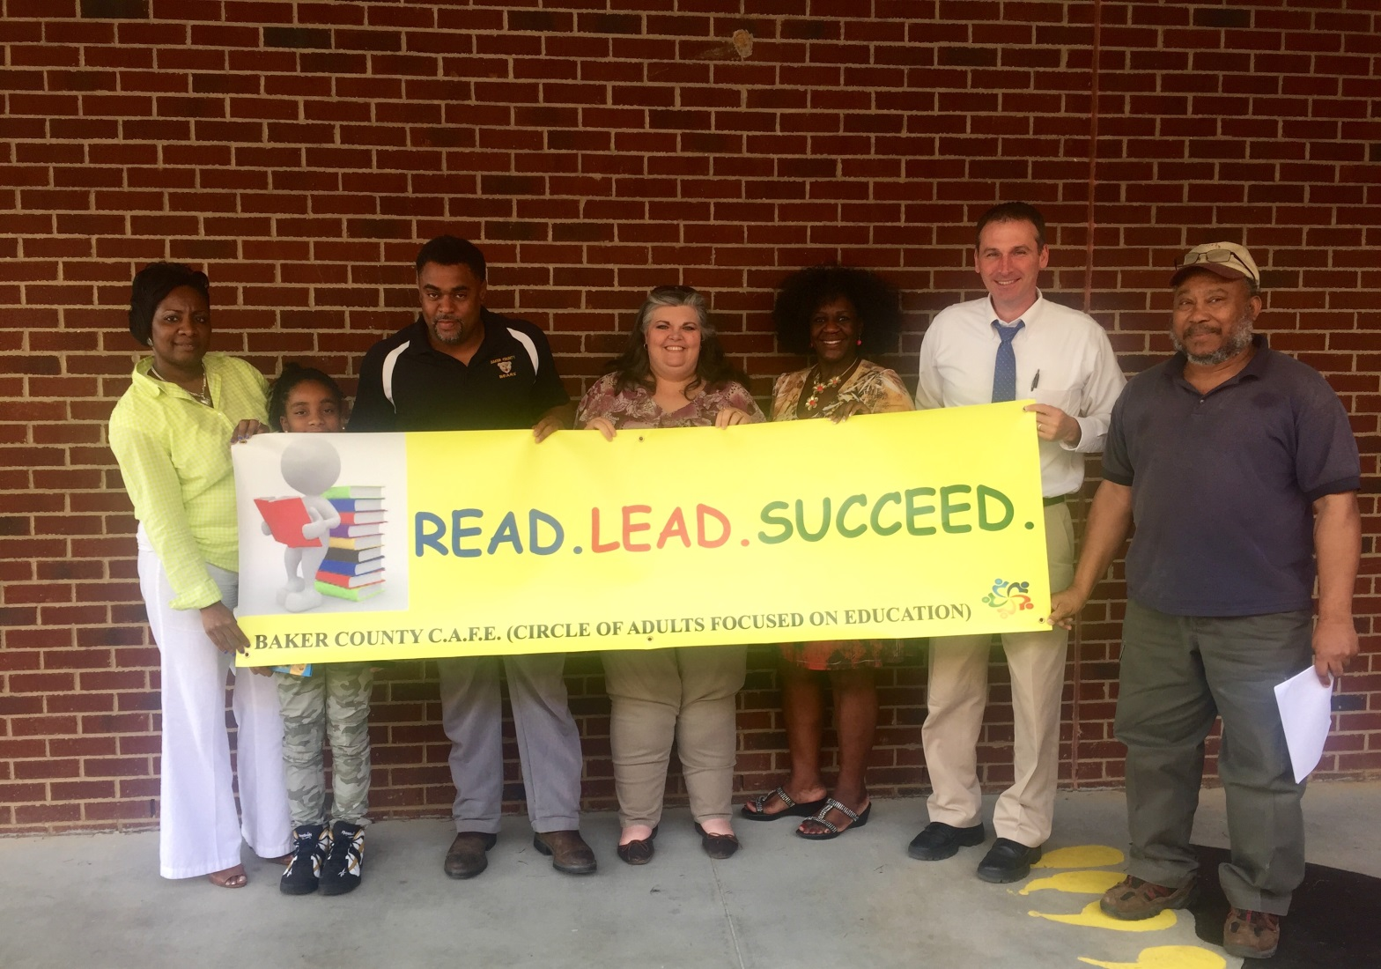
Opening Presentation:
The Baker County Story

Slide 4
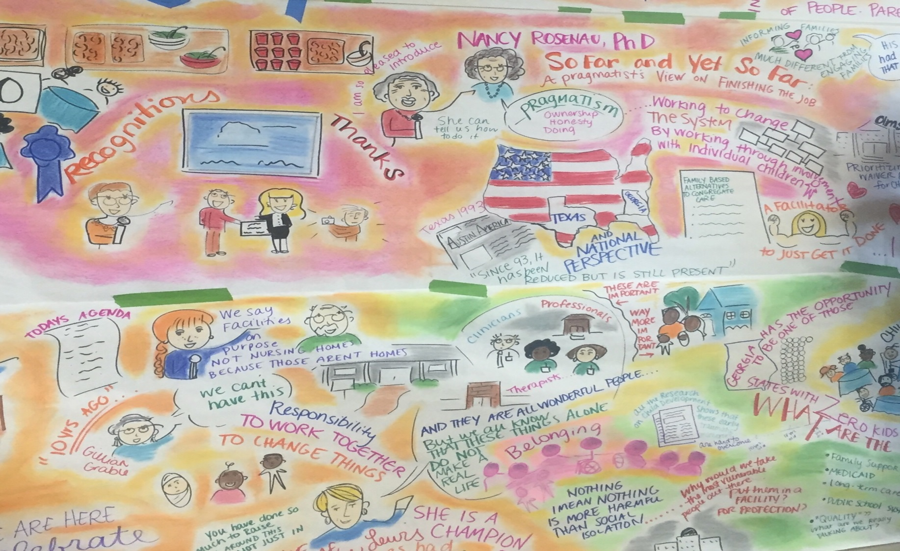
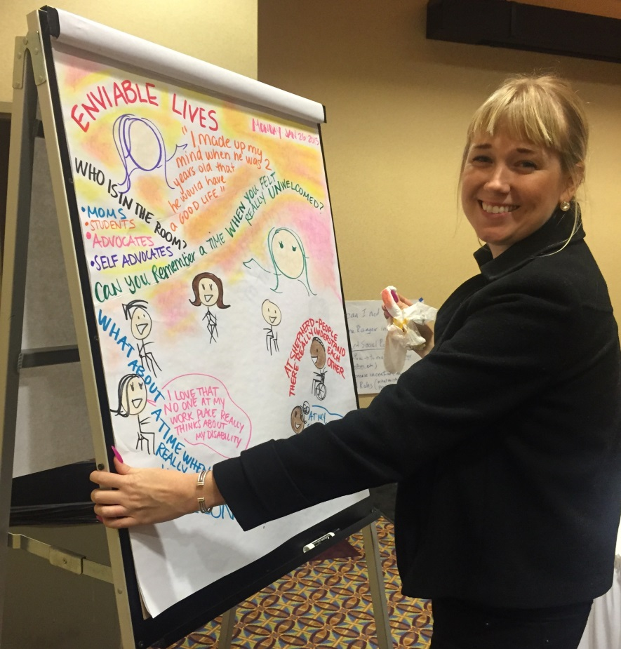
Brittany Curry- Graphic Facilitator

Slide 5


Regional Collaboration

Slide 6
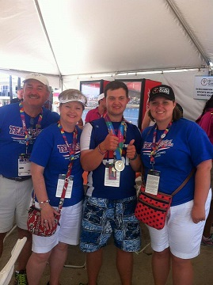
Special Olympics World Games: Will Crain
Communities of Practice
Mental Health in Schools
Person Centered Planning
Transition
Cultural Competency
A Community of Practice (CoP) is a group of people that agree to interact regularly to solve a persistent problem or improve practice in an area that is important to them.

Slide 7
GaPMP Regional Meetings
Graduation, IEP Awareness/SD, Communication, Partnerships
District Teams
Problems Come Bundled
Who Else Cares?
Problem Statements
Research Statements
Metro
Northeast
Middle
Northwest
Southeast
Southwest

Slide 8
Wednesday, September 22, 2015 Breakouts
Increasing Student Success with Accessible Educational Material (AEM) and Technology
Groups at Work: Strategies and Structures for Professional Learning
Explore Work! SSI and SSDI transition age youth. How Social Security Work Incentives can help
Inclusive Post-Secondary Education Options
Keys to Help Your Teen Get a First Job
Graduation Requirements
Dispute Resolution
Effective Practice for Creating Family-School Partnerships
Making a Collective Impact Through Community Stakeholder Collaboration
ASPIRE- Student Led IEP – Novice and Advanced

Slide 9
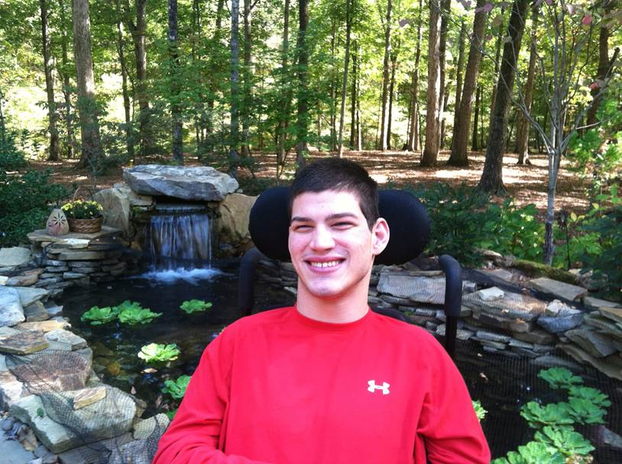
You won’t want to miss the closing keynote!
Life Lessons
Matthew Dooley
Student, Athens Technical College

Slide 10

Parking
If you are not staying at the Marriot City Center, you will want to parking in the numbered areas on the attached map.
For conference registration and opening events each day, use the entrance closest to numbers 8 and 12 .

Slide 11

Things to Remember for the Sessions
Please be ON time and stay the ENTIRE time.
When you arrive early, please fill up the front rows and sit towards the middle of the row.
  When you leave spaces in the back or the sides for the late comers, there is less disruption.
  Handouts will be put on the GaPMP website.

Slide 12

Volunteer Opportunities
There are several areas that you may serve to help the conference run smoothly.
  Room host
  Phil Pickens Award luncheon photographer
  Phil Pickens Award nominee poster set up
  There will be a survey sent out to sign up.

Slide 13
Partnership Tables
Instead of “Region Tables”, this year we are featuring items from the entire partnership in the following areas:
  IEP Awareness
  Communication
  Academics
  Caring Adult
  Attendance/Importance of School
  Behavior
  There will be a survey, similar to last year’s Region Table sign up, that will be sent out following the webinar.

Slide 14

Dinner Tuesday Night
Dinner is on your own.
In your registration packet, there will a list of area restaurants and gathering places to try.
  Per our locals PMs, Do not walk to these places.
  Consider carpooling with a group.

Slide 15

Hotel Accommodations
The Marriott City Center is full.
The other hotels mentioned on the Conference website are still available.
Check to see if there is a shuttle from your hotel to the Conference Center.
Otherwise, consider carpooling.

Slide 16
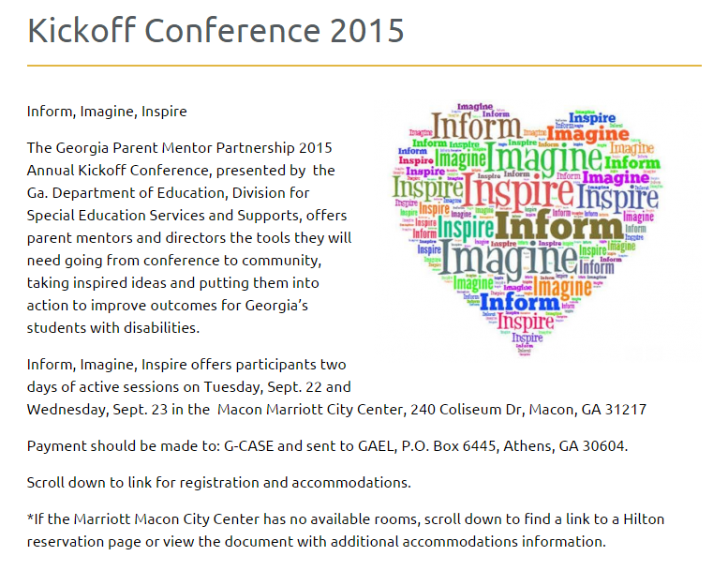
Main Page
Conference Tools
There will be more features posted on this page in the next few days. Look for them under Related Pages in a tab on the right.

Slide 17
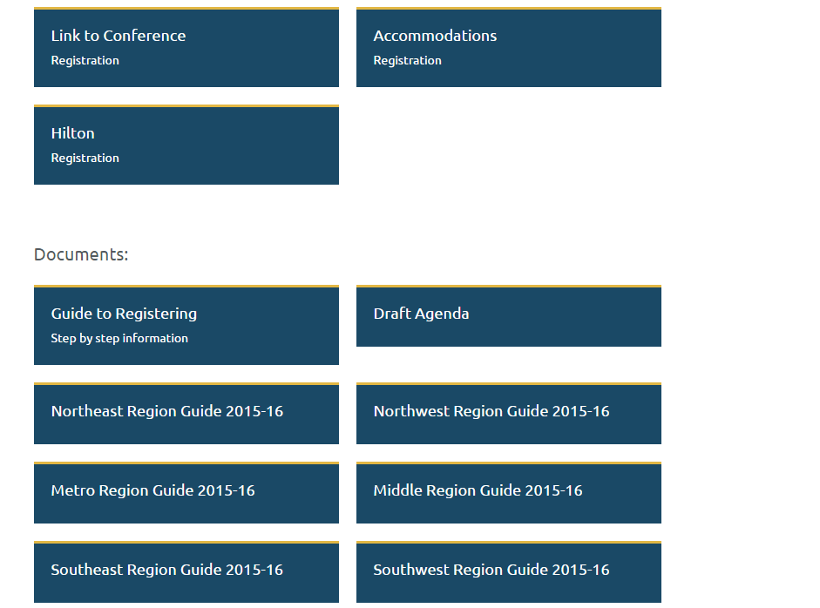
Main Page Features
Registration information
Download the Yearbooks and draft agenda in preparation for Kickoff

Slide 18
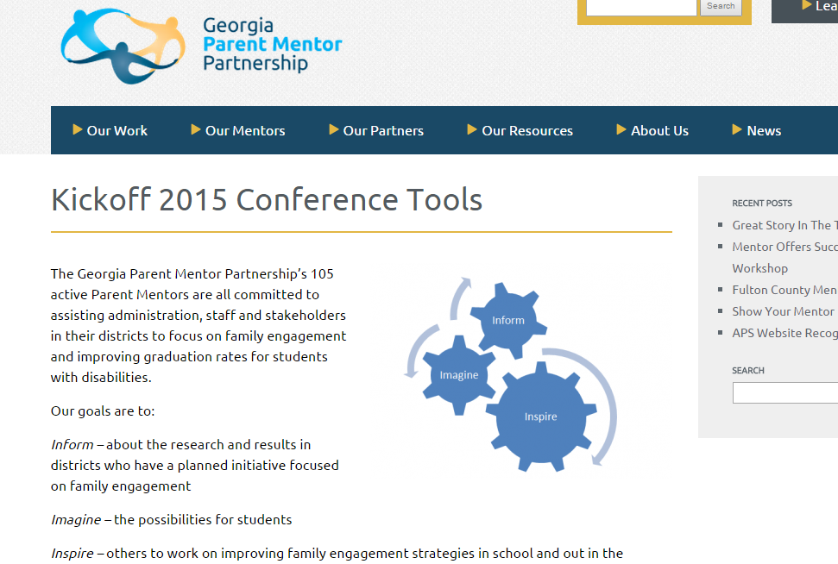
Coming Soon to a Webpage near you…

Slide 19

“Tools” will include:
Information about speakers and sessions
FY16 Toolkit
Downloads from speakers/sessions
Other important updates and information

Slide 20
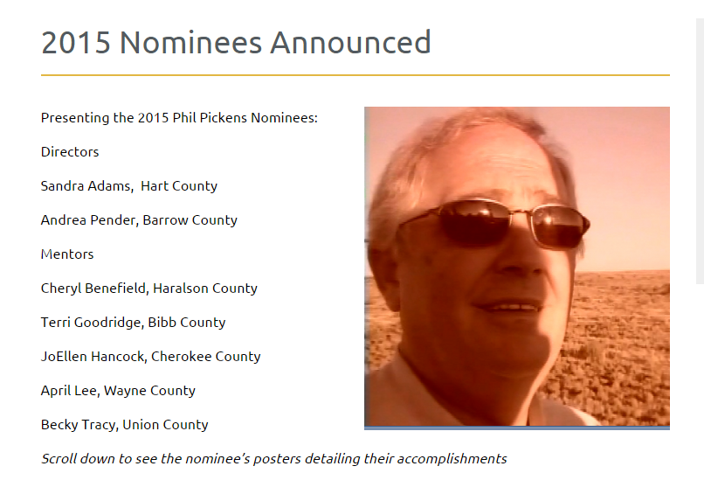
Phil Pickens Award

Slide 21
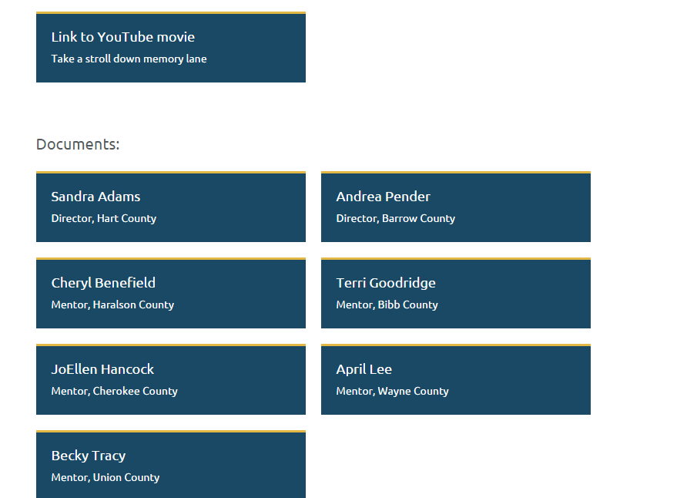
PPA Downloads

Slide 22
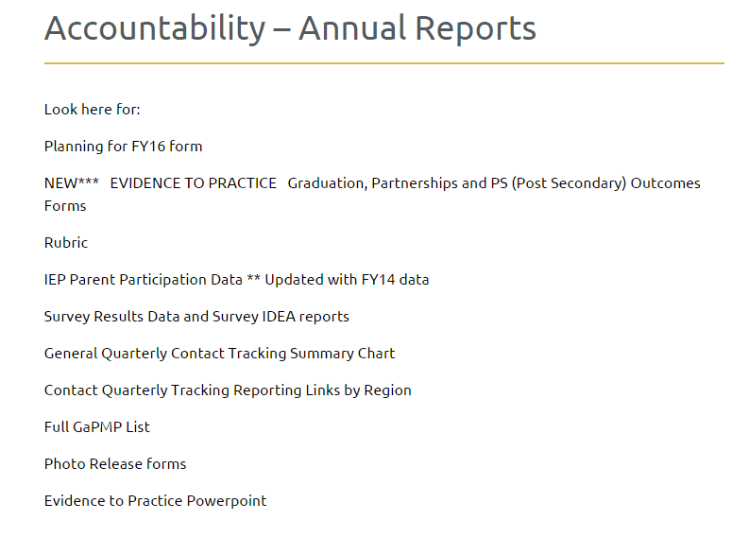
Learning Curve
Follow the curve to get where you need to go

Slide 23
2015-2016 Family Engagement Framework
Implementing the Evidence during FY16

Slide 24
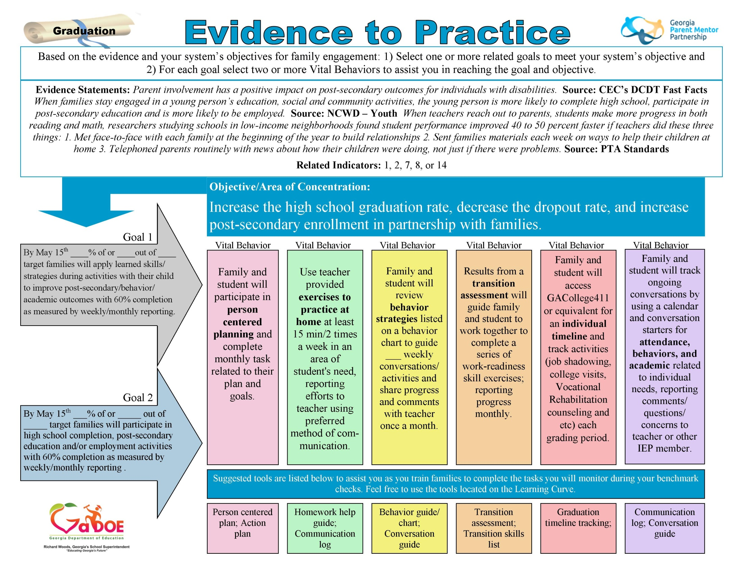
Notes:
NOT FINAL but a glimpse at what we have captured…..Pass copies of each one (3)
April----- introduce the E2P sheets and walk-thru quickly
Activity:
Discuss a mock plan in pairs of two
Activity sheet with just the Goal/VB sections of plan form
Table Facilitators will be Team Members

Slide 25


Slide 26
FY16 Tools and Resources
.Evidence to Practice Guides– Parent Mentors will use these guides to utilize family and community engagement research related to Parent Mentor initiatives. Data results will be demonstrated as Parent Mentor and their partners collaborate, using goals and vital behaviors to reach positive outcomes related to improving graduation rates.
. Parent Survey– Data collection tool for end of the year evaluation of your target group. Will assist in validating the family engagement work during FY16.
. Pre and Post Survey– Data collection tool for target group, administered prior to targeted activities and at the end of year, to assist in identifying impact of family engagement work during FY16.
. Data Reporting Tool– Shortened version of reporting form to record Parent Mentor related work.

Slide 27
Can’t Wait To See You!

