Slide 1

Notes:
Intro self

Slide 2
P2P
Programs & Services
PTI F2F BCW RPTAC
Special Needs Database
Roadmap to Success
Supporting Parents
One-On-One Assistance
Free Trainings
On-Line Opportunities
Navigator Project
Notes:
Staff and volunteers at P2P are trained and required to give a 1 minute version of our programs and services everywhere we go, so here is mine
Parent to Parent is a statewide non profit that assists families impacted by disability. All are services are FREE!
We are Georgia’s Parent Training and Information Center (PTI).
Also the Family to Family Health Information Center (F2F) and the Central Directory for Babies Can’t Wait –
That means we provide information and resources to families regarding the education, healthcare and early intervention so they can make better decisions for their children. RPTAC – we assist 8 other PTI
Our core services are:
Special Needs Database: Database has over 5,000 resources in 140 categories.
Roadmap to Success: an easy to navigate online guide to the major topics around disability
Supporting Parents are the HEART and SOUL of P2P! provide emotional support to families in need by matching them with other parents who can relate. We can match on the child’s disability or medical condition, on specific educational or health issues,
One on one assistance: When you call P2P, a parent of a child with disability will answer the phone and assist you in accessing our many services, Our regional coordinators
.Free Trainings. our trainings are available in many languages. offered anywhere in the state, current and accurate.
Online Opportunities: We have live webinars. email list we send out an eblast to get information about opportunities around the state. you can “like” us on Facebook or follow us on Twitter. Even check us out on Pinterest.
And the Navigator Project Our Volunteer leadership program.

Slide 3
Navigator Project
Volunteer leadership program
Notes:
Guess what,? I'm not here to talk about the P2P programs & services, I’m here to see if there are and leaders in this group!
How many Supporting parents are here?
How many of you attended a Regional Meeting this past spring? Did you win a prize? Get a tshirt? It was a Lotta of fun. Would you recommend the parents you serve to come to our next Reg Mtgs?
Let me Just to quickly sum up what the Navigator Project is for any newbies.

Slide 4
Notes:
SP is the first way someone can volunteer with P2P We would love for every one here to be a SP if your are not already, if we get a client who has a child similar to yours it would be a simple phone call.
But WE have 3 other ways.
Local Guide: a second support for families
So, now let me ask: how many of you share our outreach materials or refer parents to us? That’s all we ask of local guide. But we put their name in a drawing for a gift card for every 3 referrals they make to us because you’re doing it already we would love for you to be a Local Guide. 23 minute webinar and a test and boom you're an LG.
Broker: Outreach & Community Leadership How many have hosted a P2P training? Wow! That’s a Broker!! They can also, if they choose, man a resources table for us or if they like public speaking they can present the shorten version of P2P & Me (our programs and services power point) to local agencies. If you're going to host a P2p training anyway be a Broker and get a few more perks
Navigator: Community Organizer.
Now the Navigator Level could benefit you, if you want to host a fun event or two. Could get you some funds But better yet, If you had a go to parent to send to us, let them lead a team, you could be a member to give the team instant credibility.
Let me tell you about what some of our Navigator teams are doing…

Slide 5
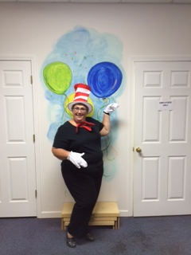
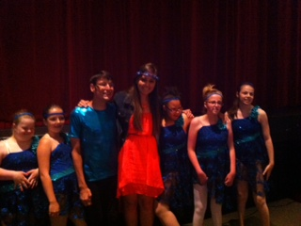
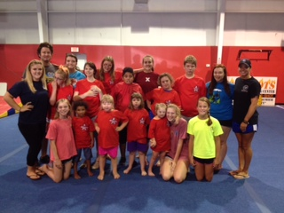
Notes:
WE have Navigator Teams that are collaborating with existing programs to either include children with disabilities or create new programs for them,
to give all an opportunity to have a great experience
Teams can partner with P2P to host ELCOP and create a literacy event. Like the one the Gordon team did with a Cat in the Hat theme.
We have some teams that host an annual dance, others who run dance classes , with the goal to build the skills the kids need to move in to a typical dance class.
Did you know there is a category in the world of competitive cheering just for children with special needs? There is! and we have several teams who've partnered with cheer gyms and have brought home the winning trophy. One competition in Atlanta had 36 Special needs teams competing. They're required to have to have 2 minute routine with lifts, jumps and a cheer. Awesome to see.

Slide 6
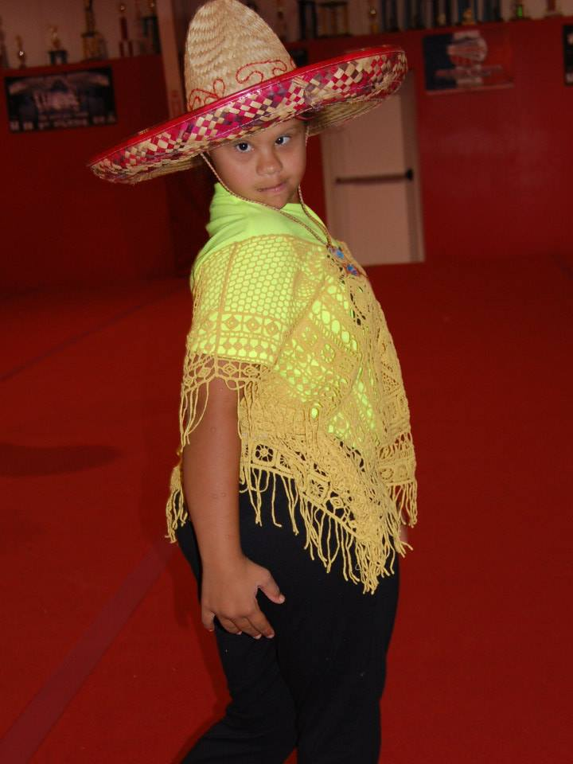
Diverse
Fun Events
Support Groups
Trainings
Recreation
Socialization
Education
Notes:
Navigator Teams look different in every county. Its what leaders what for their community.

Slide 7
Growing Leaders Across Georgia
Notes:
A poem by Ilan Shamir
Here the garden comes alive with abundant wisdom and sage advice.
Timeless reminders to help us grow and harvest the best of life
At P2P I am a gardener, helping to grow leaders all across Georgia. I recruit train and encourage parents who want to be a volunteer with us. I teach leadership skills and give them activities to put those skills in action.

Slide 8
Grow your dreams in fertile soil
Notes:
It all starts with a seed. with just the right amount of sun and rain and patience,
I know this audience is full of leaders. But lets think about the families you serve. Aren't there a few , that with a little mentoring, training and encouragement, could grow in to a leadership position . Could gain enough confidence and skills to help your community and other families that don’t have the same capacity.
We have Regional Meetings coming up fast. Claire will tell you about those in a minute. How great would it be if you brought a car load of parents to the meeting, Let them get a taste of the P2P fruit. It might be the first encouraging environment thy are exposed to, think back to your early days in the super exciting world of disability.

Slide 9
More grows in a garden than a gardener sows
Notes:
the hard shell softens and green life begins its journey
P2p does a great job of growing a leader. Building leadership skills, rooting them in our programs and services. Letting them come into there own. Each time they do a volunteer activity they build confidence.
More does grow in a garden than a gardener sows. You will see lives changed
I need parents who want to help in the P2P garden. All Were asking today is “are you willing to talk about the navigator project, share our fliers, give your endorsement so the parents you serve will join us as volunteer and help us spread the word about P2P programs and services.
Can we have your support???

Slide 10
Don’t beet around the bush
Notes:
Intro Claire
Tell you story

Slide 11
P2P is Cultivating Leaders
Leadership and volunteer training
Building an Advocacy team
Teaching: how to tell stories effectively
Notes:
Leadership and volunteer training
2- Building an Advocacy team
3- Teaching parents how to tell stories of challenges and successes effectively (Employment stories needed)
Refer parents to us !

Slide 12
Regional Meetings 2014/2015
October 21, 2014 Rome
November 18, 2014 Valdosta
December 2, 2014 Atlanta
January 13, 2015 Statesboro
Notes:
Reg. mtgs

Slide 13
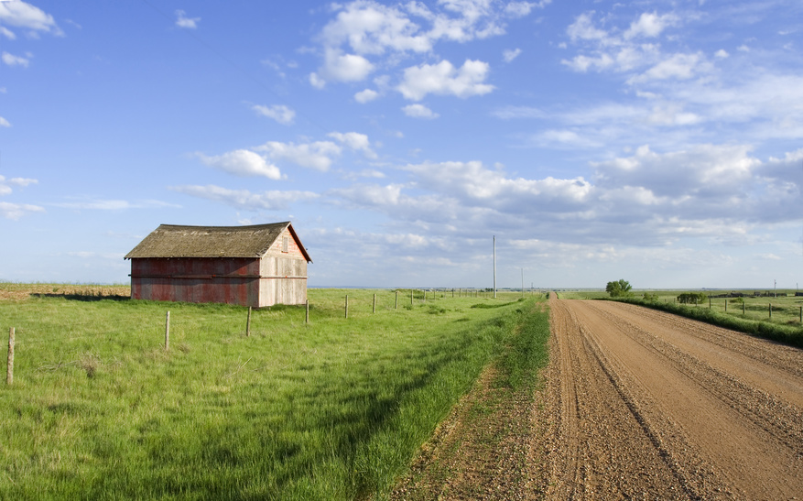
The grass is greener here
Notes:
Intro Dave
call to action

Slide 14

Sandra@p2pga.org
Claire@p2pga.org
Dave@p2pga.org
Notes:
Wrap up
Thanks
If interested email sandra

