Slide 1


“Making Education Work for all Georgians”
Welcome Aboard!

Slide 2

Statewide Family Engagement Initiative:
Anne Ladd
Family Engagement Specialist
Division for Special Education
Georgia Department of Education

Slide 3
Learning Targets
I can explain why family engagement is important.
I can explain how the Ga Parent Mentor Partnership impacts family engagement.
I can identify resources for additional information relating to supporting families.

Slide 4
The Research Says
30 Years of National Achievement Research Shows a Direct Correlation Between Families Engaged/Involved in Their Child’s Education To Higher ACHIEVEMENT
2010 Presidents and Fellows of Harvard College,
Harvard Family Research Project
The Important Role of Family Engagement
Notes:
What Are the GaDOE's Family
Engagement Strategies?
1. IDENTIFY Parent Leaders Among the
Students Who Are Being Identified
2. EMBED Family Engagement into the
work of Achievement
3. COLLABORATE
School/Home/Community
Karent Mapp

Slide 5

Engagement vs Volunteering?
Engagement vs. Volunteering?
Volunteering Refers to Those Who Show Up During the School Day or extracurricular Activities.
Being Engaged is Supporting School Goals and Children's Learning Anyway & Anytime!!
Notes:
The roles Families play when they
are engaged are**:
• Supporters of their children’s learning
• Encouragers of an achievement identity, a
positive self image, and a “can do” spirit
• Monitors of their children’s time, behavior
boundaries and resources
• Models of lifelong learning and enthusiasm for
education
Advocates for improved learning
opportunities for their children and at their
school
• Decision-makers/Choosers of educational
options for their child, the school, and
community
• Collaborators with school staff and members
of community

Slide 6
History
The Parent Mentor Partnership was founded in 2002 when six school districts partnered with the Georgia Department of Education, Division for Special Education, to hire parent mentors.

Slide 7

Who we are today….
92 School Districts in Georgia
100 Mentors
Mothers and Fathers of a student(s) who has or has had an IEP
Notes:
Parents of children with disabilities hired by the district to support family engagement, as well as special education directors and other administrators, teachers, and support personnel within the district.
Parents of children with disabilities hired by the district to support family engagement, as well as special education directors and other administrators, teachers, and support personnel within the district.

Slide 8
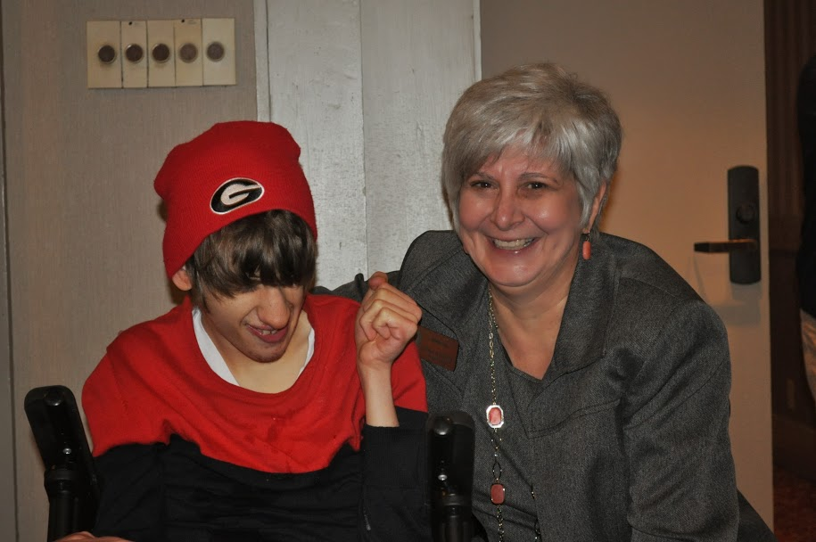
Notes:
My story
The early years
Partners- the transformational change
Read read read
Beginning school- IFSP to IEP “they take the family out!”
Typical child….learning challenges
Read, read read
Began work in Kindergarten- learned differentiation
PTA- Legislative chair and exceptional children’s committee
Need more information!!!
PLSP- Heard about the Parent Mentor Partnership
Worked on a project of National Significance “Building One Community”
Joined Transition Coalition
Became Parent Mentor

Slide 9

Our Mission
To Build Effective Family, School, and Community Partnerships That Lead to Greater Achievement for All Students, Especially Those with Disabilities.

Slide 10

Our Objective
To Impact Student Achievement through Family Engagement Strategies.

Slide 11

Mentor’s work is focused on enhancing communication and collaboration between families, schools, and communities in order to improve outcomes for students with disabilities and their families.

Slide 12

Families
Parent mentors provide information and resources to parents of students with disabilities on a variety of topics and issues related to home, school, and community.

Slide 13

Schools
Mentors also work with teachers, staff, and administrators to integrate family engagement into school and district activities and to build a culture in which family engagement is expected and valued.

Slide 14

Community
Mentors also work to support integration of students with disabilities into the community by working with partners to build a community in which students with disabilities are included and valued.

Slide 15
Achievement
community
home
school

Slide 16
Georgia Parent Mentor Partnership Leadership Council 2014-2015
Chair Allison Stevenson
Fayette County
Chair Elect Cheryl Benefield
Haralson County
Vice Chair Amy McCullom
Oconee County
Recorder April Wooten
Jones County
Immediate Past Chair Cynthia White
Barrow County

Slide 17
Georgia Parent Mentor Partnership Leadership Council 2014-2015
Region Reps
Committee Chairs
NW Kim Chester
Bartow County
NE Teresa Bruce
Franklin County
Metro Edith Abakare
Atlanta City
Middle Michelle Law
Henry County
SW Cathy Green
Early
SE Amanda Locke
Evans
Education Marsha Sahlman
Hart County
Special Projects Cheryl Benefield
Haralson
Phil Pickens Award Kathy Simmons
Dodge County
Sunshine JoEllen Hancock
Cherokee

Slide 18

Georgia Parent Mentor Partnership Leadership Council 2014-2015
Past Chairs
Scott Crain
Hall County
Pam Moore
Madison County
April Lee
Wayne County
Kathy Simmons
Dodge County
Cynthia White
Barrow County

Slide 19

How to Stay Connected
Parent Mentor List Serve
www.Parentmentors.org
Learning Curve
Region Meetings
Leadership Council Members
Family Engagement Specialist

Slide 20
Where to find information
GaDOE Website www.gadoe.org
Parent Rights
Parent Information Fact Sheets
The Implementation Manual
Georgia Performance Goals and Indicators
Notes:
are the state’s Goals for improving special education services and supports and the achievement of students with disabilities. They include Goals such as improving the graduation rate with a general education diploma, decreasing the dropout rate, improving statewide test scores, and increasing the number of graduates who are continuing their education or are employed. The state’s performance on these Goals is measured by Indicators that show whether or not each school district and the state as a whole have met the target for each Goal for the year or not. Each Goal has at least one Indicator; most have several. The Indicators are measures that “indicate” how well the state/district/school is doing at meeting the Goal.

Slide 21
What we measure
State Performance Goal, Indicator # 8 for Parent Engagement:
“Increase the percentage of parents of students with IEPs who report that the school facilitates parent involvement as a means of improving services and results for students with disabilities.”
This is measured through a Parent Satisfaction Survey administered each year to a statewide sampling.

Slide 22

Consolidated application/Local improvement plan (CLIP)
Your school district has an annual plan that includes a special education plan for meeting the statewide Performance Goals and Indicators.
Your activities should relate to helping your district meet the statewide Performance Indicators and Goals for parent involvement and at least one of the other goals
GaPMP Annual Accountability Plan/Report
PMs work with their director to develop a plan
in the spring for the next school year
An Annual Accountability Report based on the plan
is due the next Spring

Slide 23
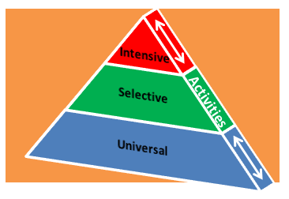
Targeting Students and Their Families
Notes:
Universal strategies that encourage family involvement focus on creating a welcoming, culturally responsive environment and establishing lines of communication that help build trusting relationships. Programs and supports that are given to families of all students.
Selective strategies in the middle layer of the pyramid focus on two different objectives. One objective is to reach families who are interested in being involved in their child’s education but lack the means or need additional encouragement or support to participate. A second objective offers families who are already engaged in their child’s education opportunities to become more involved in the overall education program.
Intensive Strategies focus on meeting individual needs and more substantial challenges that keep the few families at the top of the pyramid from getting involved.
Families and students may need multiple school and community supports coordinated in addition to the universal and/or targeted services.
Universal: Group Conferences – things to do at home with their child, Welcoming Schools Campaign/ Community Hub
Selective: Faith-Based Organizations and Afterschool Programs with small Group Learning Sessions(Sunday/Wednesday), computer classes and GED Classes with activities/homework related to working (coordinate with early ed so parents are more prepared when entering the school)
Intensive: Go to job site – work with employers to put a computer on job site or in complex centers. Community gatherings Meetings at job sites.

Slide 24

Barriers to Effective
Communication
Economic and Time Constraints
Lack of Technology
Education Lingo (Example)
“Know it all” Approach
Pre-Judging
Frequent Negative Reports
Unwelcoming Environments
Notes:
Identify each of the barriers to effective communication with parents as listed.

Slide 25

In 124 of Georgia’s
159 counties,
the poverty rate is at 16.3 percent or higher!
The US Poverty Rate is
14.3 percent
US Census Bureau Numbers/ GaDOE Student Data/ GA State Office of Rural Health
Poverty
Notes:
85,000 in Ga Pre-K
Kidscount

Slide 26
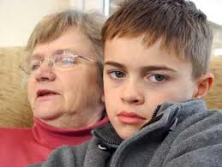
Grandparents Raising our Kids

Slide 27

Youth Mental Health First Aid
  Designed to teach lay people methods of assisting a young person who may be in the early stages of developing a mental health problem or mental health crisis..

Slide 28
Anne Ladd
Family Engagement Specialist
Division for Special Education
Georgia Department of Education
aladd@doe.k12.ga.us
404-657-7328

